Slide 1

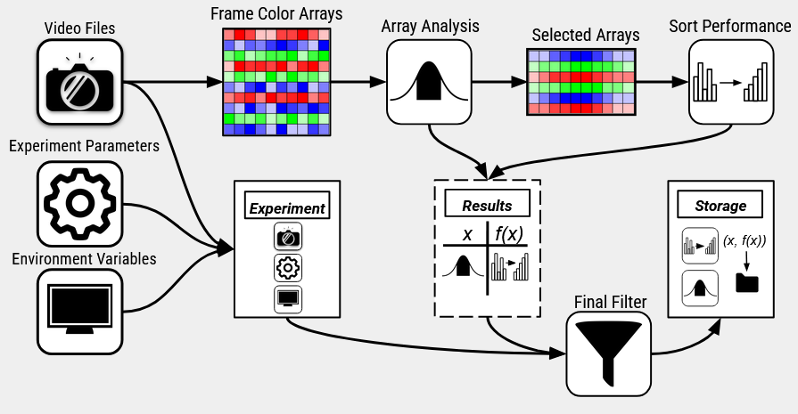
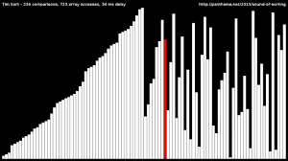

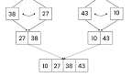
Benchmarking Algorithms With Paint
Caden Pink
Faculty Sponsor: Dr. Regina Rahn
Aurora University
Your future. Our promise.
Background
Data Processing
Tim Sort
Data Pipeline
Tim sort is cool and awesome.
Purpose
Algorithm Analysis
Outcomes
Linear Regression – Tau Distance vs Instruction Count
Data Pipelines
w
Obtaining Data
Future Development
Sortedness
Polyglottal Implementation
Conclusion
Video Data
Advanced Video Analysis

