Slide 1

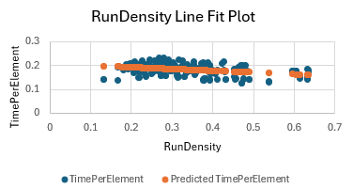
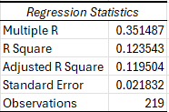


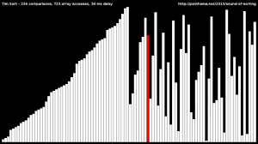
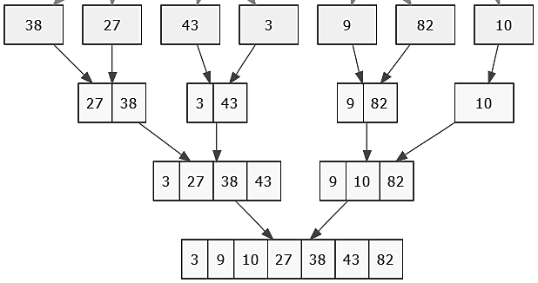

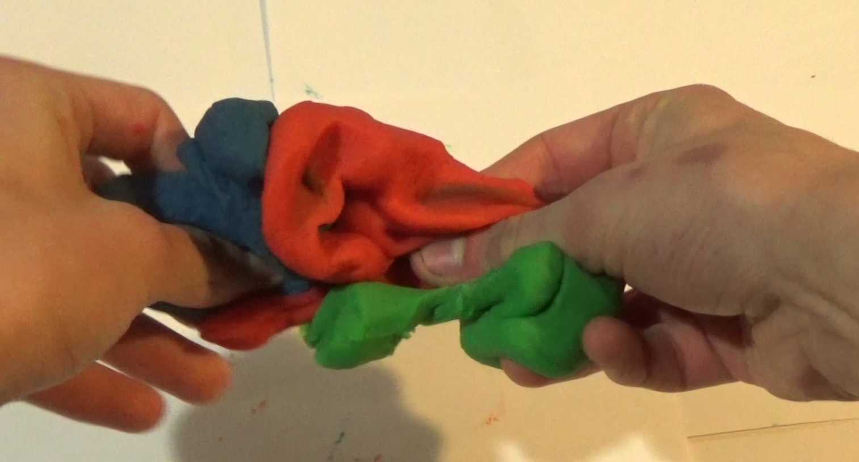

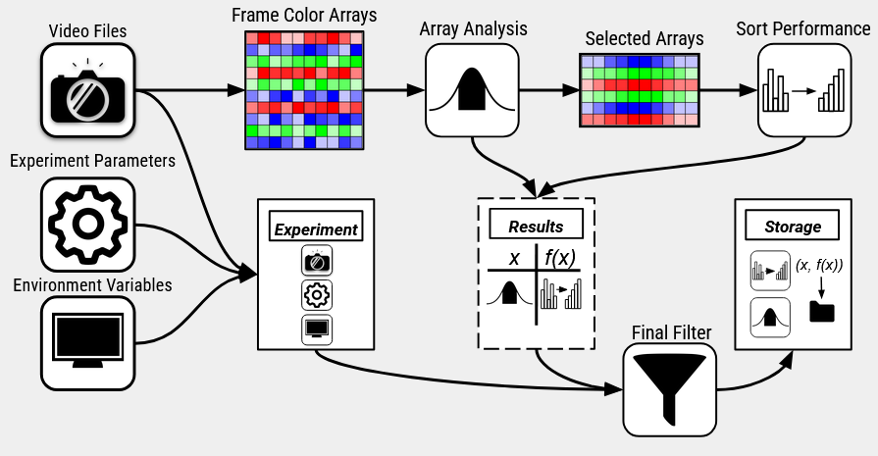
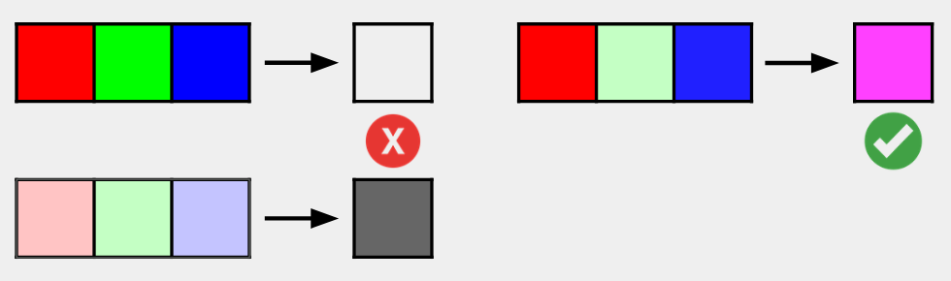
Benchmarking Algorithms With Color
Caden Pink
Faculty Sponsor: Dr. Regina Rahn
Aurora University
Your future. Our promise.
Background
Obtaining Data
Outcomes
Tim Sort
Array Sortedness
Run Density vs Sort Time Per Element
Tim Sort is an O(n*log(n)) hybrid sorting algorithm implemented by Tim Peters in 2002 for the Python programming language. It takes advantage of existing order in real-world data.
Sorting Algorithm: A process that re-orders a list of values in order from smallest value to greatest value.
Hybrid Sorting Algorithm: a sorting algorithm that utilizes at least two separate sorting algorithms. Tim Sort uses insertion sort, margining (merge sort) and some other algorithms.
Sortedness: how close a list of numbers is to being ordered.
Importance: Tim Sort utilizes the natural order from real data to increase performance.
Run: a stretch of naturally increasing or decreasing numbers in a list.
Video Data – Red, Green, and Blue Values
Natural Order: the intensity of color of the frames in a video follow a natural order
Variety: by selecting sections of the video’s frames, a variety of distributions and degrees of order of arrays can be selected.
Ease of Access: Creating video data is simple, all it requires is a camera and something to record. The recording can even be automated.
Sorting Algorithm
Insertion Sort
Merging
Conclusion
Conclusion: Because of the negative run density coefficient, it can be said that as the number of natural runs increases, the time needed to sort per element decreases.
- This proves that Tim Sort is an adaptive algorithm.
- Run Density explains 12.4 % of time variance in this sample.
- Computer performance changes, run lengths, and inversion. counts could account for the rest of the variance.
Purpose
Data Processing
Algorithm Analysis
Data Pipeline
Goal: Prove that Tim Sort is adaptive to pre-existing order
- As the number of natural occurring runs occurs in an array, the amount of sorting time per element decreases.
Task: collect data of different sizes and levels of sortededness. Perform Tim Sort on all of them, record the results.
Future Development
Polyglottal Implementation
Polyglottal Programs: polyglottal programs are written in more than one programming language.
Importance: important in data science to handle repeated calculations in a faster programming language.
Implementation: although the NumPy library is written in C, most of my program was written in regular Python. I can refactor my program to handle result filtering and validation in a C program.
Data Pipelines
Goal: Develop a system of producing, curating, manipulating, and storing data in an automated method.
Solution: Use many various Python libraries and file types to produce data for the goal of implement.
Implementation: OpenCV, NumPy, SciPy, TinyDB, JSON
Challenge: Manage memory and CPU usage .
Advanced Video Analysis
Object Oriented Databases
Advanced Techniques: motion analysis, entropy, random texture
Importance: provides more data of different distributions from any video. This can increase the throughput of the data pipeline.
Goal: Develop a system of producing, curating, manipulating, and storing data in an automated method.
Solution: Develop an object-oriented database to hold data and the results of algorithms.
Implementation: Use TInyDB, a single file Object Oriented Database package. With TinyDB V3, the DB will be git merge friendly.
Challenge: maintaining data integrity across multiple devices.
Removing Gray Values
Issue: The video data contained lots of grayscale pixels.
Solution: Remove the gray pixels before finding average color of frame.
- If the different between two colors is large, a color is present.
Agentic AI Data Processing
Agentic AI: advanced AI systems that can independently plan, reason, and take complex actions to achieve goals with minimal human oversight.
Importance: an LLM can collect video data, run the pipeline, and interpret the results.

