Slide 1

Analyzing Crowdedness at a Gym
Data: The data consist of the number of people present at different times in gym and also includes additional factors like temperature. Using this dataset interesting insights into attendance of the gym shall be derived. This dataset is from Kaggle : https://www.kaggle.com/nsrose7224/crowdedness-at-the-campus-gym
Goal: We want to predict the number of people attending the gym given the values of other factors from information such as day of the week, weather, is during semester, etc. Using this we will be able to predict how crowded the gym will be in the future.

Slide 2

Data description
The dataset consists of 26,000 people counts (about every 10 minutes) over the last year. The label is the number of people, which we would like to predict given some subset of the features.
Label columns:
number_people: Number of people at gym at a given particular time
Feature columns:
date (string; datetime of data)
timestamp (int; number of seconds since beginning of day)
dayofweek (int; 0 [monday] - 6 [sunday])
is_weekend (int; 0 or 1) [boolean, if 1, it's either saturday or sunday, otherwise 0]
is_holiday (int; 0 or 1) [boolean, if 1 it's a federal holiday, 0 otherwise]
isstartof_semester (int; 0 or 1) [boolean, if 1 it's the beginning of a school semester, 0 otherwise]
hour (int; 0 - 23)
temperature (float; degrees fahrenheit)
month (int; 1 [jan] - 12 [dec])

Slide 3
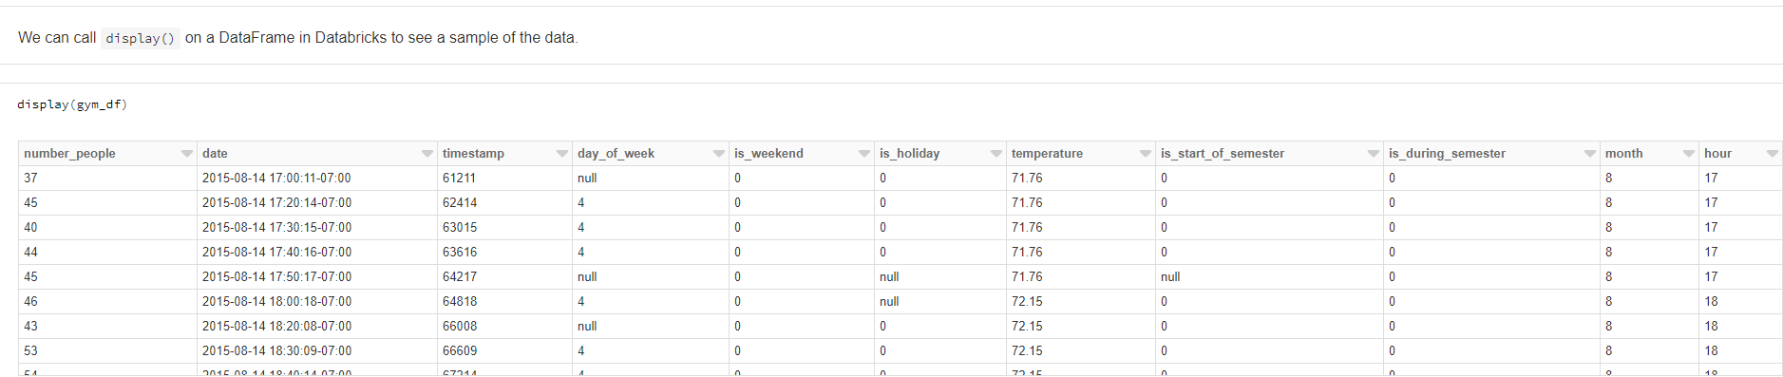
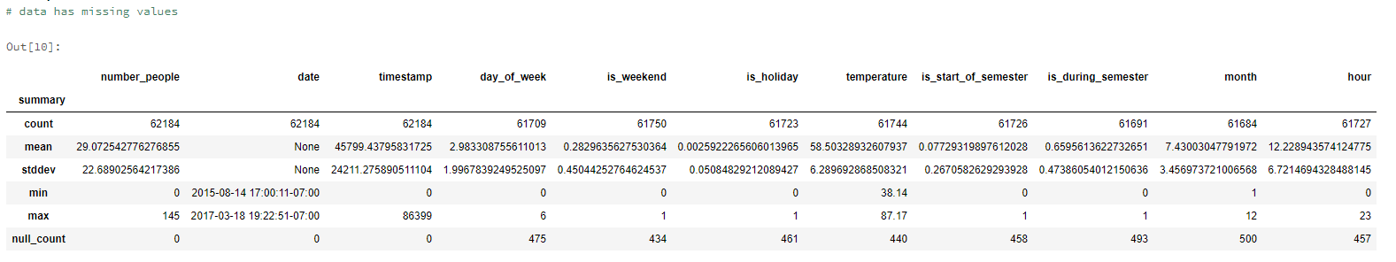

Slide 4
Exploratory Data Analysis

Slide 5
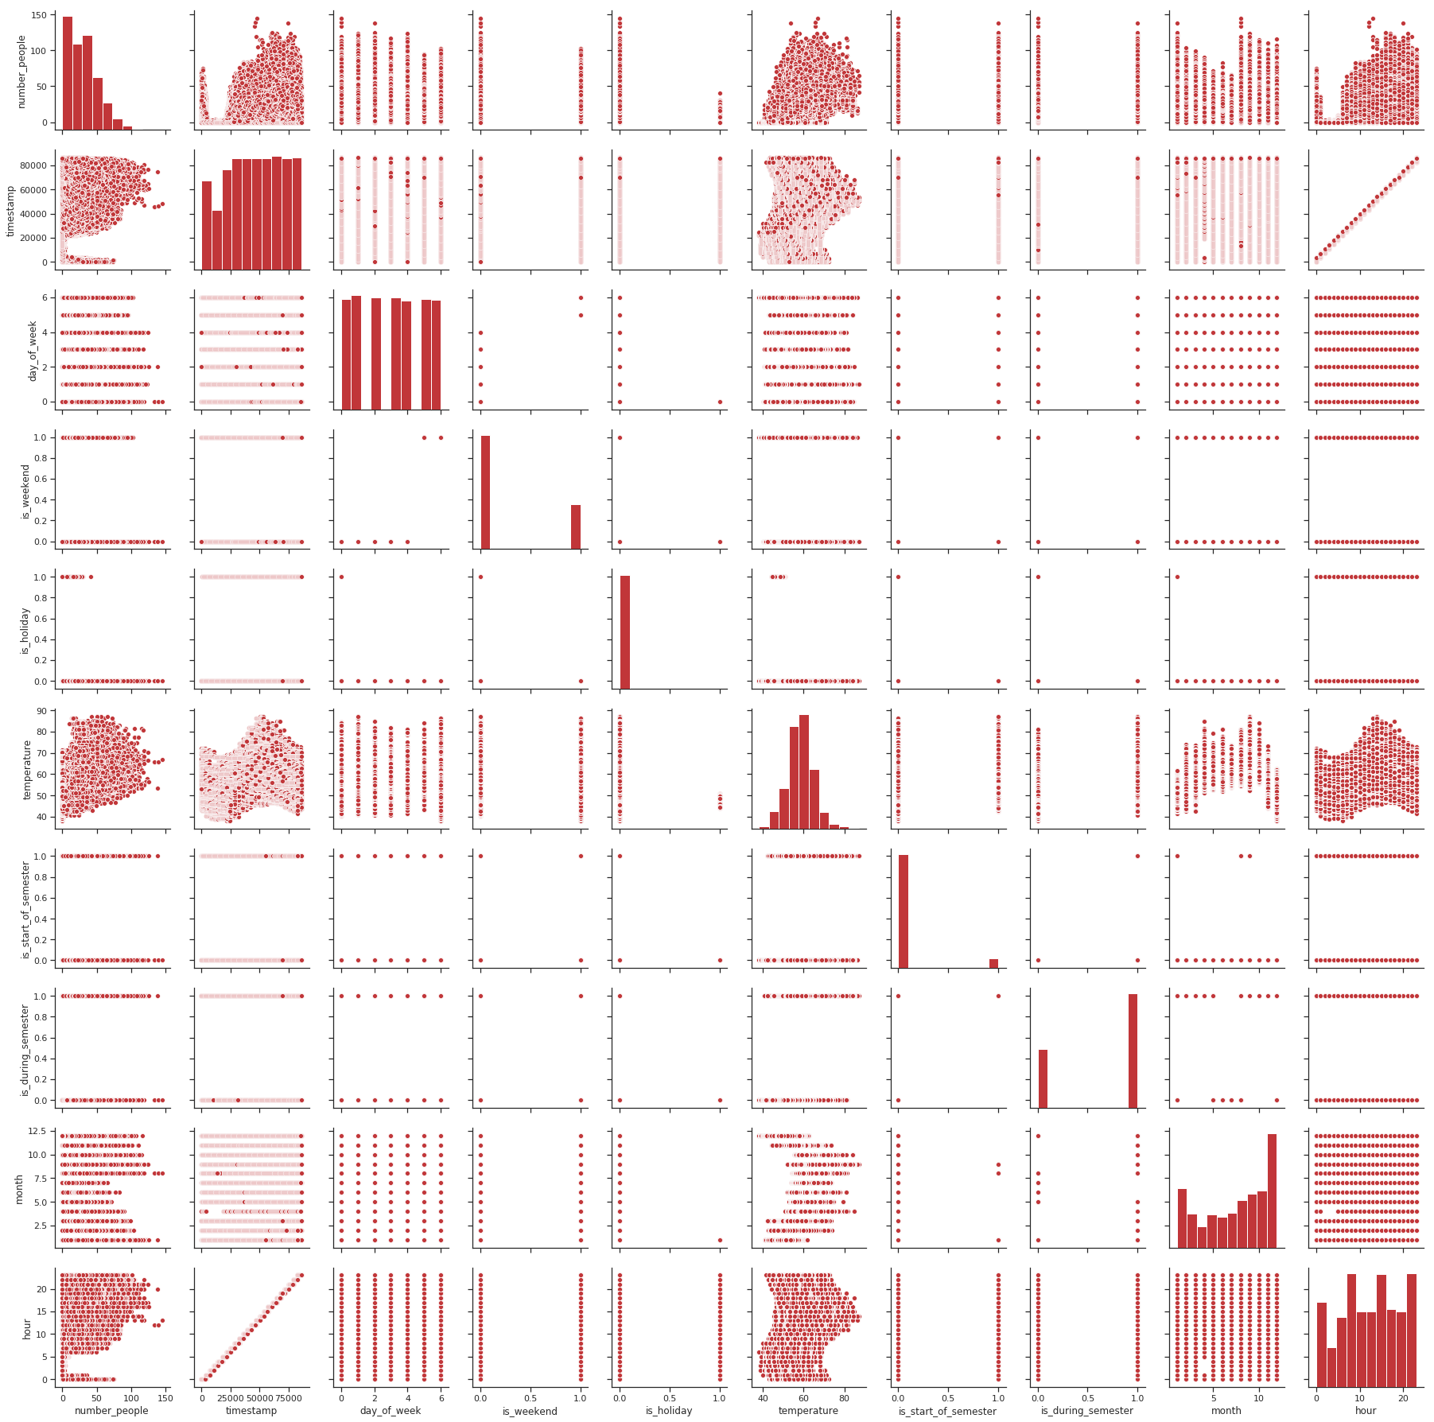
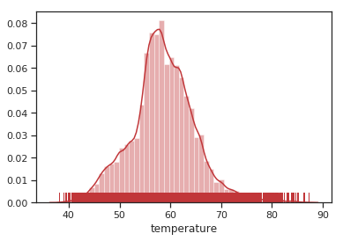
Pairplot of all variables
Interpretations:
Distribution of data (Histogram) in diagonal matrix.
Number of people coming to gym and Temperature – Normal distribution.
Rest of all variables - categorical and nominal variables.
Notes:
1. In Pairplot, to get a pictorial view of all data, diagonal matrix always shows the distribution of data (Histogram).
2. It is very evident from the plot that number of people coming to Gym and Temperature are showing Normal distribution as both are continuous numerical variables and it don’t need any further data transformation Pre-processing work.
3. Rest of all variables are categorical and nominal variables and it is well explained by plots

Slide 6
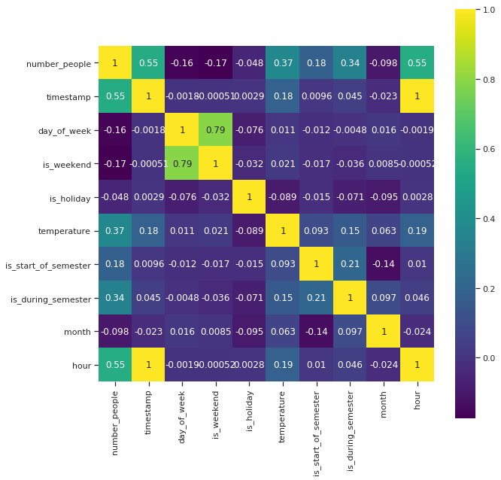
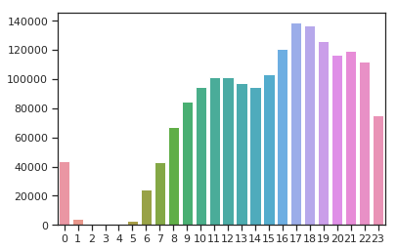
Correlation Matrix between different features
High positive correlation - Number of people and Timestamp.
Number of people coming to Gym are higher at 17th and 18th hour.
More number of people - above 17th hour
Notes:
Correlation matrix between different features will help us to understand the relationship that exist between features.
1. There is a high positive correlation between Number of people coming to Gym and Timestamp. Does it mean more number of people are coming at higher timestamp? Lets find out.
2. To further validate this, we can take a look at the distribution of number of people across different hours of the day.
3. Number of people coming to Gym are higher at 17th and 18th hour. It can also be interpreted in a way that more number of people are coming at above 17th hour (17-23rd hour) timestamp when compared to 0-16th hour

Slide 7
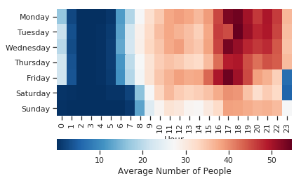
Heat Map to show Busiest hour of the day
Weekend – Less number of people coming to Gym compared to weekdays
Peak Hours – 17th and 18th hour.
Opposite effect on Tuesday at 17th Hour
Notes:
Heat map across hours of the day will give a clear view about the gym crowdedness.
It is very clear not much activity in early morning for all days in a week. People coming to gym in a day time in weekend is also very less when compared to weekdays.
More number of people are coming at 17th and 18th hour and it further validates our previous slide result.
One strange thing to notice here is that there is an opposite effect on Tuesday at 17th hour. It is completely vacant at 5pm compared to the rest of the week at the same time.

Slide 8
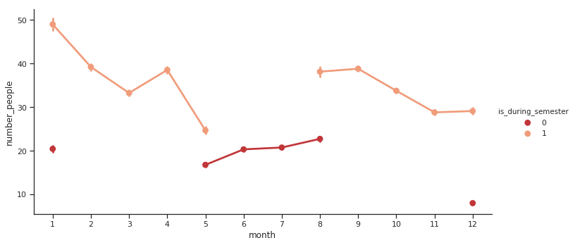
Variation of people coming to Gym across Months
At Start of semester, people coming to Gym are higher.
Steady crowdedness during the semester.
Crowd declined steadily in semester end.
Notes:
Variation of people coming to Gym across Months and influence of crowdedness by semester.
We can see at the start of semester (In January and August), There is a sudden rise in people coming to Gym.
During the semester there's good amount of crowdedness compared to Semester holiday period (May to August, December and January).
We can see, when it comes to semester end (April - May, November - December), the crowdedness gets declined slowly, may be because people will be busy in preparing for exams or completing assignments, etc.

Slide 9
DATA PREPROCESSING
Feature Selection
Some of the columns contain duplicate information. Variable 'is_weekend' is derived from 'day_of_week' (saturday = 5 or sunday = 6), hence removed 'is_weekend’.
Since 'timestamp' variable gives exact time in seconds number of seconds since beginning of day, dropping 'hour' variable because it adds redundancy.
Except for 'number_people', 'date', and 'timestamp' all the variables has null values.
Variable 'is_holiday' has less than 1% of data for holidays. Dropping this variable, since we do not enough data for holidays.
Removed Date column and added day
Notes:
We need to get our data ready for Machine Learning!!
Goal: We want to learn to predict the number of people (the number_people column). We refer to the 'number_people' as our
target "label".
We only have 3 years of data. Performing analysis using 'date' variable would not be helpful since we already have month and timestamp variable, we will only fetch day_of_month from date variable, which will help us to identify what time of the month people count is more.

Slide 10
IMPUTATION
Creating Custom Transformer for Imputation
Imputing numerical, ordinal, & binary variables with median

Slide 11
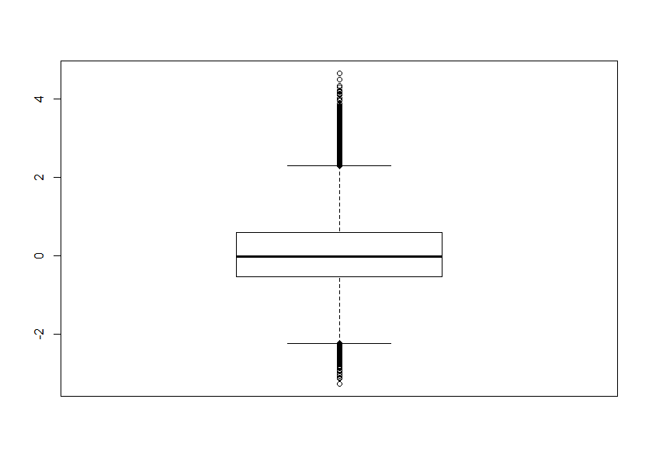
OUTLIERS
Replaced the outliers which are less than (Q1 - 1.5*IQR) with the 5th percentile and
Replaced the outliers which are greater than (Q3 + 1.5*IQR) with the 95th percentile of the data.
Notes:
Looking at the boxplot of temperature variable, we can see that there are many outliers and we don’t want them to impact our model. Hence we have replaced them.

Slide 12
Created Custom Standardization
Since variables have different units, also 'timestamp' and 'temperature' have much higher values than other variables, standardizing the data.

Slide 13
TEST & TRAIN SPLIT
Split data into training and test sets (70% & 30 %)
Our final data preparation step will split our dataset into separate training and test sets. We can train and tune our model as much as we like on the training set, as long as we do not look at the test set. After we have a good model (based on the training set), we can validate it on the held-out test set in order to know with high confidence our well our model will make predictions on future (unseen) data.

Slide 14
Building Stages for the Pipeline
Train a Machine Learning Pipeline
Now that we have understood our data and prepared it as a DataFrame with numeric values, let's learn an ML model to predict number of people attending gym in the future. Most ML algorithms expect to predict a single "label" column (`number_people` for our dataset) using a single "features" column of feature vectors. For each row in our data, the feature vector should describe what we know: temperature, day of the week, etc., and the label should be what we want to predict (`number_people`).

Slide 15
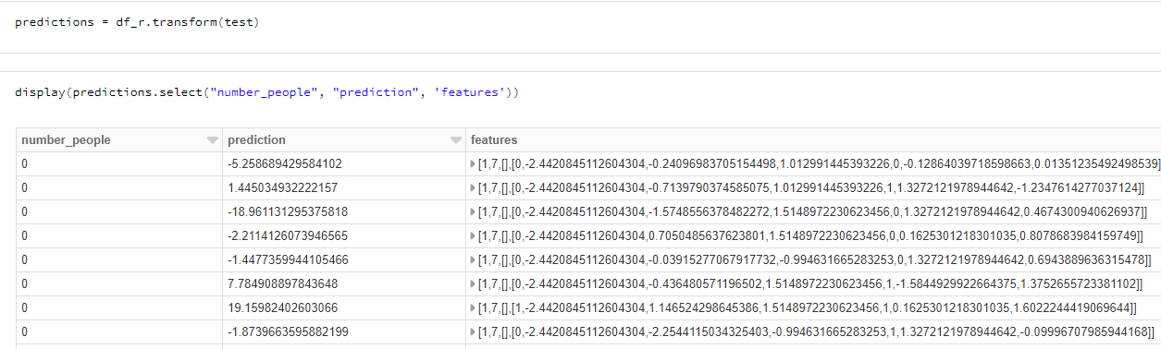

LINEAR REGRESSION

Slide 16
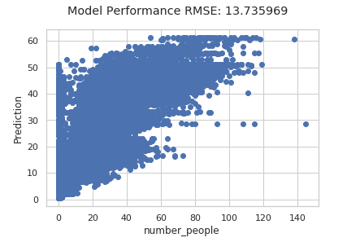
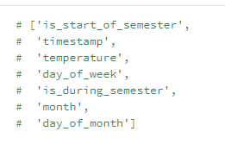
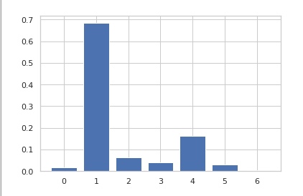
RANDOM FOREST REGRESSION

Slide 17
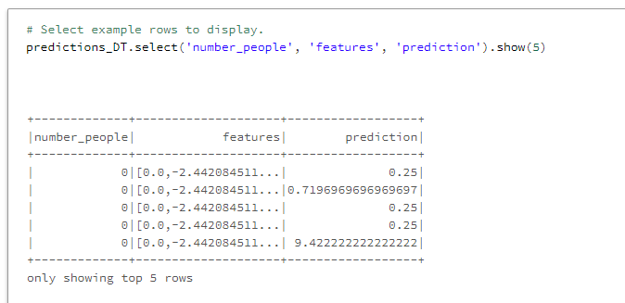
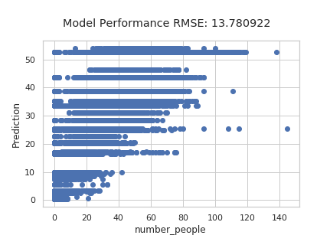
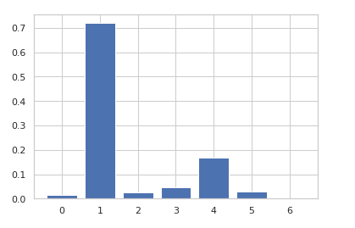
DECISION TREE REGRESSION

Slide 18
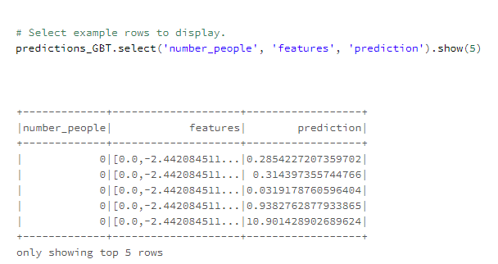
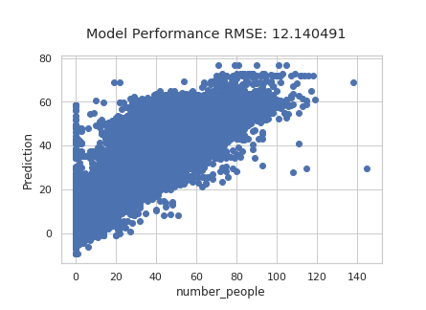

Gradient Boosted Trees Regression

Slide 19

CONCLUSION
Metrics: Manually viewing the predictions gives intuition about accuracy, but it can be useful to have a more concrete metric. Here, we used RMSE metric to compare all the models to tell us how well our model makes predictions on all of our data. In this case (for RMSE), lower is better. This metric does not mean much on its own, but it can be used to compare different models. (This is what CrossValidator does internally.)
Linear Regression RMSE - 17.35
RANDOM FOREST RMSE - 13.73
DECISION TREE RMSE - 13.78
GRADIENT BOOSTING TREE RMSE - 12.14
GRADIENT BOOSTING TREE Regression model achieved the best results as it has the lowest RMSE out of all.

Slide 20
TAKEAWAYS
To sum it up, we have learned how to build regression models using PySpark and MLlib Pipelines and how to use Spark to process large amounts of data in a distributed manner which will helps to reduce the processing time.
We also learnt how data is replicated on multiple nodes on a cluster.
We tried four algorithms and gradient boosting performed best on our data set.

Slide 21
LIMITATIONS/CHALLENGES
Since it’s a huge data, performing visualizations of the data became difficult.
Already built-in ML models in Spark provides limited features.
When the data is small, Spark takes more time to process as compared to R and Python. Hence it is suitable to only a large data sets.
Lack of enough data available.
Notes:
(Its difficult to improve performance).
There was limited documentation and resources are available on PySpark for building our models and still reasearches are going in improving the existing models
Used pandas to visualize

Slide 22

THANK YOU

