Slide 1
Object-Oriented
Programming
Concepts, Principles, Classes, Constructors & Destructors
With hard tricky examples to test your understanding
1

Slide 2
Agenda
1
Introduction to OOP
6
Private & Public Members
2
Procedural vs. Object-Oriented Programming
7
Static Data Members & Member Functions
3
Principles of OOP
8
Constructors and their Types
4
Benefits & Applications of OOP
9
Destructors
5
Objects and Classes
2

Slide 3
Covered in c#
1
Token: Keyword, variable, Constant
6
Functions, parameters in function, call by value, call by pointer, call by reference
2
Data Types, type casting
7
pointer
3
Array, String, Functions
8
Function overloading,
4
Operators
9
Inbuild math functions
5
Control statements: If, For, Foreach, While, do while, switch
2

Slide 4
Method Overloading
With method overloading, multiple methods can have the same name with different parameters:
1. By changing the Number of Parameters
2. By changing the Data types of the parameters
3. By changing the Order of the parameters
https://www.geeksforgeeks.org/c-sharp-method-overloading/

Slide 5
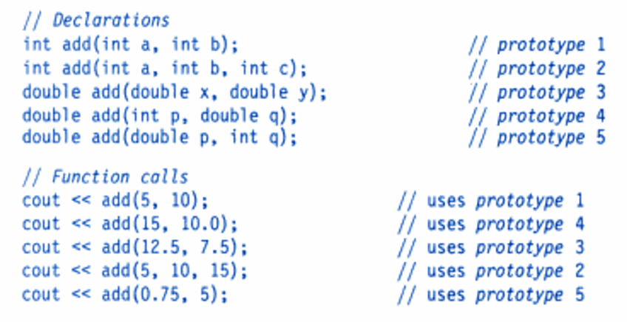
Overloading

Slide 6
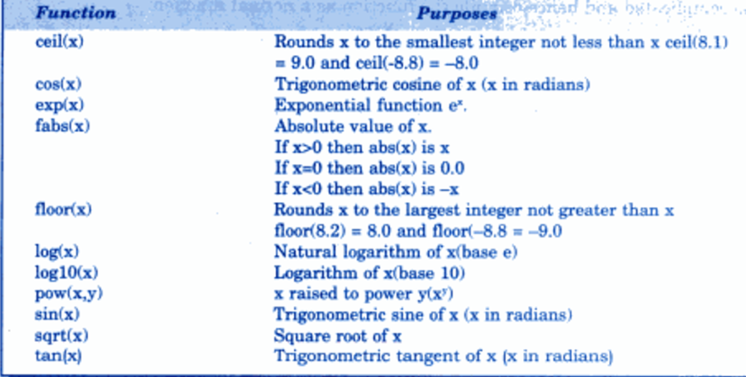
Math functions

Slide 7
Introduction to OOP
THE BIG IDEA
●
OOP is a programming paradigm based on the concept of “objects”
Object: Car
●
Each object bundles together data (attributes) and the code that operates on that data (methods)
Data (Attributes)
color, speed, fuelLevel
●
Models real-world entities directly: a Car, a BankAccount, a Student
●
Popular OOP languages: C++, Java, C#, Python
Functions (Methods)
accelerate(), brake()
3

Slide 8
Procedural Programming
Top-down: a main program calls functions, which may call further functions
Main Program
Function - 1
Function - 2
Function - 3
Function - 4
Function - 5
Function - 6
Function - 7
Function - 8
Fig ⇔ Typical structure of procedure-oriented programs
4

Slide 9
Tricky Example #1
HARD
TOPIC: PROCEDURAL PROGRAMMING — SCOPE & PARAMETER PASSING
int x = 5;
void update(int x) {
x = x * 2;
}
int main() {
update(x);
cout << x;
}
❓ Question
What value is printed by cout << x; in main()?
Think carefully about how the argument is passed into update().
6

Slide 10
Answer: Tricky Example #1
Output: 5
●
x is passed by value — update() receives a copy of the global x
●
The line x = x * 2 inside update() modifies only the local copy
●
The global x in main() is never touched, so it still prints 5
●
This is exactly the fragility procedural code struggles with: it's easy to assume shared state changed when it didn't (or vice-versa)
●
OOP addresses this by binding data and behavior together inside objects, with clear rules for what can modify what
7

Slide 11
What is OOP?
Data and the functions that act on it are bundled together inside objects
Object A
Object B
Data
Data
Communication
Functions
Functions
Object C
Functions
Data
Fig ⇔ Organization of data and functions in OOP
8

Slide 12
Basics of a Class
●
A class is a user-defined blueprint / template
class Student {
int rollNo;
string name;
public:
void setData(int r, string n) {
rollNo = r;
name = n;
}
void display() {
cout << rollNo << " " << name;
}
};
●
Defines what data members and member functions its objects will have
●
No memory is allocated for data until an object is created
●
Declared using the keyword class
16

Slide 13
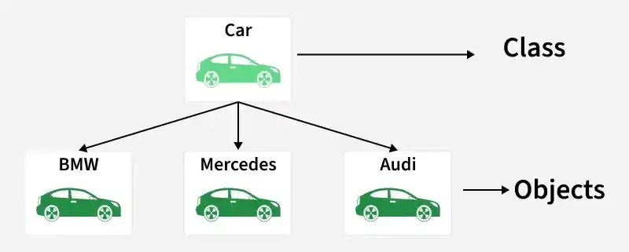
Basics of an Object
●
An object is a runtime instance of a class
class Car {
public:
string color;
int speed;
void accelerate() { speed += 10; }
};
int main() {
Car myCar; // object
myCar.color = "Red";
myCar.speed = 0;
myCar.accelerate();
}
●
Has state (data / attributes) and behavior (member functions)
●
Each object gets its own copy of the data members
●
Created using the class as a blueprint
15

Slide 14
Class vs. Object
Class Student (blueprint)
Student s1;
(roll 101, “Asha”)
Student s2;
(roll 102, “Ravi”)
Defines: rollNo, name, setData(), display()
No memory used until objects are made
Student s3;
(roll 103, “Kabir”)
...and so on
One class → many independent objects, each with its own data
17

Slide 15
Benefits & Applications of OOP
Benefits
Applications
●
Modularity — objects are self-contained units
●
GUI-based desktop applications
●
Reusability through inheritance
●
Game development & simulations
●
Data security via encapsulation
●
CAD / CAM and modeling systems
●
Easier maintenance & debugging
●
Object-oriented databases
●
Flexibility via polymorphism
●
Real-time & embedded systems
●
Natural real-world modeling
●
Web frameworks and enterprise software
14

Slide 16
Principles of OOP — The Four Pillars
1
Encapsulation
2
Abstraction
Bundling data & methods together; hiding internal details
Exposing only essential features, hiding complexity
3
Inheritance
4
Polymorphism
A class acquires properties & behavior of another class
Same interface, different underlying implementations
10

Slide 17
Principles of OOP — Quick Examples
Encapsulation
class Account {
private: double balance;
public: void deposit(double a);
};
Abstraction
class Shape {
public: virtual double area() = 0;
}; // interface only
Inheritance
class Animal { ... };
class Dog : public Animal { ... };
Polymorphism
Shape* s = new Circle();
s->area(); // resolved at runtime
11

Slide 18
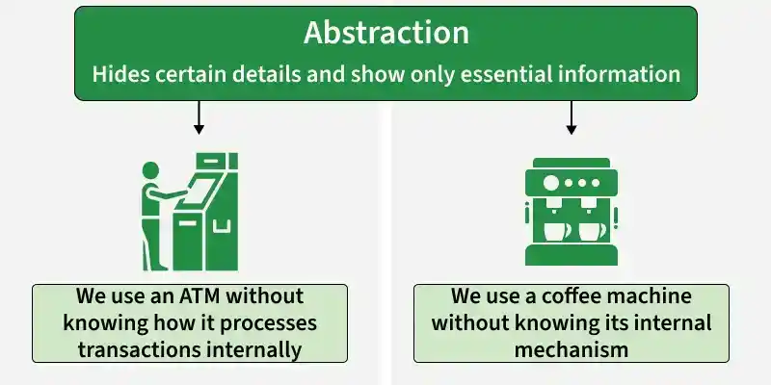
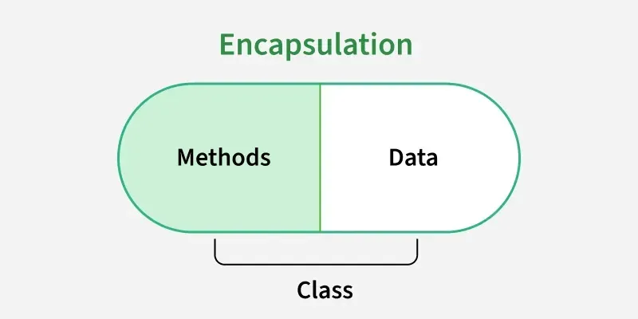

Slide 19
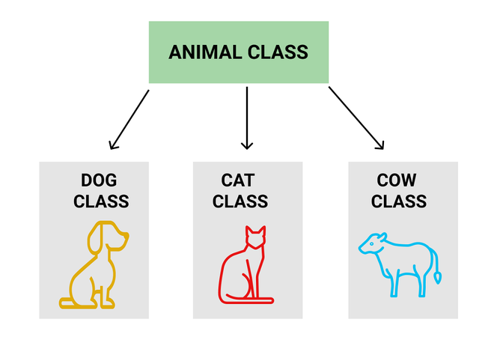
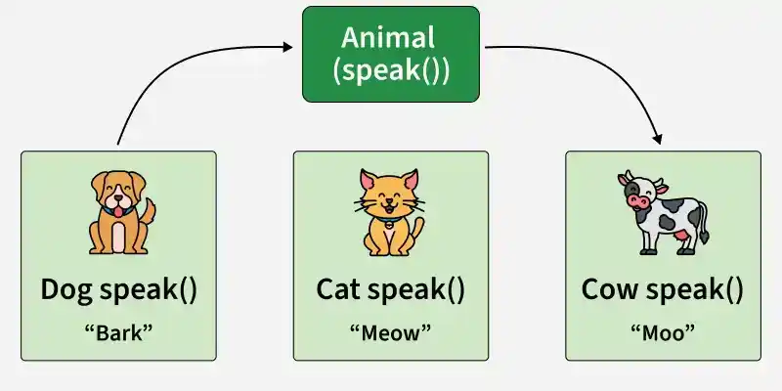

Slide 20
Tricky Example #2
HARD
TOPIC: ENCAPSULATION & ACCESS CONTROL
class Account {
int balance;
public:
Account(int b) { balance = b; }
void show() { cout << balance; }
};
int main() {
Account a(100);
a.balance = 500;
a.show();
}
❓ Question
Does this code compile? If not, why not?
Look closely at where balance is declared, and where it is being accessed from.
12

Slide 21
Answer: Tricky Example #2
Compile Error
●
balance is private by default (class members are private unless stated otherwise)
●
a.balance = 500; tries to access a private member from outside the class (in main)
●
The compiler rejects it: “balance is a private member of Account”
●
Only member functions of Account (like the constructor or show()) may touch balance directly
●
This is encapsulation working as intended — external code must go through public methods
13

Slide 22
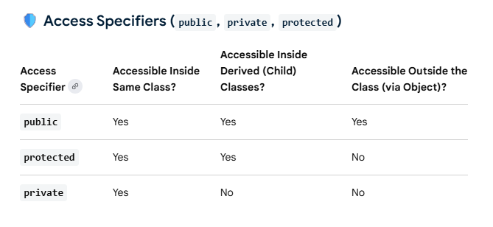
Private & Public Members
Specifier
Accessible from
private
Only member functions of the same class (default for class)
public
Anywhere the object is visible — inside or outside the class
protected
Same class and derived classes (brief note, covered under inheritance)
20

Slide 23
Tricky Example #4
HARD
TOPIC: WHAT “PRIVATE” REALLY MEANS
class Box {
int side;
public:
Box(int s) { side = s; }
void compare(Box b) {
if (side > b.side)
cout << "Bigger";
else
cout << "Smaller or equal";
}
};
int main() {
Box b1(10), b2(5);
b1.compare(b2);
}
❓ Question
Does b.side inside compare() compile, given side is private?
b is a different object of the SAME class — does “private” mean “this object only”, or “this class only”?
21

Slide 24
Answer: Tricky Example #4
Yes, it compiles!
●
Access specifiers apply at the class level, not the object level
●
A member function of Box can access the private members of ANY Box object — not just “this” object
●
b.side is legal inside compare() because compare() is itself a member of the Box class
●
Output: “Bigger” (b1.side = 10 > b2.side = 5)
●
Common misconception: “private = only this instance”. Correct rule: “private = only code inside this class”
22

Slide 25
Static Data Member
●
Declared with the static keyword inside the class
class Counter {
static int count; // declaration
public:
Counter() { count++; }
int getCount() { return count; }
};
// definition + initialization
int Counter::count = 0;
int main() {
Counter s1, s2, s3;
cout << c1.getCount(); // 3
}
●
Shared by ALL objects of the class — only one copy exists in memory
●
Must be defined (and usually initialized) outside the class
●
Exists even if no object has been created yet
●
Common use: counting how many objects exist, shared configuration values
23

Slide 26
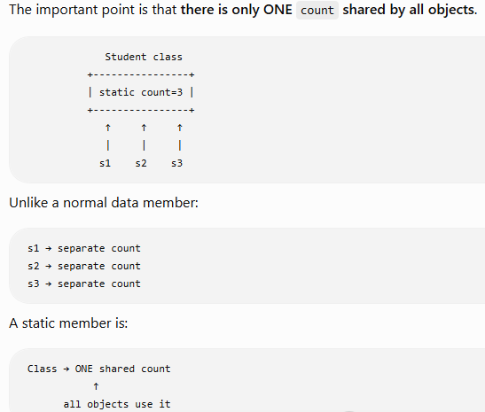

Slide 27
Static Member Function
●
Declared with static; belongs to the class, not to any one object
class Counter {
static int count;
public:
Counter() { count++; }
static int getCount() {
return count;
}
};
int Counter::count = 0;
int main() {
cout << Counter::getCount(); // call
}
●
Can be called using the class name: ClassName::function()
●
Can be called even before any object is created
●
Can directly access only static members (no access to “this” pointer)
●
Cannot be declared const or virtual
24

Slide 28
Tricky Example #5
HARD
TOPIC: STATIC DATA MEMBERS + COPY CONSTRUCTOR
class Counter {
static int count;
public:
Counter() { count++; }
static int getCount() { return count; }
};
int Counter::count = 0;
int main() {
Counter c1, c2;
Counter c3 = c1;
cout << Counter::getCount();
}
❓ Question
What number is printed? (Most people confidently answer 3 — are they right?)
Does Counter c3 = c1; run through the constructor that does count++?
25

Slide 29
Answer: Tricky Example #5
Output: 2
●
c1 and c2 are created with Counter() — each call runs count++, so count becomes 2
●
Counter c3 = c1; is a copy initialization — it calls the compiler-generated COPY constructor
●
The copy constructor only copies member values; it does NOT call Counter() and does NOT run count++
●
So count stays at 2, even though 3 objects (c1, c2, c3) now exist
●
This trips up almost everyone — static counters must account for copy construction separately if you want a true object count
26

Slide 30
Constructors
●
A constructor is a special member function that initializes an object
●
Has the SAME name as the class
●
Has NO return type — not even void
●
Called automatically the moment an object is created
●
Can be overloaded — a class may have multiple constructors with different parameters
class Point {
int x, y;
public:
Point() { x = 0; y = 0; } // constructor
};
int main() {
Point p; // constructor runs automatically here
}
27

Slide 31
Types of Constructors
Default Constructor
Parameterized Constructor
Copy Constructor
Takes no parameters
Takes arguments to set initial values
Builds an object from another object of the same class
Point() {
x = 0; y = 0;
}
Point(int a, int b) {
x = a; y = b;
}
Point(const Point &p) {
x = p.x; y = p.y;
}
Point p1; // default
Point p2(3, 4); // parameterized
Point p3 = p2; // copy
28

Slide 32
Tricky Example #6
HARD
TOPIC: CONSTRUCTORS — THE VANISHING DEFAULT
class Demo {
public:
Demo(int x) {
cout << x;
}
};
int main() {
Demo d;
}
❓ Question
Does Demo d; compile?
If a class only has a parameterized constructor, does the compiler still hand you a free default constructor?
29

Slide 33
Answer: Tricky Example #6
Compile Error
●
The compiler generates a default constructor ONLY if you define NO constructor at all
●
Here, Demo(int x) is defined, so the free auto-generated Demo() disappears
●
Demo d; needs a no-argument constructor — none exists — compile error
●
Fix: either call Demo d(5); or add an explicit Demo() {} yourself
●
Very common interview trap: “writing any constructor removes the compiler's default one”
30

Slide 34
Destructors
●
A destructor is a special member function that cleans up when an object's life ends
●
Same name as the class, prefixed with a tilde: ~ClassName()
●
Takes NO parameters and returns NO value
●
Cannot be overloaded — a class has exactly one destructor
●
Called automatically when an object goes out of scope, or is deleted
class FileHandler {
public:
FileHandler() { cout << "File opened\n"; }
~FileHandler() { cout << "File closed\n"; } // destructor
};
int main() {
FileHandler f;
} // f goes out of scope here -> destructor runs -> "File closed"
31

Slide 35
Tricky Example #3
HARD
TOPIC: OBJECT CREATION & COPY BEHAVIOR
class Test {
public:
int a;
Test() { cout << "Constructor called "; }
};
int main() {
Test t1;
Test t2 = t1;
Test t3(t1);
cout << t2.a;
}
❓ Question
How many times does “Constructor called” print?
t1, t2, and t3 all become objects — but are they all created the same way?
18

Slide 36
Answer: Tricky Example #3
Prints once
●
Only Test t1; calls the user-defined default constructor Test()
●
Test t2 = t1; and Test t3(t1); both invoke the compiler-generated copy constructor — NOT Test()
●
So “Constructor called” prints exactly once, not three times as many people guess
●
t2.a and t3.a hold whatever garbage value t1.a had (a was never initialized)
●
Key lesson: initializing an object from another existing object always goes through the copy constructor
19

Slide 37
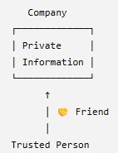
Friend function
A friend function is a normal function that is given special permission to access the private and protected members of a class.
🔐 Private members = "Only class members can access me." 🤝 Friend function = "This particular outside function is allowed to access me.“

