Slide 1
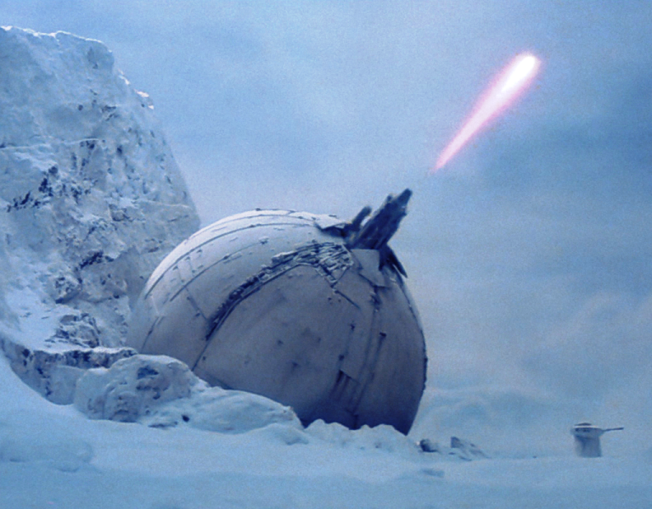
IoCannon
Marion Marschalek
@pinkflawd
Eireann Leverett
@blackswanburst

Slide 2
Indicators of Compromise
Intro, idea, concepts

Slide 3
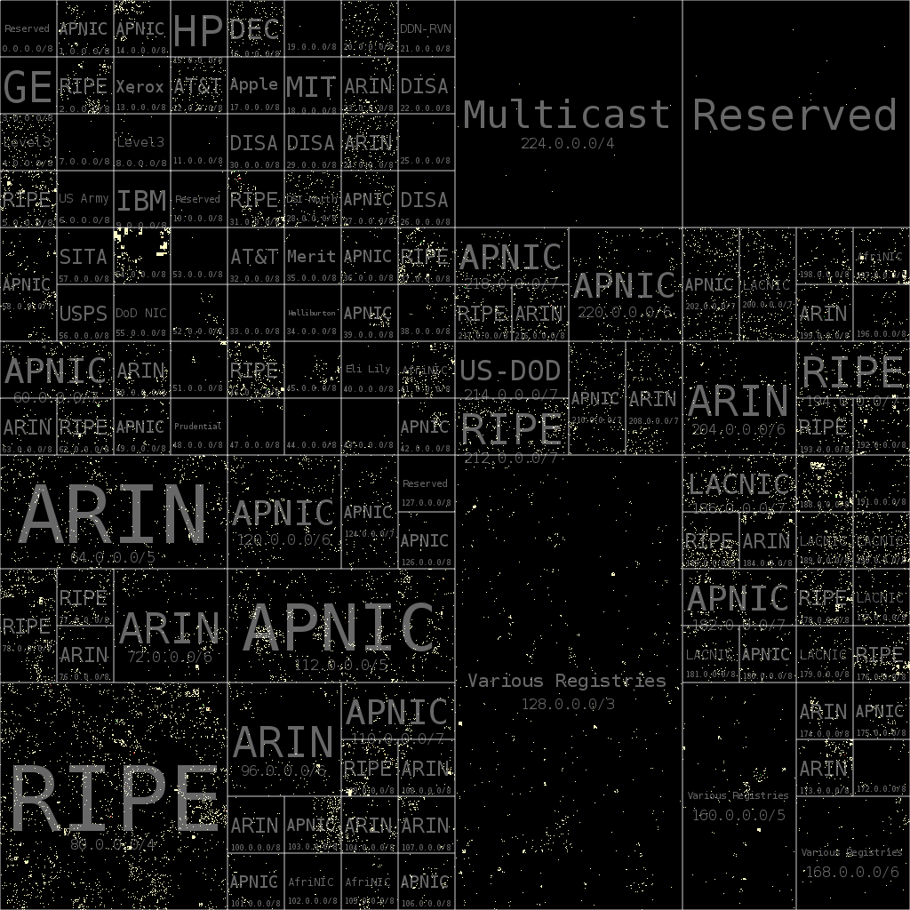
Network IoC and Attacker Costs
IoC | Buy | Rent
IPv4 | ~$ 14 | ~$2
IPv6 | ~$250 | ~$2
Domain | $1 | $1

Slide 4

Code and Binaries take time not money...
Marion to talk about measuring effort to alter binaries or source...

Slide 5
Indicator cost types
extraction
application/deployment
resilience and expiry time

Slide 6
Feeds
actionable, contextual, timely
See notes

Slide 7
Logistical Burden
How to measure?
Software development cost, personnel
Stealth cost
Operations < Infrastructure
I4CS slides here

Slide 8
The AV Paradox
ridiculous how AV sold detection products, with a cumulative TI feed; while TI now sells singular standalone feeds
AV has always just seen black and white; the road to hell is paved with good intentions
Threat modeling is an approach to data reduction and specialization
Cost of feeds nowadays limits coverage, limitations on TI heavier than ever seen in AV
No independent evaluation results of TI data available as of today

Slide 9
Moarrrr IoC
We can‘t find the needle in the haystack, give us more hay!

Slide 10
Measuring what you don‘t see
The time black spot: historical data relevance
The geographical black spot: customers in China deliver TI for China
The data quality black spot: file hash cant be compared to domain name

Slide 11
Binary layout
File size
Original file name
Section data, sizes, entropies
Imphash
Etc.
Most common approach, rather pointless

Slide 12
Call graph layout
Call graph reconstruction with radare2
Local functions, API calls, strings
Feature factory

Slide 13
API calls
Interface between software and operating system
Windows executables w/o API calls highly unlikely
Documented ^^ - mostly..
Frequently „hidden“ within malware

Slide 14
Behavior gadgets
Combinations of API calls allow conclusion about certain functionality
CreateFile -> SetFilePointer -> WriteFile -> FlushFileBuffers -> CloseHandle
Graph structure allows to put the gadgets in context

Slide 15
Behaviorgadgets for mini-bot
For SEND found {'send': '0x40128a'}
For SEND found {'send': '0x401ad5'}
For SEND found {'send': '0x402315'}
For SEND found {'send': '0x4016d2'}
For CREATEPROC found {'CreateProcess': '0x402aa1'}
For EXITSYSTEM found {'ExitWindows': '0x402aa1'}
For CREATETHREAD found {'CreateThread': '0x402aa1'}
For APILOADING found {'GetProcAddress': '0x407313'}
For RECV found {'recv': '0x402230'}
For RECV found {'recv': '0x40198f'}
For REGSETVAL found {'RegOpenKey': '0x402670', 'RegSetValue': '0x402670'}
Which gadgets, how often, where => matrix

Slide 16
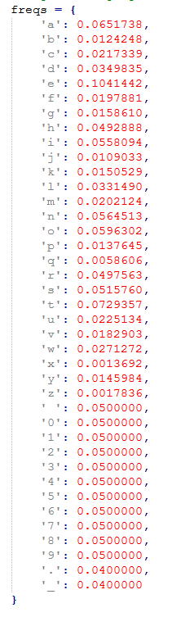
Strings
Human readable strings give information away, thus frequently obfuscated
Presence or absence of readable strings is relevant information
Graph structure, character frequency and character repetition allow string constant evaluation
Histogram of string evaluation results as fuzzy eval value

Slide 17
Mnemonics
Arithmetic operations as indicator for crypto / algos / compression
Leveraging radare2‘s instruction type
'shl‚
'shr‚
'mul‚
'div‚
'rol‚
'ror‚
'sar‚
'load‚
'store'

Slide 18
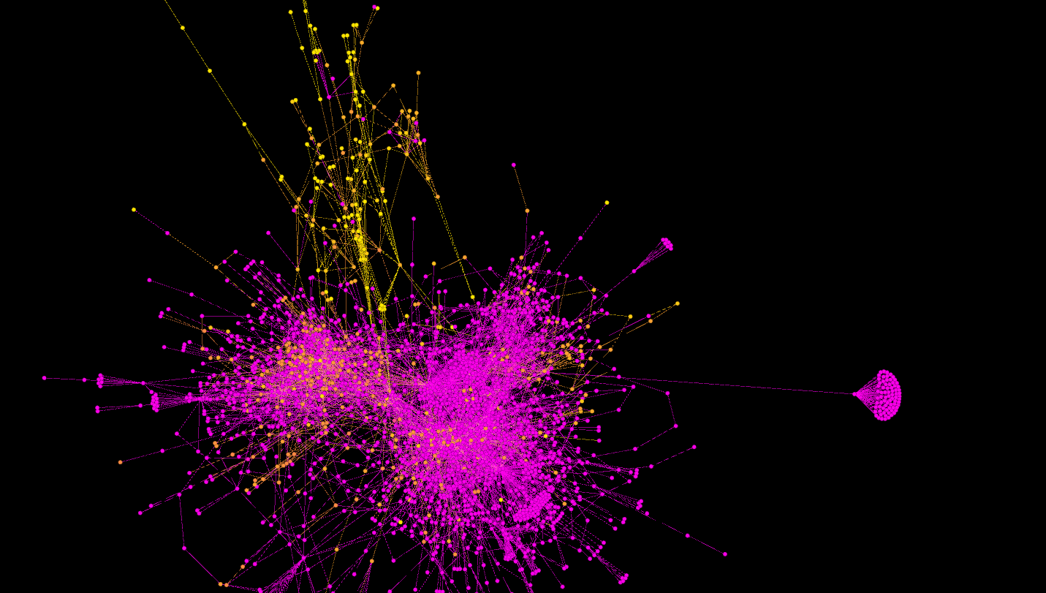

Slide 19
Feasibility

Slide 20
Assumption:
Any protection stragety a malware author applies only serves a limited set of goals.
Attackers aim to operate simpler & more creative, not more complex

Slide 21
The AV Factor
Packrat as "APT" using runtime packers, repetitive use of packers, infrastructure connects different attacks
targeted attacks are becoming cheaper as techniques are being reused, APT as a service maybe
Research on commodity RATs from I4CS Vienna
Enterprise networks vs. private computers and the runtime packers

Slide 22
DATA
Show the CSV, somehow
APT28, Animalfarm, Packrat
rBot case study

Slide 23
Discussion: Cost, Scalability, Resilience, Reliability
Cost: parsing time and setup, cost to deploy, cost to maintain
Scalability as in flexibility
Resilience: compiling robustness, packers
Reliability: the radare issue
extraction
change
application/deployment
resilience and expiry time

Slide 24
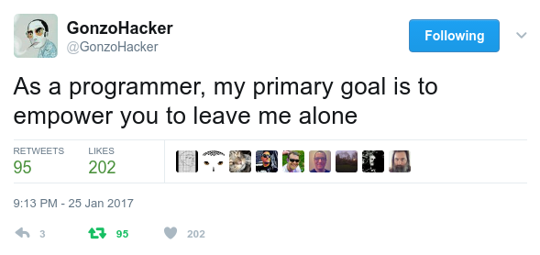
MISP Integration

Slide 25

Feature integration with MISP
Objects to group indicators as one entity
Feasible way to extract the indicators from binaries & graphs
Organise, store & display everything
Means for object interconnection & correlation
Flexibility & scalability & buzzwordbuzzword
Notes:
Not sure how often you used the DOS headers in an investigation, but MAEC allows you to share that.
Protip: don’t base your backend on a standard described solely in an office document… or the new version is totally incompatible with the old one.

Slide 26

MASTERPLAN
Object definition which can be plugged into MISP
PE & graph feature extraction
Mapping of features to object definition
Generate a JSON file in MISP Object format
Implementation of objects in MISP core
Objects for other file formats
Integration of the feature generator in the STL
Soon-ish: string search, automatic correlation on per-instance basis
Later-ish: behaviour gadget search, straight from the graphs

Slide 27
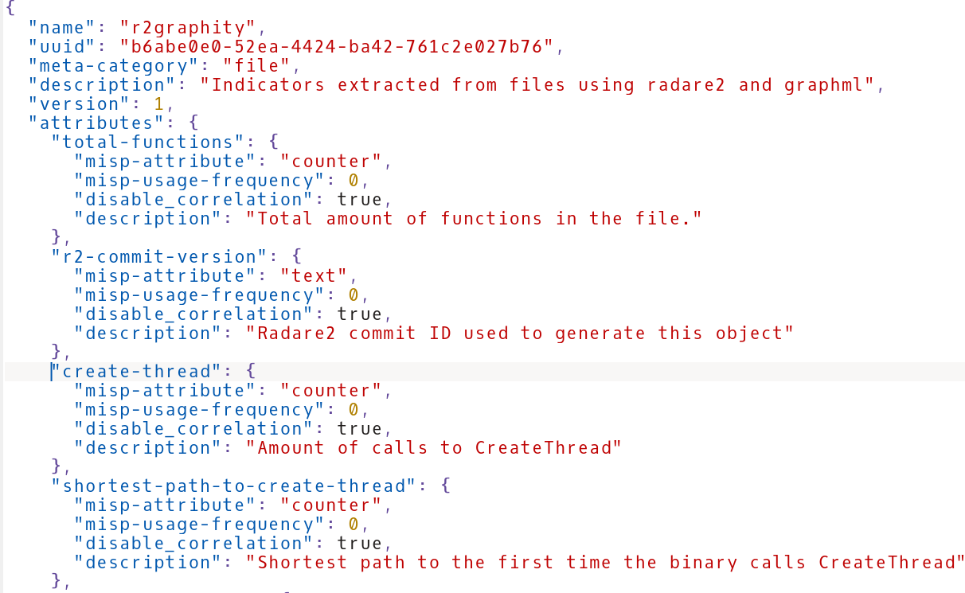

Slide 28
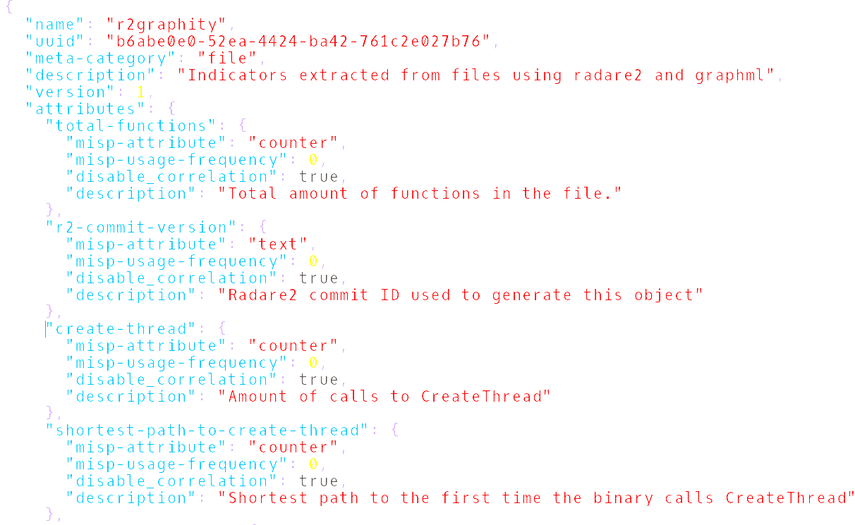
Metrics Engineering
Feature extraction
In a normalized way
Using open source tools
Producing comparable results
With practical relevance

Slide 29

Chicken & Egg Problem
You can’t identify good indicators if they aren’t stored, accessible, and easy to generate
It doesn't make sense to rely on indicators if every other research project creates new ones

Slide 30
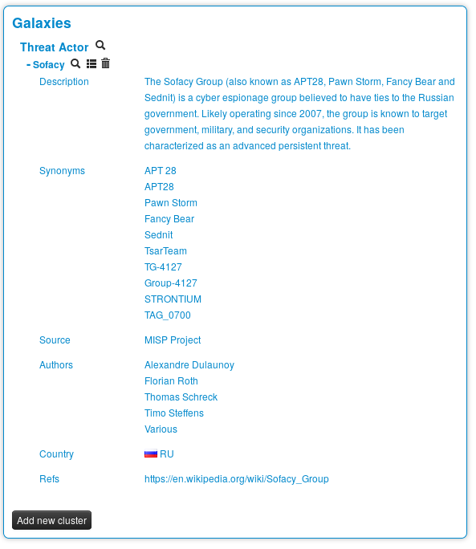
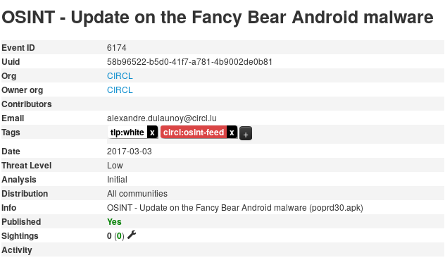

Slide 31
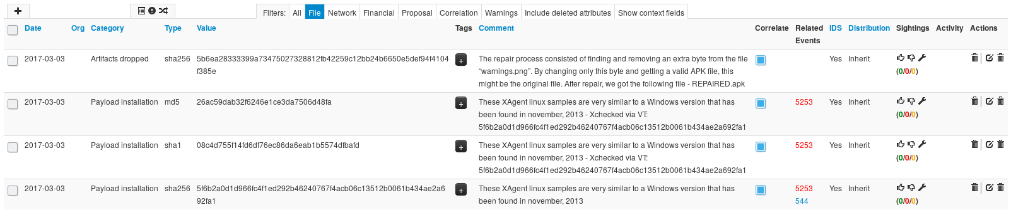

Slide 32
Conclusions etc.
The IoC ecosystem – sharing and caring for driving up attack costs
How possible is it to drive attackers out of business?
Sharing indicators done right will not disclose who you are or that you were breached
Driving down cost of defense will sooner or later drive up cost of attack
The average attacker doesn‘t write exploits or design intrusions or even write malware, but does copy paste and send e-mails all day

Slide 33
Ctd.
Money is a factor always, cause even in state sponsored hacking we can say that Somalia definitely doesn't have the same resources to spend as the US
State hacking tools sold today for compromise of "terrorists" could in the future very well be reused for economical targets or other nation state targets
reuse is a weak spot, common TI just like AV relies on reuse of code and infrastructure

