Slide 1
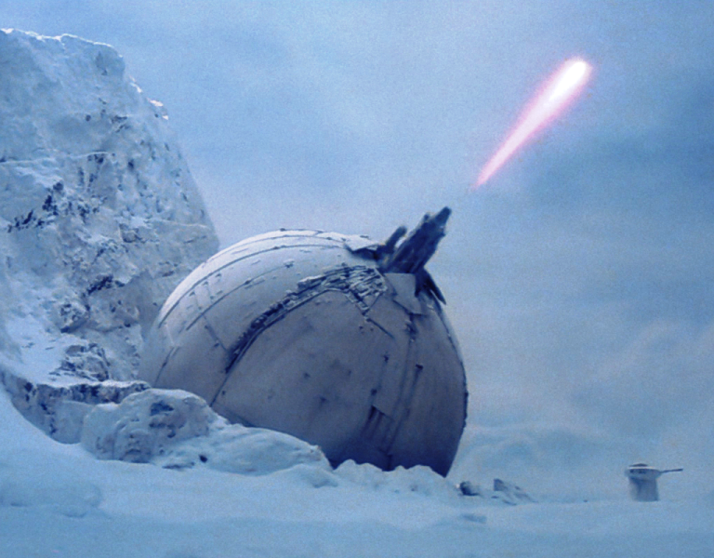
IoCannon
Marion Marschalek
@pinkflawd
Eireann Leverett
@blackswanburst

Slide 2

„There is hardly anything in the world that someone cannot make a little worse and sell a little cheaper“ – J. Ruskin

Slide 3
LOCATION
THREATS
TARGETS
THREAT ACTORS
ATTACK INFRASTRUCTURE
ACTOR CAPABILITIES
ACTOR RESOURCES
TIMELINE

Slide 4
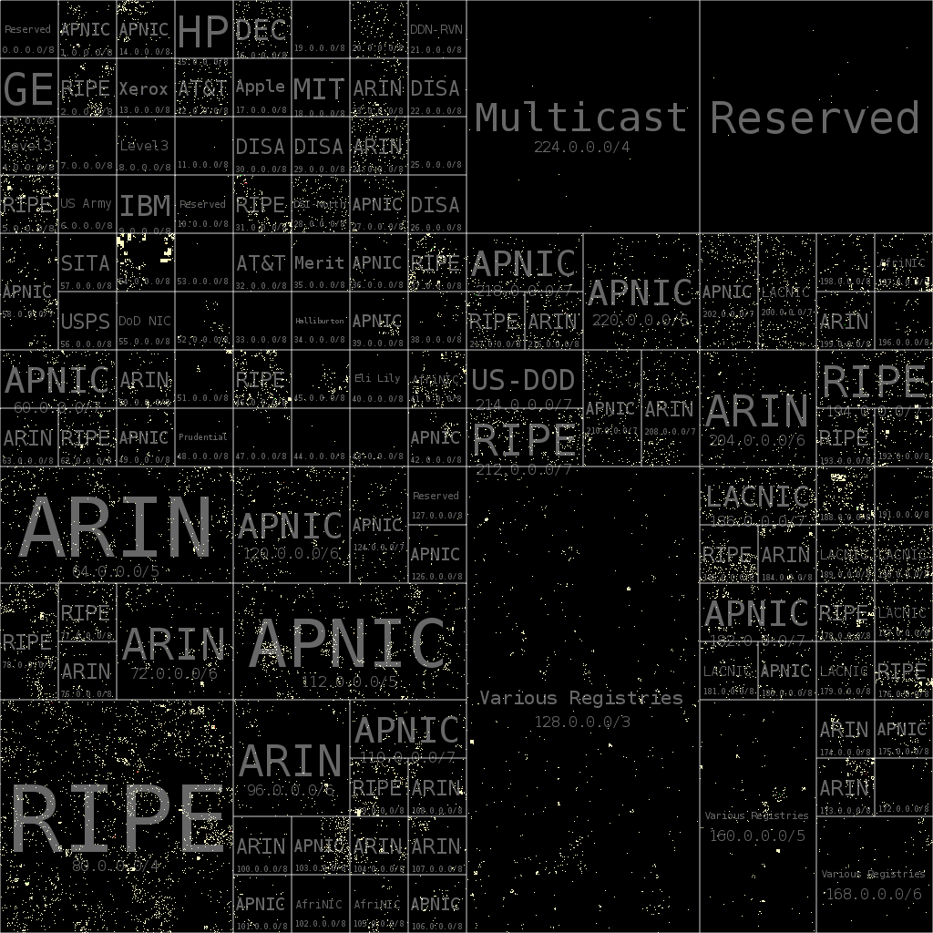
Network IoC and Attacker Costs
IoC | Buy | Rent
IPv4 | ~$ 14 | ~$2
IPv6 | ~$250 | ~$2
Domain | $1 | $1

Slide 5
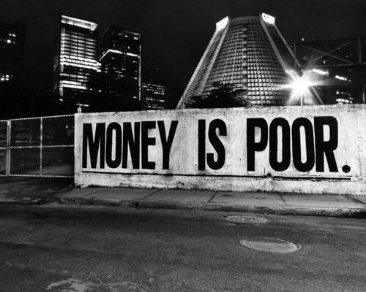
Code and Binaries take time not money...
Marion to talk about measuring effort to alter binaries or source...

Slide 6
Logistical Burden
How to measure?
Software development cost, personnel
Stealth cost
Operations < Infrastructure

Slide 7
Cost of Attack
Time
Skills
Tools
Hardware
Software
Personnel
Offices
Salaries
Insurance
Taxes?

Slide 8
Cost of Attack
Time
Skills
Tools
World class exploit developer $250k/year
Estimating cyber war costs: $45.9 Mio/year
Estimated costs for development of Stuxnet: $500k
APT1 group thoroughly exposed in Feb. 2013, back in business 160 days after exposure

Slide 9
Attacker cost
If the cost to attack is less than the value of your information to the attacker, you will be attacked
Mass malware must be financially profitable for the profit-driven attackers
APT campaigns must scale according to the resources at the attacker’s disposal
How targeted is your attacker?
No attacker has infinite resources
- Dino Dai Zovi, „Attacker Math“

Slide 10
APT research as a tool
Compromising the attackers
Infrastructure takedowns
Leakage of tools/exploits/vulnerabilities
Time-to-market
Scalability
Ease of deployment
Quality of service
Cost reduction

Slide 11
The AV Paradox
ridiculous how AV sold detection products, with a cumulative TI feed; while TI now sells singular standalone feeds
AV has always just seen black and white; the road to hell is paved with good intentions
Threat modeling is an approach to data reduction and specialization
Cost of feeds nowadays limits coverage, limitations on TI heavier than ever seen in AV
No independent evaluation results of TI data available as of today

Slide 12
Moarrrr IoC
We can‘t find the needle in the haystack, give us more hay!
In malware classification I learned that every malware offers a great set of features, but sadly they don‘t usually perfectly overlap among different samples

Slide 13
Indicator cost types
extraction
application/deployment
resilience and expiry time

Slide 14
Threat Detection
File hashes
File fragments
File behavior
File properties
System behavior
Network patterns
Abnormal system behavior
Abnormal network patterns
Known-bad
Non known-good
Known-bad origin
Non known-good origin
Threat detection metrics heavily build on known fragments, while aiming to find the largely unknown.

Slide 15
Measuring what you don‘t see
The time black spot: historical data relevance
The geographical black spot: customers in China deliver TI for China
The data quality black spot: file hash cant be compared to domain name

Slide 16
Binary layout
File size
Original file name
Section data, sizes, entropies
Imphash
Many many more
Most common approach, rather pointless, mention installers

Slide 17
Call graph layout
Call graph reconstruction with radare2
Local functions, API calls, strings
Feature factory
Measuring the graph
Counting functions, edges, calls, calc ratios by code section size, etc.

Slide 18
API calls
Interface between software and operating system
Windows executables w/o API calls highly unlikely
Documented ^^ - mostly..
Frequently „hidden“ within malware

Slide 19
Behavior gadgets
Combinations of API calls allow conclusion about certain functionality
CreateFile -> SetFilePointer -> WriteFile -> FlushFileBuffers -> CloseHandle
Graph structure allows to put the gadgets in context

Slide 20
Behaviorgadgets for mini-bot
For SEND found {'send': '0x40128a'}
For SEND found {'send': '0x401ad5'}
For SEND found {'send': '0x402315'}
For SEND found {'send': '0x4016d2'}
For CREATEPROC found {'CreateProcess': '0x402aa1'}
For EXITSYSTEM found {'ExitWindows': '0x402aa1'}
For CREATETHREAD found {'CreateThread': '0x402aa1'}
For APILOADING found {'GetProcAddress': '0x407313'}
For RECV found {'recv': '0x402230'}
For RECV found {'recv': '0x40198f'}
For REGSETVAL found {'RegOpenKey': '0x402670', 'RegSetValue': '0x402670'}
Which gadgets, how often, where => matrix

Slide 21
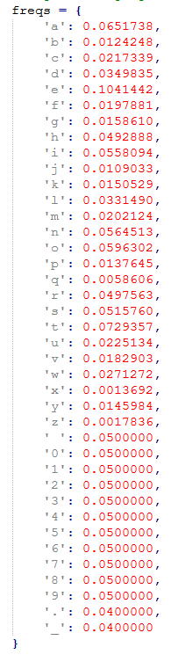
Strings
Human readable strings give information away, thus frequently obfuscated
Presence or absence of readable strings is relevant information
Graph structure, character frequency and character repetition allow string constant evaluation
Histogram of string evaluation results as fuzzy eval value

Slide 22
Mnemonics
Arithmetic operations as indicator for crypto / algos / compression
Leveraging radare2‘s instruction type
'shl‚
'shr‚
'mul‚
'div‚
'rol‚
'ror‚
'sar‚
'load‚
'store'

Slide 23
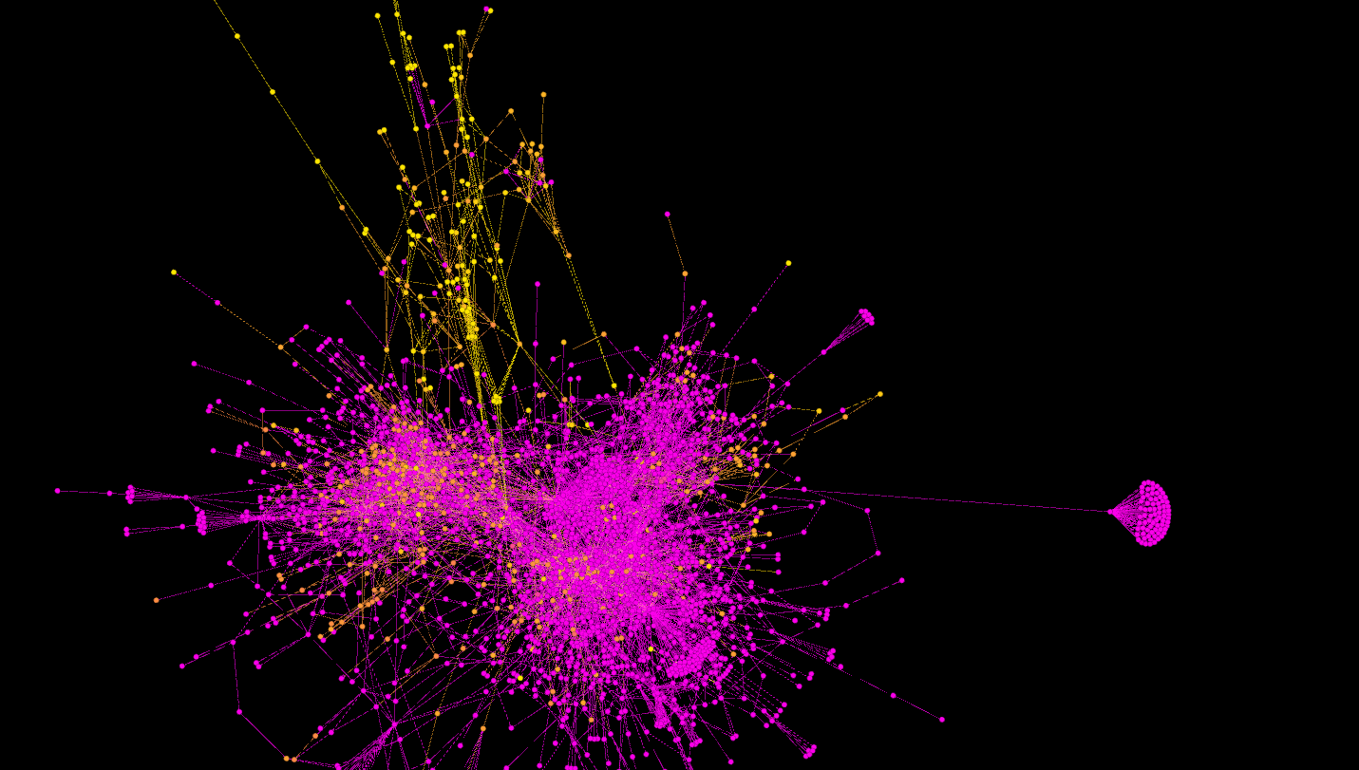
Babar

Slide 24
Feasibility
Files >2mb problematic, still
Radare needs fixing
Parsing time <1s – ~40min
Parse once, derive features foreva
Get fresh stats

Slide 25
Assumption:
Any protection stragety a malware author applies only serves a limited set of goals.
Attackers aim to operate simpler & more creative, not more complex

Slide 26
The AV Factor
Packrat as "APT" using runtime packers, repetitive use of packers, infrastructure connects different attacks
targeted attacks are becoming cheaper as techniques are being reused, APT as a service maybe
Research on commodity RATs from I4CS Vienna
Enterprise networks vs. private computers and the runtime packers

Slide 27
DATA
Show the CSV, somehow
APT28, Animalfarm, Packrat
rBot case study

Slide 28
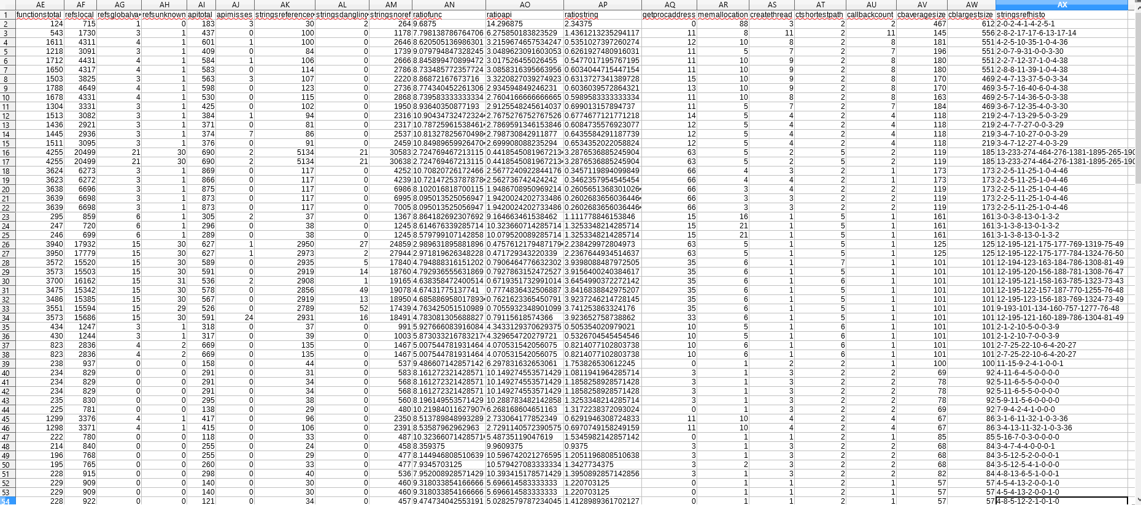

Slide 29
Discussion: Cost, Scalability, Resilience, Reliability
Cost: parsing time and setup, cost to deploy, cost to maintain
Scalability as in flexibility
Resilience: compiling robustness, packers
Reliability: the radare issue
extraction
change
application/deployment
resilience and expiry time

Slide 30
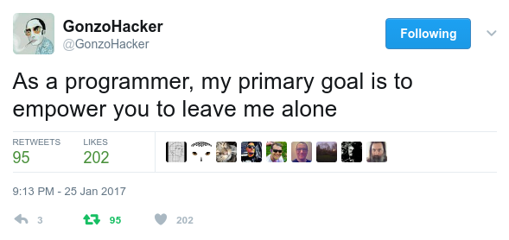
Feature integration with MISP

Slide 31

Feature integration with MISP
Objects to group indicators as one entity
Feasible way to extract the indicators from binaries & graphs
Organise, store & display everything
Means for object interconnection & correlation
Flexibility & scalability
Notes:
Not sure how often you used the DOS headers in an investigation, but MAEC allows you to share that.
Protip: don’t base your backend on a standard described solely in an office document… or the new version is totally incompatible with the old one.

Slide 32

MASTERPLAN
Object definition which can be plugged into MISP
PE & graph feature extraction
Mapping of features to object definition
Generate a JSON file in MISP Object format
Implementation of objects in MISP core
Objects for other file formats
Integration of the feature generator in the STL
Soon-ish: string search, automatic correlation on per-instance basis
Later-ish: behaviour gadget search, straight from the graphs

Slide 33
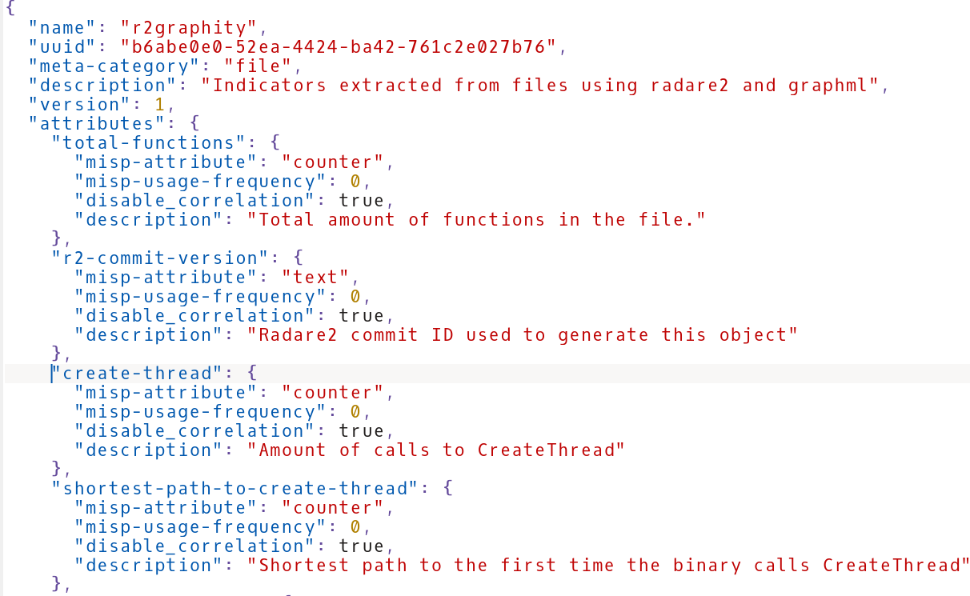

Slide 34
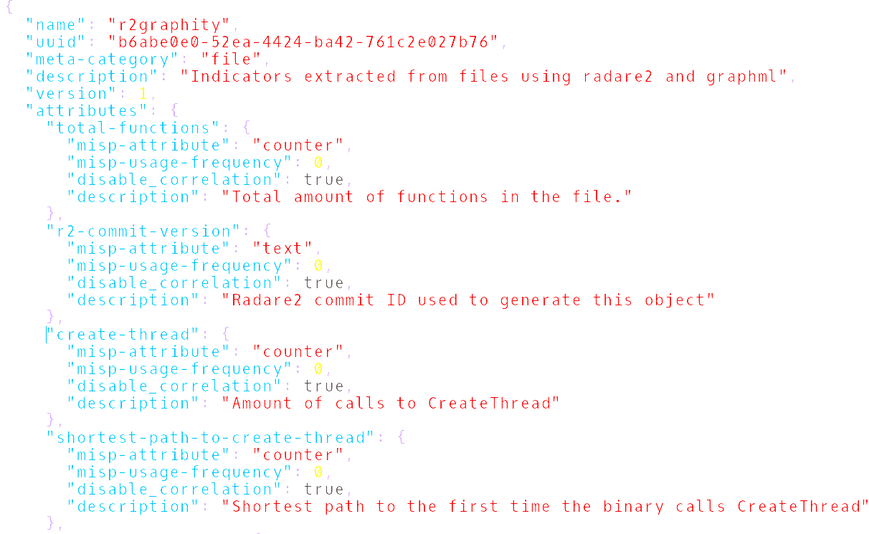
Metrics Engineering
Feature extraction
In a normalized way
Using open source tools
Producing comparable results
With practical relevance

Slide 35
Conclusions etc.
The IoC ecosystem – sharing and caring for driving up attack costs
How possible is it to drive attackers out of business?
Sharing indicators done right will not disclose who you are or that you were breached
Driving down cost of defense will sooner or later drive up cost of attack
The average attacker doesn‘t write exploits or design intrusions or even write malware, but does copy paste and send e-mails all day

Slide 36
Ctd.
Money is a factor always, cause even in state sponsored hacking we can say that Somalia definitely doesn't have the same resources to spend as the US
State hacking tools sold today for compromise of "terrorists" could in the future very well be reused for economical targets or other nation state targets
reuse is a weak spot, common TI just like AV relies on reuse of code and infrastructure

Slide 37
Ctd.
Currently no established method to evaluate the sophistication of a threat or threat actor.
Success of an attack does not correlate with sophistication of an attacker.
Resilience of the target network, does.
Attacker sophistication is somewhat closely related to attacker budget.
Again, no attacker has infinit budget.
By driving up attack costs infosec can improve security for all.
Taking out attacker tools does not necessarily do the job.

Slide 38

thank you

