Slide 1


Principles of Information Security, Fourth Edition
Chapter 5
Planning for Security

Slide 2
Learning Objectives
Upon completion of this material, you should be able to:
Define management’s role in the development, maintenance, and enforcement of information security policy, standards, practices, procedures, and guidelines
Describe what an information security blueprint is, identify its major components, and explain how it supports the information security program
Notes:
Upon completion of this material you should be able to:
Understand management’s responsibilities and role in the development, maintenance, and enforcement of information security policy, standards, practices, procedures, and guidelines
Understand the differences between the organization’s general information security policy and the needs and objectives of the various issue-specific and system-specific policies the organization will create
Know what an information security blueprint is and what its major components are
Understand how an organization institutionalizes its policies, standards, and practices using education, training and awareness programs
Become familiar with what viable information security architecture is, what it includes, and how it is used

Slide 3
Learning Objectives (cont’d.)
Discuss how an organization institutionalizes its policies, standards, and practices using education, training, and awareness programs
Explain what contingency planning is and how it relates to incident response planning, disaster recovery planning, and business continuity plans

Slide 4
Introduction
Creation of information security program begins with creation and/or review of an organization’s information security policies, standards, and practices
Then, selection or creation of information security architecture and the development and use of a detailed information security blueprint creates a plan for future success
Without policy, blueprints, and planning, an organization is unable to meet information security needs of various communities of interest
Notes:
Introduction
The creation of an information security program begins with an information security blueprint, and before we can discuss the creation and development of a blueprint, it is important to look at management’s responsibility in shaping policy.
It is prudent for information security professionals to know the information security polices and how these policies contribute to the overall objectives of the organization.

Slide 5
Information Security Planning and Governance
Planning levels
Planning and the CISO
Information Security Governance
Governance:
Set of responsibilities and practices exercised by the board and executive management
Goal to provide strategic direction, ensuring that objectives are achieved
Ascertaining that risks are managed appropriately and verifying that the enterprise’s resources are used responsibly

Slide 6
Information Security Planning and Governance (cont’d.)
Information Security Governance outcomes
Five goals
Strategic alignment
Risk management
Resource management
Performance measures
Value delivery
Governance framework
CGTF(Ideal framework from CMU)

Slide 7
Information Security Policy, Standards, and Practices
Communities of interest must consider policies as the basis for all information security efforts
Policies direct how issues should be addressed and technologies used
Policies should never contradict law
Security policies are the least expensive controls to execute but most difficult to implement properly
Shaping policy is difficult
Notes:
Information Security Policy, Standards, and Practices
Management from all communities of interest must consider policies as the basis for all information security planning, design, and deployment.
In general, policies direct how issues should be addressed and technologies used, not cover the specifics on the proper operation of equipment or software.
Quality security programs begin and end with policy.
As information security is primarily a management rather than technical problem, policy guides personnel to function in a manner that will add to the security of its information assets.
Security policies are the least expensive control to execute but the most difficult to implement.
Shaping policy is difficult because it must:
1) Never conflict with laws
2) Stand up in court, if challenged
3)Be properly administered, including thorough dissemination and documentation from personnel showing they have read the policies

Slide 8
Definitions
Policy: course of action used by organization to convey instructions from management to those who perform duties
Policies are organizational laws
Standards: more detailed statements of what must be done to comply with policy
Practices, procedures, and guidelines effectively explain how to comply with policy
For a policy to be effective, it must be properly disseminated, read, understood, and agreed to by all members of organization and uniformly enforced
Notes:
A policy is:
A plan or course of action, as of a government, political party, or business, intended to influence and determine decisions, actions, and other matters
Policies are organizational laws.
Policies must contain information on what is right and what is not; what the penalties are for violating policy; and what the appeal process is.
Standards, on the other hand, are more detailed statements of what must be done to comply with policy.
Practices, procedures, and guidelines effectively explain how to comply with policy.
For a policy to be effective, it must be properly disseminated, read, understood, and agreed to by all members of the organization.

Slide 9
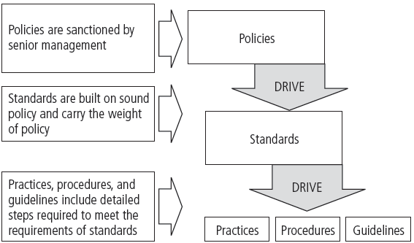
Figure 5-1 Policies, Standards, and Practices
Notes:
Types of Policy
Management defines three types of security policy:
1) General or security program policy
2) Issue-specific security policies
3) Systems-specific security policies

Slide 10
Enterprise Information Security Policy (EISP)
Also known as a general security policy, organizational security policy, IT security policy, or information security policy
Based on and directly supports the mission, vision, and direction of the organization
Sets strategic direction, scope, and tone for all security efforts within the organization
Executive-level document, usually drafted by or with CIO of the organization
Needs to be modified only when there is a change in the strategic direction of the organization.
Notes:
Security Program Policy
A security program policy (SPP) is also known as a general security policy, IT security policy, or information security policy. This policy sets the strategic direction, scope, and tone for all security efforts within the organization.
The SPP is an executive-level document, usually drafted by or with the CIO of the organization, and it is usually two to 10 pages long.
When the SPP has been developed, the CISO begins forming the security team and initiates the SecSDLC process.

Slide 11
Cotd...
The EISP guides the development, implementation, and management of the security program
It also assigns responsibilities for the various areas of security, including systems administration, maintenance of the information security policies, and the practices and responsibilities of the users
It addresses legal compliance
Typically addresses compliance in two areas
Ensure meeting requirements to establish program and responsibilities assigned therein to various organizational components
Use of specified penalties and disciplinary action

Slide 12
EISP Elements
An overview of the corporate philosophy on security
Information on the structure of the information security organization and individuals who fulfill the information security role
Fully articulated responsibilities for security that are shared by all members of the organization (employees, contractors, consultants, partners, and visitors)
Fully articulated responsibilities for security that are unique to each role within the organization

Slide 13
Issue-Specific Security Policy (ISSP)
The ISSP:
Addresses specific areas of technology
Requires frequent updates
Contains statement on organization’s position on specific issue
Three approaches when creating and managing ISSPs:
Create a number of independent ISSP documents
Create a single comprehensive ISSP document
Create a modular ISSP document
Notes:
Issue-Specific Security Policy (ISSP)
As the organization executes various technologies and processes to support routine operations, certain guidelines are needed to instruct employees to use these technologies and processes properly.
In general, the ISSP:
1) Addresses specific areas of technology
2) Requires frequent updates
3) Contains an issue statement on the organization’s position on an issue
There are a number of approaches toward creating and managing ISSPs within an organization.
Three of the most common are:
Create a number of independent ISSP documents, each tailored to a specific issue
Create a single comprehensive ISSP document attempting to cover all issues
Create a modular ISSP document that unifies policy creation and administration, while maintaining each specific issue’s requirements

Slide 14
Cotd...
Components of the policy
Statement of Policy
Authorized Access and Usage of Equipment
Prohibited Use of Equipment
Systems Management
Violations of Policy
Policy Review and Modification
Limitations of Liability

Slide 15
Cotd...
Number of approaches to creating and managing ISSPs within an organization
Independent ISSP documents, each tailored to a specific issue
A single comprehensive ISSP document covering all issues
A modular ISSP document that unifies policy creation and administration, while maintaining each specific issue’s requirements

Slide 16
Systems-Specific Policy (SysSP)
SysSPs frequently function as standards and procedures used when configuring or maintaining systems
Systems-specific policies fall into two groups
Managerial guidance
Technical specifications
ACLs can restrict access for a particular user, computer, time, duration—even a particular file
Configuration rule policies
Combination SysSPs
Notes:
Systems-Specific Policy (SysSP)
While issue-specific policies are formalized as written documents, distributed to users, and agreed to in writing, SysSPs are frequently codified as standards and procedures used when configuring or maintaining systems.
Systems-specific policies fall into two groups:
1) Access control lists (ACLs) consists of the access control lists, matrices, and capability tables governing the rights and privileges of a particular user to a particular system.
2) Configuration rules comprise the specific configuration codes entered into security systems to guide the execution of the system.
ACL Policies
ACLs allow configuration to restrict access from anyone and anywhere. ACLs regulate:
Who can use the system
What authorized users can access
When authorized users can access the system
Where authorized users can access the system from
Rule Policies
Rule policies are more specific to the operation of a system than ACLs, and they may or may not deal with users directly.
Many security systems require specific configuration scripts telling the systems what actions to perform on each set of information they process.

Slide 17
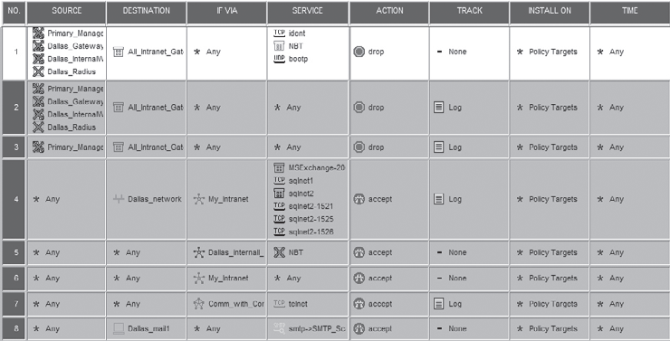
VPN-1/Firewall-1 Policy Editor courtesy of Check Point Software Technologies Ltd.
Figure 5-4 Check Point VPN-1/Firewall-1 Policy Editor

Slide 18
Policy Management
Policies must be managed as they constantly change
To remain viable, security policies must have:
Individual responsible for the policy (policy administrator)
A schedule of reviews
Method for making recommendations for reviews
Specific policy revision date
Automated policy management
Notes:
Policy Management
Policies are living documents that must be managed and nurtured, and they are constantly changing and growing. These documents must be properly disseminated and managed.
Special considerations should be made for organizations undergoing mergers, takeovers, and partnerships.
In order to remain viable, these policies must have:
An individual responsible for reviews
A schedule of reviews
A method for making recommendations for reviews
An indication of policy and revision date
Automated Policy Management
There is an emergence of a new category of software for managing information security policies. In recent years, this category has emerged in response to needs articulated by information security practitioners.
While there have been many software products that meet specific technical control needs, there is now a need for software to automate some of the busywork of policy management.

Slide 19
The Information Security Blueprint
Basis for design, selection, and implementation of all security policies, education and training programs, and technological controls
More detailed version of security framework (outline of overall information security strategy for organization)
Should specify tasks to be accomplished and the order in which they are to be realized
Should also serve as scalable, upgradeable, and comprehensive plan for information security needs for coming years
Notes:
Information Security Blueprints
One approach to selecting a methodology is to adapt or adopt a published model or framework for information security.
A framework is the basic skeletal structure within which additional detailed planning of the blueprint can be placed as it is developed or refined.
Experience teaches us that what works well for one organization may not precisely fit another.

Slide 20
The ISO 27000 Series
One of the most widely referenced and often discussed security models
Framework for information security that states organizational security policy is needed to provide management direction and support
Purpose is to give recommendations for information security management
Provides a common basis for developing organizational security
Notes:
ISO 17799/BS 7799
One of the most widely referenced and often discussed security models is the Information Technology – Code of Practice for Information Security Management, which was originally published as the British Standard BS 7799.
This Code of Practice was adopted as an international standard by the International Organization for Standardization (ISO) and the International Electrotechnical Commission (IEC) as ISO/IEC 17799 in 2000 as a framework for information security.
ISO/IEC 17799
1. Organizational Security Policy is needed to provide management direction and support for information security.
2. Organizational Security Infrastructure objectives:
Manage information security within the company
Maintain the security of organizational information processing facilities and information assets accessed by third parties
Maintain the security of information when the responsibility for information processing has been outsourced to another organization
3. Asset Classification and Control is needed to maintain appropriate protection of corporate assets and to ensure that information assets receive an appropriate level of protection.
4. Personnel Security objectives:
Reduce risks of human error, theft, fraud, or misuse of facilities
Ensure that users are aware of information security threats and concerns and are equipped to support the corporate security policy in the course of their normal work
Minimize the damage from security incidents and malfunctions and learn from such incidents
5. Physical and Environmental Security objectives:
Prevent unauthorized access, damage, and interference to business premises and information
Prevent loss, damage, or compromise of assets and interruption to business activities
Prevent compromise or theft of information and information processing facilities
6. Communications and Operations Management objectives:
Ensure the correct and secure operation of information processing facilities
Minimize the risk of systems failures
Protect the integrity of software and information
Maintain the integrity and availability of information processing and communication
Ensure the safeguarding of information in networks and the protection of the supporting infrastructure
Prevent damage to assets and interruptions to business activities
Prevent loss, modification, or misuse of information exchanged between organizations
7. System Access Control objectives in this area include:
Control access to information
Prevent unauthorized access to information systems
Ensure the protection of networked services
Prevent unauthorized computer access
Detect unauthorized activities
Ensure information security when using mobile computing and telecommunication networks
8. System Development and Maintenance objectives:
Ensure security is built into operational systems
Prevent loss, modification, or misuse of user data in application systems
Protect the confidentiality, authenticity, and integrity of information
Ensure IT projects and support activities are conducted in a secure manner
Maintain the security of application system software and data
9. Business Continuity Planning to counteract interruptions to business activities and to critical business processes from the effects of major failures or disasters.
10. Compliance objectives:
Avoid breaches of any criminal or civil law, statutory, regulatory, or contractual obligations and of any security requirements
Ensure compliance of systems with organizational security policies and standards
Maximize the effectiveness of and minimize interference to/from the system audit process

Slide 21
Table 5-4 The ISO/IEC 27001: 2005 Plan-Do-Check-Act Cycle¹⁴
Plan
1 | Define the scope of the ISMS
2 | Define an ISMS policy
3 | Define the approach to risk assessment
4 | Identify the risks
5 | Assess the risks
6 | Identify and evaluate options for the treatment of risk
7 | Select control objectives and controls
8 | Prepare a statement of applicability (SOA)

Slide 22
Table 5-4 (continued)
Do
9 | Formulate a risk treatment plan
10 | Implement the risk treatment plan
11 | Implement controls
12 | Implement training and awareness programs
13 | Manage operations
14 | Manage resources
15 | Implement procedures to detect and respond to security incidents

Slide 23
Table 5-4 (continued)
Check
15 | Execute monitoring procedures
16 | Undertake regular reviews of ISMS effectiveness
17 | Review the level of residual and acceptable risk
18 | Conduct internal ISMS audits
19 | Undertake regular management review of the ISMS
20 | Record actions and events that impact an ISMS

Slide 24
Table 5-4 (continued)
Act
21 | Implement identified improvements
22 | Take corrective or preventive action
23 | Apply lessons learned
24 | Communicate results to interested parties
25 | Ensure improvements achieve objectives

Slide 25
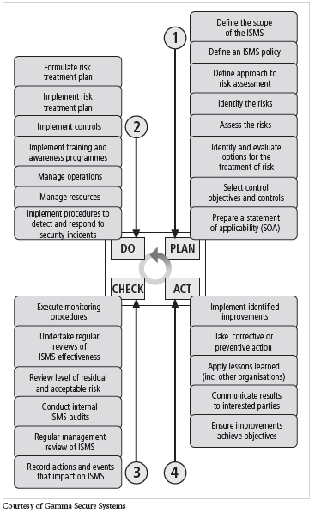
Figure 5-6 BS7799:2 Major Process Steps

Slide 26
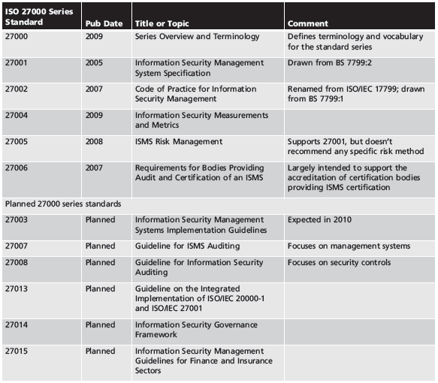
Table 5-5 ISO 27000 Series Current and Planned Standards

Slide 27
NIST Security Models
Documents available from Computer Security Resource Center of NIST
SP 800-12, The Computer Security Handbook
SP 800-14, Generally Accepted Principles and Practices for Securing IT Systems
SP 800-18, The Guide for Developing Security Plans for IT Systems
SP 800-26, Security Self-Assessment Guide for Information Technology Systems
SP 800-30, Risk Management Guide for Information Technology Systems
Notes:
NIST Security Models
Another approach available is described in the many documents available from the Computer Security Resource Center of the National Institute for Standards and Technology (csrc.nist.gov).
These are among the references cited by the government of the U.S. when deciding not to select the ISO/IEC 17799 standards.
NIST SP 800-12 - The Computer Security Handbook is an excellent reference and guide for the security manager or administrator in the routine management of information security.
NIST SP 800-14 - Generally Accepted Principles and Practices for Securing IT Systems provides best practices and security principles that can direct the development of a security blueprint.
NIST SP 800-18 - The Guide for Developing Security Plans for IT Systems is considered the foundation for a comprehensive security blueprint and framework. It provides detailed methods for assessing, designing, and implementing controls and plans for various sized applications.

Slide 28
NIST Special Publication 800-14
Security supports mission of organization; is an integral element of sound management
Security should be cost effective; owners have security responsibilities outside their own organizations
Security responsibilities and accountability should be made explicit; security requires a comprehensive and integrated approach
Security should be periodically reassessed; security is constrained by societal factors
33 principles for securing systems (see Table 5-7)
Notes:
NIST SP 800-14 Generally Accepted Principles and Practices
Security Supports the Mission of the Organization
Security is an Integral Element of Sound Management
Security Should Be Cost Effective
Systems Owners Have Security Responsibilities Outside Their Own Organizations
Security Responsibilities and Accountability Should Be Made Explicit
Security Requires a Comprehensive and Integrated Approach
Security Should Be Periodically Reassessed
Security is Constrained by Societal Factors
1. Establish a sound security policy as the “foundation” for design.
2. Treat security as an integral part of the overall system design.
3. Clearly delineate the physical and logical security boundaries governed by associated security policies.
4. Reduce risk to an acceptable level.
5. Assume that external systems are insecure.
6. Identify potential trade-offs between reducing risk and increased costs and decrease in other aspects of operational effectiveness.
7. Implement layered security (Ensure no single point of vulnerability).
8. Implement tailored system security measures to meet organizational security goals.
9. Strive for simplicity.
10. Design and operate an IT system to limit vulnerability and to be resilient in response.
11. Minimize the system elements to be trusted.
12. Implement security through a combination of measures distributed physically and logically.
13. Provide assurance that the system is, and continues to be, resilient in the face of expected threats.
14. Limit or contain vulnerabilities.
15. Formulate security measures to address multiple overlapping information domains.
16. Isolate public access systems from mission critical resources (e.g., data, processes, etc.).
17. Use boundary mechanisms to separate computing systems and network infrastructures.
18. Where possible, base security on open standards for portability and interoperability.
19. Use common language in developing security requirements.
20. Design and implement audit mechanisms to detect unauthorized use and to support incident investigations.
21. Design security to allow for regular adoption of new technology, including a secure and logical technology upgrade process.
22. Authenticate users and processes to ensure appropriate access control decisions both within and across domains.
23. Use unique identities to ensure accountability.
24. Implement least privilege.
25. Do not implement unnecessary security mechanisms.
26. Protect information while being processed, in transit, and in storage.
27. Strive for operational ease of use.
28. Develop and exercise contingency or disaster recovery procedures to ensure appropriate availability.
29. Consider custom products to achieve adequate security.
30. Ensure proper security in the shutdown or disposal of a system.
31. Protect against all likely classes of “attacks.”
32. Identify and prevent common errors and vulnerabilities.
33. Ensure that developers are trained in how to develop secure software.

Slide 29
IETF Security Architecture
Security Area Working Group acts as advisory board for protocols and areas developed and promoted by the Internet Society
RFC 2196: Site Security Handbook covers five basic areas of security with detailed discussions on development and implementation
Notes:
IETF Security Architecture
While no specific architecture is promoted through the Internet Engineering Task Force, the Security Area Working Group acts as an advisory board for the protocols and areas developed and promoted through the Internet Society.
RFC 2196: Site Security Handbook provides an overview of five basic areas of security with detailed discussions on development and implementation.
There are chapters on such important topics as security policies, security technical architecture, security services, and security incident handling.

Slide 30
Baselining and Best Business Practices
Baselining and best practices are solid methods for collecting security practices, but provide less detail than a complete methodology
Possible to gain information by baselining and using best practices and thus work backwards to an effective design
The Federal Agency Security Practices (FASP) site (http://csrc.nist.gov/groups/SMA/fasp) is designed to provide best practices for public agencies and is adapted easily to private institutions
Notes:
Baselining and Best Business Practices
Baselining and best practices are solid methods for collecting security practices, but they can have the drawback of providing less detail for the design and implementation of all the practices needed by an organization than would a complete methodology.
However, it is possible to gain information by baselining and using best practices, to piece together the desired outcome of the security process, and thus work backwards to an effective design.
The Federal Agency Security Practices site (fasp.nist.gov) is designed to provide best practices for public agencies, but it can be adapted easily to private institutions.
The documents found in this site include specific examples of key policies and planning documents, implementation strategies for key technologies, and outlines of hiring documents for key security personnel.

Slide 31
Design of Security Architecture
Spheres of security: foundation of the security framework
Levels of controls
Management controls cover security processes designed by strategic planners and performed by security administration
Operational controls deal with operational functionality of security in organization
Technical controls address tactical and technical implementations related to designing and implementing security in organization
Notes:
Controls
Management controls cover security processes that are designed by the strategic planners and performed by security administration of the organization.
Management controls address the design and implementation of the security planning process and security program management.
Operational controls deal with the operational functionality of security in the organization.
They cover management functions and lower-level planning, such as disaster recovery and incident response planning.
Operational controls also address personnel security, physical security, and the protection of production inputs and outputs.
Technical controls address those tactical and technical issues related to designing and implementing security in the organization.
Technical controls cover logical access controls like identification, authentication, authorization, and accountability.

Slide 32
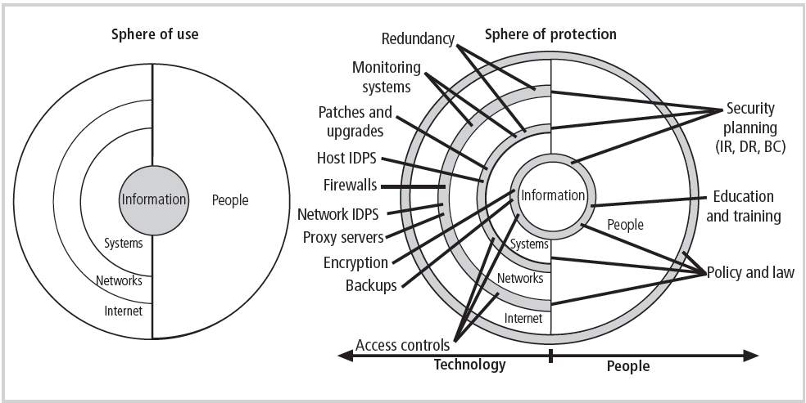
Figure 5-8 Spheres of Security
Notes:
Figure 6-16, showing the sphere of security, is the foundation of the security framework.
Generally speaking, the sphere of security represents the fact that information is under attack from a variety of sources. The sphere of use, at the left of the figure, illustrates the ways in which people can directly access information; for example, people read hard copies of documents; they also access information through systems, such as the electronic storage of information.
Information, as the most important asset to security, is illustrated at the core of the sphere. Information is always at risk from attacks through the people and computer systems that have direct access to the information. Networks and the Internet represent indirect threats, as exemplified by the fact that a person attempting to access information from the Internet must first go through the local networks and then access systems that contain the information. The sphere of protection, at the right of the figure, illustrates that between each layer of the sphere of use there must exist a layer of protection to prevent access to the inner layer from the outer layer. Each shaded band is a layer of protection and control. For example, the layer labeled “policy education and training” is located between people and the information.
Controls are also implemented between systems and the information, between networks and the computer systems, and between the Internet and internal networks. This reinforces the concept of defense in depth.
As illustrated in the sphere of protection portion of Figure 6-16, a variety of controls can be used to protect the information. The list in the figure is not intended to be comprehensive but illustrates individual safeguards that protect the various systems that are located closer to the center of the sphere. However, as people can directly access each ring as well as the information at the core of the model, people require unique approaches to security.
In fact, the resource of people must become a layer of security, a human firewall that protects the information from unauthorized access and use. The members of the organization must become a safeguard, which is effectively trained, implemented, and maintained, or else they, too, become a threat to the information.

Slide 33
Design of Security Architecture (cont’d.)
Defense in depth
Implementation of security in layers
Requires that organization establish sufficient security controls and safeguards so that an intruder faces multiple layers of controls
Security perimeter
Point at which an organization’s security protection ends and outside world begins
Does not apply to internal attacks from employee threats or on-site physical threats
Notes:
The Design of Security Architecture
Defense in Depth – One of the foundations of security architectures is the requirement to implement security in layers. Defense in depth requires that the organization establish sufficient security controls and safeguards, so that an intruder faces multiple layers of controls.
Security Perimeter – The point at which an organization’s security protection ends and the outside world begins is referred to as the security perimeter. Unfortunately, the perimeter does not apply to internal attacks from employee threats or on-site physical threats.

Slide 34
Design of Security Architecture (cont’d.)
Firewall: device that selectively discriminates against information flowing in or out of organization
DMZs: no-man’s land between inside and outside networks where some place Web servers
Proxy servers: performs actions on behalf of another system
Intrusion detection systems (IDSs): in effort to detect unauthorized activity within inner network, or on individual machines, organization may wish to implement an IDS
Notes:
Key Technology Components
A few other key technology components that are important to understand during the design phase of a security architecture are the firewall, proxy server, intrusion detection systems, and the DMZ.
A firewall is a device that selectively discriminates against information flowing into or out of the organization.
A firewall is usually a computing device or specially configured computer that allows or prevents information from entering or exiting the defined area based on a set of predefined rules.
The DMZ (demilitarized zone) is a no-man’s land between the inside and outside networks, where some organizations place Web servers. These servers provide access to organizational Web pages, without allowing Web requests to enter the interior networks.
An alternative approach to this strategy is to use a proxy server or firewall. A proxy server performs actions on behalf of another system. When an outside client requests a particular Web page, the proxy server receives the request then asks for the same information from the true Web server.
In an effort to detect unauthorized activity within the inner network or on individual machines, an organization may wish to implement intrusion detection systems or IDS.
Host-based IDS are usually installed on the machine the organization wishes to protect and to safeguard that particular system from unauthorized use by monitoring the status of various files stored on that system.
Network-based IDS look at patterns of network traffic and attempt to detect unusual activity based on previous baselines.

Slide 35
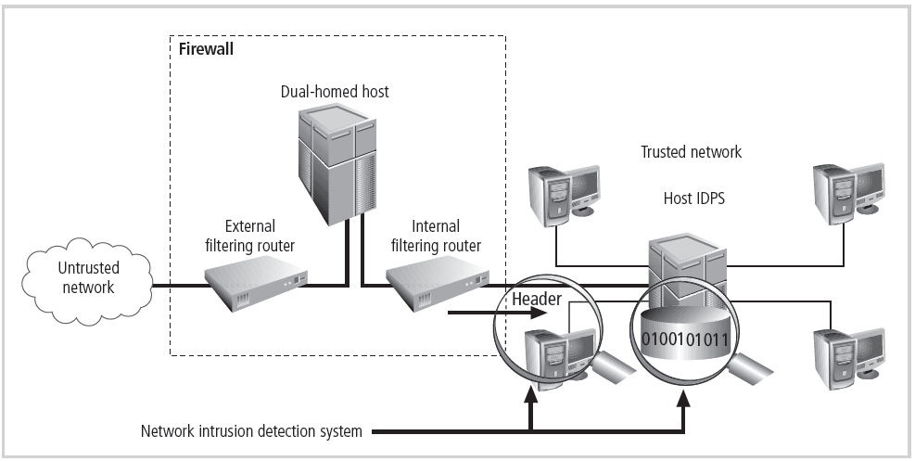
Figure 5-9 Defense in Depth

Slide 36
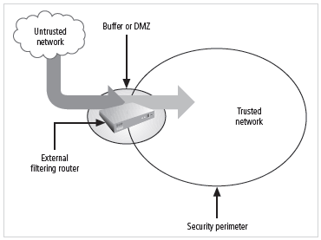
Figure 5-10 Security Perimeters

Slide 37
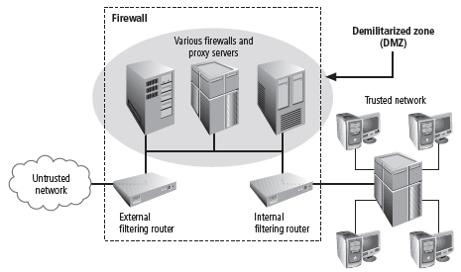
Figure 5-11 Firewalls, Proxy Servers, and DMZs

Slide 38
Security Education, Training, and Awareness Program
As soon as general security policy exists, policies to implement security education, training, and awareness (SETA) program should follow
SETA is a control measure designed to reduce accidental security breaches
Security education and training builds on the general knowledge the employees must possess to do their jobs, familiarizing them with the way to do their jobs securely
The SETA program consists of: security education; security training; and security awareness
Notes:
Security Education, Training, and Awareness Program
As soon as the policies have been drafted outlining the general security policy, policies to implement security education, training, and awareness (SETA) programs in the organization should follow.
The SETA program is a control measure designed to reduce the incidences of accidental security breaches by employees.
SETA programs are designed to supplement the general education and training programs in place to educate staff on information security.
Security education and training is designed to build on the general knowledge the employees must possess to do their jobs, familiarizing them with the way to do their jobs, securely.

Slide 39
Security Education
Everyone in an organization needs to be trained and aware of information security; not every member needs formal degree or certificate in information security
When formal education for individuals in security is needed, an employee can identify curriculum available from local institutions of higher learning or continuing education
A number of universities have formal coursework in information security
Notes:
Security Education
Everyone in an organization needs to be trained and aware of information security, but not every member of the organization needs a formal degree or certificate in information security.
When formal education for appropriate individuals in security is needed, with the support of management, an employee can identify curriculum available from local institutions of higher learning or continuing education.
A number of universities have formal coursework in information security. See, for example, http://infosec.kennesaw.edu.

Slide 40
Security Training
Involves providing members of organization with detailed information and hands-on instruction designed to prepare them to perform their duties securely
Management of information security can develop customized in-house training or outsource the training program
Alternatives to formal training include conferences and programs offered through professional organizations
Notes:
Security Training
Security training involves providing members of the organization with detailed information and hands-on instruction designed to prepare them to perform their duties securely.
Management of information security can develop customized in-house training or outsource the training program.

Slide 41
Security Awareness
One of least frequently implemented but most beneficial programs is the security awareness program
Designed to keep information security at the forefront of users’ minds
Need not be complicated or expensive
If the program is not actively implemented, employees begin to “tune out” and risk of employee accidents and failures increases
Notes:
Security Awareness
One of the least frequently implemented but the most beneficial programs is the security awareness program.
A security awareness program is designed to keep information security at the forefront of the users’ minds at they work day to day. These programs don’t have to be complicated or expensive.
The goal is to keep the idea of information security in the user’s minds and to stimulate them to care about security.
If the program is not actively implemented, employees begin to ‘tune out,’ and the risk of employee accidents and failures increases.

Slide 42
Continuity Strategies
Incident response plans (IRPs); disaster recovery plans (DRPs); business continuity plans (BCPs)
Primary functions of above plans
IRP focuses on immediate response; if attack escalates or is disastrous, process changes to disaster recovery and BCP
DRP typically focuses on restoring systems after disasters occur; as such, is closely associated with BCP
BCP occurs concurrently with DRP when damage is major or long term, requiring more than simple restoration of information and information resources
Notes:
We can classify incident response, disaster recovery, and business continuity planning as components of contingency planning.
Contingency planning (CP) is the entire planning conducted by the organization to prepare for, react to, and recover from events that threaten the security of information and information assets in the organization, and the subsequent restoration to normal modes of business operations.
Incident response planning (IRP) is the planning process associated with the identification, classification, response, and recovery from an incident.
Disaster recovery planning (DRP) is the planning process associated with the preparation for and recovery from a disaster, whether natural or man-made.
Business continuity planning (BCP) is the planning process associated with ensuring that critical business functions continue if a catastrophic incident or disaster occurs.
The primary functions of these three types of planning are:
IRP focuses on immediate response, but if the attack escalates or is disastrous the process changes to disaster recovery and BCP.
DRP typically focuses on restoring systems after disasters occur, and as such it is closely associated with BCP.
BCP occurs concurrently with DRP when the damage is major or long term, requiring more than simple restoration of information and information resources.

Slide 43
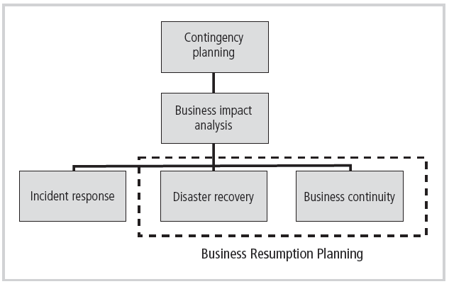
Figure 5-14 Components of Contingency Planning

Slide 44
Continuity Strategies (cont’d.)
Before planning can actually begin, a team has to plan the effort and prepare resulting documents
Champion: high-level manager to support, promote, and endorse findings of project
Project manager: leads project and makes sure sound project planning process is used, a complete and useful project plan is developed, and project resources are prudently managed
Team members: should be managers, or their representatives, from various communities of interest: business, IT, and information security
Notes:
Contingency Planning Team
Before any planning can begin, a team has to plan the effort and prepare the resulting documents
Champion - A high-level manager to support, promote, and endorse the findings of the project
Project Manager - Leads the project and makes sure a sound project planning process is used, a complete and useful project plan is developed, and project resources are prudently managed
Team Members - Should be the managers or their representatives from the various communities of interest: business, IT, and information security

Slide 45
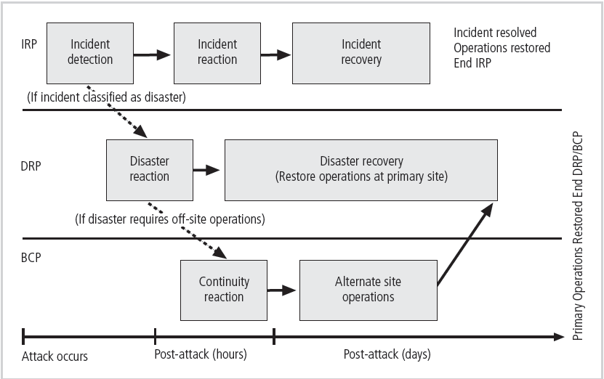
Figure 5-15 Contingency Planning Timeline
Notes:
Business Impact Analysis
The first phase in the development of the CP process is the business impact analysis or BIA.
A BIA is an investigation and assessment of the impact that various attacks can have on the organization and takes up where the risk assessment process leaves off.
The BIA assumes that these controls have been bypassed, have failed, or are otherwise ineffective in stopping the attack, and the attack was successful.
The question asked at this point is, if the attack succeeds, what do we do then?
The CP team conducts the BIA in the following stages:
Threat attack identification
Business unit analysis
Attack success scenarios
Potential damage assessment
Subordinate plan classification
Threat Attack Identification and Prioritization
Most organizations have already performed the tasks of identifying and prioritizing threats.
All that is required now is to update the threat list with the latest developments and add one additional piece of information, the attack profile.
An attack profile is a detailed description of the activities that occur during an attack, must be developed for every serious threat the organization faces, and are used to determine the extent of damage that could result to a business unit if the attack were successful.
Business Unit Analysis
The second major task within the BIA is the analysis and prioritization of business functions within the organization.
The intent of this task is to identify the functional areas of the organization and prioritize them to determine which are most vital to the continued operations of the organization.
Efforts in function analysis focus on the result of a prioritized list of the various functions the organization performs.
Attack Success Scenario Development
Next the BIA team must create a series of scenarios depicting the impact a successful attack from each threat could have on each prioritized functional area with details on the method of attack, the indicators of attack, and the broad consequences.
Then attack success scenarios with more detail are added to the attack profile, including alternate outcomes describing a best, worst, and most likely case that could result from each type of attack on this particular business functional area.
Potential Damage Assessment
From the attack success scenarios developed above, the BIA planning team must estimate the cost of the best, worst, and most likely cases.
This final result is referred to as an attack scenario end case.
Subordinate Plan Classification
Once the potential damage has been assessed and each end case has been evaluated, a subordinate plan must be developed or identified from among existing plans already in place.
These subordinate plans will take into account the identification of, reaction to, and recovery from each attack scenario.
An attack scenario end case is categorized as disastrous or not.
The qualifying difference is whether or not an organization is able to take effective action during the event to combat the effect of the attack.

Slide 46
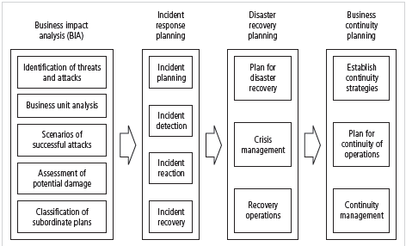
Figure 5-16 Major Steps in Contingency Planning

Slide 47
Business Impact Analysis (BIA)
Investigation and assessment of the impact that various attacks can have on the organization
Assumes security controls have been bypassed, have failed, or have proven ineffective, and attack has succeeded
Stages of BIA
Threat attack identification and prioritization
Business unit analysis
Attack success scenario development
Potential damage assessment
Subordinate plan classification

Slide 48
Incident Response Planning
Incident response planning covers identification of, classification of, and response to an incident
Attacks classified as incidents if they:
Are directed against information assets
Have a realistic chance of success
Could threaten confidentiality, integrity, or availability of information resources
Incident response (IR) is more reactive than proactive, with the exception of planning that must occur to prepare IR teams to be ready to react to an incident
Notes:
Incident Response Planning
Incident response planning covers the identification of, classification of, and response to an incident.
The IRP is made up of activities that are to be performed when an incident has been identified.
An incident is an attack against an information asset that poses a clear threat to the confidentiality, integrity, or availability of information resources.
Attacks are only classified as incidents if they have the following characteristics:
Are directed against information assets
Have a realistic chance of success
Could threaten the confidentiality, integrity, or availability of information resources.
Incident response (IR) is the set of activities taken to plan for, detect, and correct the impact of an incident on information resources.
IR is more reactive than proactive, with the exception of the planning that must occur to prepare the IR teams to be ready to react to an incident.
Planning for an incident requires a detailed understanding of the scenarios developed for the BIA.

Slide 49
Incident Response Planning (cont’d.)
Incident Planning
First step in overall process of incident response planning
Predefined responses enable organization to react quickly and effectively to detected incident if:
Organization has IR team
Organization can detect incident
IR team consists of individuals needed to handle systems as incident takes place
Planners should develop guidelines for reacting to and recovering from incident
Notes:
Incident Planning
The predefined responses enable the organization to react quickly and effectively to the detected incident.
This assumes two things:
The organization has an IR team.
The organization can detect the incident.
The IR team consists of those individuals who must be present to handle the systems and functional areas that can minimize the impact of an incident as it takes place.
The designated IR teams act to verify the threat, determine the appropriate response, and coordinate the actions necessary to deal with the situation.
The military process of planned team responses can be used in an incident response.
The planners should develop a set of documents that guide the actions of each involved individual reacting to and recovering from the incident.
These plans must be properly organized and stored to be available when, where and in a format supportive of the incident response.
The designated IR teams act to verify the threat, determine the appropriate response, and coordinate the actions necessary to deal with the situation.
The IR plan must be organized so that the organization supports rather than impedes quick and easy access to the information needed.
This can be accomplished through a number of measures, the simplest of which is to create a directory of incidents with tabbed sections for each possible incident.
When an individual needs to respond to an incident, he or she simply opens the binder, flips to the appropriate section, and follows the clearly outlined procedures for an assigned role.
The information in the IR plan should be protected as sensitive information. If attackers know how a company responds to a particular incident, it could improve their chances of success in the attack.
On the other hand, the organization needs this information readily available, usually within reach of the information assets that must be manipulated during or immediately after the attack.
The bottom line is that individuals responding to the incident should not have to search frantically for needed information, especially under stress.
A plan untested is not a useful plan. The levels of testing strategies can vary:
Checklist
Structured walk-through
Simulation
Parallel
Full-interruption

Slide 50
Incident Response Planning (cont’d.)
Incident response plan
Format and content
Storage
Testing
Incident detection
Most common occurrence is complaint about technology support, often delivered to help desk
Careful training needed to quickly identify and classify an incident
Once attack is properly identified, organization can respond
Notes:
Incident Detection
Individuals sometimes bring an unusual occurrence to the attention of systems administrators, security administrators, or their bosses.
The most common occurrence is a complaint about technology support, often delivered to the help desk.
The mechanisms that could potentially detect an incident include intrusion detection systems, both host-based and network-based, virus detection software, systems administrators, and even the end user.
Only by carefully training the user, the help desk, and all security personnel on the analysis and identification of attacks can the organization hope to quickly identify and classify an incident.
Once an attack is properly identified, the organization can effectively execute the corresponding procedures from the IR plan.
Incident classification is the process of examining a potential incident or incident candidate and determining whether or not the candidate constitutes an actual incident.

Slide 51
Incident Response Planning (cont’d.)
Incident reaction
Consists of actions that guide organization to stop incident, mitigate the impact of incident, and provide information for recovery from incident
Actions that must occur quickly:
Notification of key personnel
Documentation of incident
Incident containment strategies
First the areas affected must be determined
Organization can stop incident and attempt to recover control through a number or strategies
Notes:
Incident Reaction
When Does an Incident Become a Disaster?
1) The organization is unable to mitigate the impact of an incident during the incident.
2) The level of damage or destruction is so severe the organization is unable to quickly recover. The difference may be subtle.
It is up to the organization to decide which incidents are to be classified as disasters and thus receive the appropriate level of response.
Incident reaction consists of actions outlined in the IRP that guide the organization in attempting to stop the incident, mitigate the impact of the incident, and provide information for the recovery from the incident.
In reacting to the incident, there are a number of actions that must occur quickly.
These include notification of key personnel, assignment of tasks, and documentation of the incident.
Incident Containment Strategies
One of the most critical components of incident reaction is to stop the incident or contain its scope or impact.
However, sometimes situations prevent the most direct measures associated with simply “cutting the wire.”
Before an incident can be contained, the affected areas of the information and information systems must be determined.
In general, incident containment strategies focus on two tasks: stopping the incident and recovering control of the systems.
The organization can stop the incident and attempt to recover control through a number of strategies. If the incident:
originates outside the organization, the simplest and most straightforward approach is to sever the affected circuits.
is using compromised accounts, the accounts can be disabled.
is coming in through a firewall, the firewall can be reconfigured to block that particular traffic.
is using a particular service or process, that process or service can be disabled temporarily.
is using the organization’s systems to propagate itself, you can take down that particular application or server.
The ultimate containment option, reserved for only the most drastic of scenarios, involves a full stop of all computers and network devices in the organization.
The bottom line is that containment consists of isolating the channels, processes, services, or computers and removing the losses from that source of the incident.

Slide 52
Incident Response Planning (cont’d.)
Incident recovery
Once incident has been contained and control of systems regained, the next stage is recovery
First task is to identify human resources needed and launch them into action
Full extent of the damage must be assessed
Organization repairs vulnerabilities, addresses any shortcomings in safeguards, and restores data and services of the systems
Notes:
Incident Recovery
Once the incident has been contained and control of the systems regained, the next stage is recovery.
As with reaction to the incident, the first task is to identify the human resources needed for the recovery and launch them into action.
The full extent of the damage must be assessed.
The process of computer forensics entails determining how the incident occurred and what happened.
The organization repairs vulnerabilities, addresses any shortcomings in safeguards, and restores the data and services of the systems.

Slide 53
Incident Response Planning (cont’d.)
Damage assessment
Several sources of information on damage, including system logs; intrusion detection logs; configuration logs and documents; documentation from incident response; and results of detailed assessment of systems and data storage
Computer evidence must be carefully collected, documented, and maintained to be acceptable in formal or informal proceedings
Individuals who assess damage need special training
Notes:
Damage Assessment
Incident damage assessment is the immediate determination of the scope of the breach of CIA of information and assets after an incident.
There are several sources of information on the type, scope, and extent of damage, including system logs, intrusion detection logs, configuration logs and documents, the documentation from the incident response, and the results of a detailed assessment of systems and data storage.
Based on this information, the IR team must begin to examine the current state of the information and systems and compare them to a known state.
Related to the task of incident damage assessment is the field of computer forensics.
Computer forensics is the process of collecting, analyzing, and preserving computer-related evidence. Evidence proves an action or intent.
Computer evidence must be carefully collected, documented, and maintained to be acceptable in formal or informal proceedings.
Circumstances requires that individuals who look for the damage receive special training, should it be determined that the incident is part of a crime or may result in a civil action.

Slide 54
Incident Response Planning (cont’d.)
Automated response
New systems can respond to incident threat autonomously
Downsides of current automated response systems may outweigh benefits
Legal liabilities of a counterattack
Ethical issues
Notes:
Automated Response
While traditional systems were configured to detect incidences and then notify the human administrator, new systems can respond to the incident threat autonomously.
These systems, referred to as trap and trace, use a combination of resources to detect an intrusion and then trace incidents back to their sources.
Unfortunately, some less scrupulous administrators might even be tempted to back hack or hack into a hacker’s system to find out as much as possible about the hacker.
The problem is that the hacker may actually move into and out of a number of organizations’ systems, and by tracking the hacker, administrators may wander through other organizations’ systems.
The trap portion frequently involves the use of honey pots or honey nets.
Honey pots are computer servers configured to resemble production systems. If a hacker stumbles into the system, alarms are set off and the administrator is notified.
Honey nets consist of networks or subnets of systems that operate similarly.
Enticement is the process of attracting attention to a system by placing tantalizing bits of information in key locations.
Entrapment is the action of luring an individual into committing a crime to get a conviction.
Enticement is legal and ethical, while entrapment is not.

Slide 55
Disaster Recovery Planning
Disaster recovery planning (DRP) is planning the preparation for and recovery from a disaster
The contingency planning team must decide which actions constitute disasters and which constitute incidents
When situations classified as disasters, plans change as to how to respond; take action to secure most valuable assets to preserve value for the longer term
DRP strives to reestablish operations at the primary site
Notes:
Disaster Recovery Planning
Disaster recovery planning (DRP) is planning the preparation for and recovery from a disaster, whether natural or man-made.
The contingency planning team must decide which actions constitute disasters and which constitute incidents.
At the time that a decision is made and the situations is classified as a disaster, the organization may change how it is responding and take action to secure its most valuable assets to preserve value for the longer term even at the risk of more disruption in the immediate term.
Again, the key emphasis of a DRP is to reestablish operations at the ‘primary’ site, the location at which the organization performs its business. The goal is to make things ‘whole’ or ‘as they were’ before the disaster.

Slide 56
Business Continuity Planning
Outlines reestablishment of critical business operations during a disaster that impacts operations
If disaster has rendered the business unusable for continued operations, there must be a plan to allow business to continue functioning
Development of BCP is somewhat simpler than IRP or DRP
Consists primarily of selecting a continuity strategy and integrating off-site data storage and recovery functions into this strategy
Notes:
Business Continuity Planning
Business continuity planning outlines reestablishment of critical business operations during a disaster that impacts operations at the primary site.
If a disaster has rendered the current location of the business unusable for continued operations, there must be a plan to allow the business to continue to function.

Slide 57
Business Continuity Planning (cont’d.)
Continuity strategies
There are a number of strategies for planning for business continuity
Determining factor in selecting between options is usually cost
Dedicated recovery site options
Hot sites – fully operational sites
Warm sites – fully operational hardware but software may not be present
Cold sites – rudimentary services and facilities
Notes:
Continuity Strategies
There are a number of strategies that an organization can choose from when planning for business continuity.
The determining factor in selection between these options is usually cost.
In general there are three exclusive options:
Hot sites
Warm sites
Cold sites
There are three shared functions:
Time-share
Service bureaus
Mutual agreements

Slide 58
Business Continuity Planning (cont’d.)
Shared site options: time-share, service bureaus, and mutual agreements
Time-share - A hot, warm, or cold site that is leased in conjunction with a business partner or sister organization
Service Bureaus – An agency that provides a service for a fee.
Mutual agreement - A contract between two or more organizations that specifies how each will assist the other in the event of a disaster.

Slide 59
Business Continuity Planning (cont’d.)
Off-Site disaster data storage
To get sites up and running quickly, an organization must have the ability to port data into new site’s systems
Options for getting operations up and running include:
Electronic vaulting
Remote journaling
Database shadowing
Notes:
Off-Site Disaster Data Storage
To get these types of sites up and running quickly, the organization must have the ability to port data into the new site’s systems.
There are a number of options for getting operations up and running quickly, and some of these options can be used for purposes other than restoration of continuity.
These include:
Electronic vaulting - The bulk batch-transfer of data to an off-site facility.
Remote journaling - The transfer of live transactions to an off-site facility; only transactions are transferred, not archived data; the transfer is real-time.
Database shadowing - Not only processing duplicate real-time data storage, but also duplicating the databases at the remote site to multiple servers.

Slide 60
Crisis Management
Actions taken during and after a disaster that focus on people involved and address viability of business
What may truly distinguish an incident from a disaster are the actions of the response teams
Disaster recovery personnel must know their roles without any supporting documentation
Preparation
Training
Rehearsal
Notes:
Crisis Management
Crisis management includes the actions taken during and after a disaster. It focuses first and foremost on the people involved and addresses the viability of the business.
The crisis management team is responsible for managing the event from an enterprise perspective and covers:
Supporting personnel and their loved ones during the crisis
Determining the event's impact on normal business operations and, if necessary, making a disaster declaration
Keeping the public informed about the event and the actions being taken to ensure the recovery of personnel and the enterprise
Communicating with major customers, suppliers, partners, regulatory agencies, industry organizations, the media, and other interested parties

Slide 61
Crisis Management (cont’d.)
Crisis management team is responsible for managing event from an enterprise perspective and covers:
Supporting personnel and families during crisis
Determining impact on normal business operations and, if necessary, making disaster declaration
Keeping the public informed
Communicating with major customers, suppliers, partners, regulatory agencies, industry organizations, the media, and other interested parties

Slide 62
Model for a Consolidated Contingency Plan
Single document set approach supports concise planning and encourages smaller organizations to develop, test, and use IR and DR plans
Model is based on analyses of disaster recovery and incident response plans of dozens of organizations
Notes:
Model for IR/DR/BC Plan
The single document set approach supports concise planning and encourages smaller organizations to develop, test, and use IR/DR plans.
The model presented is based on analyses of disaster recovery and incident response plans of dozens of organizations.

Slide 63
Model for a Consolidated Contingency Plan (cont’d.)
The planning document
Six steps in contingency planning process
Identifying mission- or business-critical functions
Identifying resources that support critical functions
Anticipating potential contingencies or disasters
Selecting contingency planning strategies
Implementing contingency strategies
Testing and revising strategy
Notes:
The Planning Process
There are six steps in the contingency planning process.
1. Identifying the mission, or business-critical functions
2. Identifying the resources that support the critical functions
3. Anticipating potential contingencies or disasters
4. Selecting contingency planning strategies
5. Implementing the contingency strategies
6. Testing and revising the strategy
The Planning Document
1. During the incident Develop and document the procedures that must be performed during the incident. Group procedures and assign to individuals. Each member of the planning committee begins to draft a set of function-specific procedures.
2. After the incident Develop the procedures that must be performed immediately after the incident has ceased. Again, separate functional areas may develop different procedures.
3. Before the incident Draft those tasks that must be performed to prepare for the incident. These are the details of the data backup schedules, the disaster recovery preparation, training schedules, testing plans, copies of service agreements, and business continuity plans if any.
The Planning Document
Finally the IR portion of the plan is assembled. Sections detailing the organization’s DRP and BCP efforts are placed after the incident response sections.
Critical information as outlined in these planning sections are recorded, including information on alternate sites, etc. as indicated in the “before the incident” section, applicable to the disaster recovery and business continuity efforts.
Multiple copies for each functional area are created, cataloged, and signed out to responsible individuals.

Slide 64
Law Enforcement Involvement
When incident at hand constitutes a violation of law, organization may determine involving law enforcement is necessary
Questions:
When should law enforcement involved?
What level of law enforcement agency should be involved (local, state, federal)?
What happens when law enforcement agency is involved?
Some questions are best answered by the legal department
Notes:
Law Enforcement Involvement
There may come a time when it has been determined that the incident at hand exceeds the violation of policy and constitutes a violation of law.
The organization may determine that involving law enforcement is necessary.
There are several questions that must then be answered.
When should the organization get law enforcement involved?
What level of law enforcement agency should be involved: local, state, or federal?
What will happen when the law enforcement agency is involved?
Some of these questions are best answered by the organization’s legal department.

Slide 65
Benefits and Drawbacks of Law Enforcement Involvement
Involving law enforcement agencies has advantages:
Agencies may be better equipped at processing evidence
Organization may be less effective in convicting suspects
Law enforcement agencies are prepared to handle any necessary warrants and subpoenas
Law enforcement is skilled at obtaining witness statements and other information collection
Notes:
Benefits of Law Enforcement Involvement
Involving law enforcement agencies has both advantages and disadvantages. The agencies may be much better equipped at processing evidence than a particular organization.
Unless the security forces in the organization have been trained in processing evidence and computer forensics, they may do more harm than good in extracting the necessary information to legally convict a suspected criminal.
Law enforcement agencies are also prepared to handle the warrants and subpoenas necessary to documenting a case.
They are also adept at obtaining statements from witnesses, affidavits, and other required documents.
Law enforcement personnel can be a security administrator’s greatest ally in the war on computer crime.
It is therefore important to get to know your local and state counterparts before you have to make a call announcing a suspected crime.

Slide 66
Benefits and Drawbacks of Law Enforcement Involvement (cont’d.)
Involving law enforcement agencies has disadvantages:
Once a law enforcement agency takes over case, organization cannot control chain of events
Organization may not hear about case for weeks or months
Equipment vital to the organization’s business may be tagged as evidence
If organization detects a criminal act, it is legally obligated to involve appropriate law enforcement officials
Notes:
Drawbacks to Law Enforcement Involvement
Involving law enforcement agencies has both advantages and disadvantages. On the downside, once a law enforcement agency takes over a case, the organization loses complete control over the chain of events, the collection of information and evidence, and the prosecution of suspects.
An individual the organization may wish only to censure and dismiss may face criminal charges whereby the intricate details of their crimes become matters of public record.
The organization may not hear about the case for weeks or even months.
Equipment vital to the organization’s business may be tagged evidence, to be removed, stored, and preserved until it can be examined for possible support for the criminal case.
However, if the organization detects a criminal act, it is a legal obligation to involve the appropriate law enforcement officials.

Slide 67
Summary
Management has essential role in development, maintenance, and enforcement of information security policy, standards, practices, procedures, and guidelines
Information security blueprint is planning document that is basis for design, selection, and implementation of all security policies, education and training programs, and technological controls

Slide 68
Summary (cont’d.)
Information security education, training, and awareness (SETA) is control measure that reduces accidental security breaches and increases organizational resistance to many other forms of attack
Contingency planning (CP) made up of three components: incident response planning (IRP), disaster recovery planning (DRP), and business continuity planning (BCP)

