Slide 1
SDLC-AI-ENHANCED
SOFTWARE DEVELOPMENT LIFECYCLE

Slide 2
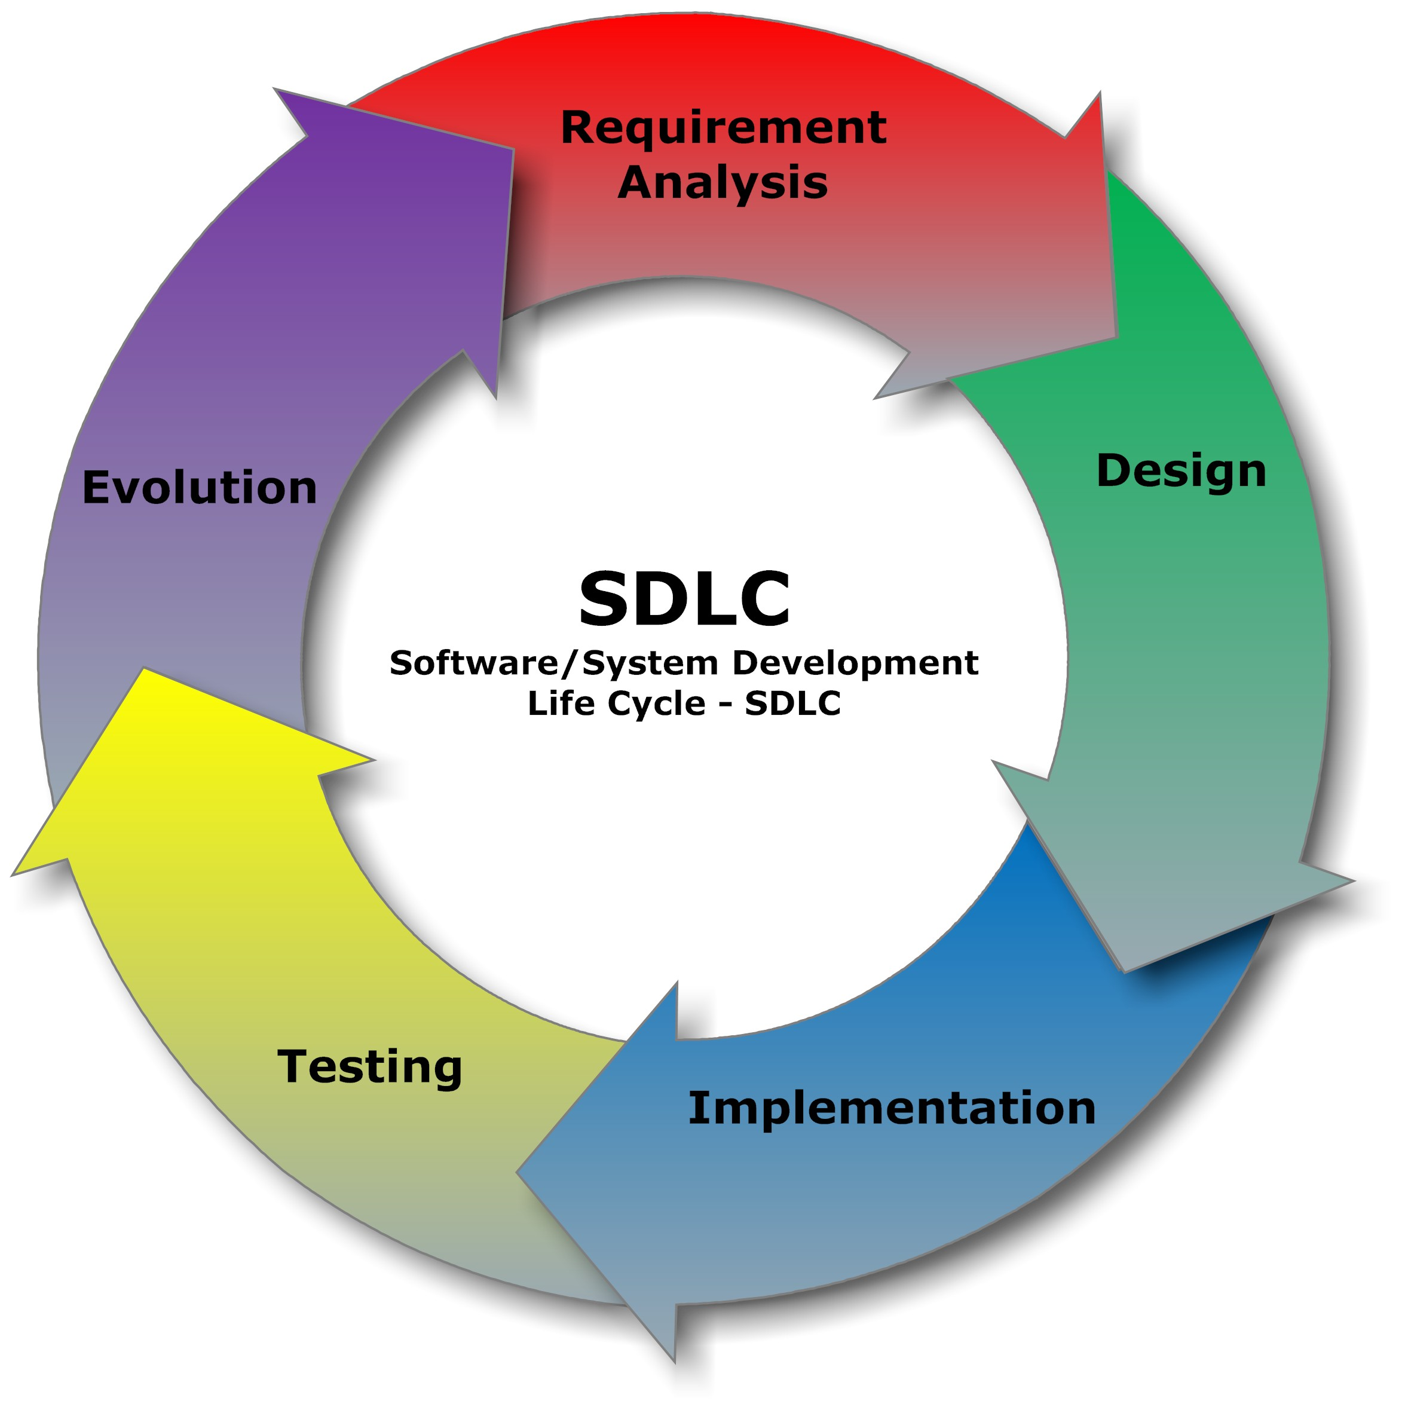
INTRODUCTION OF SDLC
The Software Development Life Cycle (SDLC) is a systematic process used in the software industry to design, develop, test, and deploy high-quality software. It provides a structured framework that ensures the software meets user requirements, is delivered on time, and stays within budget. By following SDLC, teams can minimize risks, improve efficiency, and maintain consistency throughout the development process.

Slide 3
FEATURES AND MODULES
Features of Smart SDLC:
The Software Development Life Cycle (SDLC) has several key features that make it a structured and reliable approach to building software. It provides a step-by-step process starting from requirement analysis to system maintenance, ensuring that every stage is clearly defined. One of its main features is planning and organization, which helps in estimating time, cost, and resources effectively. SDLC also emphasizes documentation, making the process transparent and easier to understand for all stakeholders.
Modules of Smart SDLC:
The Software Development Life Cycle (SDLC) is divided into several important modules that guide the software creation process in an organized manner. The first module is Requirement Analysis, where the needs of users and stakeholders are collected and studied. Next is the System Design module, which creates blueprints for how the software will function. The Development module focuses on coding and building the actual application based on the design.

Slide 4
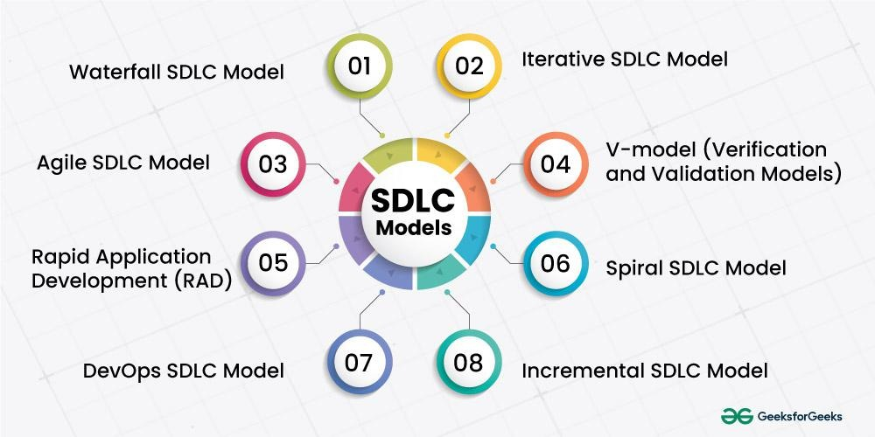
MODELS OF SDLC
1. Waterfall Model
2. Agile Model
3. V-Model
4. Spiral Model
5. Incremental Model

Slide 5
AI AND AUTOMATION
Artificial Intelligence (AI) is transforming the way software is developed, tested, deployed, and maintained. AI tools analyze patterns, predict risks, automate repetitive tasks, and assist in decision-making. Some applications include:
1. Requirement Analysis
2. Design & Architecture
3. Coding & Development
4. Testing
5. Deployment
6. Maintenance & Support

Slide 6
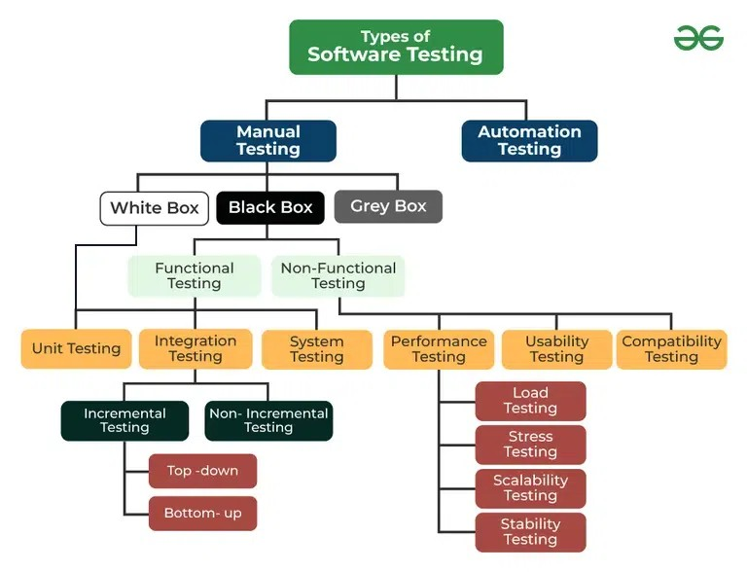
TESTING OF SDLC
Objectives of Testing:
1. Identify and fix bugs or defects.
2. Ensure the software meets functional and non-functional requirements.
3. Verify performance, security, and reliability.
4. Reduce risks of software failure after deployment.
5. Deliver a high-quality product to the customer.

Slide 7
THANK YOU

