Slide 1

Redfin
Studying a sample set of Silicon Valley’s housing market
By Pinky Chandan

Slide 2
Housing crisis in the bay area
Silicon Valley’s real estate market is one of the most ridiculously overheated market.
Tech companies continue hiring that leads to new buyers moving into the area further driving the market up.
In the last 5 years, market has seen heavy bidding (up to $200K over asking price) driven by high tech salaries, IPOs and overseas investments.
Demand has been higher than the inventory.
Affordability is low

Slide 3
Objective
To understand the dynamics that have changed over the last 2 years.
Sample set- Listings for sold homes for the last 2 years in the city of Los Gatos
Website scraped - https://www.redfin.com/city/11234/CA/Los-Gatos/filter/include=sold-3yr

Slide 4
The Data
Sold homes listings for the last 2 years in Los Gatos, CA
Items scraped-
Street name
City
Zipcode
Bedrooms, bathrooms
Sq Feet
Sold price
Sold date

Slide 5
Scraping learnings and challenges
Used Scrapy and pandas
Websites considered for scraping –
Zillow – Sold listings data for only 1 year
Realtor - Sold listings data for only 1 year
Redfin – Sold listings for the last 2 years
On scraping, spider was detected and my IP address was banned.
Set download delays to 10 and CONCURRENT_REQUESTS = 1
Changed IP addresses
Max records scraped was 40
Downloaded all the data through API for data analysis.
Filtered out unwanted zip codes, missing values, duplicate columns, renamed the columns in the data frame.

Slide 6
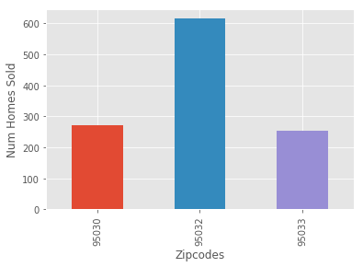
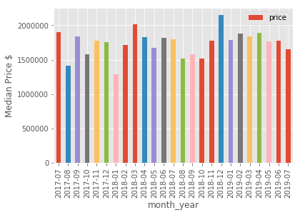
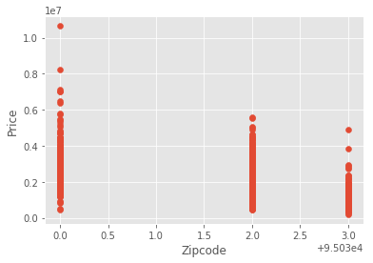
Data Visualization

Slide 7
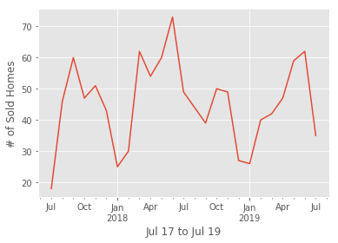
Time series analysis using Pandas

Slide 8
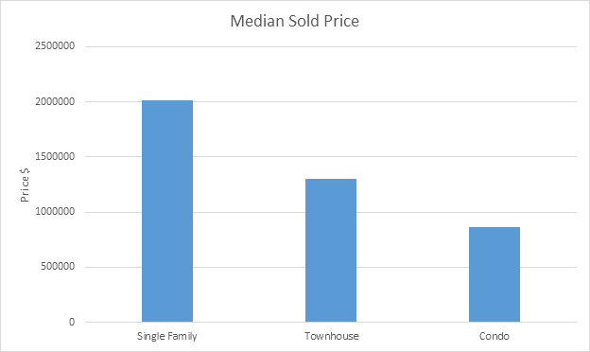
Price comparison between zip codes and home types

Slide 9
Ongoing research and analysis
Scraping with Selenium to get more underlying items that use JavaScript
Enhance data visualization to gain more insights
Correlation between property prices and household income
Web scrape other cities in Bay area to understand the correlation between property prices and property taxes and school ratings

Slide 10
Thank you!

