Slide 1

Team White
Wellcome

Slide 2
-N.G.O Webiste-
My Team
Hồ Ngọc Đức .leader
Trần Hữu Nhật Trường
Hà Sỹ Thiện
3rd semester
Class: C1908I3
Teacher : Phan Hữu Trí
https://www.google.com/url?q=http://bit.ly/2Tynxth&sa=D&source=editors&ust=1625646429376000&usg=AOvVaw0tGJ1pidp_OirC2uQDVxvR

Slide 3
Table of Contents
01
02
03
04
website
Database
Website Introduction
Database introduction
Funtion
Demo
Introduction of functions
Go to Website

Slide 4

Webstie
Our mission is to improve the performance of health workers and strengthen the systems in which they work.
Our vision is that everyone everywhere has the health care they need to thrive
We provide information and sponsorship policies for events such as natural disasters, epidemics and children around the world

Slide 5
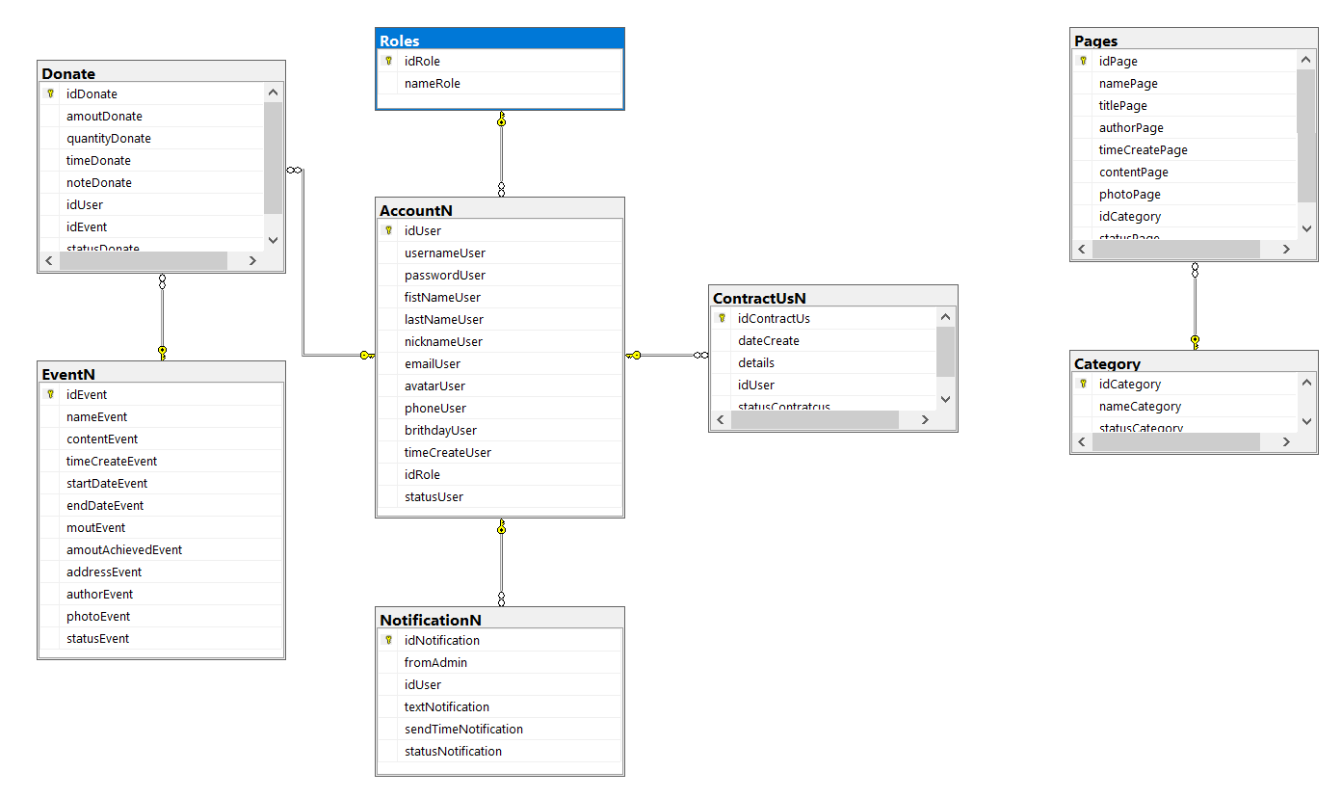
Database

Slide 6
functions
The website is designed with the aim to help the needy. Various different types of program is being
conducted for their welfare and benefits. Following is the requirement of the website:
The home page of the website must have these menus like “Home”, “Donate”, “Help
Centre”, “About us”, “ Our Partners”, “REGISTER”. The look of the page must be designed
with no blank space left.
The designing section will work with two modules:
o ADMIN
o USER
ADMIN: Admin module will manage all other content of the website like editing partner,
about us, help centre, contact us, donation link and so on.
USER: User can see and navigate the content of the website and also can register their
account and choose the donation with concerned specified. Also they can ask others to join
by sending mail to their respective ID’s.
Navigation of the project must be user friendly and uniform.

Slide 7
In the ADMIN Module:
_ Donation: In the Donation the list or other category must be included in the
application which when user wish to pay can select their concern section. For eg: a
person wants to donate for “Children Welfare Activity” or for “Disabled Person”.
_ Other Partners: Various other companies associated with the organisation must be
listed with logos (can be more précised).
_ About us: The link will have various sub links and for each link a page must be
designed whose information part can be edited by the admin member. Sub link such
as
* What we do
* Our mission
* Our team
* Career with us
* Our achievements
* Our supporters
* Read About us
_ Contact Us : Contact Us page must be designed.
_ Can view all the registered Member of the website.
_ Donate Us Link: This link will have sub link such as:
* Amount
* Cause (which will have list like Children, Education, Disabled, Woman, Youth,
Elderly and so on)
_ List of Others associated NGO’s: Admin can add the details of the NGO.
_ Our Programmes: Details of the Programmes conducted by the NGO for Education,
Health Care, Privileged children (Specially challenged).
_ Replying queries.
_ Adding Gallery section : Images of different programmes conducted must be added
by the admin

Slide 8
USER Module: Users can view the page of the website but content details cannot be
edited by them. User Task includes:
_ Registering their account. (need to enter few personal and professional data).
_ Donate the amount (can select for which cause they want to donate) //note the
payment transaction must be maintained properly by taking card details, credit card,
debit card (though it is dummy but proper validation function must be included for it)
_ Can send mail to invite other friends to join the cause
_ Raise query
_ Can send the interest take part in the upcoming programmes of NGO

Slide 9
Thank you for listening to my group's presentation

