Slide 1

Note: The data and information in this document is reflective of a hypothetical situation and client. This document is to be used for KPMG Virtual Internship purposes only.
Sprocket Central Pty Ltd
Data analytics approach
[Division Name] - [Engagement Manager], [Senior Consultant], [Junior Consultant]

Slide 2
Note: The data and information in this document is reflective of a hypothetical situation and client. This document is to be used for KPMG Virtual Internship purposes only.
Agenda
Introduction
Data Exploration
Model Development
Interpretation

Slide 3
Note: The data and information in this document is reflective of a hypothetical situation and client. This document is to be used for KPMG Virtual Internship purposes only.
Introduction
Identifying and Recommending High Value Customers
Outline of Problems
Sprocket Central is a company that specializes in high quality bike and accessories.
The Marketing team is looking to boost sales.
To target 1000 new customers that will bring the highest value to business.
Approach for Data Analysis
Bike related purchase for the last 3 years based on gender.
Top industries contributing to the maximum profit and bike related sales.
Wealth segment by Age category.
Number of cares owned in each state.
Customer classification.

Slide 4
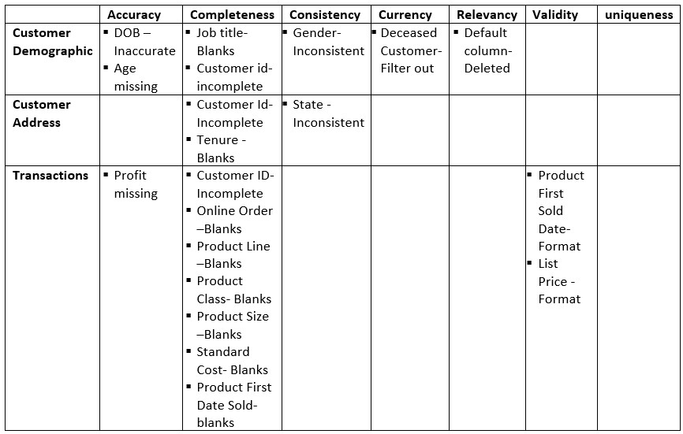
Note: The data and information in this document is reflective of a hypothetical situation and client. This document is to be used for KPMG Virtual Internship purposes only.
Data Exploration
Data Quality Assessment
Key issue dealt with for the data quality issue:

Slide 5
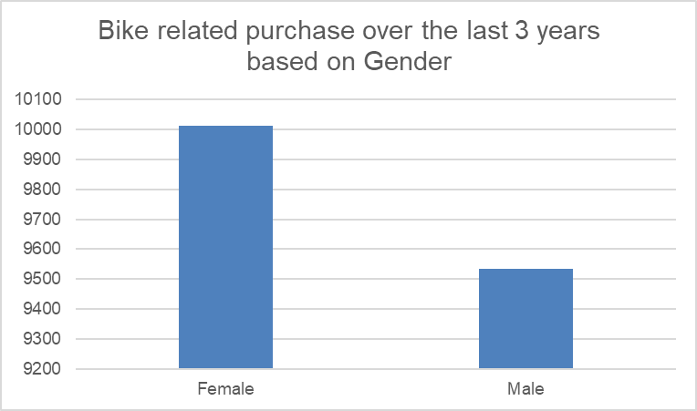
Note: The data and information in this document is reflective of a hypothetical situation and client. This document is to be used for KPMG Virtual Internship purposes only.
Data Exploration
Bike related purchase over the last 3 years based on Gender
Data shows that females have made more bike purchase in the last 3 year compared to male.

Slide 6
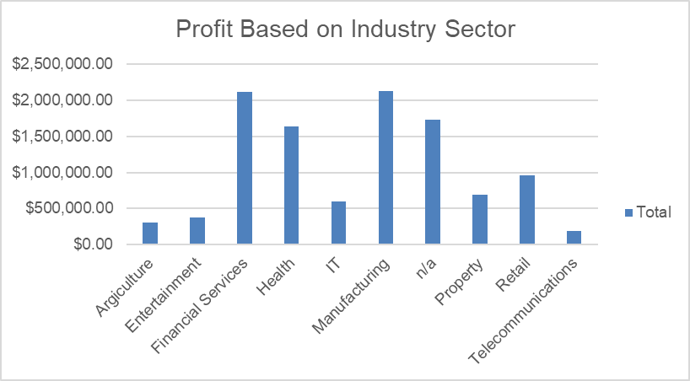
Note: The data and information in this document is reflective of a hypothetical situation and client. This document is to be used for KPMG Virtual Internship purposes only.
Data Exploration
Top job industry contributing to the maximum profit & bike related purchases.
The top 3 industry sector bringing the highest profit are: Financial Services, Manufacturing & Health.
Most of these industry sectors have returned less than $1,000,000 in profit.
Its also obvious that most of these industry sectors are based within the city or on the outskirts of the city. Therefore, consumers prefer bikes for commuting.

Slide 7
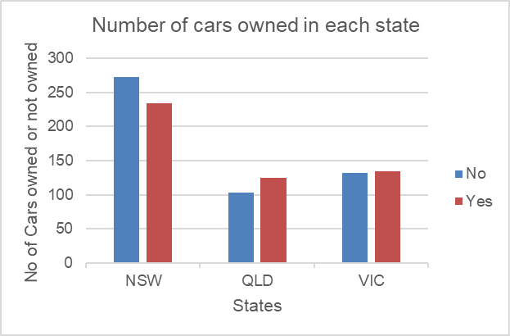
Note: The data and information in this document is reflective of a hypothetical situation and client. This document is to be used for KPMG Virtual Internship purposes only.
Data Exploration
Number of cars owned in each state.
New South Wales (NSW) has the highest car owned among the 3 states.
NSW could be the potential market opportunity for the company.
QLD & VIC are also relatively the same. They could also be targeted but not as priority.

Slide 8
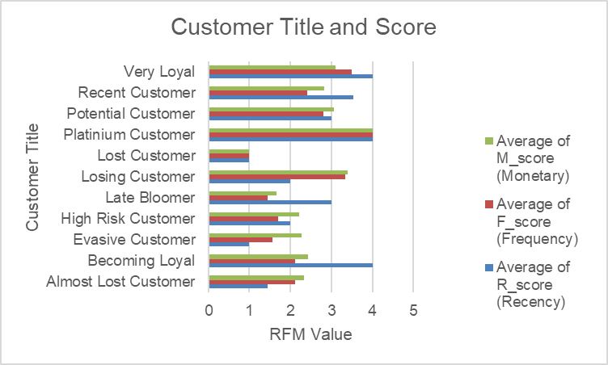
Note: The data and information in this document is reflective of a hypothetical situation and client. This document is to be used for KPMG Virtual Internship purposes only.
Model Development
RFM Analysis and Customer Classification
The RFM Analysis is used to determine which customer a business should target in order to increase it revenue and value.
The RFM model showed customers that have displayed high level of engagement with the business in the three categories mentioned.

Slide 9
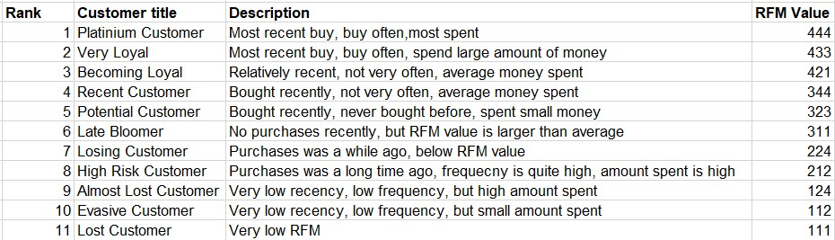
Note: The data and information in this document is reflective of a hypothetical situation and client. This document is to be used for KPMG Virtual Internship purposes only.
Model Development
Customer Title Definition List with RFM Value Assigned

Slide 10
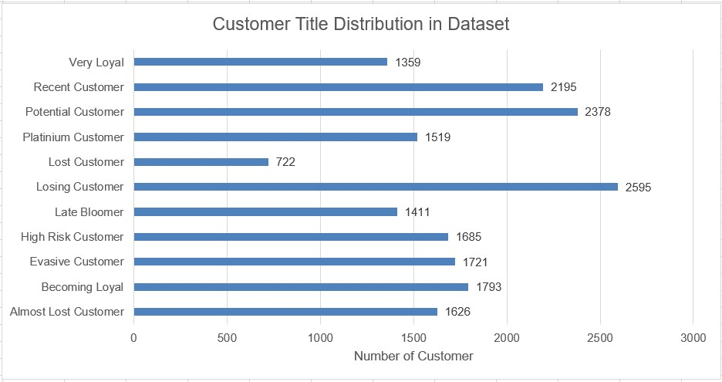
Note: The data and information in this document is reflective of a hypothetical situation and client. This document is to be used for KPMG Virtual Internship purposes only.
Model Development
Customer Title Distribution in the Dataset

Slide 11
Note: The data and information in this document is reflective of a hypothetical situation and client. This document is to be used for KPMG Virtual Internship purposes only.
Interpretation
Place headline insight or information here. This should be the most important point for this slide.
Place any information about this point here.
Place any supporting images, graphs, data or extra text here.

Slide 12
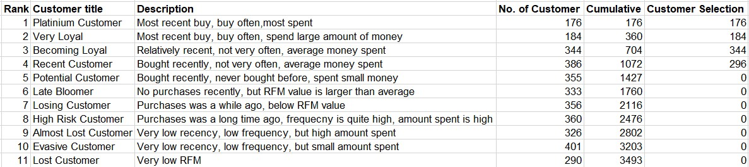
Note: The data and information in this document is reflective of a hypothetical situation and client. This document is to be used for KPMG Virtual Internship purposes only.
Interpretation
Summary Table of the Top 1000 Customers to target

Slide 13
Note: The data and information in this document is reflective of a hypothetical situation and client. This document is to be used for KPMG Virtual Internship purposes only.
Appendix

Slide 14
Note: The data and information in this document is reflective of a hypothetical situation and client. This document is to be used for KPMG Virtual Internship purposes only.
Appendix
This is an optional slide where you may place any supporting items.

