Slide 1
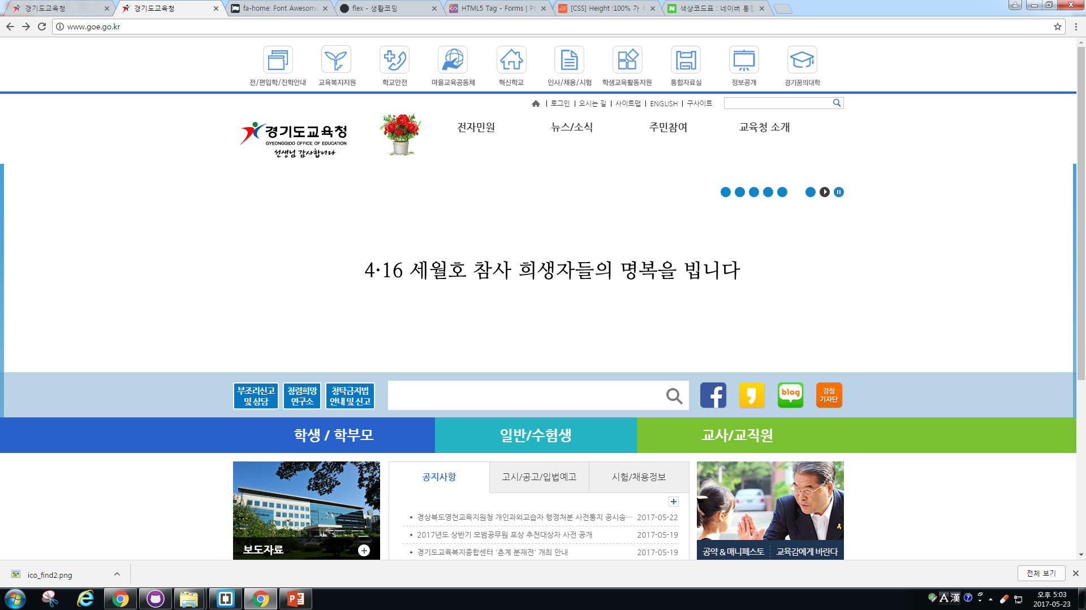
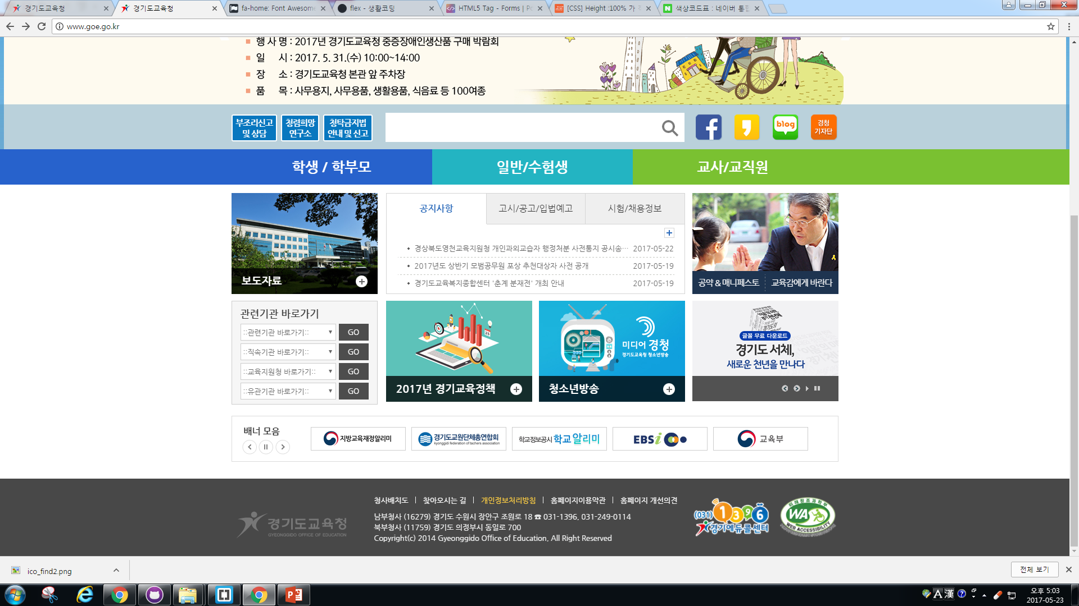
#2762CC | #23B4C2 | #7AC131 | #BBD4E5 | #1285C6
#648FCB | #484848 | #C7A544 | #1E3450 | #EFEFEF

