Slide 1
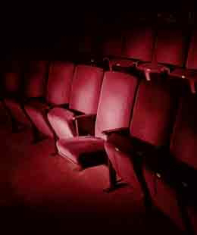
PURCHASE a
RAFFLE TICKET TO WIN
YOUR
Seat IN THE Spotlight
TICKETS are
$10 each
There will be a drawing for Every 25 tickets sold
Fill out a Raffle Ticket FORM

