Slide 1
Project Oraculum
Experiments

Slide 2
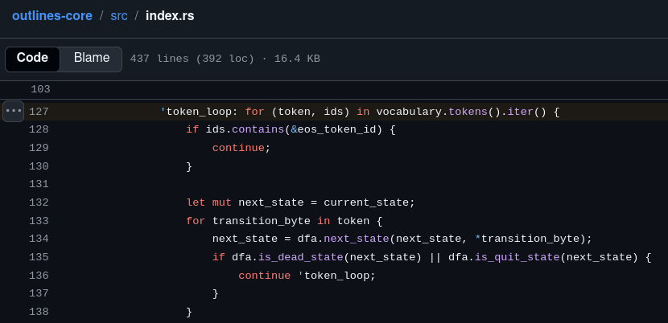
An issue with outlines-core

Slide 3
The idea of llguidance
Brzozowski derivatives
Prefix trees

Slide 4
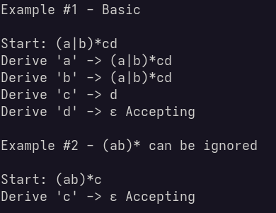
Brzozowski derivatives

Slide 5
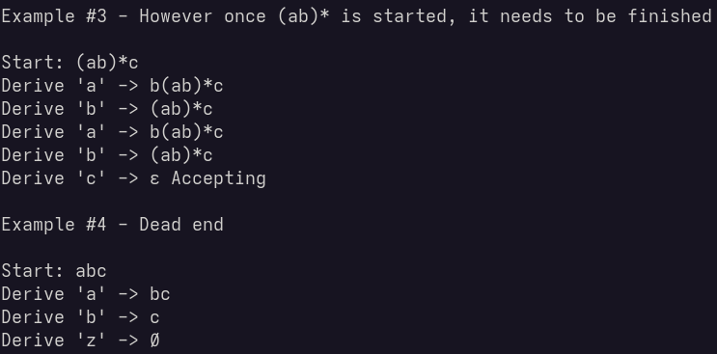
Brzozowski derivatives

Slide 6
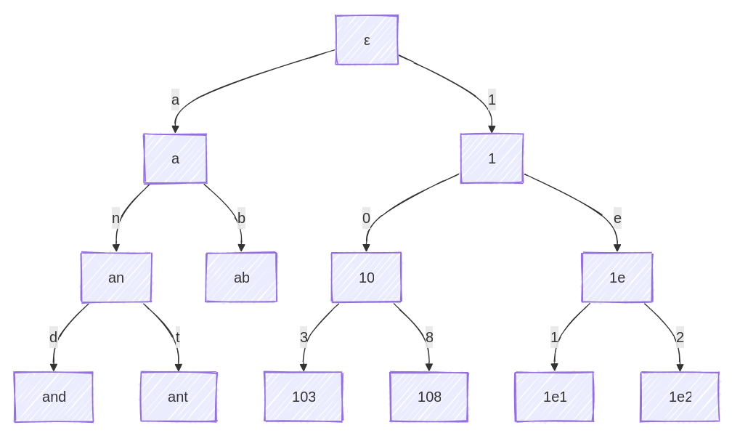
Prefix trees
where each node is a token, and each edge is a byte
if “an” is a dead state than everything with the “an” prefix is also dead

Slide 7
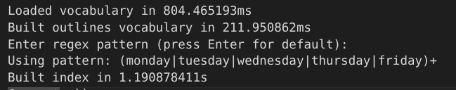
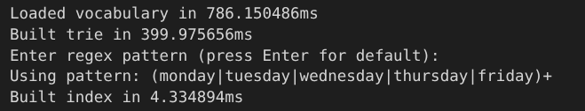
Significant speed-up

Slide 8
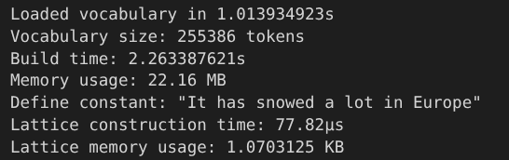
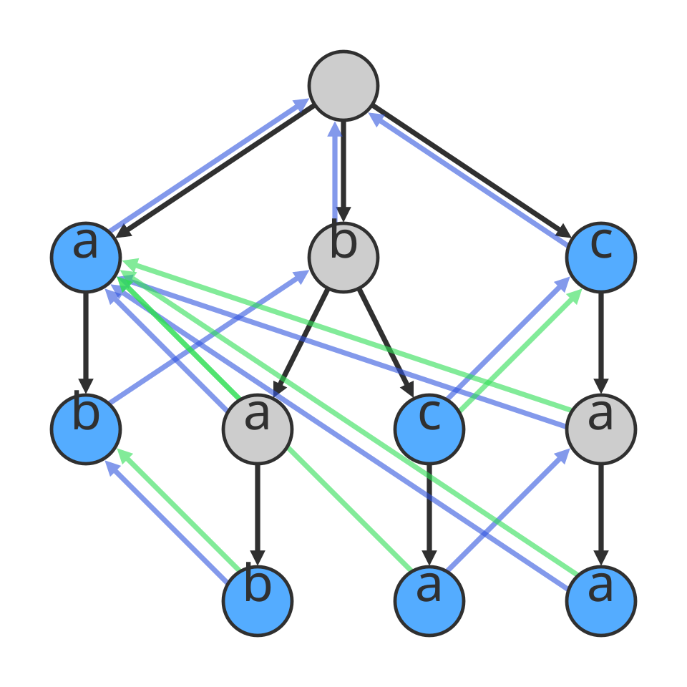
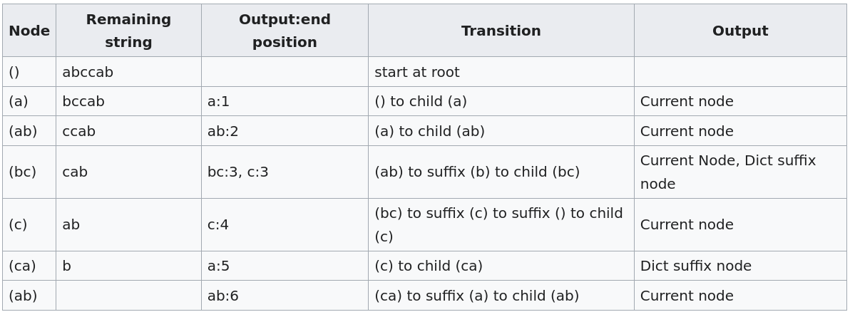
Extended prefix trees - Aho-Corasick
Input: abccab
Dictionary
a
ab
bab
bc
bca
c
caa

Slide 9
Data structure optimizations

Slide 10
Data structure optimizations

Slide 11
Data structure optimizations

Slide 12
Data structure optimizations

Slide 13
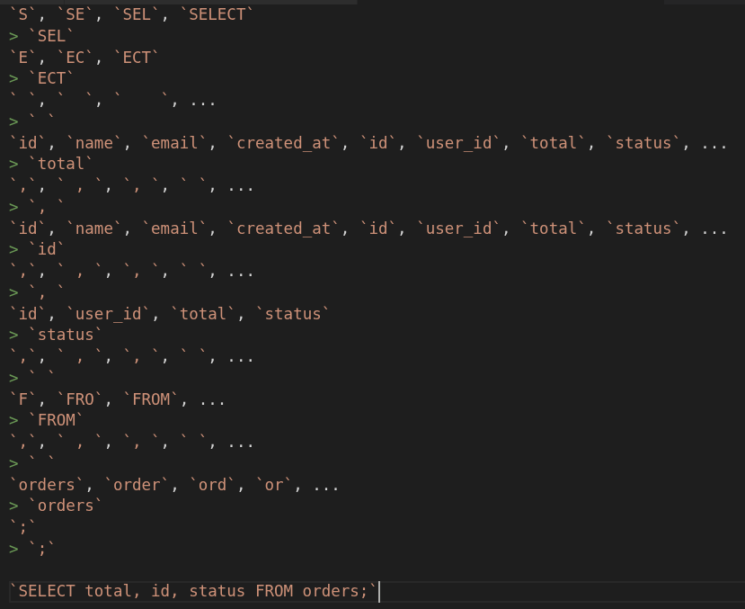
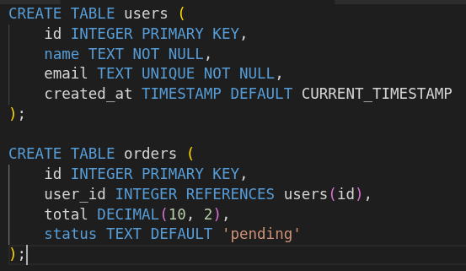
+1 SQL syntactic - semantic enforcer
“total” selected, table “orders” is needed and no table is filtered.
“id” selected, as tables are “orders” needed and “id” is conflicting between “users” and “orders”, table “users” is filtered.
Only fields of “orders” are displayed.
Selecting “orders” table is enforced.

