Slide 1

Neologix training material for freshers Coldfusion
CSS
Presentation of css-3
For beginners

Slide 2
Neologix training material for freshers css
    Introduction
CSS stands for Cascading Style Sheets
CSS (Cascading Style Sheets) is a language that describes the rendering of markup documents (e.g. HTML, XML) on various supports, such as screen, paper, speech, etc.
CSS used to control the style and layout of multiple Web pages all at once.
Styles define how to display HTML elements
Styles were added to HTML 4.0 to solve a problem
Page level css are wrote inside a <style></style> tag in
a html page . Where as inline styles are written as style attribute = property:value inside a Html element
External Style Sheets can save a lot of work
External Style Sheets are stored in CSS files

Slide 3
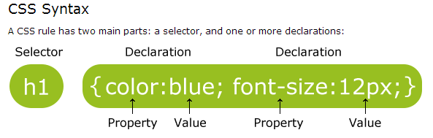
    Css syntax
The selector is normally the HTML element you want to style. Each declaration consists of a property and a value.The property is the style attribute you want to change. Each property has a value.
Neologix training material for freshers css

Slide 4
Neologix training material for freshers Css
CSS examples
Comments are used to explain your code, and may help you when you edit the source code at a later date. Comments are ignored by browsers.
A CSS comment begins with "/*", and ends with "*/",
/*This is a comment*/
p
{ text-align:center;
/*This is another comment*/
color:black;
font-family:arial;
}

Slide 5
Neologix training material for freshers Css
The id and class Selectors
In addition to setting a style for a HTML element, CSS allows you to specify your own selectors called "id" and "class".
1. The id selector is used to specify a style for a single, unique element.
Eg; #para1
{ text-align:center; color:red; }
2.The class selector is used to specify a style for a group of elements. Unlike the id selector, the class selector is most often used on several elements.
This allows you to set a particular style for many HTML elements with the same class.
.center {text-align:center;}
p.center {text-align:center;}

Slide 6
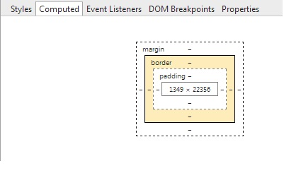
Neologix training material for freshers Css
The box modelling
  All HTML elements can be considered as boxes. In CSS, the term "box model" is used when talking about design and layout.The CSS box model is essentially a box that wraps around HTML elements, and it consists of: margins, borders, padding, and the actual content.The box model allows us to place a border around elements and space elements in relation to other elements

Slide 7
Neologix training material for freshers Css
CSS most used properties
Align
Border
Background
Font-
Margin-
        Overflow-
        Text-
        z-index

Slide 8
Neologix training material for freshers Css
CSS Positioning
Method of posiotioning of html box elements are usually Combinations of following types.
1.static
2.relative
3.absolute
4.float
Refer: http://www.barelyfitz.com/screencast/html- training/css/positioning/

Slide 9
Neologix training material for freshers Css
CSS Display and visibililty
The display property specifies if/how an element is displayed, and the visibility property specifies if an elemenHiding an Element - display:none or visibility:hidden
  visibility:hidden hides an element, but it will still take up the same space as before. The element will be hidden, but still affect the layout.
  display:none hides an element, and it will not take up any space. The element will be hidden, and the page will be displayed as if the element is not theret should be visible or hidden.
CSS Display inline , block , inlie -block

Slide 10
Neologix training material for freshers Css
CSS psuedo classes
CSS pseudo-classes are used to add special effects to some selectors.
Syntax
The syntax of pseudo-classes:
selector:pseudo-class {
property:value;
}
/* visited link */
a:visited {
color: #00FF00;
}

Slide 11
Neologix training material for freshers Css
CSS media queries
A media query consists of a media type and at least one expression that limits the style sheets' scope by using media features, such as width, height, and color. Media queries, added in CSS3.When a media query is true, the corresponding style sheet or style rules are applied, following the normal cascading rules
<!-- CSS media query on a link element -->
<link rel="stylesheet" media="(max-width: 800px)" href="example.css" />
<!-- CSS media query within a style sheet -->
<style>
@media (max-width: 600px) {
.facet_sidebar {
display: none;
}
}
</style>

Slide 12
Neologix training material for freshers Css
CSS media queries
A media query consists of a media type and at least one expression that limits the style sheets' scope by using media features, such as width, height, and color. Media queries, added in CSS3
<!-- CSS media query on a link element -->
<link rel="stylesheet" media="(max-width: 800px)" href="example.css" />
<!-- CSS media query within a style sheet -->
<style>
@media (max-width: 600px) {
.facet_sidebar {
display: none;
}
}
</style>

Slide 13
Neologix training material for freshers Css
CSS media queries
A media query consists of a media type and at least one expression that limits the style sheets' scope by using media features, such as width, height, and color. Media queries, added in CSS3
<!-- CSS media query on a link element -->
<link rel="stylesheet" media="(max-width: 800px)" href="example.css" />
<!-- CSS media query within a style sheet -->
<style>
@media (max-width: 600px) {
.facet_sidebar {
display: none;
}
}
</style>

Slide 14
Neologix training material for freshers Css
CSS media queries
A media query consists of a media type and at least one expression that limits the style sheets' scope by using media features, such as width, height, and color. Media queries, added in CSS3
<!-- CSS media query on a link element -->
<link rel="stylesheet" media="(max-width: 800px)" href="example.css" />
<!-- CSS media query within a style sheet -->
<style>
@media (max-width: 600px) {
.facet_sidebar {
display: none;
}
}
</style>

Slide 15
Neologix training material for freshers Css
CSS Ref:
1.developer.mozilla.org › MDN › Web technology for developers › CSS
2. www.w3.org/TR/CSS2/

