Slide 1
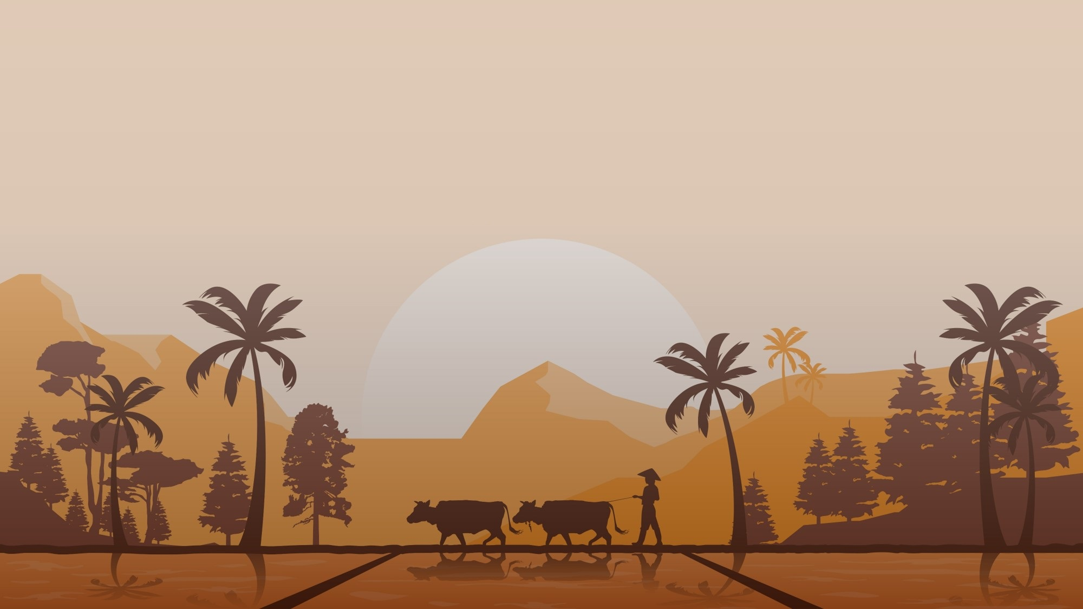
Agronomix

Slide 2
Existing Problem:
Farmers have been utilizing age-old ways to anticipate the best planting date for generations. Typically, they would sow in early June to take advantage of the monsoon season, which last’s till August.
However, changing weather patterns have resulted in unpredictable monsoons in the last decade, resulting in low crop yields. Thus, the sowing date becomes crucial in ensuring that farmers harvest a good crop.
And if it fails, it results in a loss because a lot of money is spent on seeds and fertilizer applications. Due to atmospheric circumstances and soil changeability, farmers should use the data to generate new insights to make basic cultivating decisions.

Slide 3
Solution:
To solve the problem faced by the farmers our services let’s the farmer know the best crops to be cultivated at the particular span of time.
We also do let the farmer know the yield of the crop in the Quintal/ Acre.
We do provide the expected price month wise too which helps the farmer to decide the right time to sell the crops cultivated, so this helps them to get maximum profit.

Slide 4
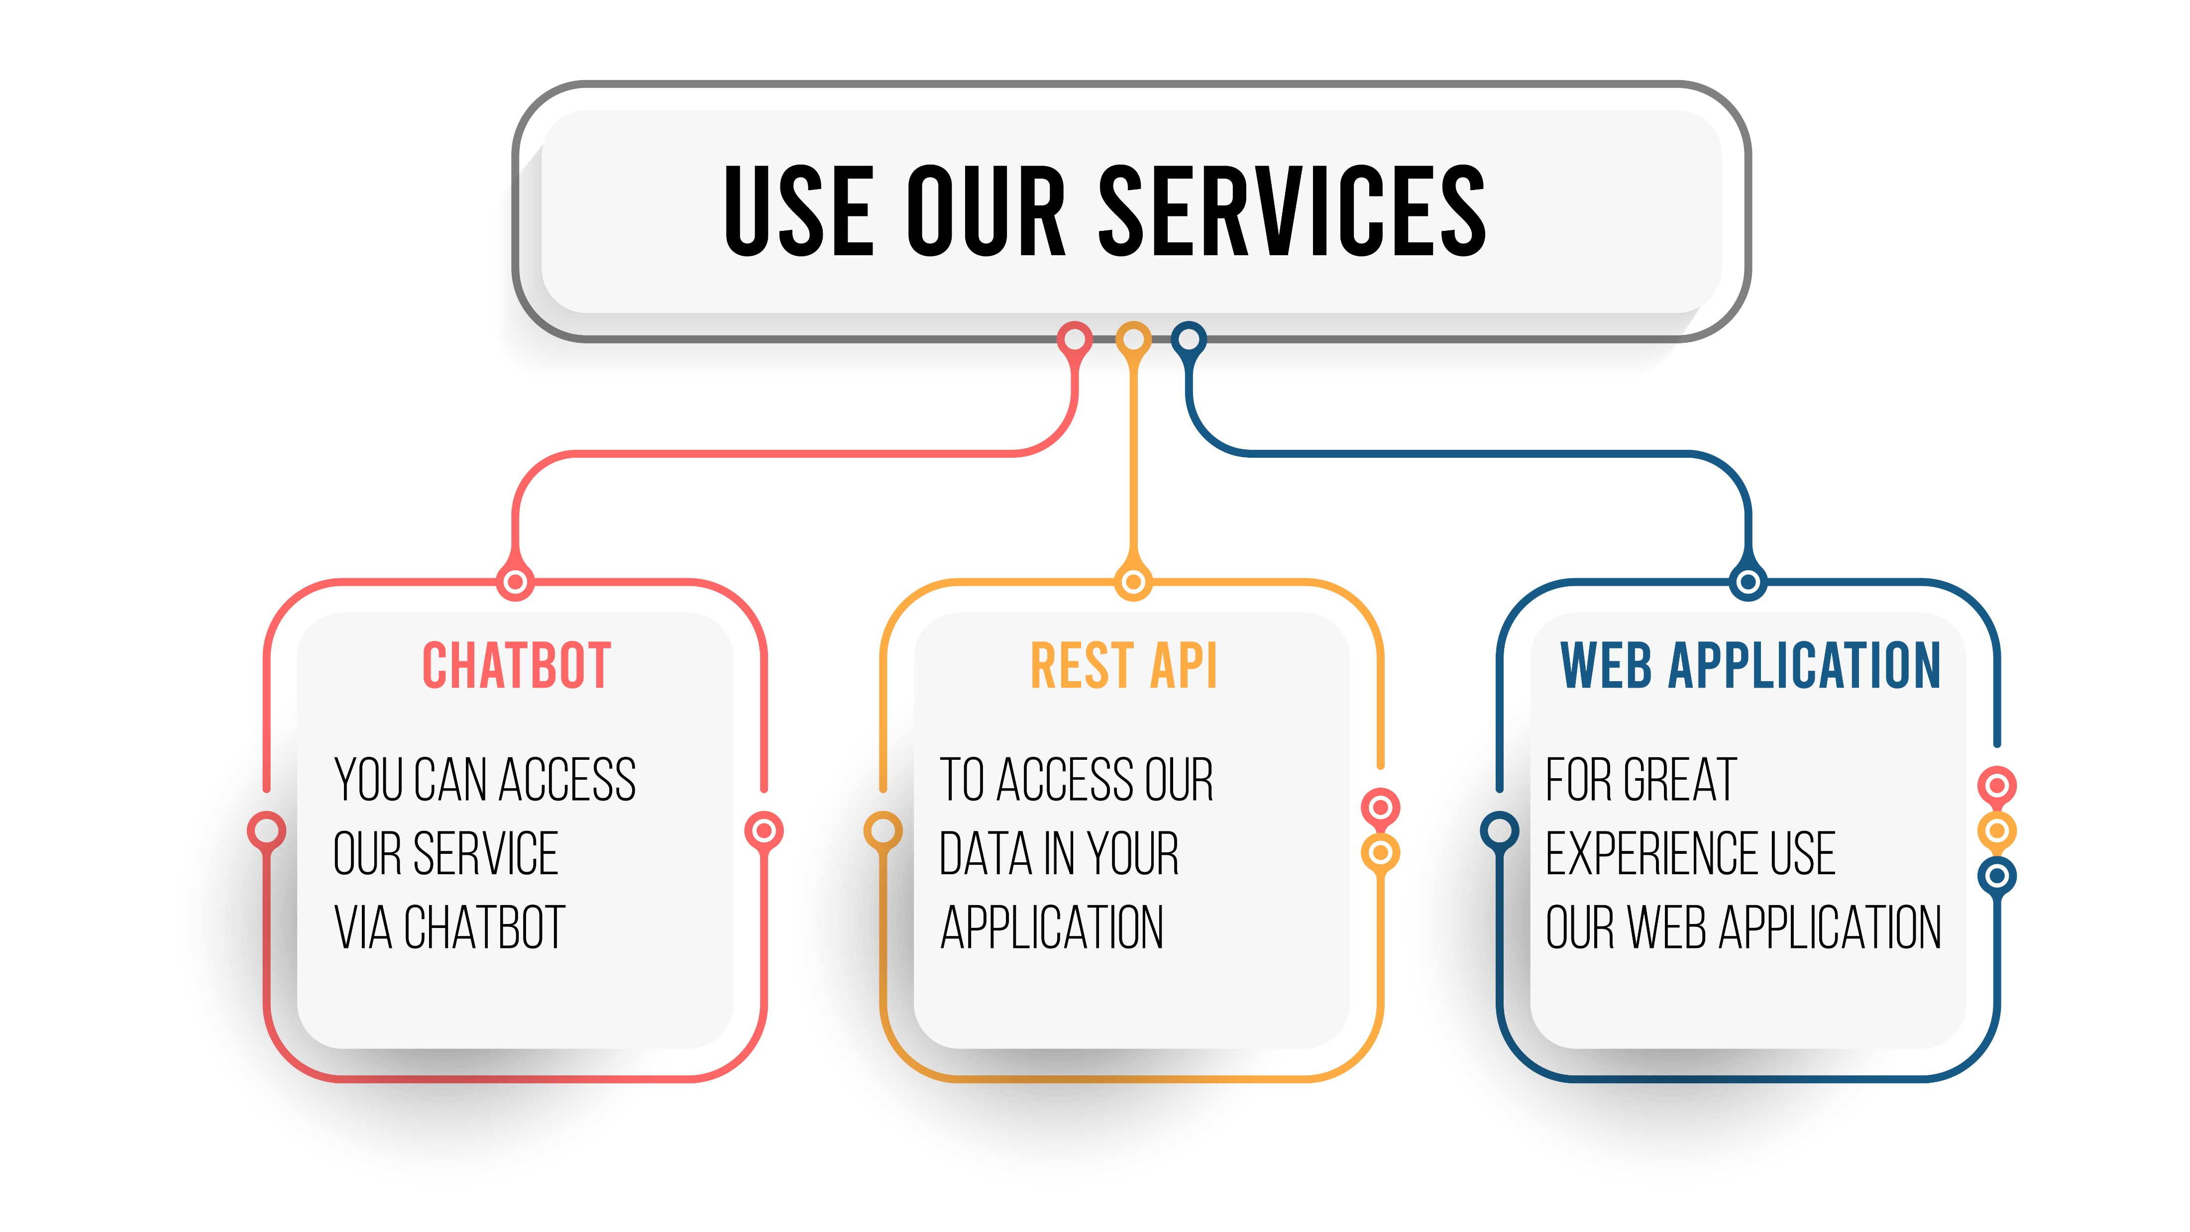

Slide 5
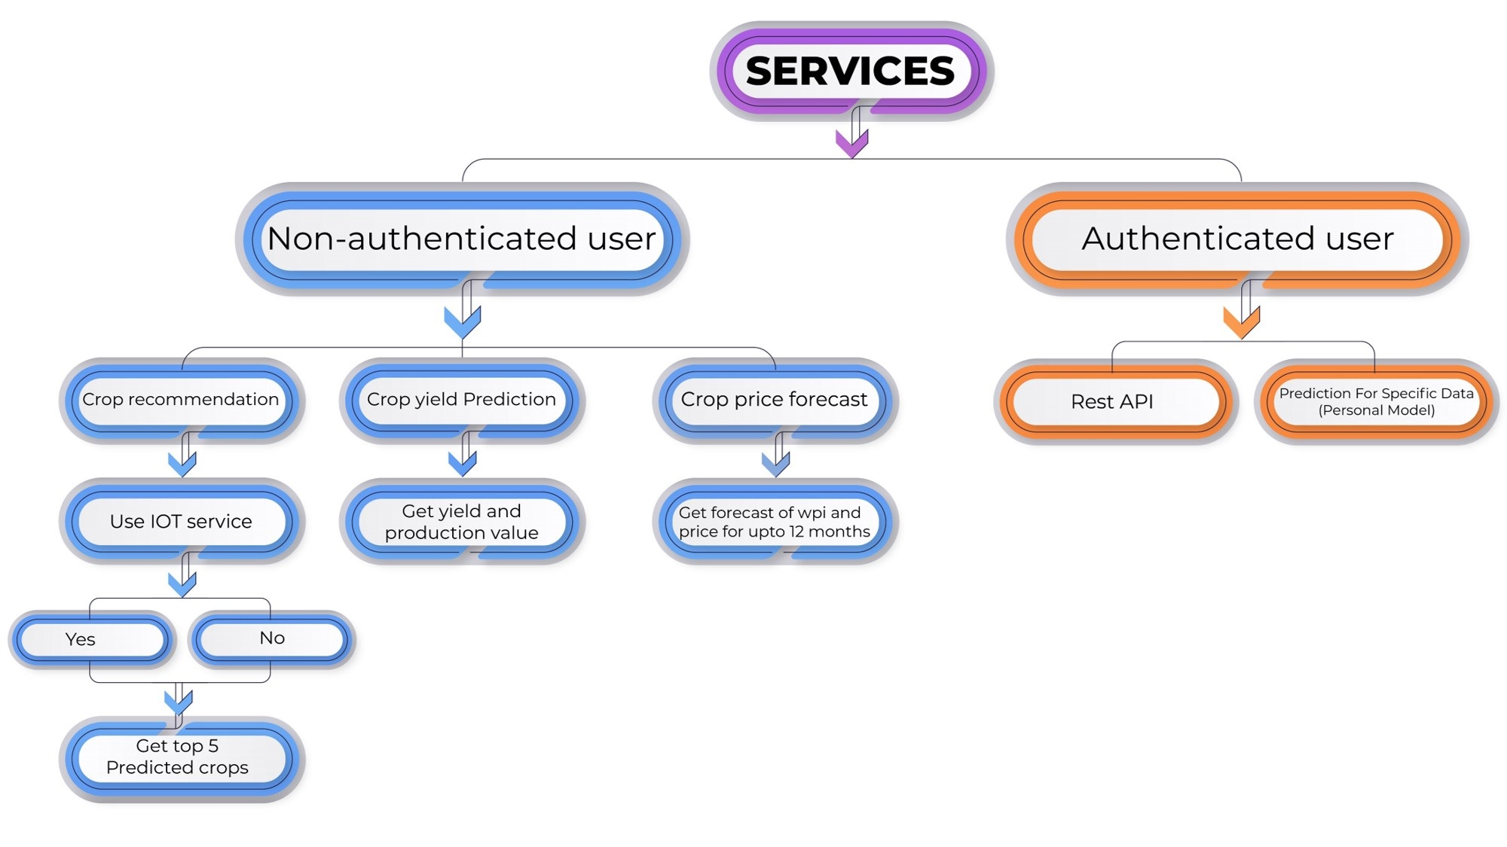

Slide 6
THANK YOU

