Slide 1

Lecture 10:
Circuit Families

Slide 2
Outline
Pseudo-nMOS Logic
Dynamic Logic
Pass Transistor Logic

Slide 3
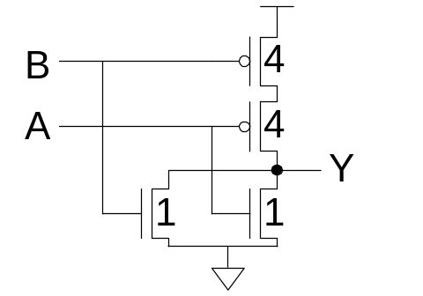
Introduction
What makes a circuit fast?
  I = C dV/dt -> t_{pd} ∝ (C/I) ΔV
  low capacitance
  high current
  small swing
Logical effort is proportional to C/I
pMOS are the enemy!
  High capacitance for a given current
Can we take the pMOS capacitance off the input?
Various circuit families try to do this…

Slide 4
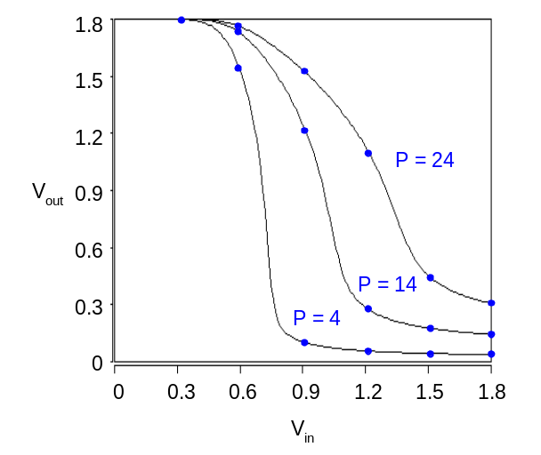
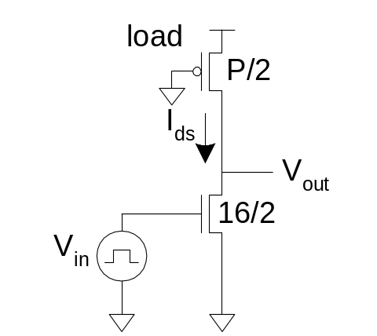
Pseudo-nMOS
In the old days, nMOS processes had no pMOS
  Instead, use pull-up transistor that is always ON
In CMOS, use a pMOS that is always ON
  Ratio issue
  Make pMOS about ¼ effective strength of pulldown network

Slide 5
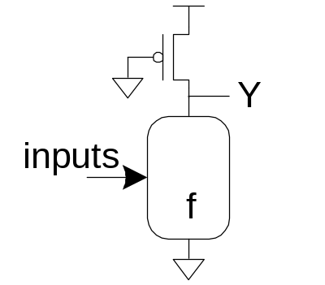
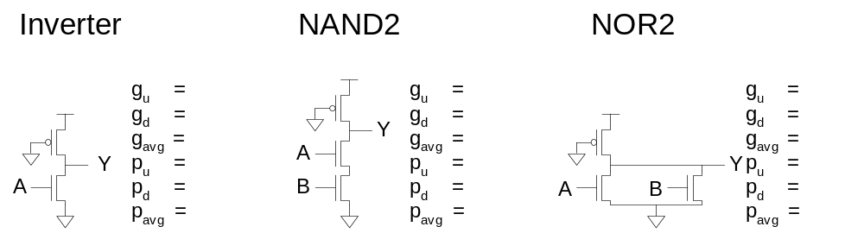
Pseudo-nMOS Gates
Design for unit current on output
to compare with unit inverter.
pMOS fights nMOS

Slide 6
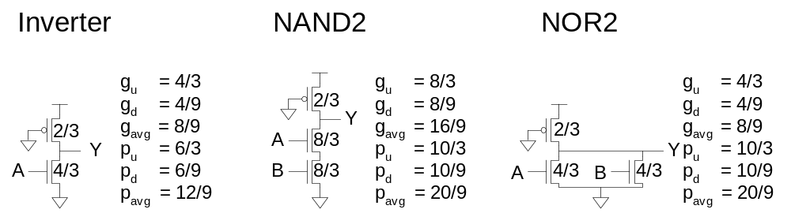
Pseudo-nMOS Gates
Design for unit current on output
to compare with unit inverter.
pMOS fights nMOS

Slide 7
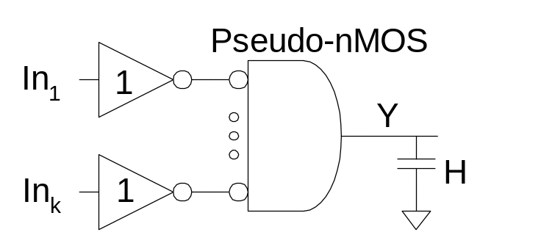
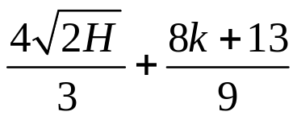
Pseudo-nMOS Design
Ex: Design a k-input AND gate using pseudo-nMOS. Estimate the delay driving a fanout of H
G = 1 * 8/9 = 8/9
F = GBH = 8H/9
P = 1 + (4+8k)/9 = (8k+13)/9
N = 2
D = NF^{1/N} + P =

Slide 8
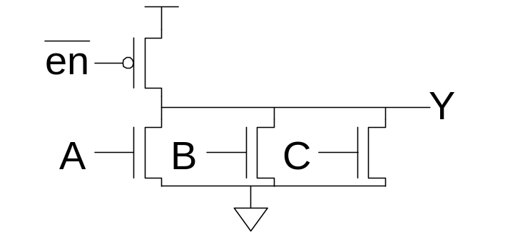
Pseudo-nMOS Power
Pseudo-nMOS draws power whenever Y = 0
  Called static power P = I_{DD}V_{DD}
  A few mA / gate * 1M gates would be a problem
  Explains why nMOS went extinct
Use pseudo-nMOS sparingly for wide NORs
Turn off pMOS when not in use

Slide 9
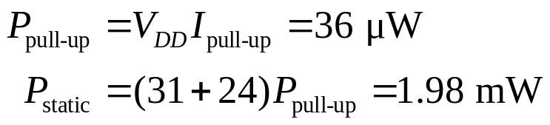
Ratio Example
The chip contains a 32 word x 48 bit ROM
  Uses pseudo-nMOS decoder and bitline pullups
  On average, one wordline and 24 bitlines are high
Find static power drawn by the ROM
  I_{on-p} = 36 μA, V_{DD} = 1.0 V
Solution:

Slide 10
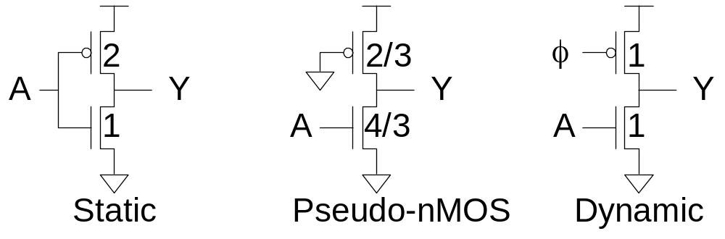
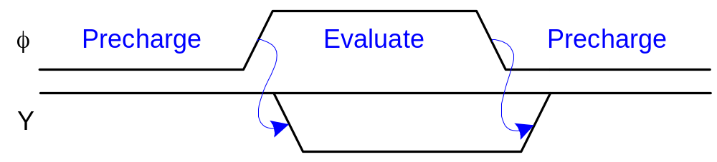
Dynamic Logic
Dynamic gates uses a clocked pMOS pullup
Two modes: precharge and evaluate

Slide 11
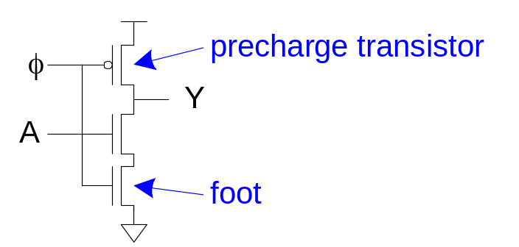
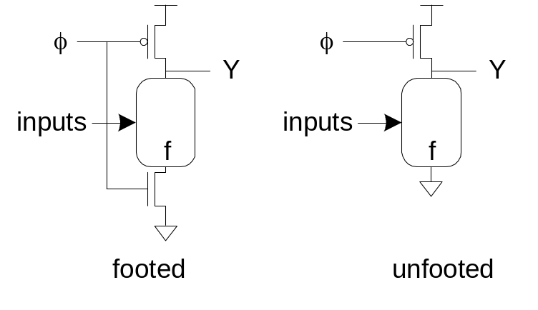
The Foot
What if pulldown network is ON during precharge?
Use series evaluation transistor to prevent fight.

Slide 12
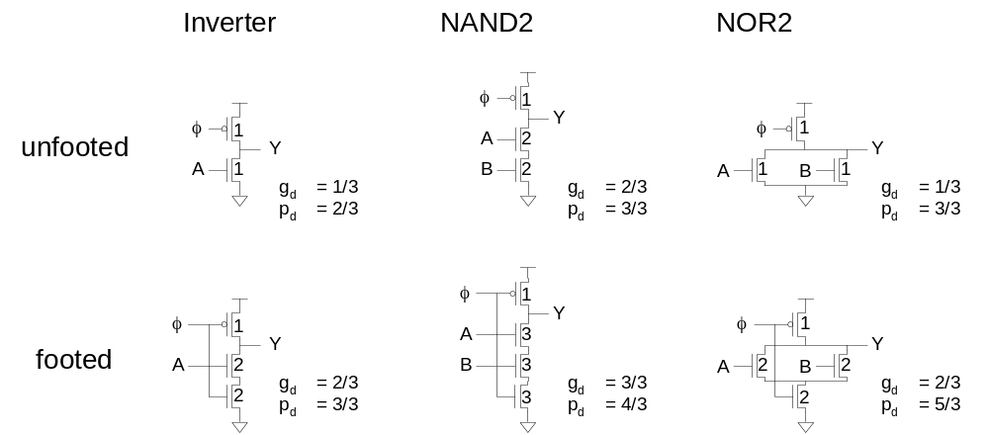
Logical Effort

Slide 13
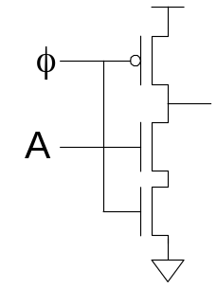
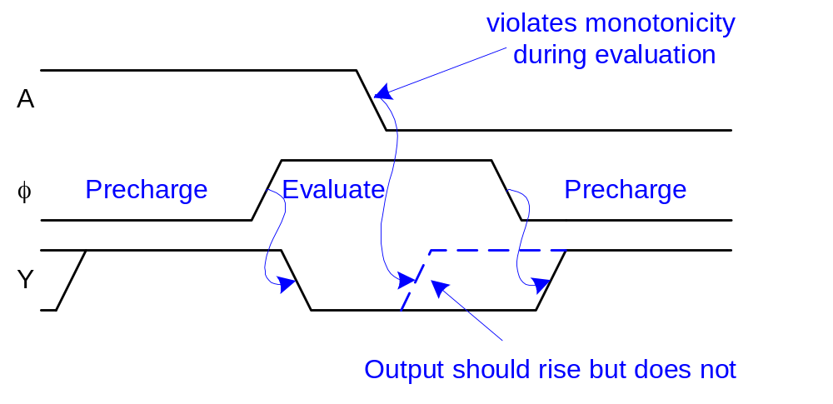
Monotonicity
Dynamic gates require monotonically rising inputs during evaluation
  0 -> 0
  0 -> 1
  1 -> 1
  But not 1 -> 0

Slide 14
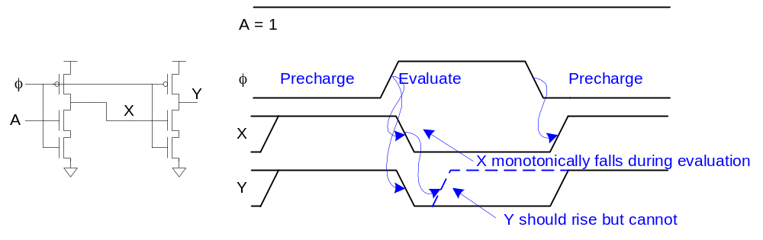
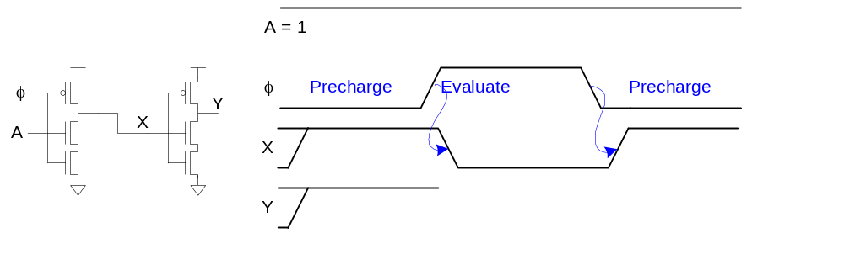
Monotonicity Woes
But dynamic gates produce monotonically falling outputs during evaluation
Illegal for one dynamic gate to drive another!

Slide 15
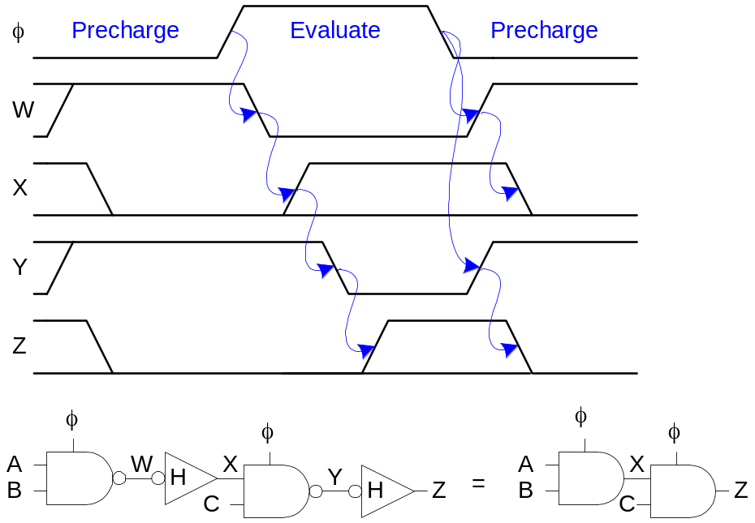
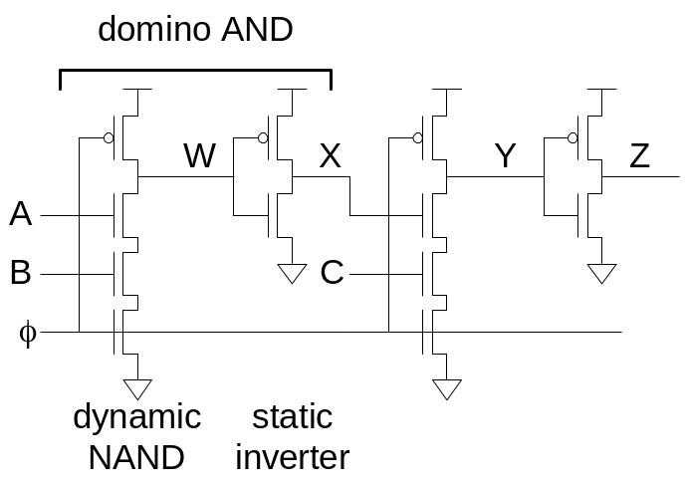
Domino Gates
Follow dynamic stage with inverting static gate
  Dynamic / static pair is called domino gate
  Produces monotonic outputs

Slide 16
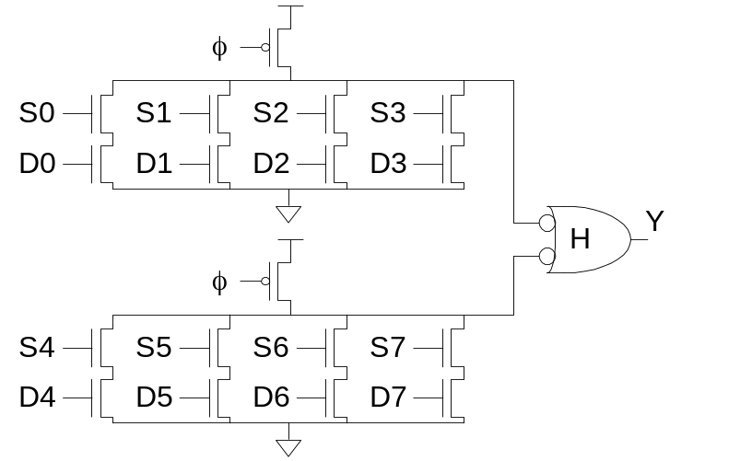
Domino Optimizations
Each domino gate triggers next one, like a string of dominos toppling over
Gates evaluate sequentially but precharge in parallel
Thus evaluation is more critical than precharge
HI-skewed static stages can perform logic

Slide 17
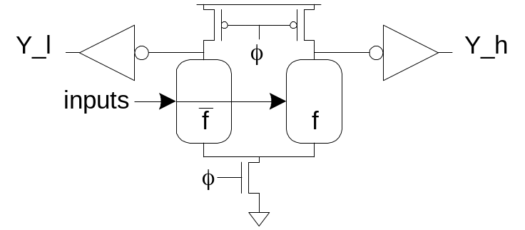
Dual-Rail Domino
Domino only performs noninverting functions:
  AND, OR but not NAND, NOR, or XOR
Dual-rail domino solves this problem
  Takes true and complementary inputs
  Produces true and complementary outputs
sig_h | sig_l | Meaning
0 | 0 | Precharged
0 | 1 | ‘0’
1 | 0 | ‘1’
1 | 1 | invalid

Slide 18
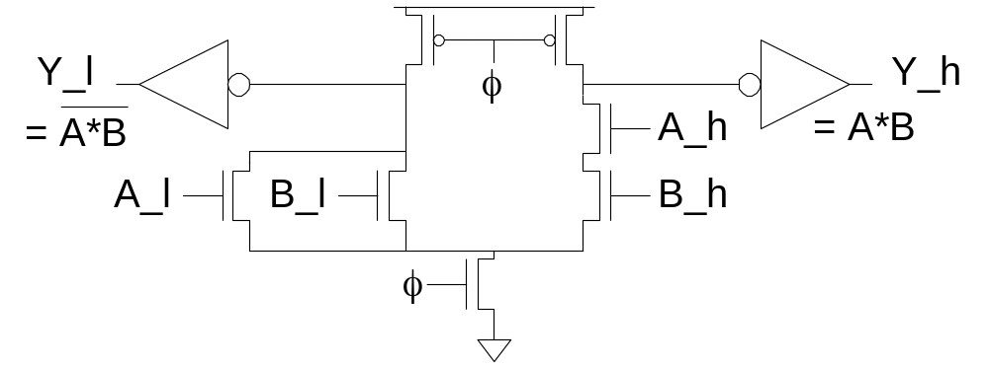
Example: AND/NAND
Given A_h, A_l, B_h, B_l
Compute Y_h = AB, Y_l = AB
Pulldown networks are conduction complements

Slide 19
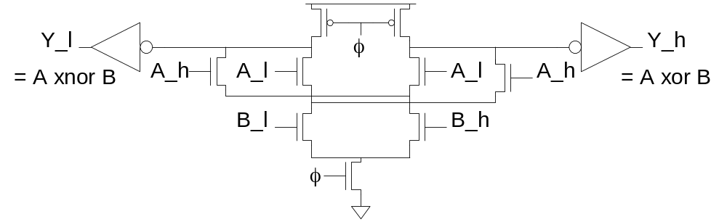
Example: XOR/XNOR
Sometimes possible to share transistors

Slide 20
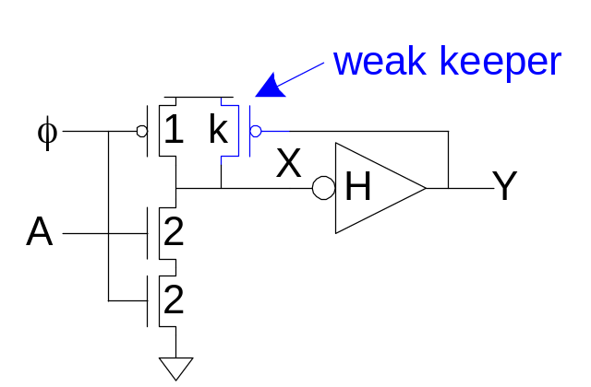
Leakage
Dynamic node floats high during evaluation
  Transistors are leaky (I_{OFF} ≠ 0)
  Dynamic value will leak away over time
  Formerly miliseconds, now nanoseconds
Use keeper to hold dynamic node
  Must be weak enough not to fight evaluation

Slide 21
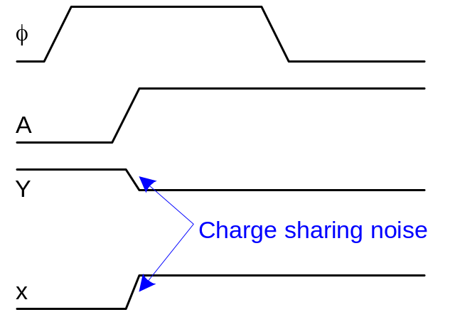
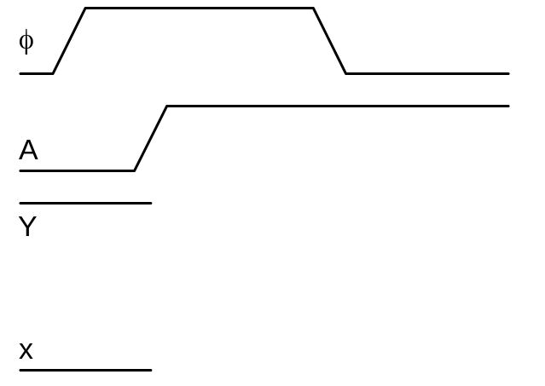
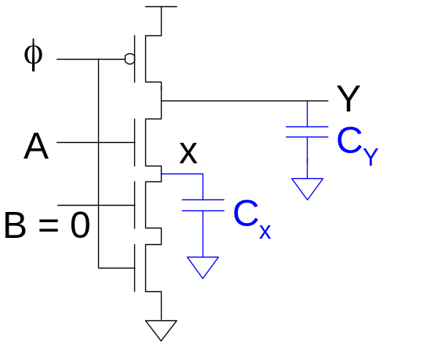
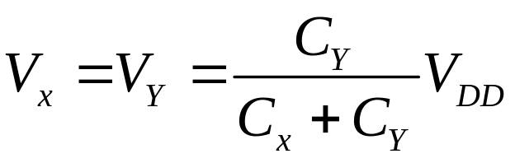
Charge Sharing
Dynamic gates suffer from charge sharing

Slide 22
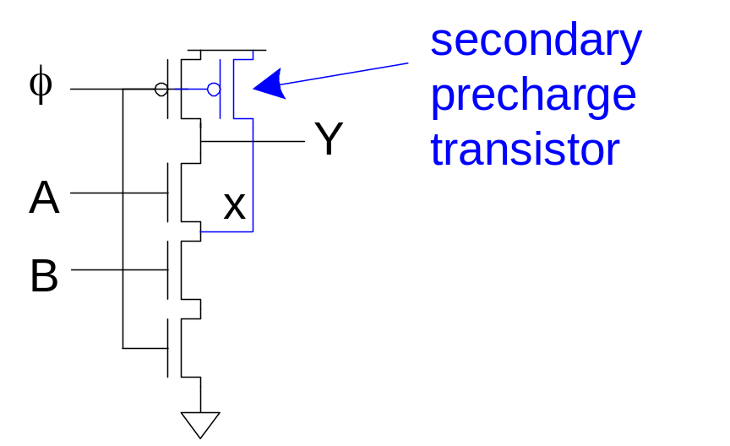
Secondary Precharge
Solution: add secondary precharge transistors
  Typically need to precharge every other node
Big load capacitance C_{Y} helps as well

Slide 23
Noise Sensitivity
Dynamic gates are very sensitive to noise
  Inputs: V_{IH} ≈ V_{tn}
  Outputs: floating output susceptible noise
Noise sources
  Capacitive crosstalk
  Charge sharing
  Power supply noise
  Feedthrough noise
  And more!

Slide 24
Power
Domino gates have high activity factors
  Output evaluates and precharges
    If output probability = 0.5, α = 0.5
      Output rises and falls on half the cycles
  Clocked transistors have α = 1
Leads to very high power consumption

Slide 25
Domino Summary
Domino logic is attractive for high-speed circuits
  1.3 – 2x faster than static CMOS
  But many challenges:
    Monotonicity, leakage, charge sharing, noise
Widely used in high-performance microprocessors in 1990s when speed was king
Largely displaced by static CMOS now that power is the limiter
Still used in memories for area efficiency

Slide 26
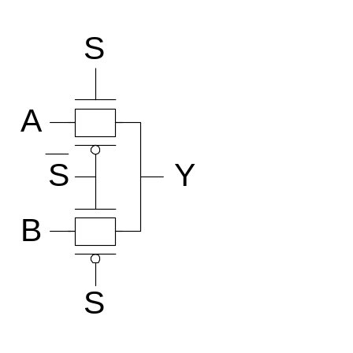
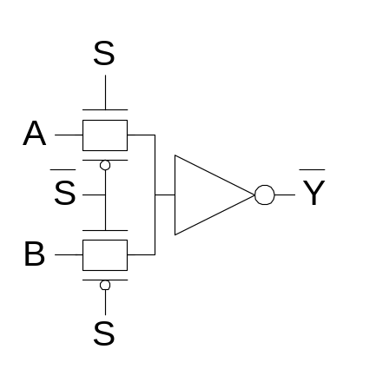
Pass Transistor Circuits
Use pass transistors like switches to do logic
Inputs drive diffusion terminals as well as gates
CMOS + Transmission Gates:
  2-input multiplexer
  Gates should be restoring

Slide 27
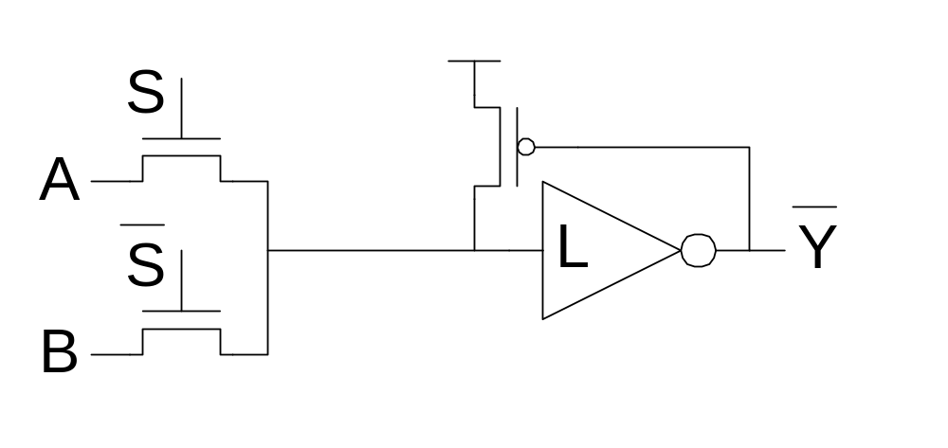
LEAP
LEAn integration with Pass transistors
Get rid of pMOS transistors
  Use weak pMOS feedback to pull fully high
  Ratio constraint

Slide 28
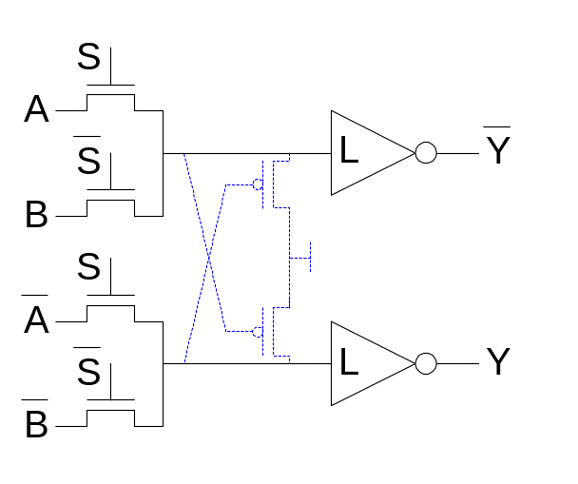
CPL
Complementary Pass-transistor Logic
  Dual-rail form of pass transistor logic
  Avoids need for ratioed feedback
  Optional cross-coupling for rail-to-rail swing

Slide 29
Pass Transistor Summary
Researchers investigated pass transistor logic for general purpose applications in the 1990’s
  Benefits over static CMOS were small or negative
  No longer generally used
However, pass transistors still have a niche in special circuits such as memories where they offer small size and the threshold drops can be managed

