Slide 1

Lecture 14:
Wires

Slide 2
Outline
Introduction
Interconnect Modeling
  Wire Resistance
  Wire Capacitance
Wire RC Delay
Crosstalk
Wire Engineering
Repeaters
14: Wires

Slide 3
Introduction
Chips are mostly made of wires called interconnect
  In stick diagram, wires set size
  Transistors are little things under the wires
  Many layers of wires
Wires are as important as transistors
  Speed
  Power
  Noise
Alternating layers run orthogonally
14: Wires

Slide 4
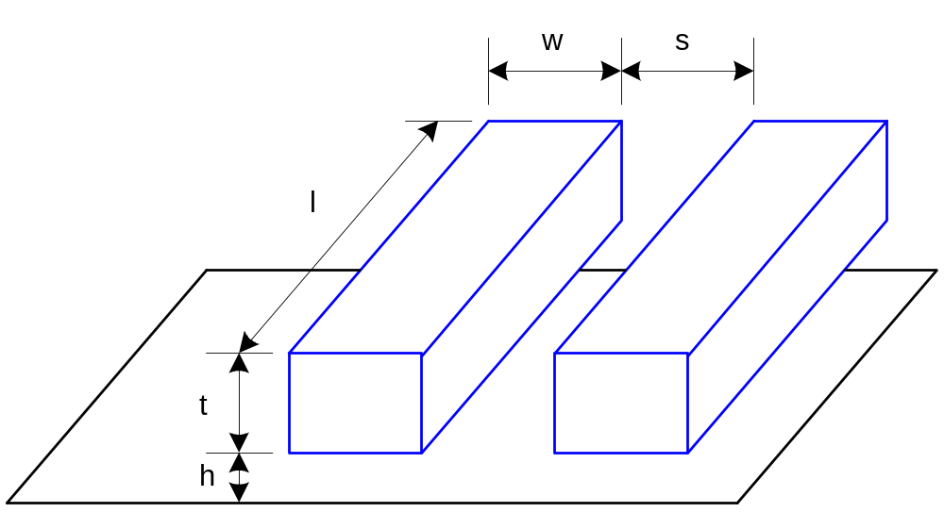
Wire Geometry
Pitch = w + s
Aspect ratio: AR = t/w
  Old processes had AR << 1
  Modern processes have AR ≈ 2
    Pack in many skinny wires
14: Wires

Slide 5
Layer Stack
AMI 0.6 μm process has 3 metal layers
  M1 for within-cell routing
  M2 for vertical routing between cells
  M3 for horizontal routing between cells
Modern processes use 6-10+ metal layers
  M1: thin, narrow (< 3λ)
    High density cells
  Mid layers
    Thicker and wider, (density vs. speed)
  Top layers: thickest
    For V_{DD}, GND, clk
14: Wires

Slide 6
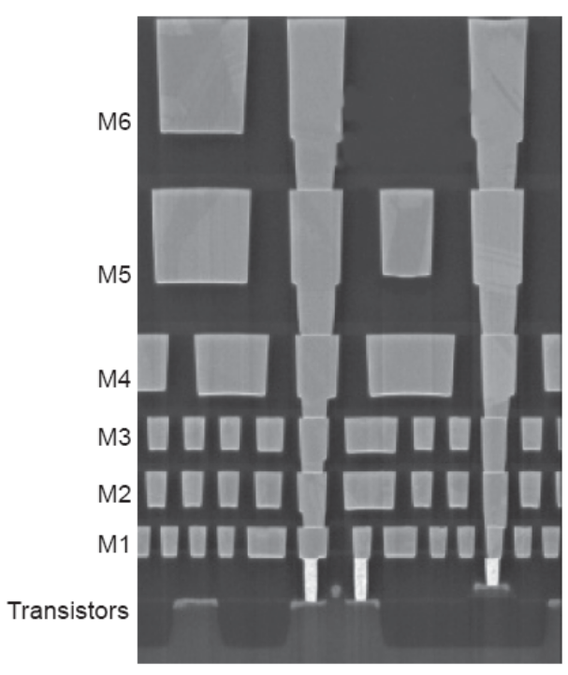
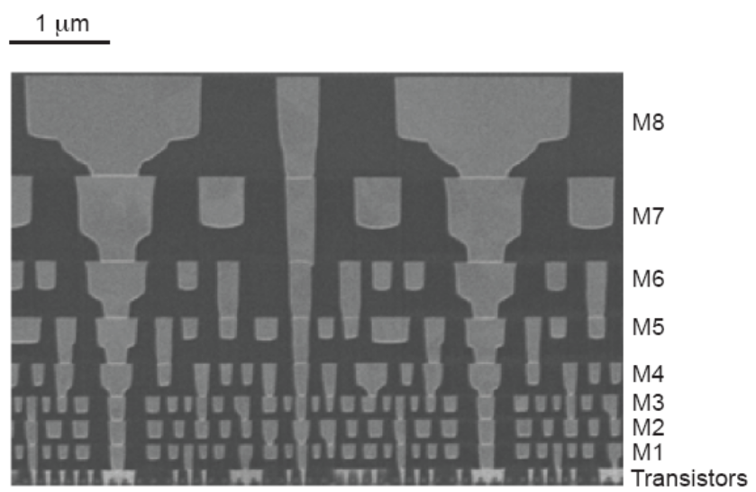
Example
Intel 90 nm Stack
Intel 45 nm Stack
[Thompson02]
[Moon08]
14: Wires

Slide 7
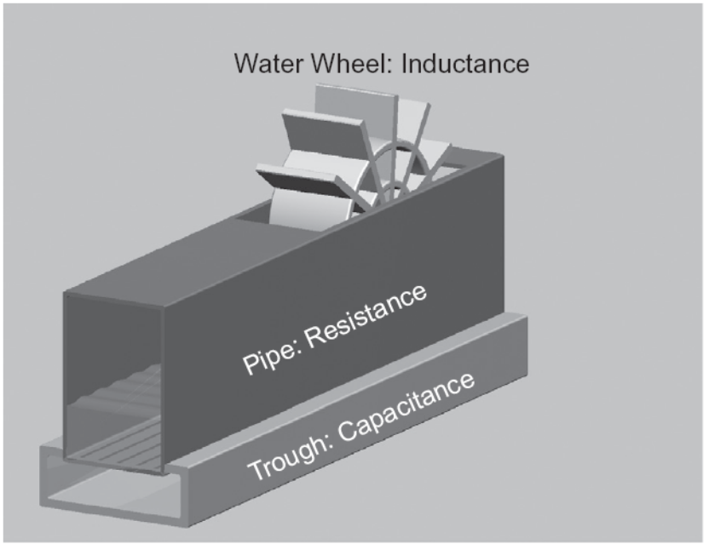
Interconnect Modeling
Current in a wire is analogous to current in a pipe
  Resistance: narrow size impedes flow
  Capacitance: trough under the leaky pipe must fill first
  Inductance: paddle wheel inertia opposes changes in flow rate
    Negligible for most
    wires
14: Wires

Slide 8
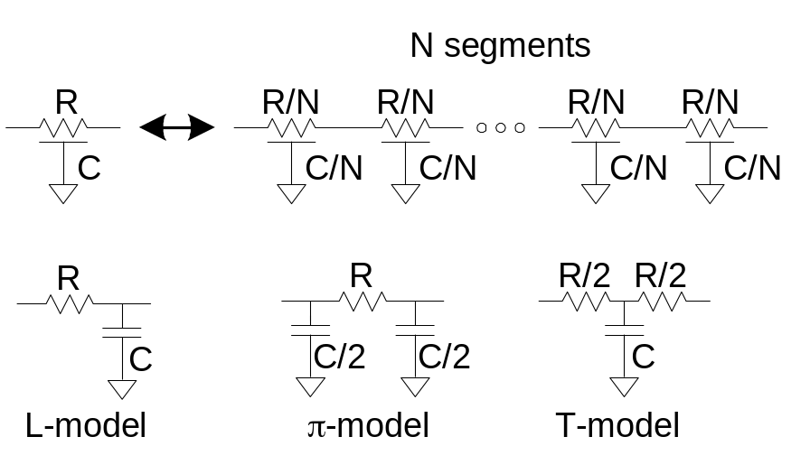
Lumped Element Models
Wires are a distributed system
  Approximate with lumped element models
3-segment π-model is accurate to 3% in simulation
L-model needs 100 segments for same accuracy!
Use single segment π-model for Elmore delay
14: Wires

Slide 9
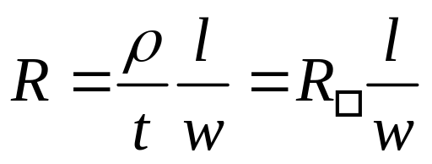
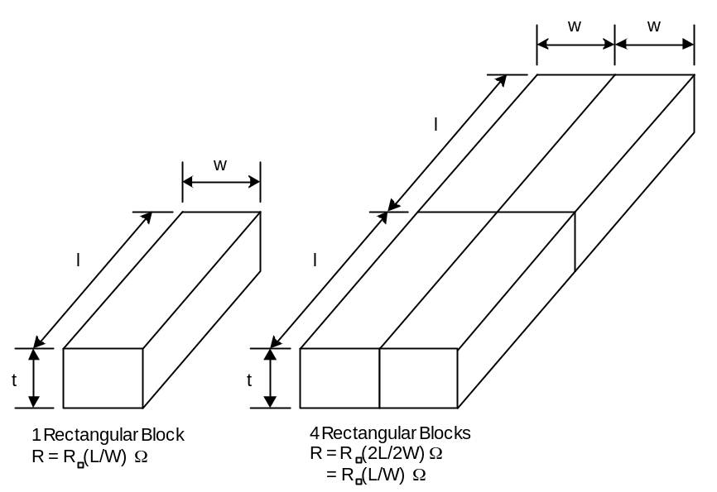
Wire Resistance
ρ = resistivity (Ω*m)
R□ = sheet resistance (Ω/□)
  □ is a dimensionless unit(!)
Count number of squares
  R = R□ * (# of squares)
14: Wires

Slide 10
Choice of Metals
Until 180 nm generation, most wires were aluminum
Contemporary processes normally use copper
  Cu atoms diffuse into silicon and damage FETs
  Must be surrounded by a diffusion barrier
Metal | Bulk resistivity (μΩ • cm)
Silver (Ag) | 1.6
Copper (Cu) | 1.7
Gold (Au) | 2.2
Aluminum (Al) | 2.8
Tungsten (W) | 5.3
Titanium (Ti) | 43.0
14: Wires

Slide 11
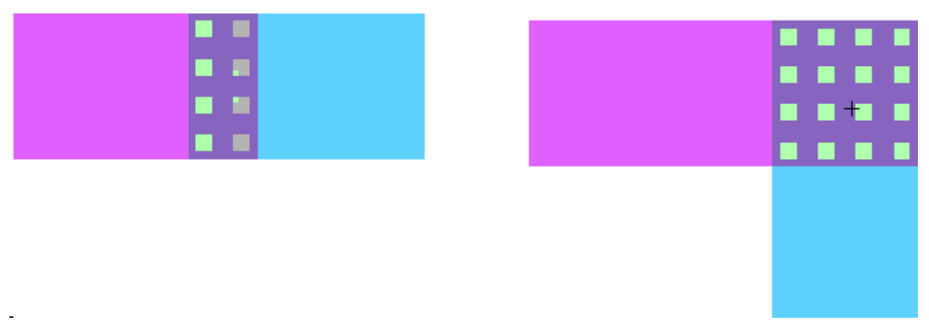
Contacts Resistance
Contacts and vias also have 2-20 Ω
Use many contacts for lower R
  Many small contacts for current crowding around periphery
14: Wires

Slide 12
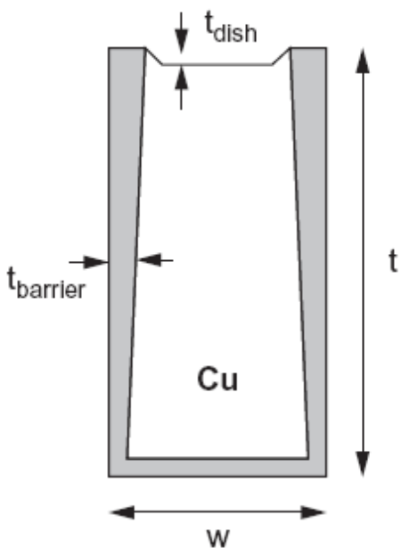
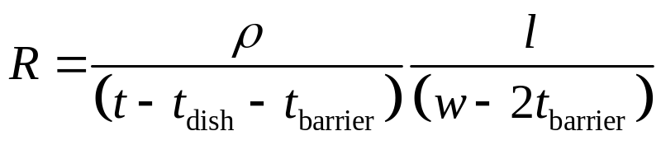
Copper Issues
Copper wires diffusion barrier has high resistance
Copper is also prone to dishing during polishing
Effective resistance is higher
14: Wires

Slide 13
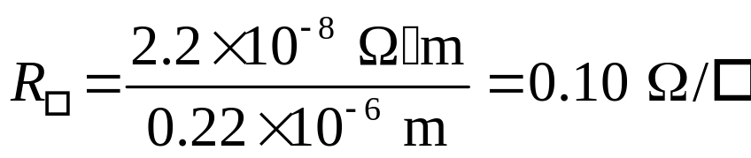
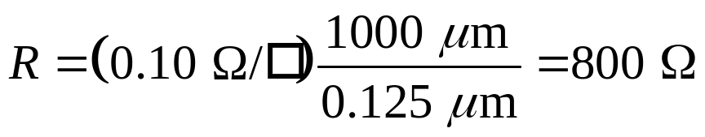
Example
Compute the sheet resistance of a 0.22 μm thick Cu wire in a 65 nm process. The resistivity of thin film Cu is 2.2 x 10-8 Ω•m. Ignore dishing.
Find the total resistance if the wire is 0.125 μm wide and 1 mm long. Ignore the barrier layer.
14: Wires

Slide 14
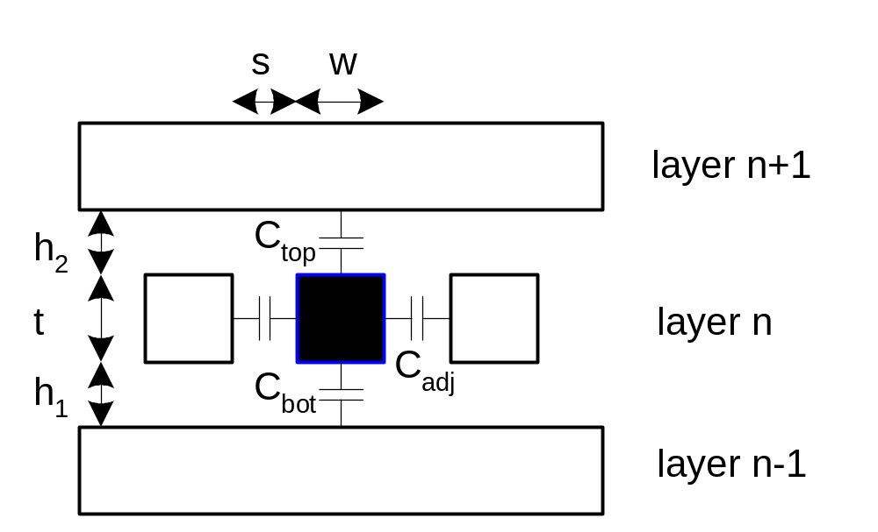
Wire Capacitance
Wire has capacitance per unit length
  To neighbors
  To layers above and below
C_{total} = C_{top} + C_{bot} + 2C_{adj}
14: Wires

Slide 15
Capacitance Trends
Parallel plate equation: C = ε_{ox}A/d
  Wires are not parallel plates, but obey trends
  Increasing area (W, t) increases capacitance
  Increasing distance (s, h) decreases capacitance
Dielectric constant
  ε_{ox} = kε₀
    ε₀ = 8.85 x 10⁻¹⁴ F/cm
    k = 3.9 for SiO₂
Processes are starting to use low-k dielectrics
  k ≈ 3 (or less) as dielectrics use air pockets
14: Wires

Slide 16
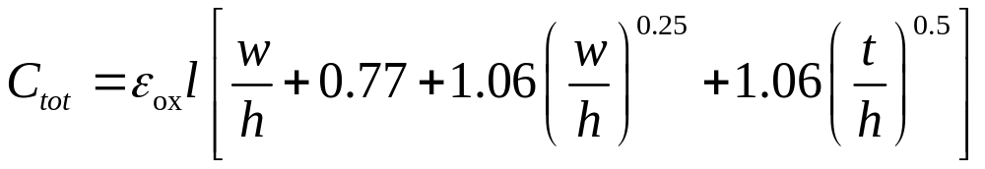
Capacitance Formula
Capacitance of a line without neighbors can be approximated as
This empirical formula is accurate to 6% for AR < 3.3
14: Wires

Slide 17
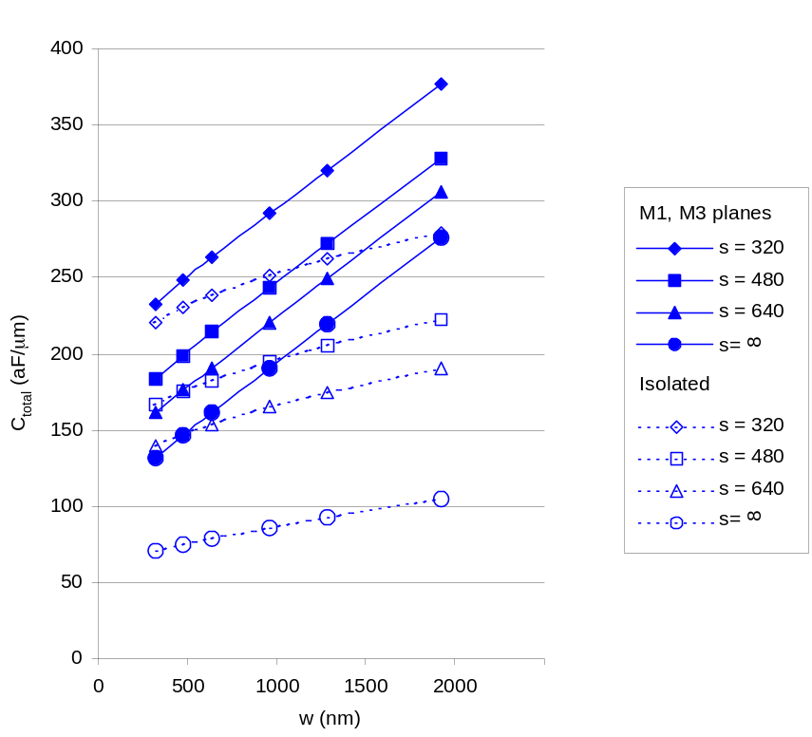
M2 Capacitance Data
Typical dense wires have ~ 0.2 fF/μm
  Compare to 1-2 fF/μm for gate capacitance
14: Wires

Slide 18
Diffusion & Polysilicon
Diffusion capacitance is very high (1-2 fF/μm)
  Comparable to gate capacitance
  Diffusion also has high resistance
  Avoid using diffusion runners for wires!
Polysilicon has lower C but high R
  Use for transistor gates
  Occasionally for very short wires between gates
14: Wires

Slide 19
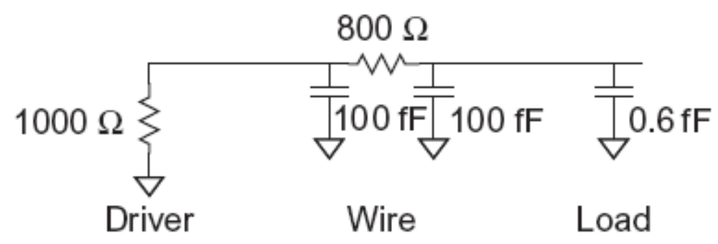
Wire RC Delay
Estimate the delay of a 10x inverter driving a 2x inverter at the end of the 1 mm wire. Assume wire capacitance is 0.2 fF/μm and that a unit-sized inverter has R = 10 KΩ and C = 0.1 fF.
  t_{pd} = (1000 Ω)(100 fF) + (1000 + 800 Ω)(100 + 0.6 fF) = 281 ps
14: Wires

Slide 20
Wire Energy
Estimate the energy per unit length to send a bit of information (one rising and one falling transition) in a CMOS process.
E = (0.2 pF/mm)(1.0 V)² = 0.2 pJ/bit/mm
  = 0.2 mW/Gbps/mm
14: Wires

Slide 21
Crosstalk
A capacitor does not like to change its voltage instantaneously.
A wire has high capacitance to its neighbor.
  When the neighbor switches from 1-> 0 or 0->1, the wire tends to switch too.
  Called capacitive coupling or crosstalk.
Crosstalk effects
  Noise on nonswitching wires
  Increased delay on switching wires
14: Wires

Slide 22
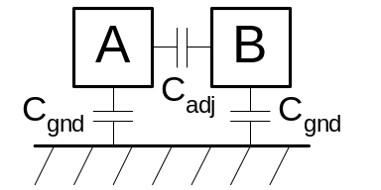
Crosstalk Delay
Assume layers above and below on average are quiet
  Second terminal of capacitor can be ignored
  Model as C_{gnd} = C_{top} + C_{bot}
Effective C_{adj} depends on behavior of neighbors
  Miller effect
B | ΔV | C_{eff(A)} | MCF
Constant | V_{DD} | C_{gnd} + C_{adj} | 1
Switching with A | 0 | C_{gnd} | 0
Switching opposite A | 2V_{DD} | C_{gnd} + 2 C_{adj} | 2
14: Wires

Slide 23
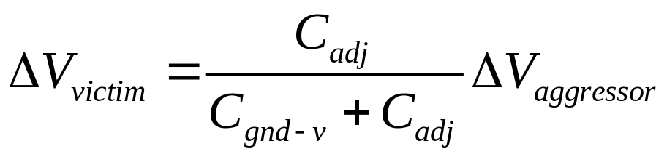
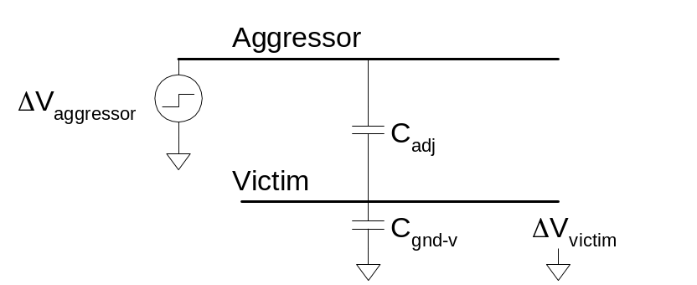
Crosstalk Noise
Crosstalk causes noise on nonswitching wires
If victim is floating:
  model as capacitive voltage divider
14: Wires

Slide 24
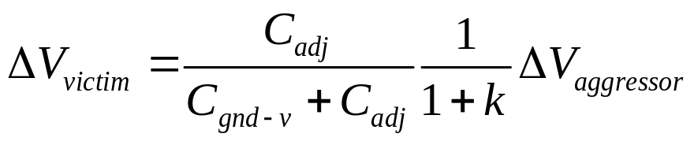
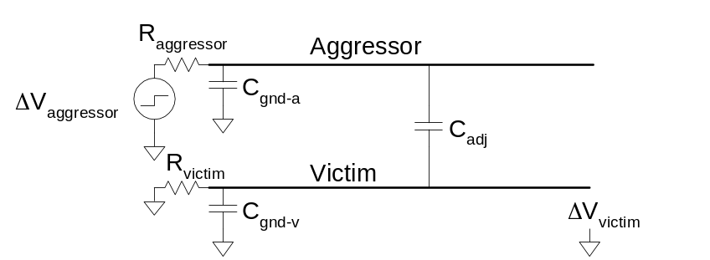
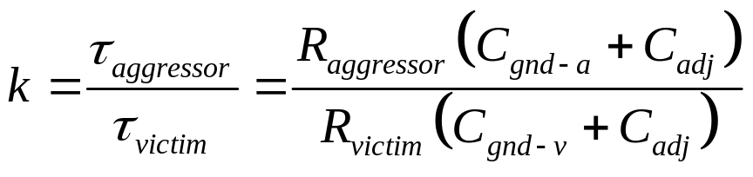
Driven Victims
Usually victim is driven by a gate that fights noise
  Noise depends on relative resistances
  Victim driver is in linear region, agg. in saturation
  If sizes are same, R_{aggressor} = 2-4 x R_{victim}
14: Wires

Slide 25
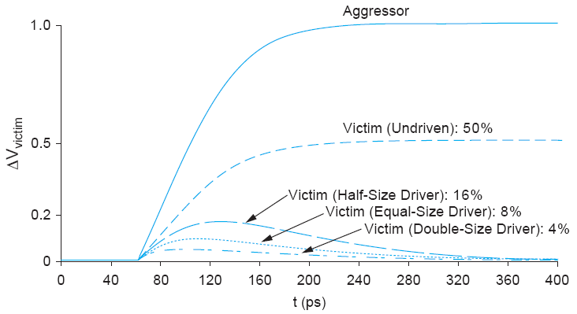
Coupling Waveforms
Simulated coupling for C_{adj} = C_{victim}
14: Wires

Slide 26
Noise Implications
So what if we have noise?
If the noise is less than the noise margin, nothing happens
Static CMOS logic will eventually settle to correct output even if disturbed by large noise spikes
  But glitches cause extra delay
  Also cause extra power from false transitions
Dynamic logic never recovers from glitches
Memories and other sensitive circuits also can produce the wrong answer
14: Wires

Slide 27
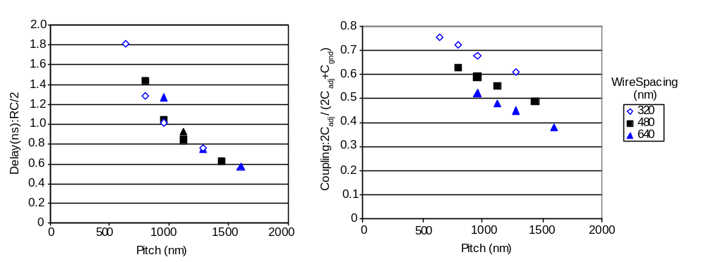
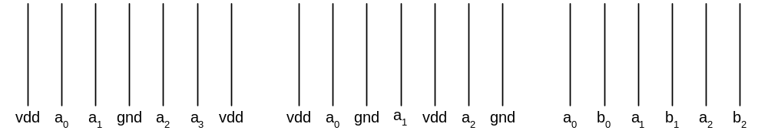
Wire Engineering
Goal: achieve delay, area, power goals with acceptable noise
Degrees of freedom:
  Width
  Spacing
  Layer
  Shielding
14: Wires

Slide 28
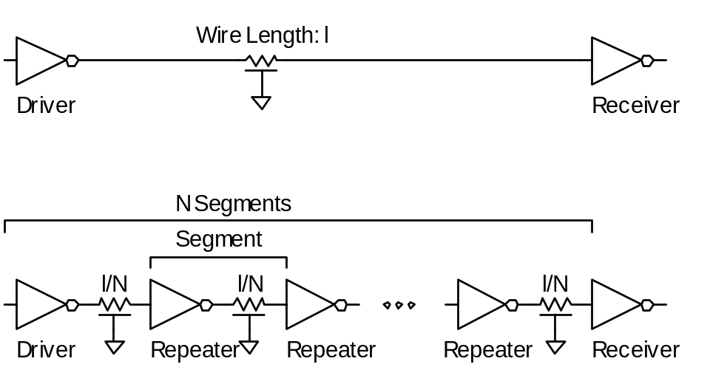
Repeaters
R and C are proportional to l
RC delay is proportional to l²
  Unacceptably great for long wires
Break long wires into N shorter segments
  Drive each one with an inverter or buffer
14: Wires

Slide 29
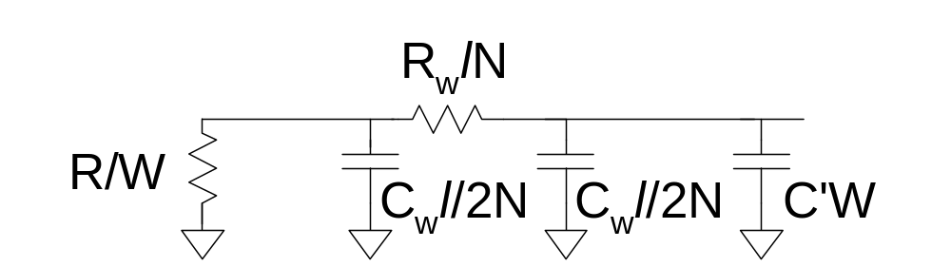
Repeater Design
How many repeaters should we use?
How large should each one be?
Equivalent Circuit
  Wire length l/N
    Wire Capacitance C_{w}*l/N, Resistance R_{w}*l/N
  Inverter width W (nMOS = W, pMOS = 2W)
    Gate Capacitance C’*W, Resistance R/W
14: Wires

Slide 30
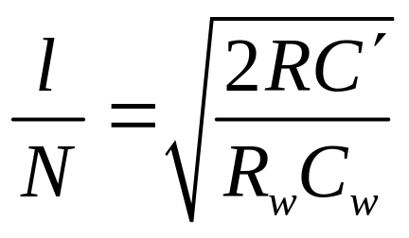
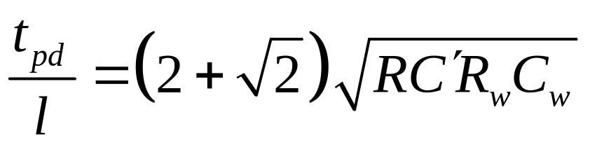
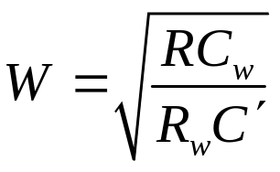
Repeater Results
Write equation for Elmore Delay
  Differentiate with respect to W and N
  Set equal to 0, solve
~40 ps/mm
in 65 nm process
14: Wires

Slide 31
Repeater Energy
Energy / length ≈ 1.87C_{w}V_{DD}²
  87% premium over unrepeated wires
  The extra power is consumed in the large repeaters
If the repeaters are downsized for minimum EDP:
  Energy premium is only 30%
  Delay increases by 14% from min delay
14: Wires

