Slide 1

Lecture 20:
CAMs, ROMs,
PLAs

Slide 2
Outline
Content-Addressable Memories
Read-Only Memories
Programmable Logic Arrays
20: CAMs, ROMs, and PLAs

Slide 3
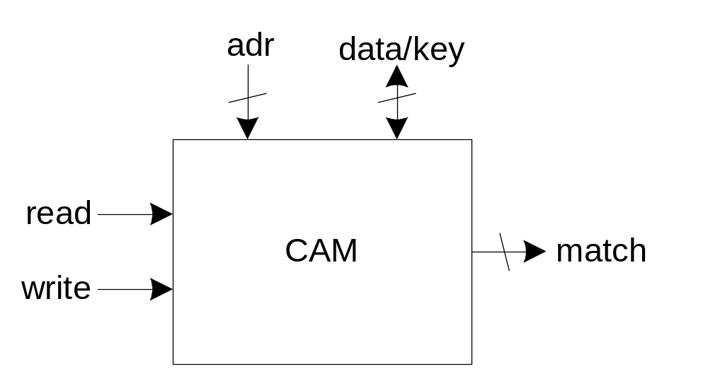
CAMs
Extension of ordinary memory (e.g. SRAM)
  Read and write memory as usual
  Also match to see which words contain a key
20: CAMs, ROMs, and PLAs

Slide 4
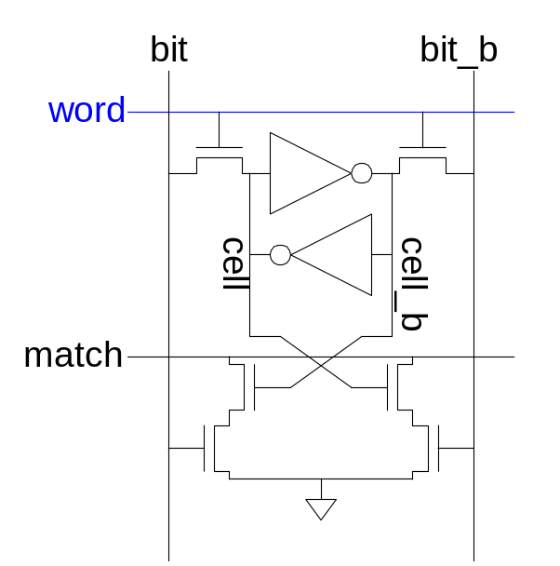
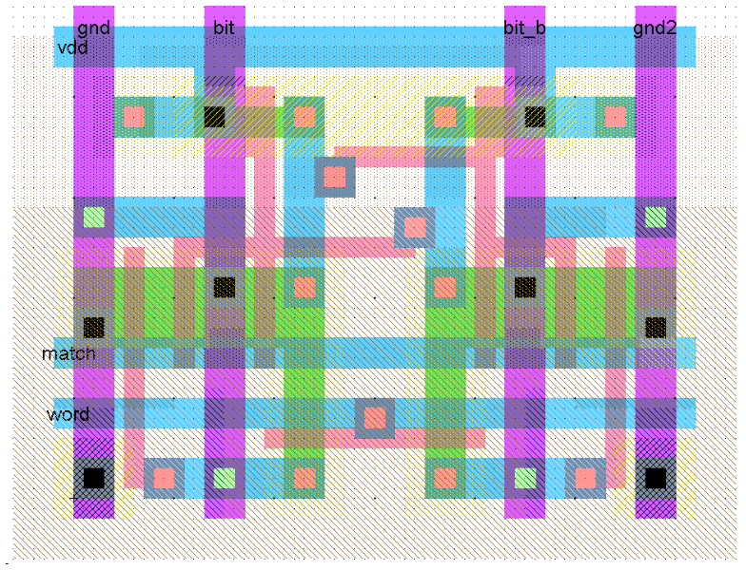
10T CAM Cell
Add four match transistors to 6T SRAM
  56 x 43 λ unit cell
20: CAMs, ROMs, and PLAs

Slide 5
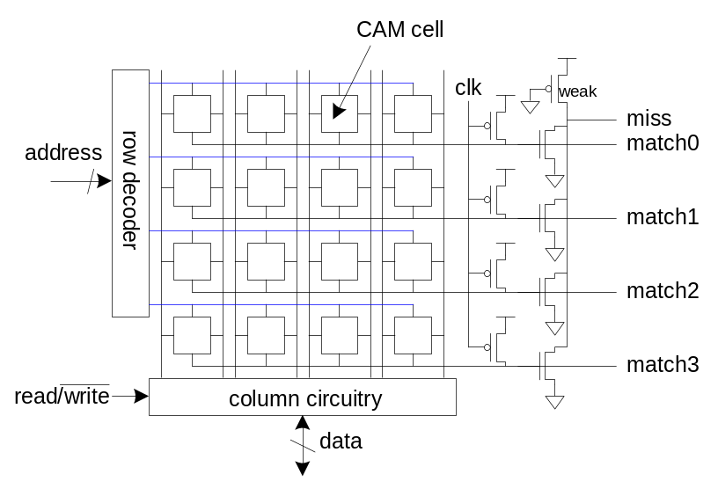
CAM Cell Operation
Read and write like ordinary SRAM
For matching:
  Leave wordline low
  Precharge matchlines
  Place key on bitlines
  Matchlines evaluate
Miss line
  Pseudo-nMOS NOR of match lines
  Goes high if no words match
20: CAMs, ROMs, and PLAs

Slide 6
Read-Only Memories
Read-Only Memories are nonvolatile
  Retain their contents when power is removed
Mask-programmed ROMs use one transistor per bit
  Presence or absence determines 1 or 0
20: CAMs, ROMs, and PLAs

Slide 7
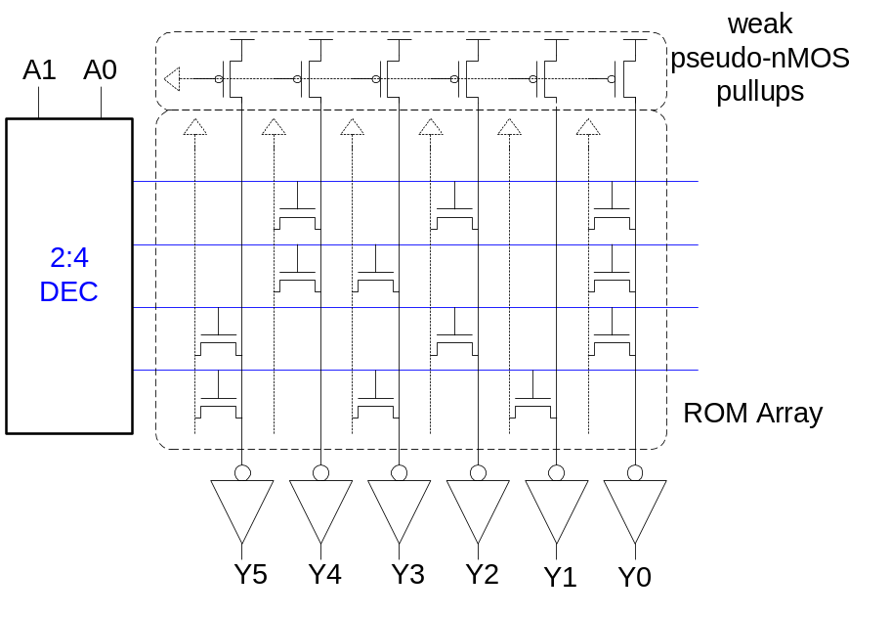
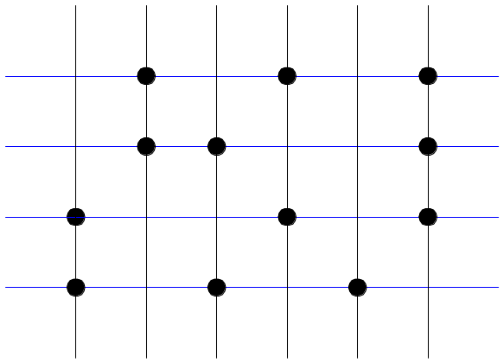
ROM Example
4-word x 6-bit ROM
  Represented with dot diagram
  Dots indicate 1’s in ROM
Word 0: 010101
Word 1: 011001
Word 2: 100101
Word 3: 101010
Looks like 6 4-input pseudo-nMOS NORs
20: CAMs, ROMs, and PLAs

Slide 8
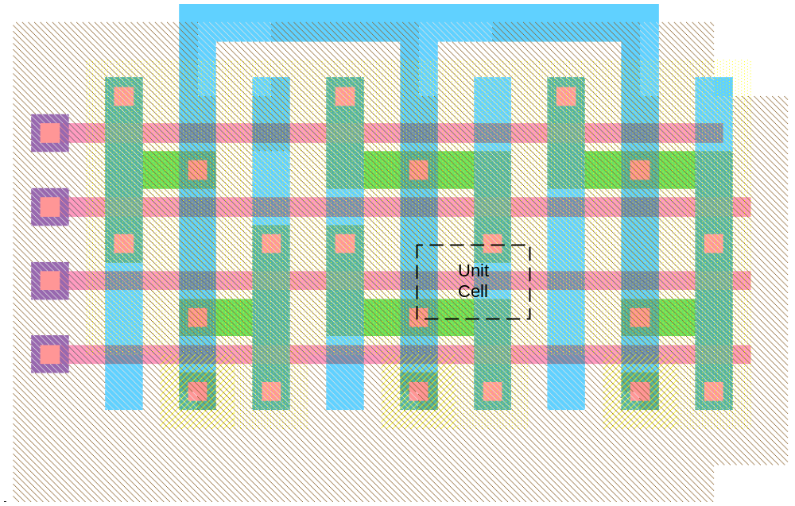
ROM Array Layout
Unit cell is 12 x 8 λ (about 1/10 size of SRAM)
20: CAMs, ROMs, and PLAs

Slide 9
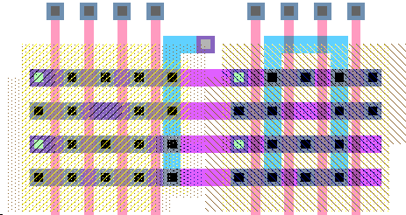
Row Decoders
ROM row decoders must pitch-match with ROM
  Only a single track per word!
20: CAMs, ROMs, and PLAs

Slide 10
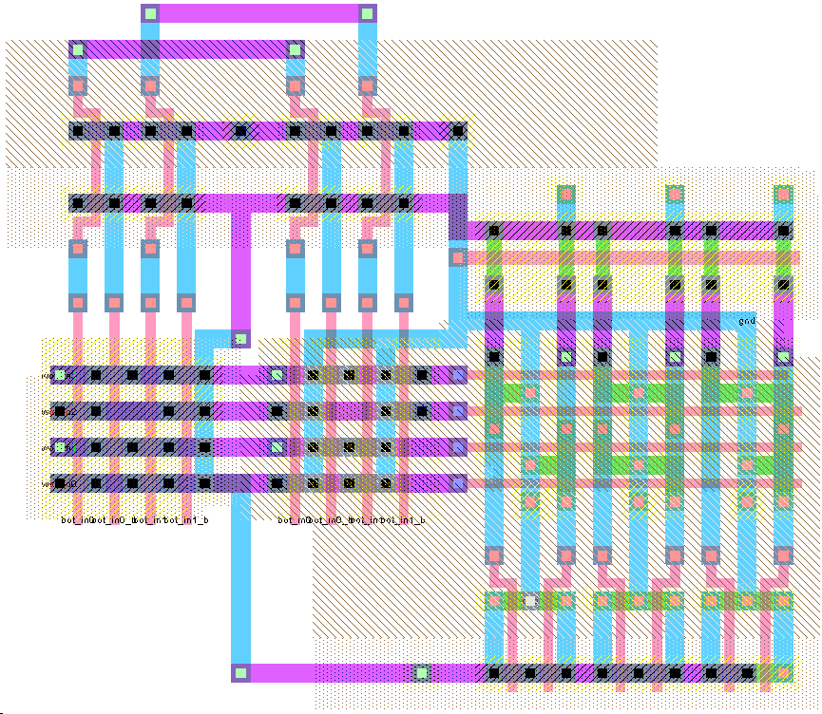
Complete ROM Layout
20: CAMs, ROMs, and PLAs

Slide 11
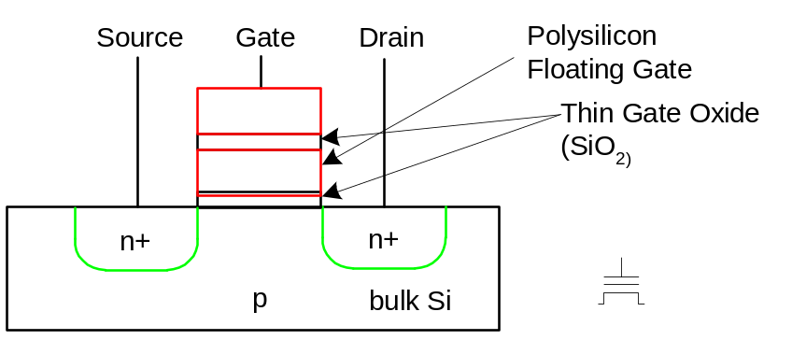
PROMs and EPROMs
Programmable ROMs
  Build array with transistors at every site
  Burn out fuses to disable unwanted transistors
Electrically Programmable ROMs
  Use floating gate to turn off unwanted transistors
  EPROM, EEPROM, Flash
20: CAMs, ROMs, and PLAs

Slide 12
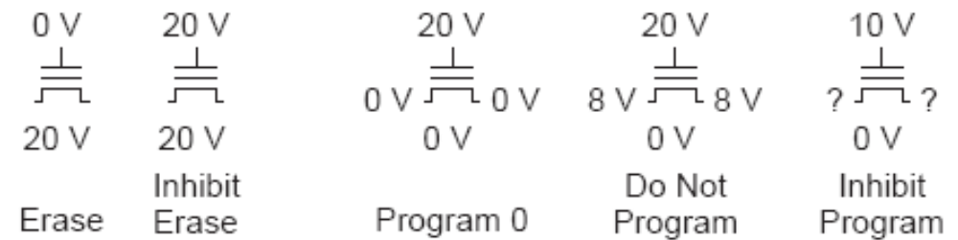
Flash Programming
Charge on floating gate determines V_{t}
Logic 1: negative V_{t}
Logic 0: positive V_{t}
Cells erased to 1 by applying a high body voltage so that electrons tunnel off floating gate into substrate
Programmed to 0 by applying high gate voltage
20: CAMs, ROMs, and PLAs

Slide 13
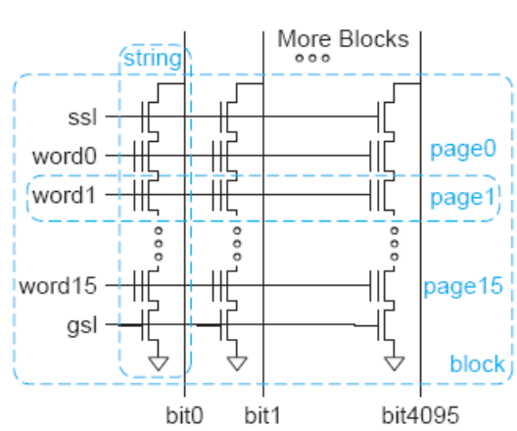
NAND Flash
High density, low cost / bit
  Programmed one page at a time
  Erased one block at a time
Example:
  4096-bit pages
  16 pages / 8 KB block
  Many blocks / memory
20: CAMs, ROMs, and PLAs

Slide 14
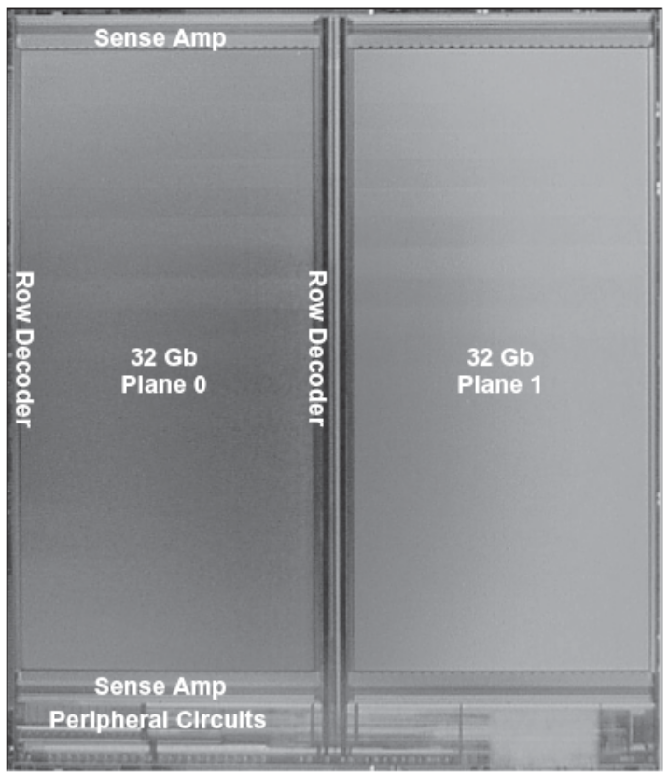
64 Gb NAND Flash
64K cells / page
4 bits / cell (multiple V_{t})
64 cells / string
  256 pages / block
2K blocks / plane
2 planes
[Trinh09]
20: CAMs, ROMs, and PLAs

Slide 15
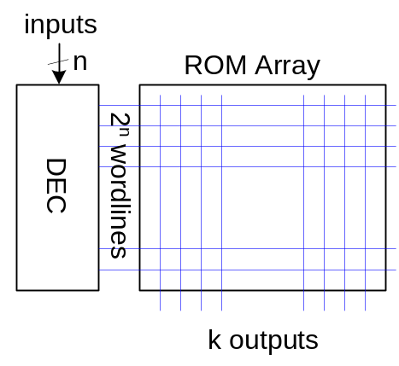
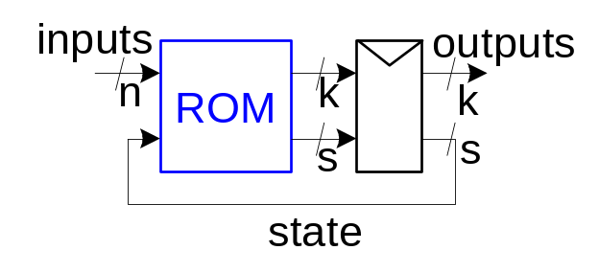
Building Logic with ROMs
Use ROM as lookup table containing truth table
  n inputs, k outputs requires 2^{n} words x k bits
  Changing function is easy – reprogram ROM
Finite State Machine
  n inputs, k outputs, s bits of state
  Build with 2^{n+s} x (k+s) bit ROM and (k+s) bit reg
20: CAMs, ROMs, and PLAs

Slide 16
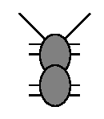

Example: RoboAnt
Let’s build an Ant
Sensors: Antennae
(L,R) – 1 when in contact
Actuators: Legs
Forward step F
Ten degree turns TL, TR
Goal: make our ant smart enough to
get out of a maze
Strategy: keep right antenna on wall
(RoboAnt adapted from MIT 6.004 2002 OpenCourseWare by Ward and Terman)
L
R
20: CAMs, ROMs, and PLAs

Slide 17

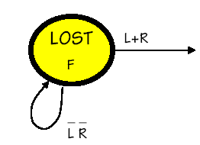
Lost in space
Action: go forward until we hit something
  Initial state
20: CAMs, ROMs, and PLAs

Slide 18
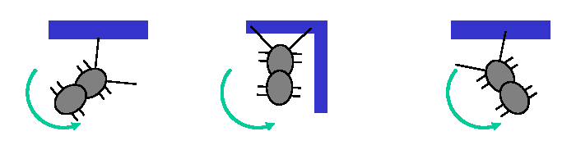
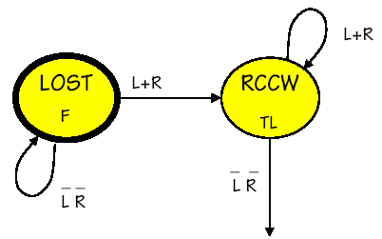
Bonk!!!
Action: turn left (rotate counterclockwise)
  Until we don’t touch anymore
20: CAMs, ROMs, and PLAs

Slide 19
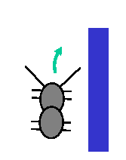
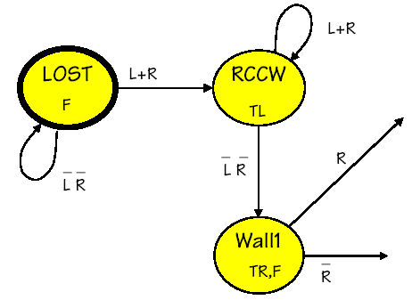
A little to the right
Action: step forward and turn right a little
  Looking for wall
20: CAMs, ROMs, and PLAs

Slide 20
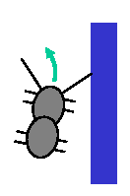
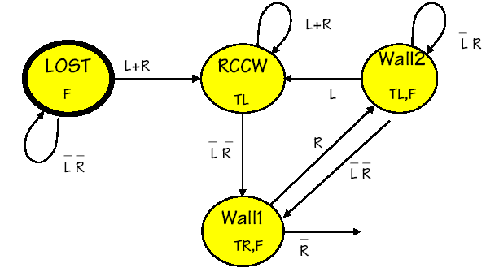
Then a little to the left
Action: step and turn left a little, until not touching
20: CAMs, ROMs, and PLAs

Slide 21
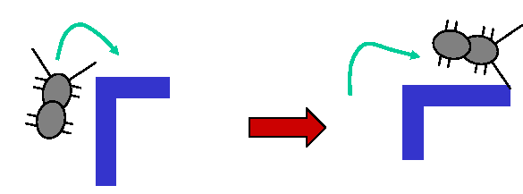
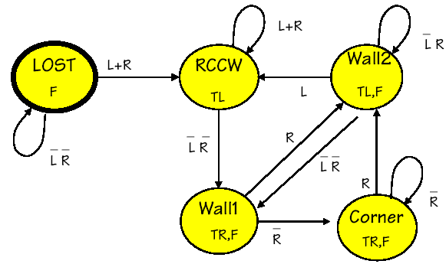
Whoops – a corner!
Action: step and turn right until hitting next wall
20: CAMs, ROMs, and PLAs

Slide 22
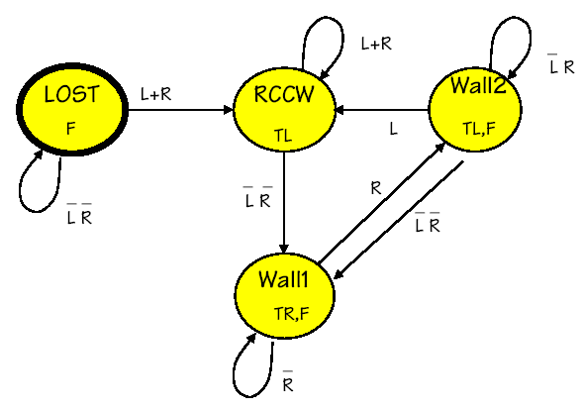
Simplification
Merge equivalent states where possible
20: CAMs, ROMs, and PLAs

Slide 23
State Transition Table
S_{1:0} | L | R | S_{1:0}’ | TR | TL | F
00 | 0 | 0 | 00 | 0 | 0 | 1
00 | 1 | X | 01 | 0 | 0 | 1
00 | 0 | 1 | 01 | 0 | 0 | 1
01 | 1 | X | 01 | 0 | 1 | 0
01 | 0 | 1 | 01 | 0 | 1 | 0
01 | 0 | 0 | 10 | 0 | 1 | 0
10 | X | 0 | 10 | 1 | 0 | 1
10 | X | 1 | 11 | 1 | 0 | 1
11 | 1 | X | 01 | 0 | 1 | 1
11 | 0 | 0 | 10 | 0 | 1 | 1
11 | 0 | 1 | 11 | 0 | 1 | 1
Lost
RCCW
Wall1
Wall2
20: CAMs, ROMs, and PLAs

Slide 24
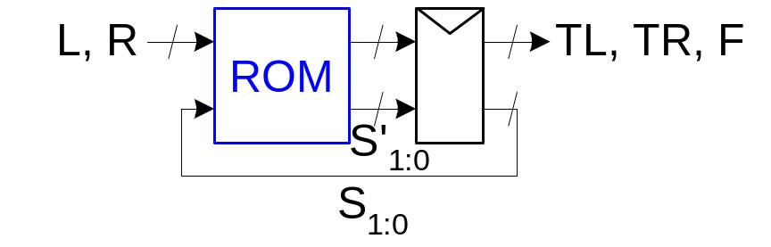
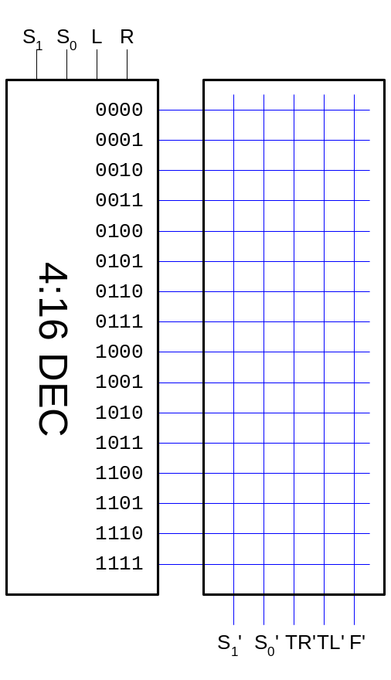
ROM Implementation
16-word x 5 bit ROM
20: CAMs, ROMs, and PLAs

Slide 25
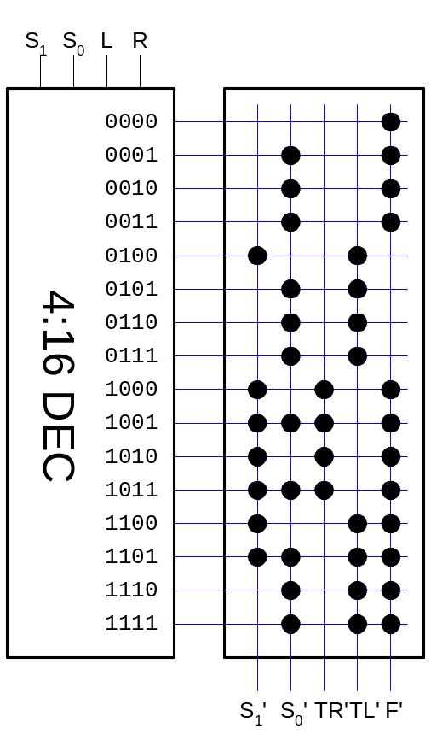
ROM Implementation
16-word x 5 bit ROM
20: CAMs, ROMs, and PLAs

Slide 26
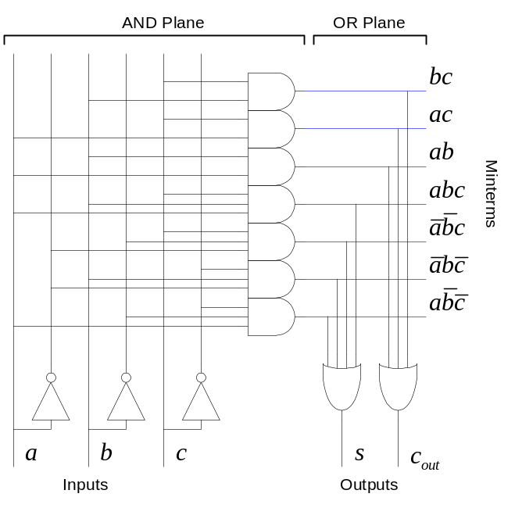
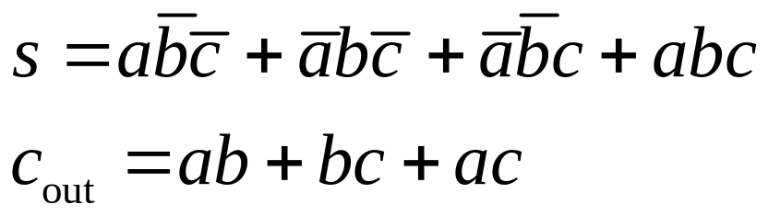
PLAs
A Programmable Logic Array performs any function in sum-of-products form.
Literals: inputs & complements
Products / Minterms: AND of literals
Outputs: OR of Minterms
Example: Full Adder
20: CAMs, ROMs, and PLAs

Slide 27
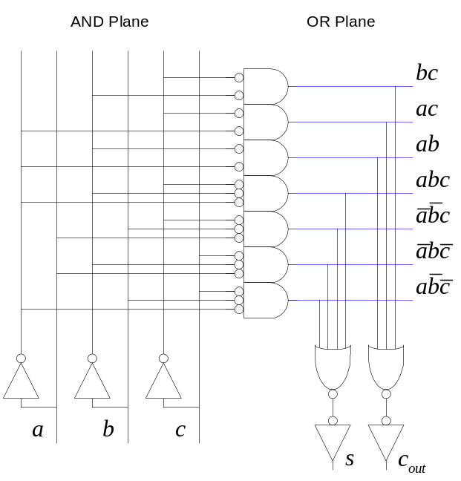
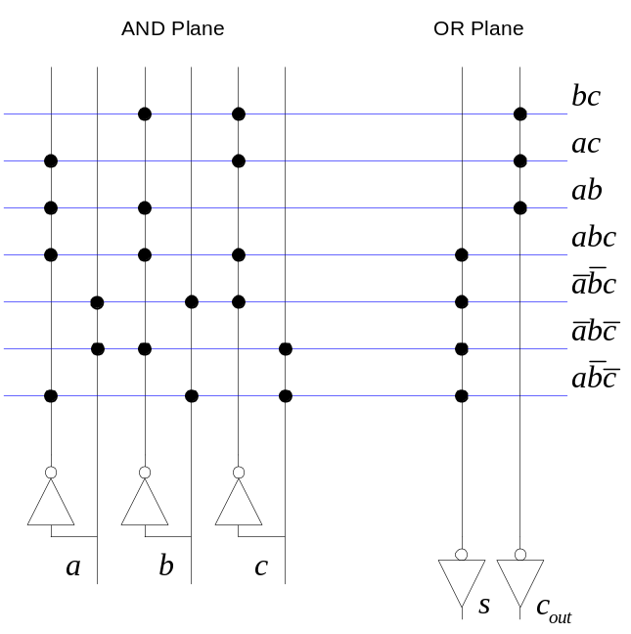
NOR-NOR PLAs
ANDs and ORs are not very efficient in CMOS
Dynamic or Pseudo-nMOS NORs are very efficient
Use DeMorgan’s Law to convert to all NORs
20: CAMs, ROMs, and PLAs

Slide 28
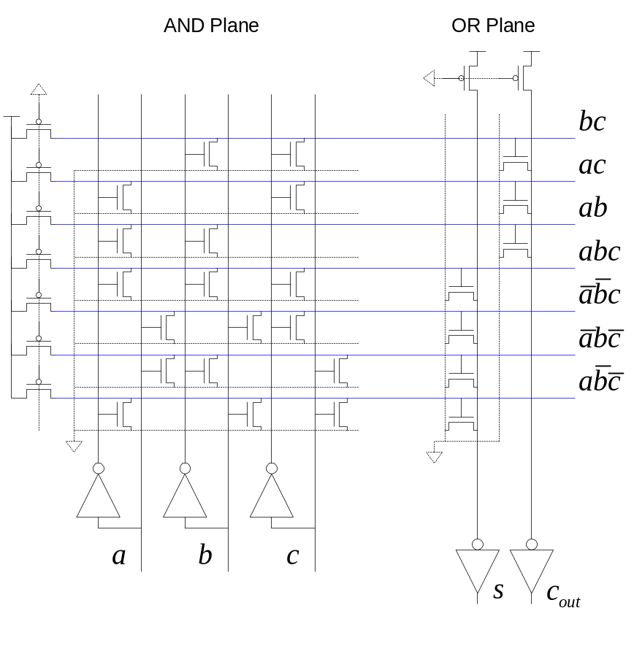
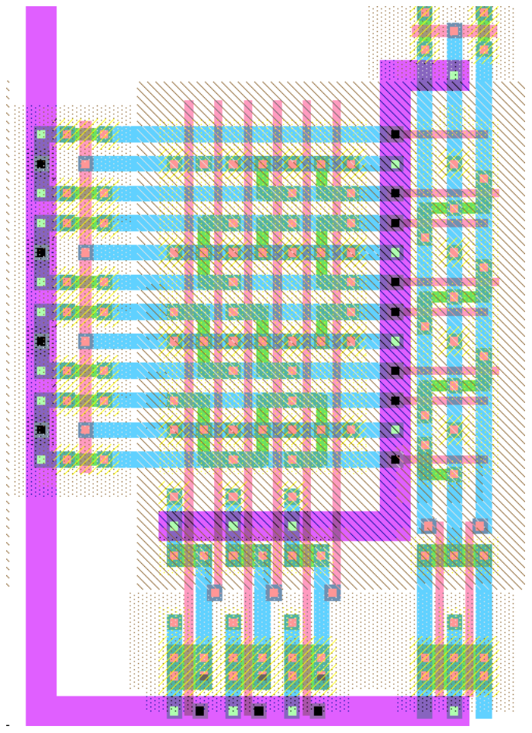
PLA Schematic & Layout
20: CAMs, ROMs, and PLAs

Slide 29
PLAs vs. ROMs
The OR plane of the PLA is like the ROM array
The AND plane of the PLA is like the ROM decoder
PLAs are more flexible than ROMs
  No need to have 2^{n} rows for n inputs
  Only generate the minterms that are needed
  Take advantage of logic simplification
20: CAMs, ROMs, and PLAs

Slide 30
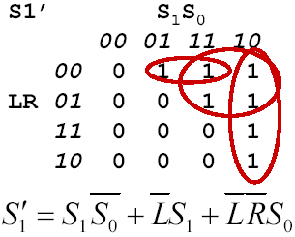
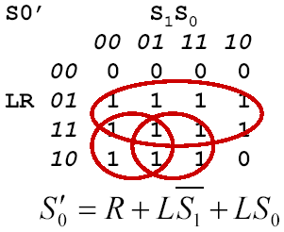
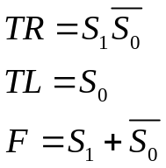
Example: RoboAnt PLA
Convert state transition table to logic equations
S_{1:0} | L | R | S_{1:0}’ | TR | TL | F
00 | 0 | 0 | 00 | 0 | 0 | 1
00 | 1 | X | 01 | 0 | 0 | 1
00 | 0 | 1 | 01 | 0 | 0 | 1
01 | 1 | X | 01 | 0 | 1 | 0
01 | 0 | 1 | 01 | 0 | 1 | 0
01 | 0 | 0 | 10 | 0 | 1 | 0
10 | X | 0 | 10 | 1 | 0 | 1
10 | X | 1 | 11 | 1 | 0 | 1
11 | 1 | X | 01 | 0 | 1 | 1
11 | 0 | 0 | 10 | 0 | 1 | 1
11 | 0 | 1 | 11 | 0 | 1 | 1
20: CAMs, ROMs, and PLAs

Slide 31
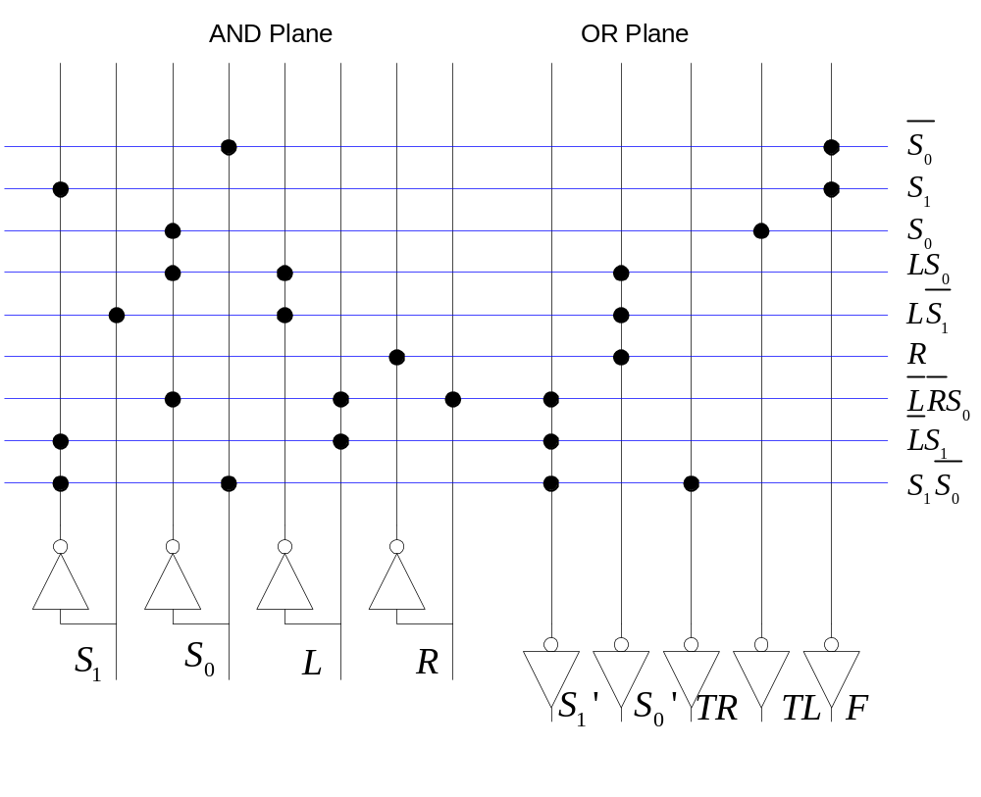
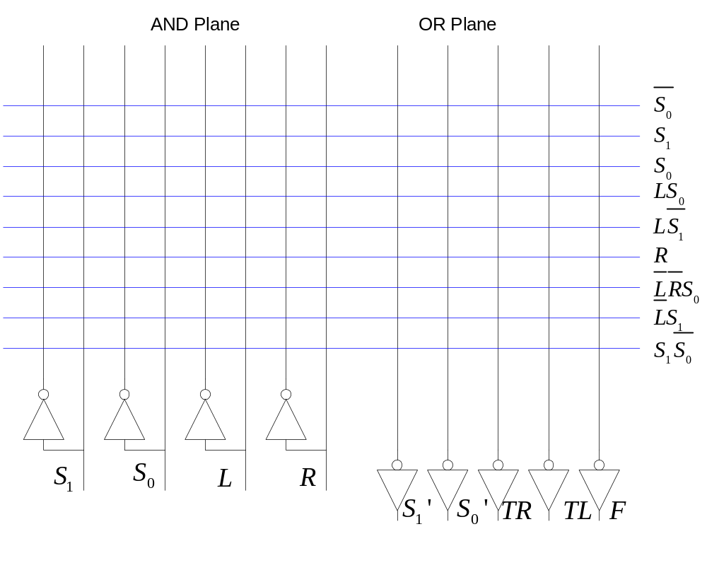
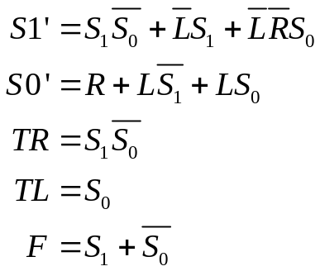
RoboAnt Dot Diagram
20: CAMs, ROMs, and PLAs

