Slide 1

Lecture 22:
PLLs and DLLs

Slide 2
Outline
Clock System Architecture
Phase-Locked Loops
Delay-Locked Loops
22: PLLs and DLLs

Slide 3
Clock Generation
Low frequency:
  Buffer input clock and drive to all registers
High frequency
  Buffer delay introduces large skew relative to input clocks
    Makes it difficult to sample input data
  Distributing a very fast clock on a PCB is hard
22: PLLs and DLLs

Slide 4
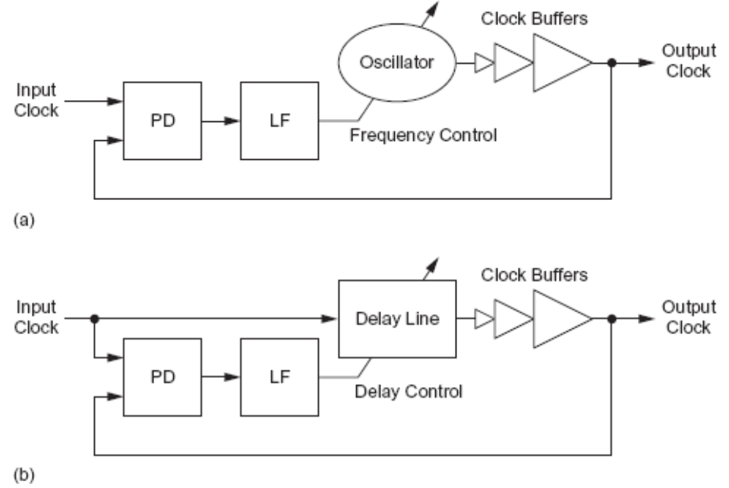
Zero-Delay Buffer
If the periodic clock is delayed by T_{c}, it is indistinguishable from the original clock
Build feedback system to guarantee this delay
Phase-Locked
Loop (PLL)
Delay-Locked
Loop (DLL)
22: PLLs and DLLs

Slide 5
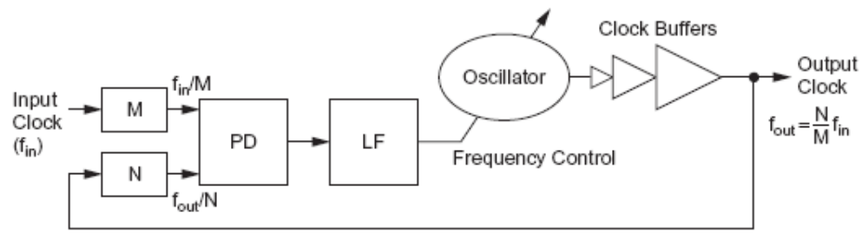
Frequency Multiplication
PLLs can multiply the clock frequency
  Distribute a lower frequency on the board
  Multiply it up on-chip
  Possible to adjust the frequency on the fly
22: PLLs and DLLs

Slide 6
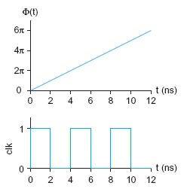
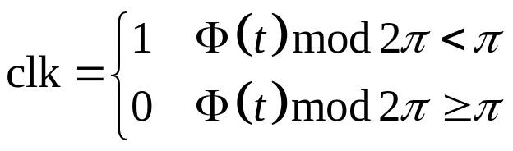
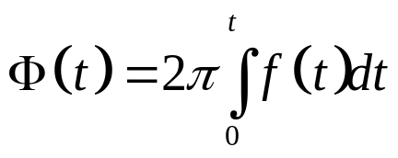
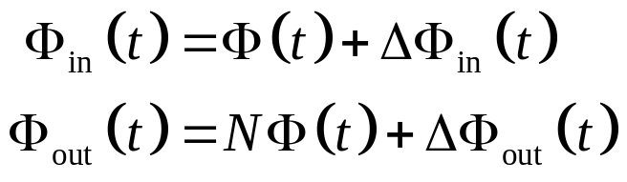
Phase and Frequency
Analyze PLLs and DLLs in term of phase Φ(t) rather than voltage v(t)
Input and output clocks may
deviate from locked phase
  Small signal analysis
22: PLLs and DLLs

Slide 7
Linear System Model
Treat PLL/DLL as a linear system
  Compute deviation ΔΦ from locked position
  Assume small deviations from locked
  Treat system as linear for these small changes
Analysis is not valid far from lock
  e.g. during acquisition at startup
Continuous time assumption
  PLL/DLL is really a discrete time system
    Updates once per cycle
  If the bandwidth << 1/10 clock freq, treat as continuous
Use Laplace transforms and standard analysis of linear continuous-time feedback control systems
22: PLLs and DLLs

Slide 8
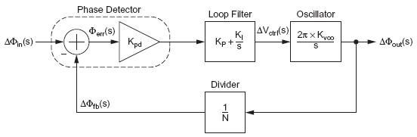
Phase-Locked Loop (PLL)
System
Linear Model
22: PLLs and DLLs

Slide 9
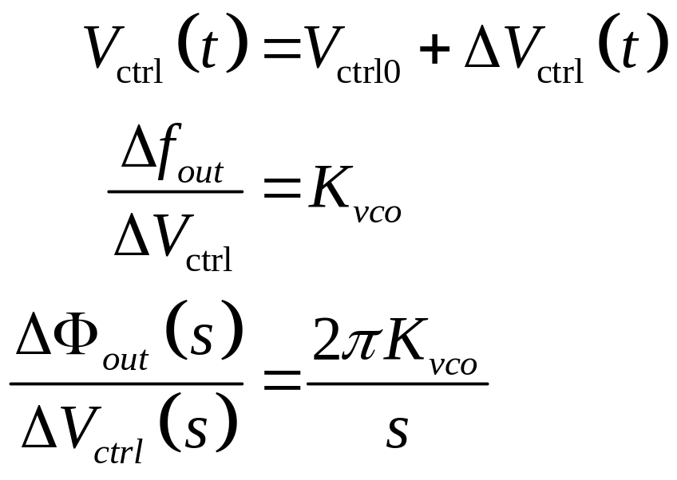
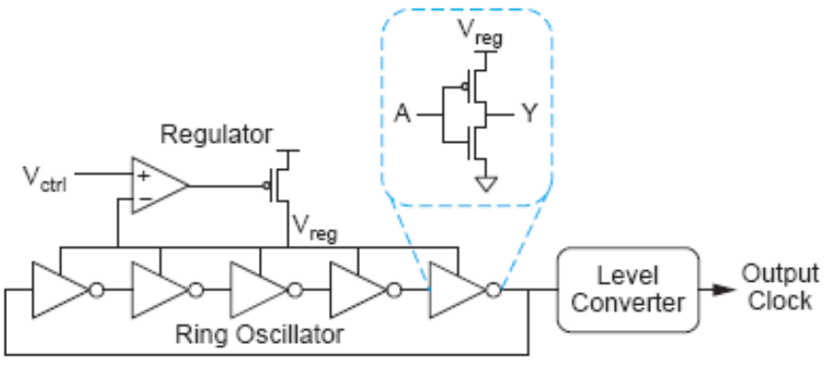
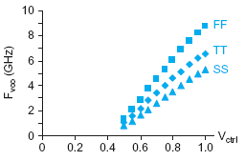
Voltage-Controlled Oscillator
VCO
-
+
22: PLLs and DLLs

Slide 10
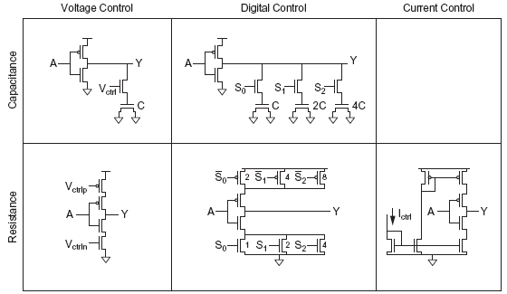
Alternative Delay Elements
22: PLLs and DLLs

Slide 11
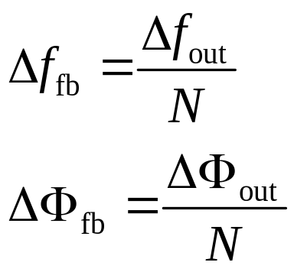
Frequency Divider
Divide clock by N
  Use mod-N counter
22: PLLs and DLLs

Slide 12
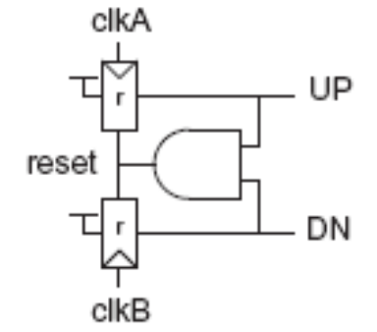
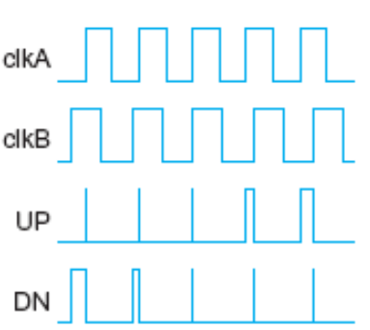
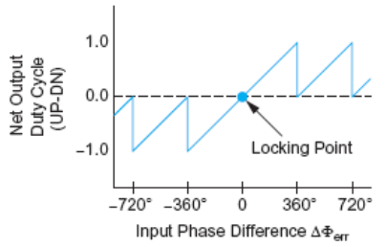
Phase Detector
Difference of input and
feedback clock phase
Often built from phase-frequency detector (PFD)
22: PLLs and DLLs

Slide 13
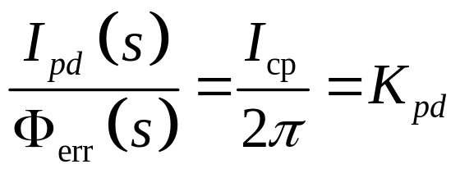
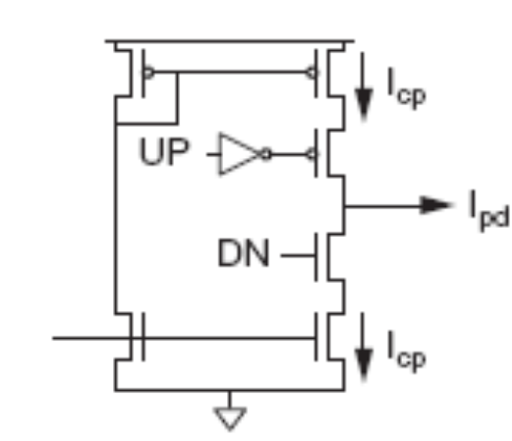
Phase Detector
Convert up and down pulses into current proportional to phase error using a charge pump
22: PLLs and DLLs

Slide 14
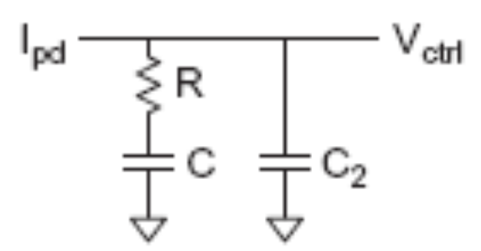
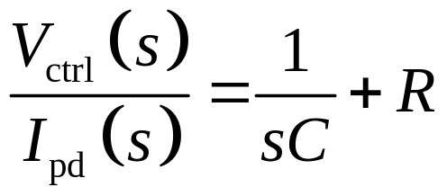
Loop Filter
Convert charge pump
current into V_{ctrl}
Use proportional-integral control (PI) to generate a control signal dependent on the error and its integral
  Drives error to 0
(negligible)
22: PLLs and DLLs

Slide 15
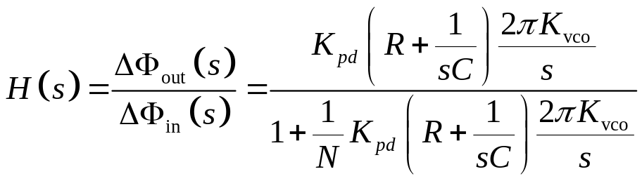
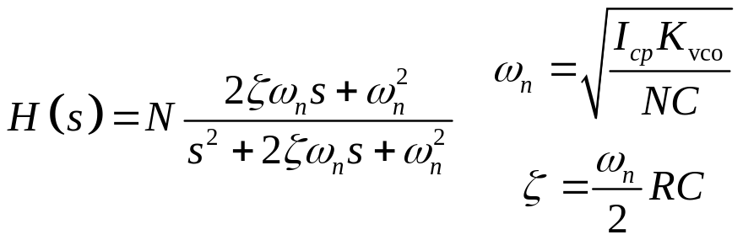
PLL Loop Dynamics
Closed loop transfer function of PLL
This is a second order system
ω_{n} indicates loop bandwidth
ζ indicates damping; choose 0.7 – 1 to avoid ringing
22: PLLs and DLLs

Slide 16
Delay Locked Loop
Delays input clock rather than creating a new clock with an oscillator
Cannot perform frequency multiplication
More stable and easier to design
  1st order rather than 2nd
State variable is now time (T)
  Locks when loop delay is exactly T_{c}
  Deviations of ΔT from locked value
22: PLLs and DLLs

Slide 17
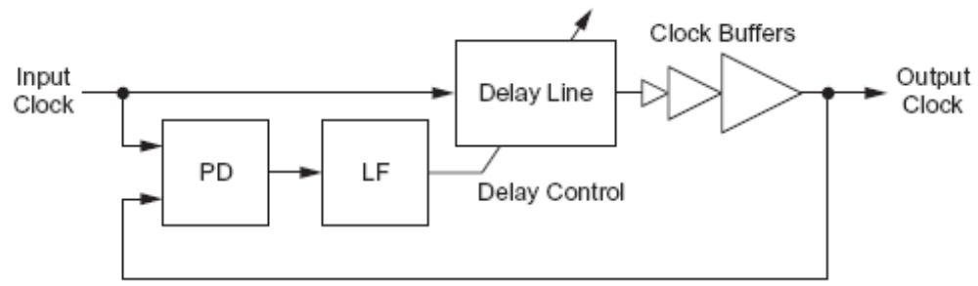
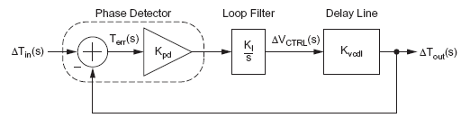
Delay-Locked Loop (DLL)
System
Linear Model
22: PLLs and DLLs

Slide 18
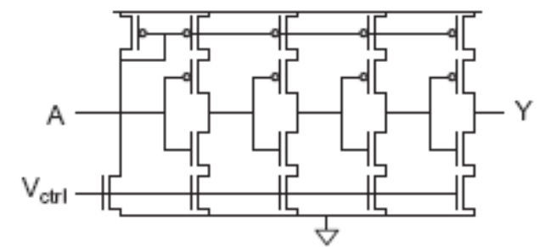
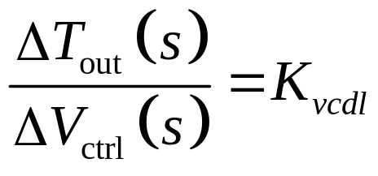
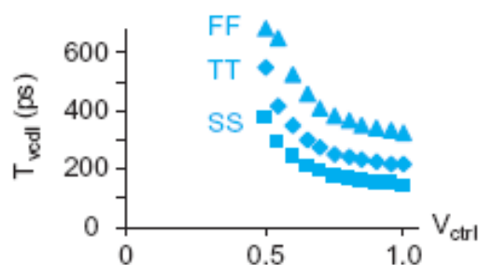
Delay Line
Delay input clock
Typically use voltage-controlled delay line
22: PLLs and DLLs

Slide 19
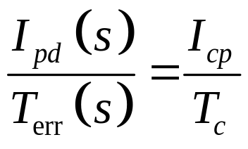
Phase Detector
Detect phase error
Typically use PFD and charge pump, as in PLL
22: PLLs and DLLs

Slide 20
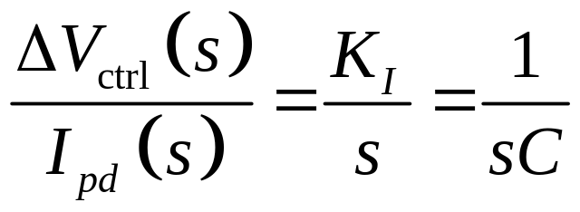
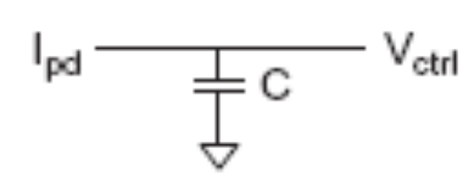
Loop Filter
Convert error current
into control voltage
Integral control is sufficient
Typically use a capacitor as the loop filter
22: PLLs and DLLs

Slide 21
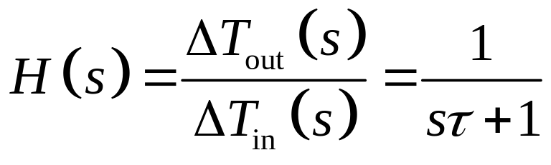
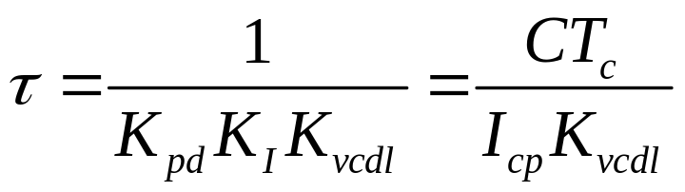
DLL Loop Dynamics
Closed loop transfer function of DLL
This is a first order system
τ indicates time constant (inverse of bandwidth)
  Choose at least 10T_{c} for continuous time approx.
22: PLLs and DLLs

