Slide 1
Fake News Detection A deep learning cnn-rnn hybrid model National Institute of Technology Karnataka, Surathkal
Team: Akshay Dhayal, 181CO105 Pintu, 181CO139

Slide 2
Introduction
Internet is full of information/news/tweets/post/articles.
No tool/mechanism to differentiate the fake and genuine.
Deep learning model can be created to filter fake news.
Convolutional-concurrent Hybrid approach is followed by us.

Slide 3
Dataset used
Taken from Kaggle.
Consists of 4 columns: title, author, text and label.
We used 2 columns: text and label.
Text language: English
Label: Binary (0 and 1).

Slide 4
Preprocessing
Delete rows with missing values.
Splitting dataset into (training, validating) and testing.
Training=60%, validation=20% and testing=20%
Tokenizing the training set.
Converting text to sequences.
Pad sequencing.

Slide 5
Word embedding
Every word of glove file is searched in the vocab dictionary.
If word found; its index is copied.
The dense vector of that word from glove is placed in embed_matrix at that index.
Total comparison = |glove file| * |vocab|

Slide 6
Model
Embedding layer
Convolutional layer: 128 neurons, filter size = 5
Pooling layer: filter size = 2
LSTM layer: 32 cells
Dense layer: 1 neuron
Optimizer: adam
Loss: binary_crossentropy
Metric: accuray

Slide 7
Training
Training set: x_train, y_train
Epochs= 10 & 12
Validation set: x_valid, y_valid
Batch_size = 64
Training time= 15 minutes.

Slide 8
Saving the model
Model.save(‘my_model.h5’)
Pickle the history
Pickle the x_test and y_test.
Pickling: create a new pickle file with writing mode.
Dump function is used.

Slide 9
Testing
The saved files are loaded: history, x_test, y_test, model.
Model is tested against x_test and y_test.
Performance measure:
Confusion matrix
Classification report
Accuracy= approx. 95% for 3 different executions.

Slide 10
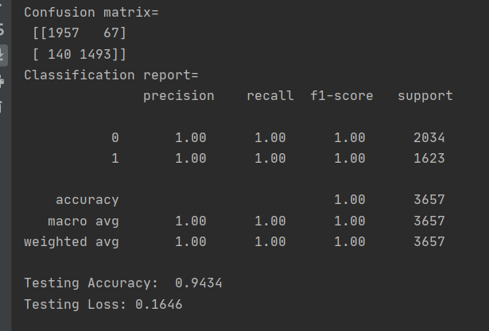
CM & CR

Slide 11
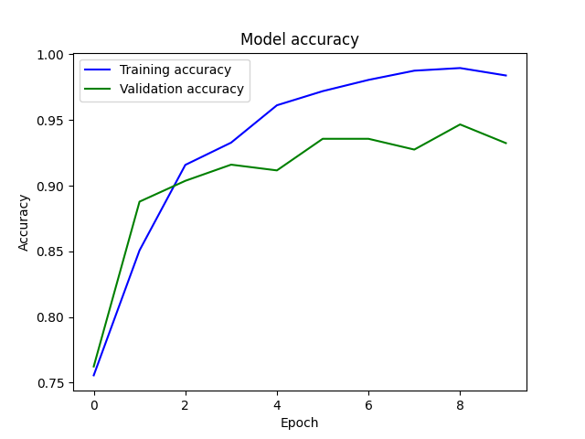
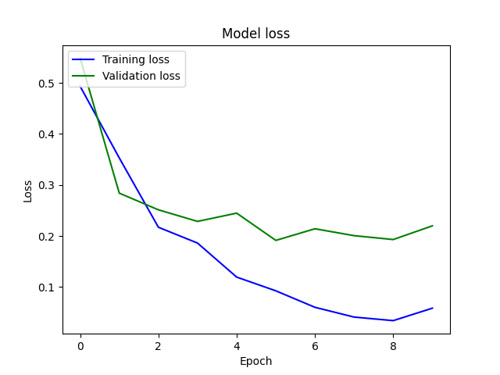
Output of execution_1

Slide 12
.
THANK YOU

