Slide 1
Test Automation using Selenium

Slide 2


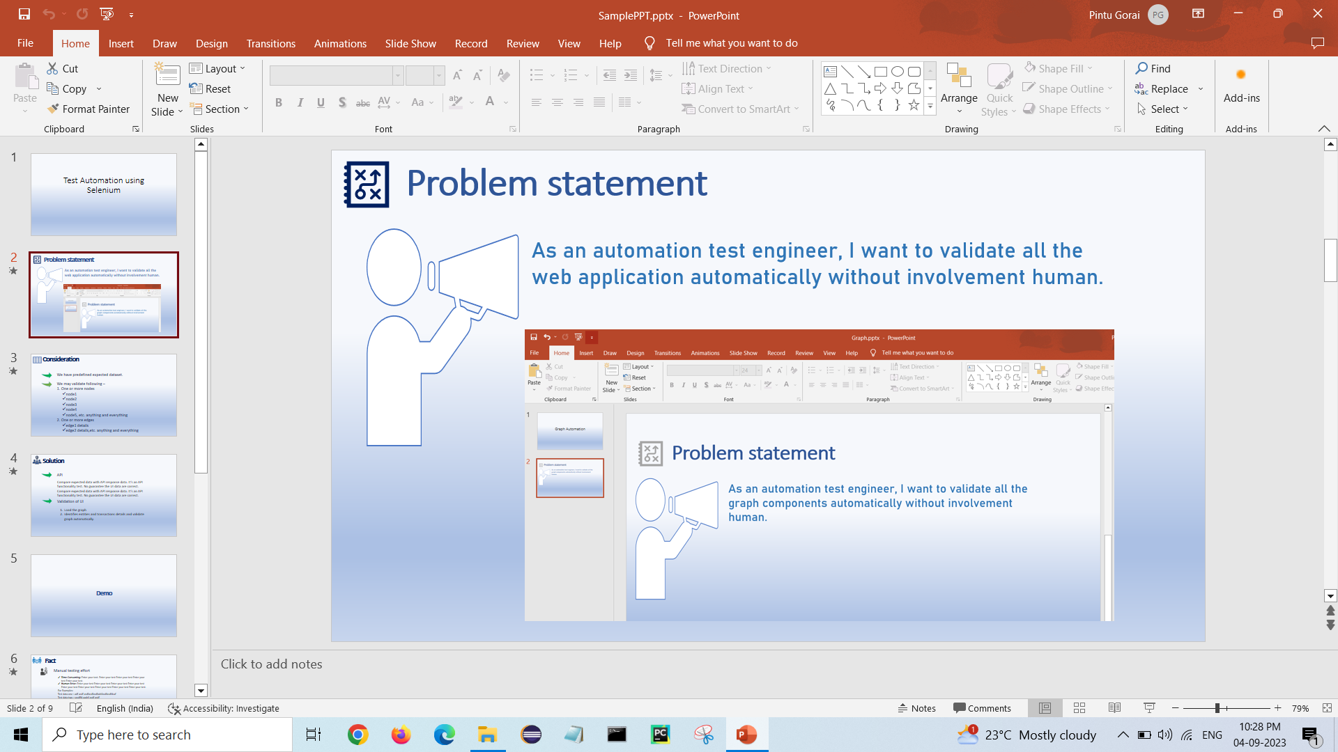
Problem statement
As an automation test engineer, I want to validate all the web application automatically without involvement human.

Slide 3



Consideration
We have predefined expected dataset.
We may validate following – 1. One or more nodes
node1
node2
node3
node4
node5, etc. anything and everything
2. One or more edges
edge1 details
edge2 details,etc. anything and everything

Slide 4

Solution
API
Compare expected data with API response data. It’s an API functionality test. No guarantee the UI data are correct. Compare expected data with API response data. It’s an API functionality test. No guarantee the UI data are correct.
Validation of UI
Load the application.
Identifies elements and fields details and validate it automatically.

Slide 5
Demo

Slide 6



Fact
Manual testing effort
Time-Consuming: Enter your test. Enter your test Enter your test Enter your test Enter your test.
Human Error: Enter your test Enter your test Enter your test Enter your test Enter your test Enter your test Enter your test Enter your test Enter your test.
For Examples:
Test data one : adf asdf asdfasdfasdfadsfasdfasdfdsaf
Test data two : sasdffd aadsf asdf asdf
Test data three : Enter your test
Automation test benefit
Faster and cost-effective
Improve Accuracy
Report
BCT

Slide 7


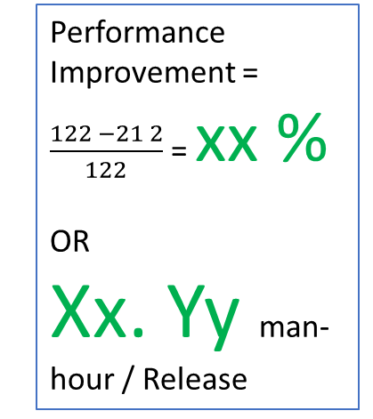
Performance Improvement: Success Story
Save 99% manual execution or 80 man-hour/Regression Cycle per release.
Manual execution time(per cycle)
Point one
Point two
Point three
Point four
Point five
Point six, en adfadf adsf adsf asdfasdf adsfasdf asdfasdf asdfasdfasdfadsfasdf adsfasdf a adsf
Performance Improvement = $\frac{122 −21 2}{122}$ = xx %
OR
Xx. Yy man-hour / Release
Automation Execution time(per cycle)
Faster and cost-effective
Improve Accuracy
Report
BCT
Five
Six adfasdfadf a dfasd fadsf asdf asdfa sdasdf asdf asdfasdf asdf asdf asdf asd fasd

Slide 8


Benefit
Eventually you can save xx – yy = zz hours on a single 24 hours business case.

Slide 9


