Slide 1
The Battle with Neighborhoods
Capstone Data Science

Slide 2
Restaurant recommending system
APPLIED DATA Science Capstone project

Slide 3
Methodology
Recommending System
Machine learning
Exploratory analysis
Inferential analysis

Slide 4
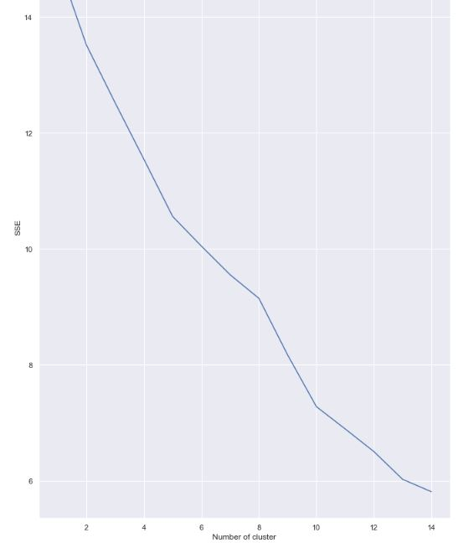

Slide 5
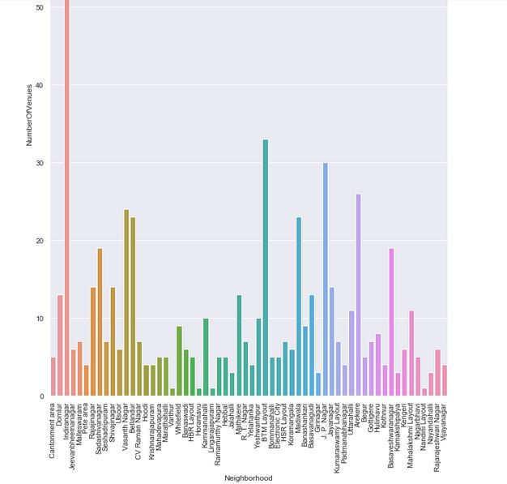

Slide 6
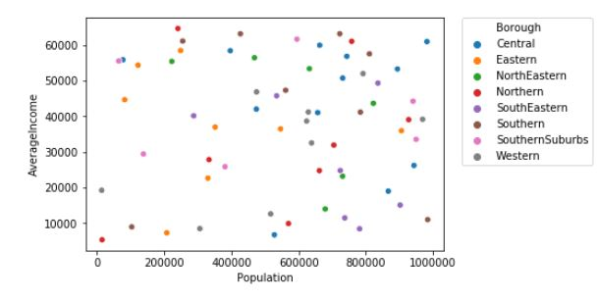

Slide 7
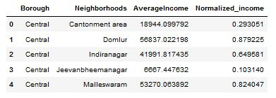
Datasets

Slide 8
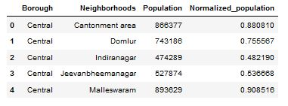

Slide 9
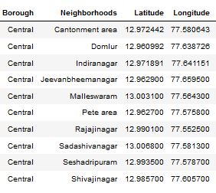

Slide 10
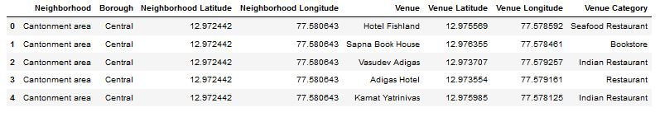

Slide 11
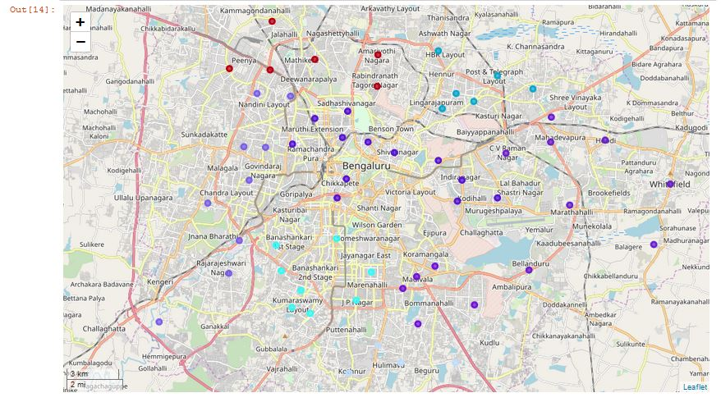
Mapping and clustering

Slide 12
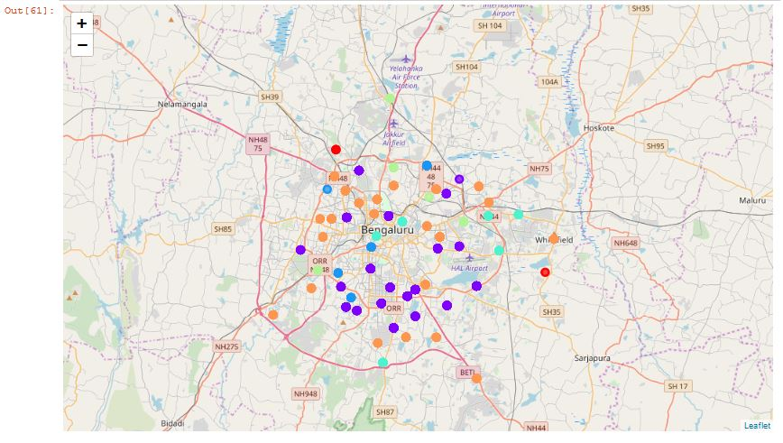

Slide 13
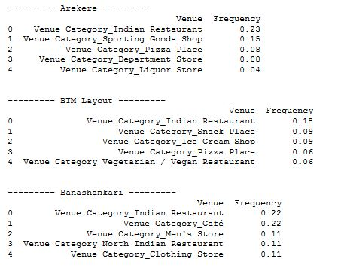
Results and conclusion

