Slide 1
OLA Ride Insights Dashboard
Subtitle: Data Analysis using Power BI & Python
Name: Nivedita Das

Slide 2
Project Overview
Ola Ride Insights analyzes ride-sharing data to extract meaningful business insights.
Tools: SQL, Power BI, Streamlit, Python.

Slide 3
Objectives
• Analyze ride patterns
• Improve customer satisfaction
• Optimize driver allocation
• Identify revenue trends

Slide 4
Data Processing
Data Cleaning
Data Preprocessing
Handling missing values
Feature Engineering
Data transformation

Slide 5


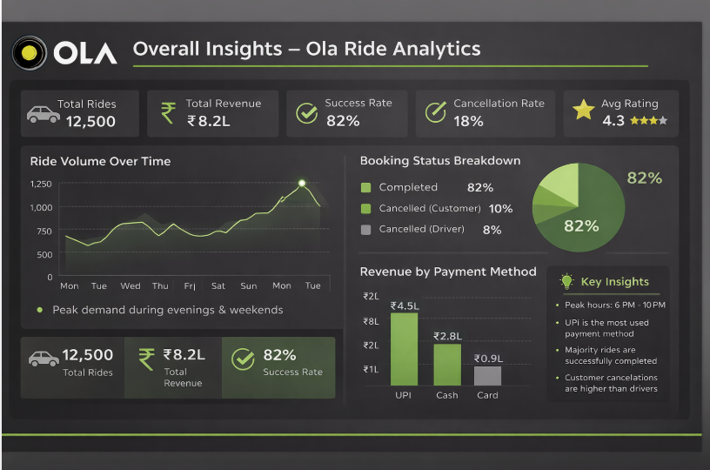





Overall
Vehicle Type
Revenue
Cancellation
Ratings

Slide 6










Vehicle Type | Total Booking Value | Success Booking Value | Avg. Distance Travelled | Total Distance Travelled
Prime Sedan | ₹ 3.2L | ₹ 2.6L | 12.4 km | 65K
Prime SUV | ₹ 2.8L | ₹ 2.2L | 14.8 km | 52K
Prime Plus | ₹ 2.1L | ₹ 1.7L | 10.5 km | 45K
Mini | ₹ 1.8L | ₹ 1.5L | 8.9 km | 42K
Auto | ₹ 1.1L | ₹ 0.9L | 5.4 km | 22K
Bike | ₹ 0.8L | ₹ 0.6L | 6.7 km | 15K
E-Bike | ₹ 0.4L | ₹ 0.3L | 4.2 km | 8K
Overall
Vehicle Type
Revenue
Cancellation
Ratings

Slide 7
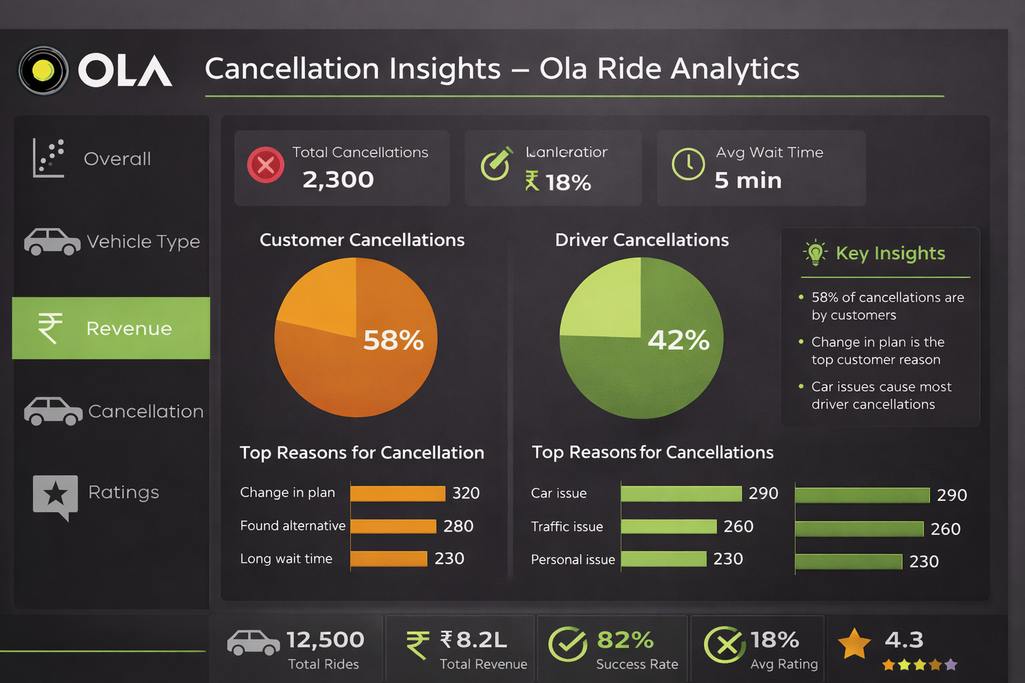

Overall
Vehicle Type
Revenue
Cancellation
Ratings

Slide 8
SQL Analysis
• Retrieve successful bookings
• Analyze cancellations
• Customer & driver insights
• Revenue calculations

Slide 9
Dashboard Insights
• Ride volume trends
• Revenue by payment method
• Ratings distribution
• Cancellation reasons

Slide 10
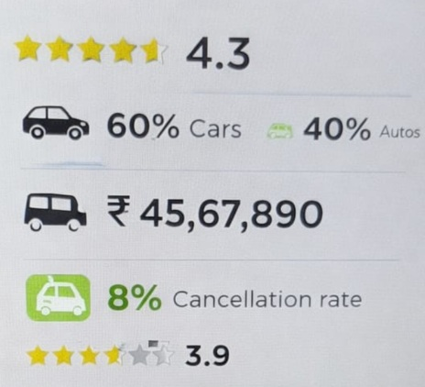
Overall
Vehicle Type
Revenue
Cancellation
Ratings

Slide 11
Business Insights
• Peak demand hours identified
• Pricing strategy optimization
• Customer behavior patterns
• Improved operational efficiency

Slide 12
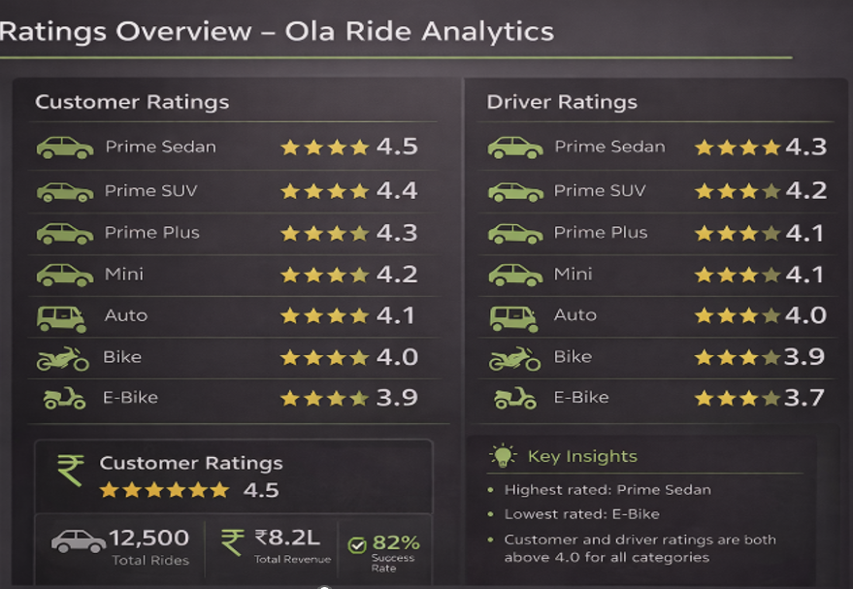

Overall
Vehicle Type
Revenue
Cancellation
Ratings

Slide 13
CONCLUSION
This study shows how ride data may be converted into useful insights by using:
Python (Data Analysis)
Power BI (Visualization)
It enhances:
1. Efficiency of operations
2. Client contentment
3. Optimization of revenue
This project demonstrates end-to-end analytics from raw data to business insights using modern data tools.

