Slide 1
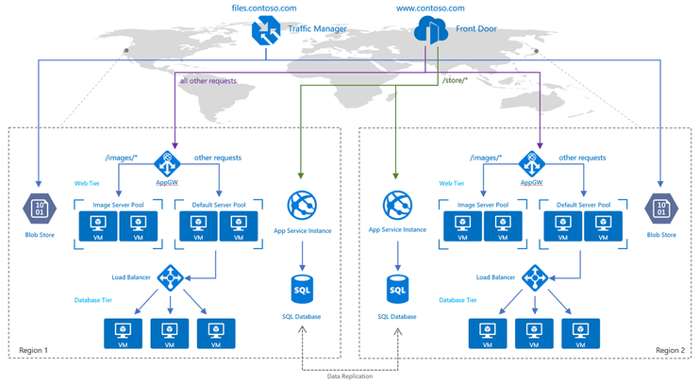
Azure Networking
Azure Virtual Network (VNet) is the fundamental building block for your private network in Azure.
ExpressRoute enables you to extend your on-premises networks into the Microsoft cloud over a private connection facilitated by a connectivity provider.
VPN Gateway helps you create encrypted cross-premises connections to your virtual network from on-premises locations, or create encrypted connections between VNets.
Azure Virtual WAN is a networking service that provides optimized and automated branch connectivity to, and through, Azure.
Azure DNS is a hosting service for DNS domains that provides name resolution by using Microsoft Azure infrastructure.
The Azure Bastion service is a new fully platform-managed PaaS service that you provision inside your virtual network.
Virtual Network NAT (network address translation) simplifies outbound-only Internet connectivity for virtual networks.
Azure Peering service enhances customer connectivity to Microsoft cloud services such as Microsoft 365, Dynamics 365, software as a service (SaaS) services, Azure, or any Microsoft services accessible via the public internet.
Azure Edge Zone is a family of offerings from Microsoft Azure that enables data processing close to the user.
Azure DDoS Protection provides countermeasures against the most sophisticated DDoS threats.
Azure Private Link enables you to access Azure PaaS Services (for example, Azure Storage and SQL Database) and Azure hosted customer-owned/partner services over a private endpoint in your virtual network.
Azure Firewall is a managed, cloud-based network security service that protects your Azure Virtual Network resources.
Azure Web Application Firewall (WAF) provides protection to your web applications from common web exploits and vulnerabilities such as SQL injection, and cross site scripting.
You can filter network traffic to and from Azure resources in an Azure virtual network with a network security group.
Virtual Network (VNet) service endpoints extend your virtual network private address space and the identity of your VNet to the Azure services, over a direct connection.
Azure Content Delivery Network (CDN) offers developers a global solution for rapidly delivering high-bandwidth content to users by caching their content at strategically placed physical nodes across the world.
Azure Traffic Manager is a DNS-based traffic load balancer that enables you to distribute traffic optimally to services across global Azure regions, while providing high availability and responsiveness.
The Azure Load Balancer provides high-performance, low-latency Layer 4 load-balancing for all UDP and TCP protocols.
Azure Application Gateway is a web traffic load balancer that enables you to manage traffic to your web applications.
https://docs.microsoft.com/en-us/azure/networking/fundamentals/networking-overview

Slide 2
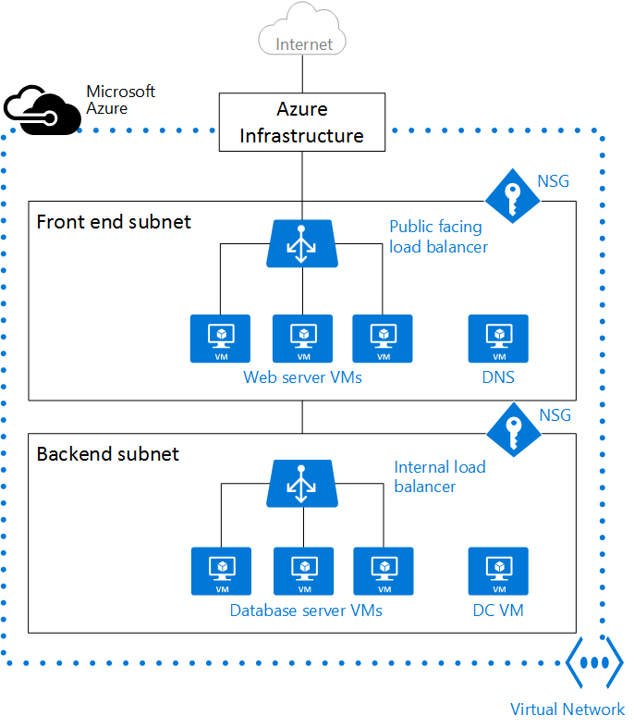
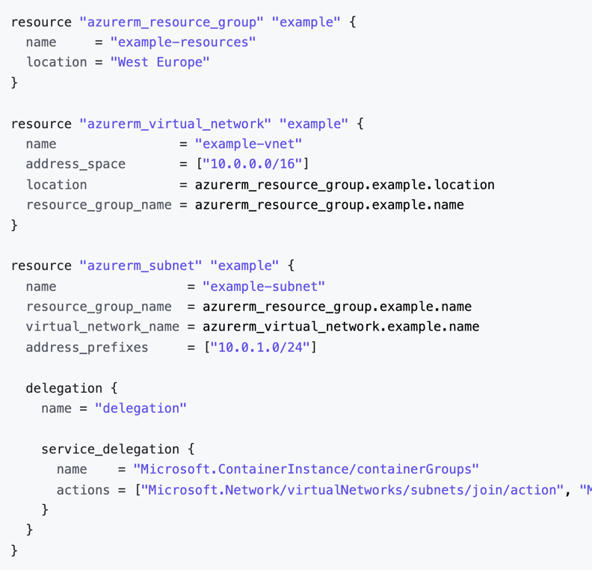
Azure Virtual Network (VNet & Subnet)
Address space: When creating a VNet, you must specify a custom private IP address space using public and private (RFC 1918) addresses. Azure assigns resources in a virtual network a private IP address from the address space that you assign. For example, if you deploy a VM in a VNet with address space, 10.0.0.0/16, the VM will be assigned a private IP like 10.0.0.4.
Subnets: Subnets enable you to segment the virtual network into one or more sub-networks and allocate a portion of the virtual network's address space to each subnet. You can then deploy Azure resources in a specific subnet. Just like in a traditional network, subnets allow you to segment your VNet address space into segments that are appropriate for the organization's internal network. This also improves address allocation efficiency. You can secure resources within subnets using Network Security Groups. For more information, see Network security groups.
Regions: VNet is scoped to a single region/location; however, multiple virtual networks from different regions can be connected together using Virtual Network Peering.
Subscription: VNet is scoped to a subscription. You can implement multiple virtual networks within each Azure subscription and Azure region.
https://docs.microsoft.com/en-us/azure/virtual-network/concepts-and-best-practices
https://docs.microsoft.com/en-us/azure/virtual-network/virtual-networks-overview
https://docs.microsoft.com/en-us/azure/virtual-network/virtual-networks-udr-overview
https://registry.terraform.io/providers/hashicorp/azurerm/latest/docs/resources/virtual_network
https://registry.terraform.io/providers/hashicorp/azurerm/latest/docs/resources/subnet

Slide 3
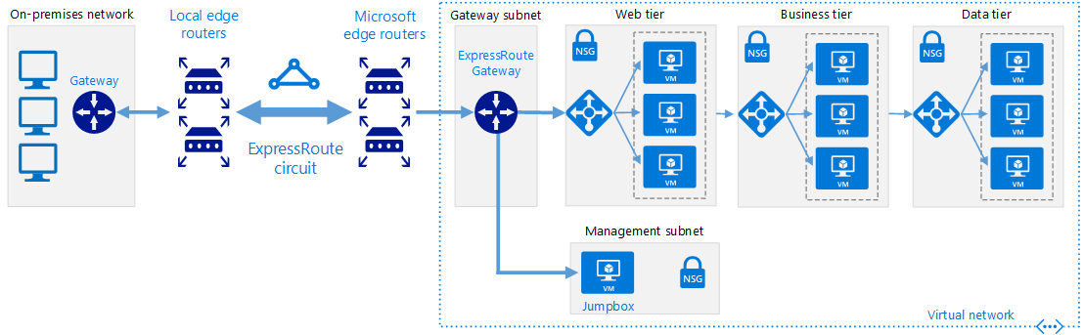
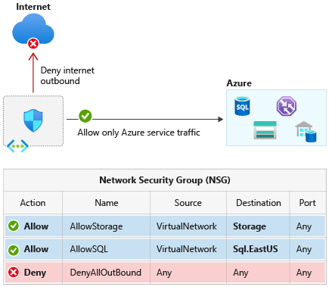
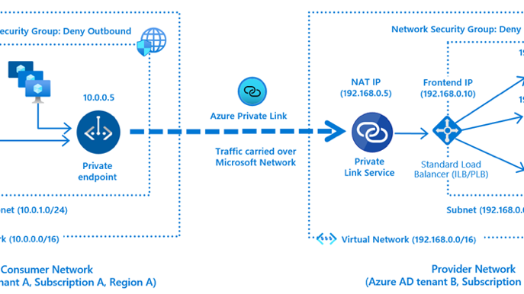
Network Security Groups & Application Security Groups
A service tag represents a group of IP address prefixes from agiven Azure service.
Network Security Group | DENYALLINBOUND
 | Priority | Source | Source ports | Destination | Destination ports | Protocol | Access
 | 65500 | 0.0.0.0/0 | 0-65535 | 0.0.0.0/0 | 0-65535 | Any | Deny
 | ALLOWVNETINBOUND
 | Priority | Source | Source ports | Destination | Destination ports | Protocol | Access
 | 65000 | VirtualNetwork | 0-65535 | VirtualNetwork | 0-65535 | Any | Allow
 | DENYALLOUTBOUND
 | Priority | Source | Source ports | Destination | Destination ports | Protocol | Access
 | 65500 | 0.0.0.0/0 | 0-65535 | 0.0.0.0/0 | 0-65535 | Any | Deny
 | ALLOWVNETOUTBOUND
 | Priority | Source | Source ports | Destination | Destination ports | Protocol | Access
 | 65000 | VirtualNetwork | 0-65535 | VirtualNetwork | 0-65535 | Any | Allow
Application Security Group | DENY-DATABASE-ALL
 | Because the AllowVNetInBound default security rule allows all communication between resources in the same virtual network, this rule is needed to deny traffic from all resources.
 | Priority | Source | Source ports | Destination | Destination ports | Protocol | Access
 | 120 | * | * | Data Tier | 1433 | Any | Deny
 | ALLOW-DATABASE-BUSINESSLOGIC
 | This rule allows traffic from the Business Tier application security group to the Data Tier application security group. The priority for this rule is higher than the priority for the Deny-Database-All rule. As a result, this rule is processed before the Deny-Database-All rule, so traffic from the Business Tier application security group is allowed, whereas all other traffic is blocked.
 | Priority | Source | Source ports | Destination | Destination ports | Protocol | Access
 | 110 | Business Tier | * | Data Tier | 1433 | TCP | Allow
Private Link access so that consumers to your service can access it privately from their own VNets behind an Azure Standard Load Balancer
https://docs.microsoft.com/en-us/azure/cloud-adoption-framework/decision-guides/software-defined-network/hybrid
https://registry.terraform.io/providers/hashicorp/azurerm/latest/docs/resources/network_security_group
https://docs.microsoft.com/en-us/azure/virtual-network/network-security-groups-overview
https://docs.microsoft.com/en-us/azure/virtual-network/application-security-groups
https://docs.microsoft.com/en-us/azure/virtual-network/service-tags-overview
https://docs.microsoft.com/en-us/azure/private-link/private-link-service-overview

Slide 4
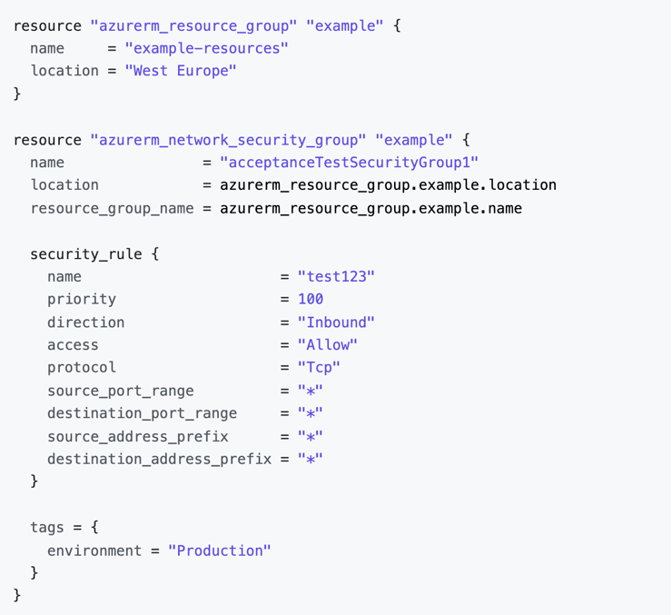
Network Security Groups & Application Security Groups Continued
You can reuse your security policy at scale without manual maintenance of explicit IP addresses.
 | Network Security Group | Application Security Group
Description | A network security group is used to enforce and control network traffic. | An application security group is an object reference within an NSG.
Features | Controls the inbound and outbound traffic at the subnet level. | Controls the inbound and outbound traffic at the network interface level.
Rules | Rules are applied to all resources in the associated subnet. | Rules are applied to all ASGs in the same virtual network.
Direction | Has separate rules for inbound and outbound traffic. | Has separate rules for inbound and outbound traffic.
Limits | NSG has a limit of 1000 rules. | ASGs that can be specified within all security rules of an NSG have a limit of 100 rules.
Action | Supports ALLOW and DENY rules. | Supports ALLOW and DENY rules.
Constraints | You are not allowed to specify multiple IP addresses and IP address ranges in the NSG created by the classic deployment model. | You are not allowed to specify multiple ASGs in the source or destination.
SECURITY RULES
Property | Explanation
Name | A unique name within the network security group.
Priority | A number between 100 and 4096. Rules are processed in priority order, with lower numbers processed before higher numbers, because lower numbers have higher priority. Once traffic matches a rule, processing stops. As a result, any rules that exist with lower priorities (higher numbers) that have the same attributes as rules with higher priorities are not processed.
Source or destination | Any, or an individual IP address, classless inter-domain routing (CIDR) block (10.0.0.0/24, for example), service tag, or application security group. If you specify an address for an Azure resource, specify the private IP address assigned to the resource. Network security groups are processed after Azure translates a public IP address to a private IP address for inbound traffic, and before Azure translates a private IP address to a public IP address for outbound traffic. . Specifying a range, a service tag, or application security group, enables you to create fewer security rules. The ability to specify multiple individual IP addresses and ranges (you cannot specify multiple service tags or application groups) in a rule is referred to as augmented security rules. Augmented security rules can only be created in network security groups created through the Resource Manager deployment model. You cannot specify multiple IP addresses and IP address ranges in network security groups created through the classic deployment model.
Protocol | TCP, UDP, ICMP, ESP, AH, or Any.
Direction | Whether the rule applies to inbound, or outbound traffic.
Port range | You can specify an individual or range of ports. For example, you could specify 80 or 10000-10005. Specifying ranges enables you to create fewer security rules. Augmented security rules can only be created in network security groups created through the Resource Manager deployment model. You cannot specify multiple ports or port ranges in the same security rule in network security groups created through the classic deployment model.
Action | Allow or deny

Slide 5
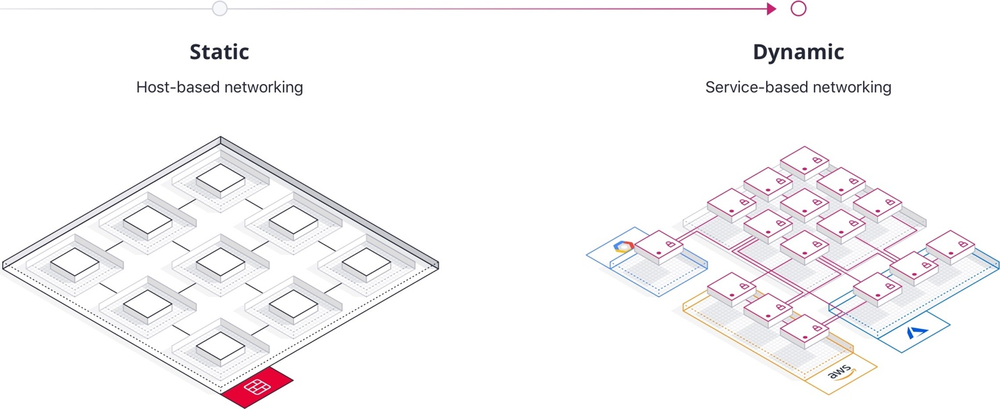
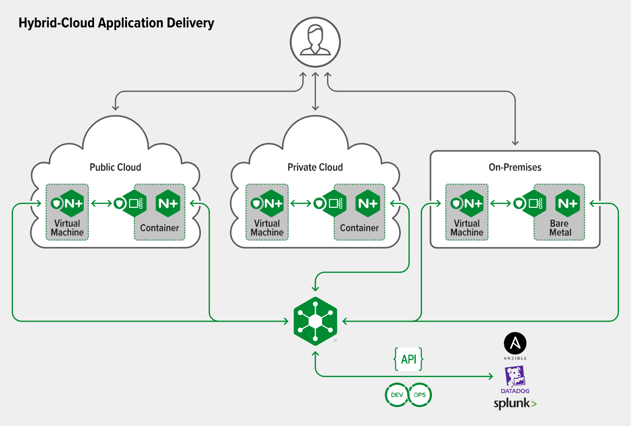
Move to Service Based Networking rather than Host Based Networking
Traditional service-to-service traffic still needs to be routed, and typically load balancers are paired with each service. This results in a proliferation of load balancers, increasing cost and request latency.
As the infrastructure becomes larger and more dynamic, this puts pressure on networking and security teams to keep pace with more changes to load balancers and firewall rules.
A service mesh is a software-driven approach to routing and segmentation. The goal is to solve the networking and security challenges of operating microservices and cloud infrastructure. Service mesh solutions bring additional benefits such as failure handling, retries, and network observability.
https://www.hashicorp.com/resources/service-mesh-microservices-networking
https://www.nginx.com/resources/glossary/multi-hybrid-cloud-strategy/
https://cloud.google.com/architecture/exposing-service-mesh-apps-through-gke-ingress

Slide 6
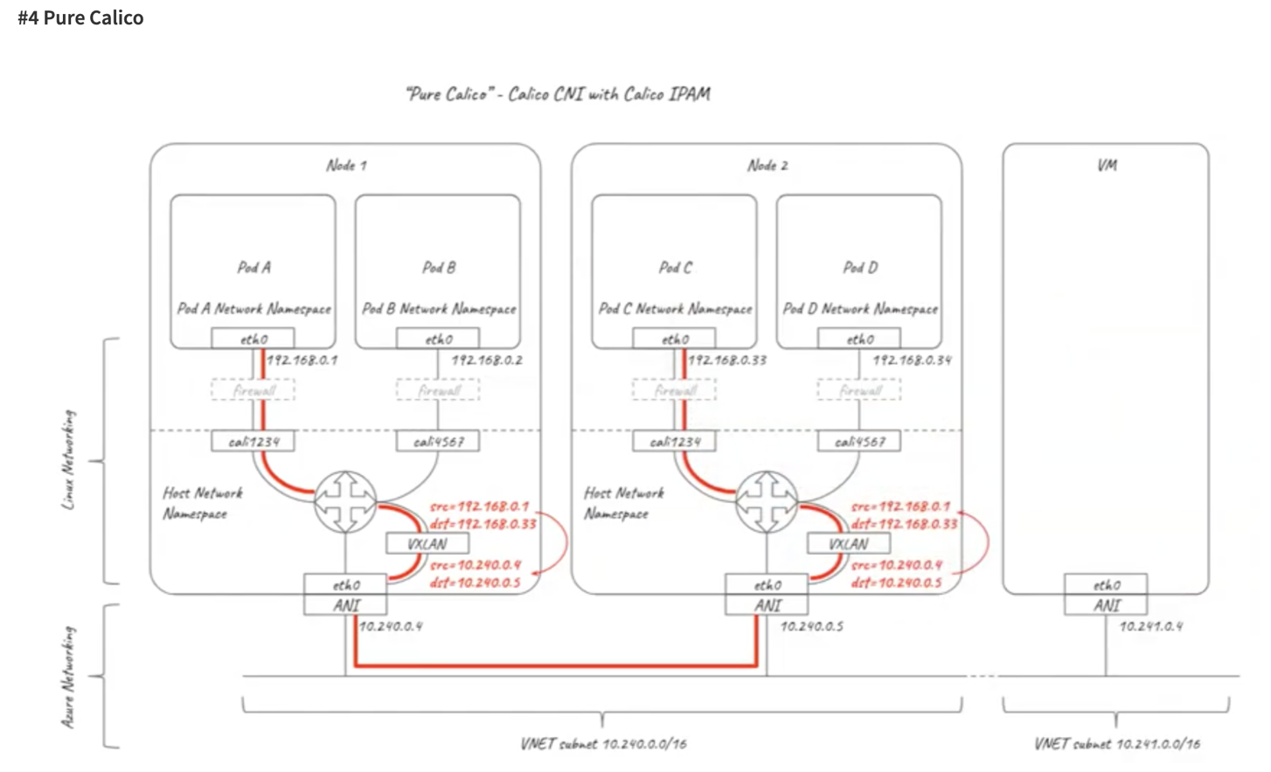
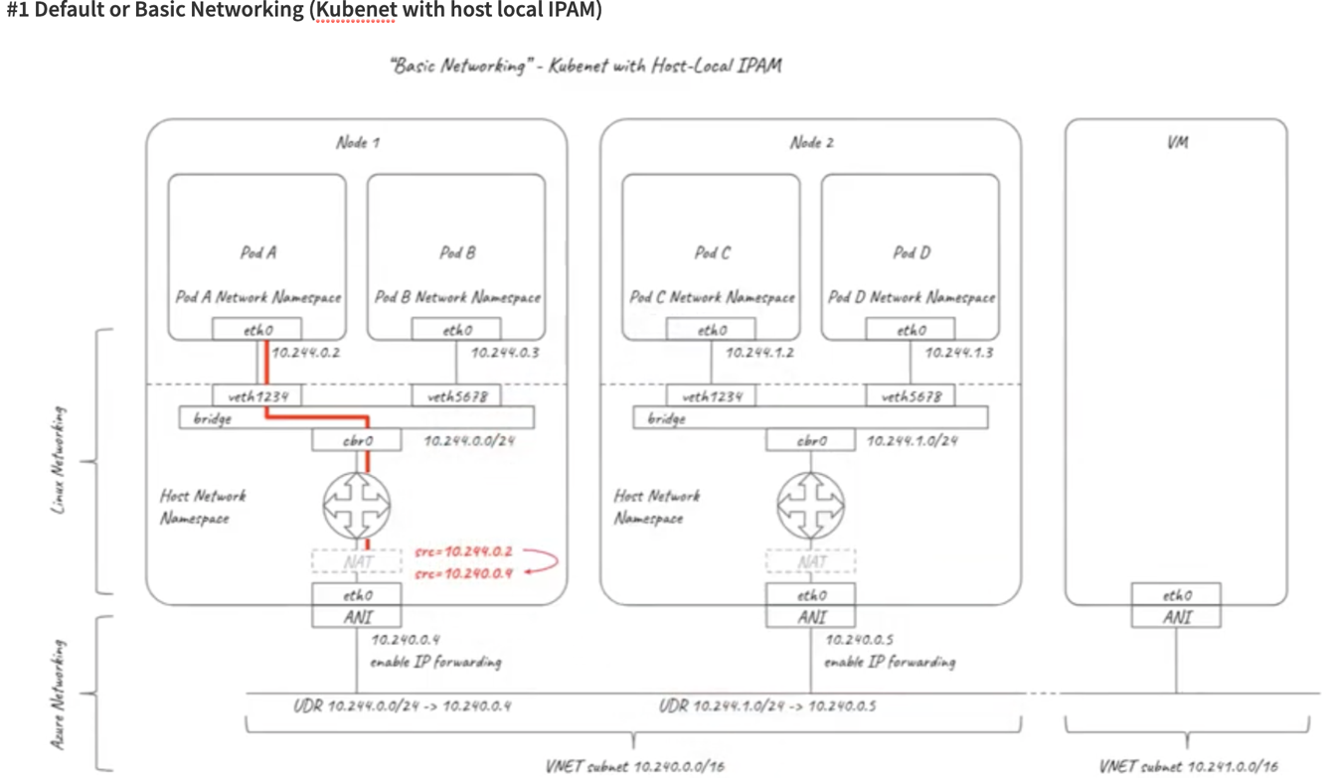
Azure AKS Networking
https://www.tigera.io/blog/everything-you-need-to-know-about-kubernetes-networking-on-azure/

Slide 7
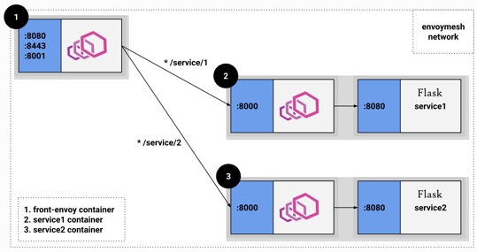
Envoy as the Data Plane
Azure, Google, AWS have all selected Envoy to power their Service Mesh
Advanced Load Balancing
Dynamic stats: Per zone, canary specific stats, etc.
Circuit breaking: Max connections, requests, and retries
Rate limiting: Integration with global rate limit service
Shadowing: Fork traffic to a test cluster.
Retries: HTTP router has built in retry capability with different policies.
Timeouts: Both “outer” (including all retries) and “inner” (per try) timeouts.
Outlier detection: Consecutive 5xx
Deploy control: Blue/green, canary, etc.
Speed: C++ L3/L4 filter architecture so a TCP proxy at its core
Flexibility: Can be used for things other than HTTP
Plugins: HTTP L7 filter architecture
HTTP/2: including gRPC and gRPC HTTP/1.1 bridge)
Features: Service discovery, active health checking, load balancing (retry, circuit breaking, rate limiting, timeouts), observability (stats, logging, and tracing), edge proxy (routing and TLS)

Slide 8
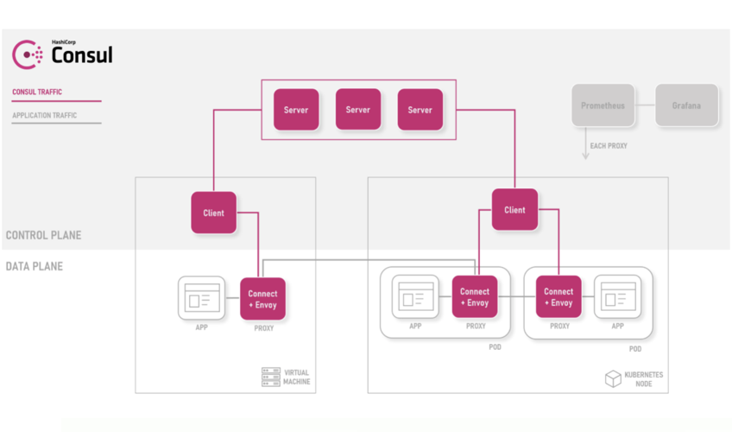
Service Mesh
What are Control and Data Planes?
Control Plane: Provides the configuration for the proxies, issues the TLS certificates, contain the policy managers, collects telemetry and other metrics including the ability to perform tracing.
example: update from 20% to s30%
Data Plane: Made up of lightweight proxies (NGINX, HAProxy, or Envoy). In Kubernetes, these proxies are run as sidecars in every Pod next to your application.
example: send 20% traffic to service A

Slide 9
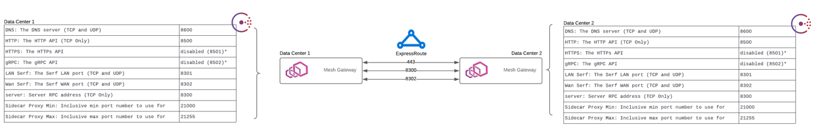
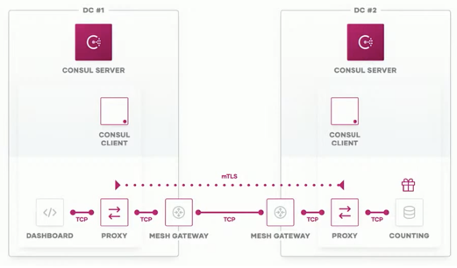
Only 3 ports between Data Centers
Dramatically limit attack surface while improving application flexibility

Slide 10
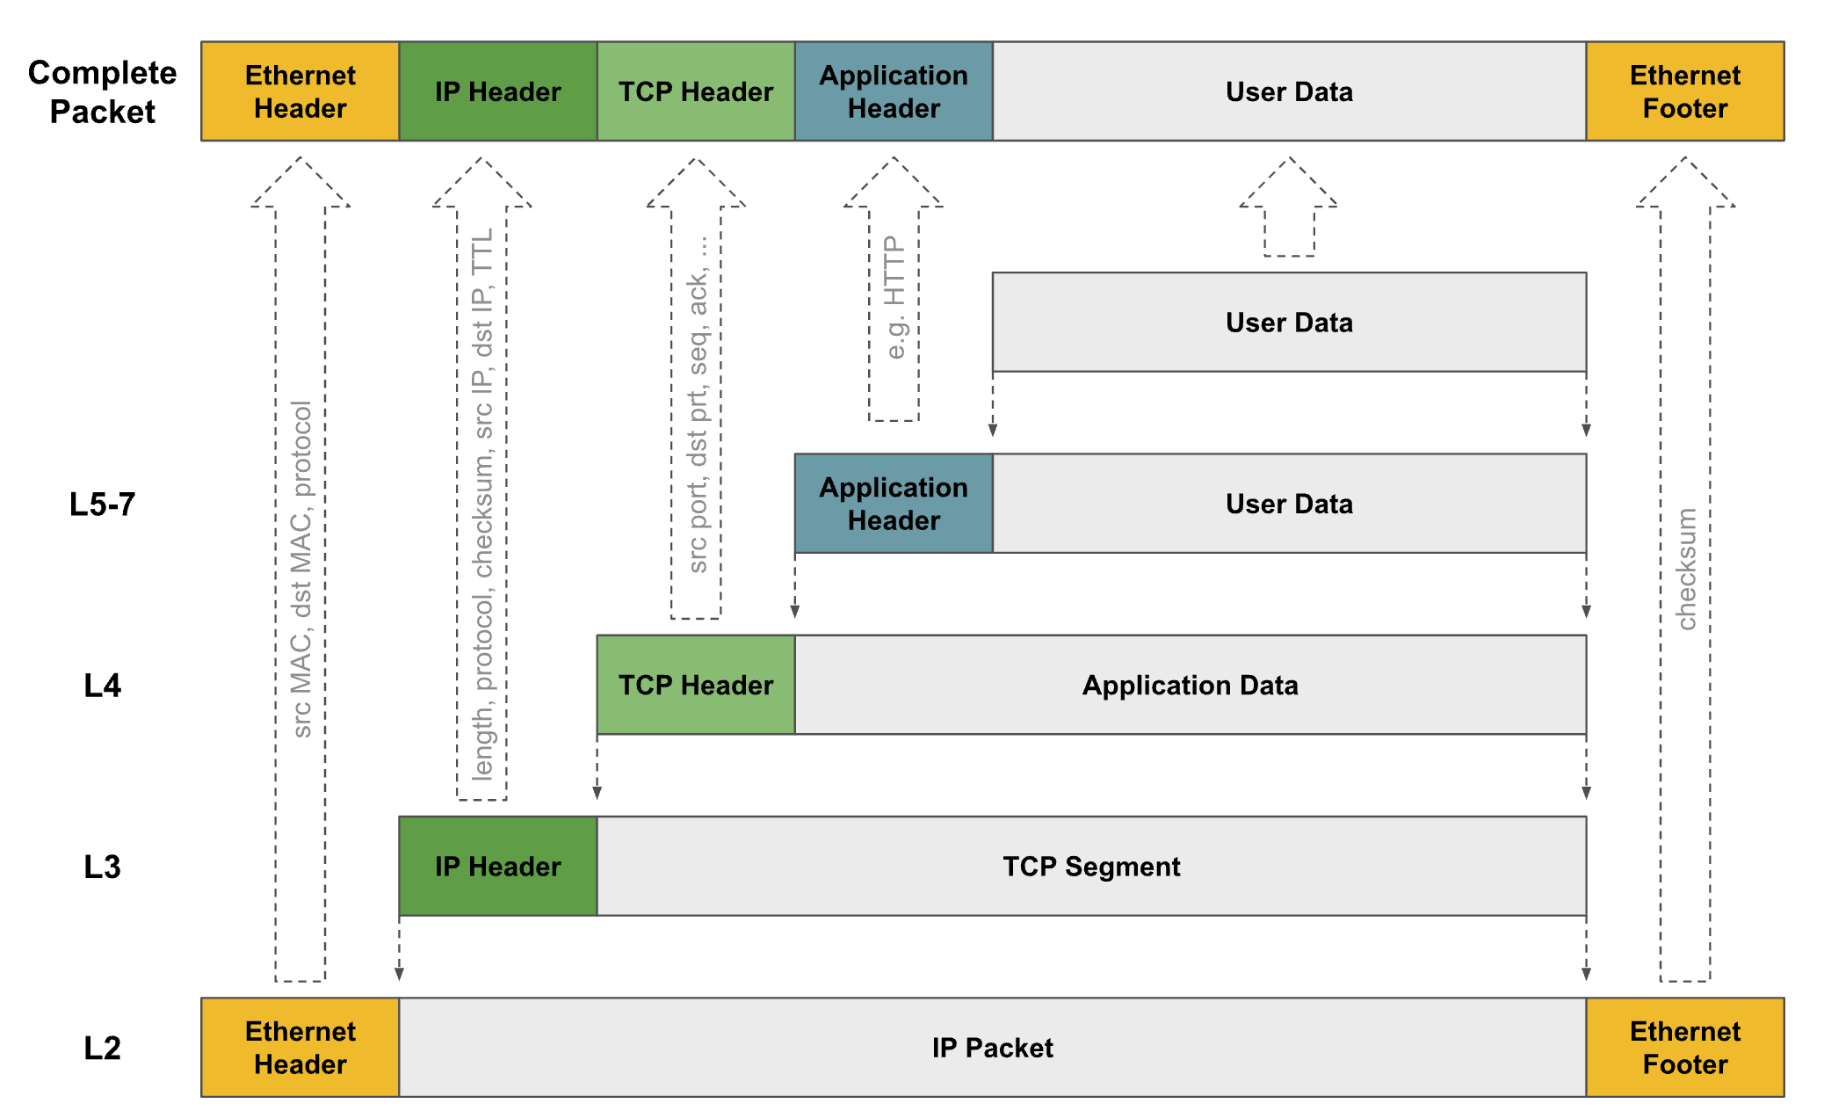
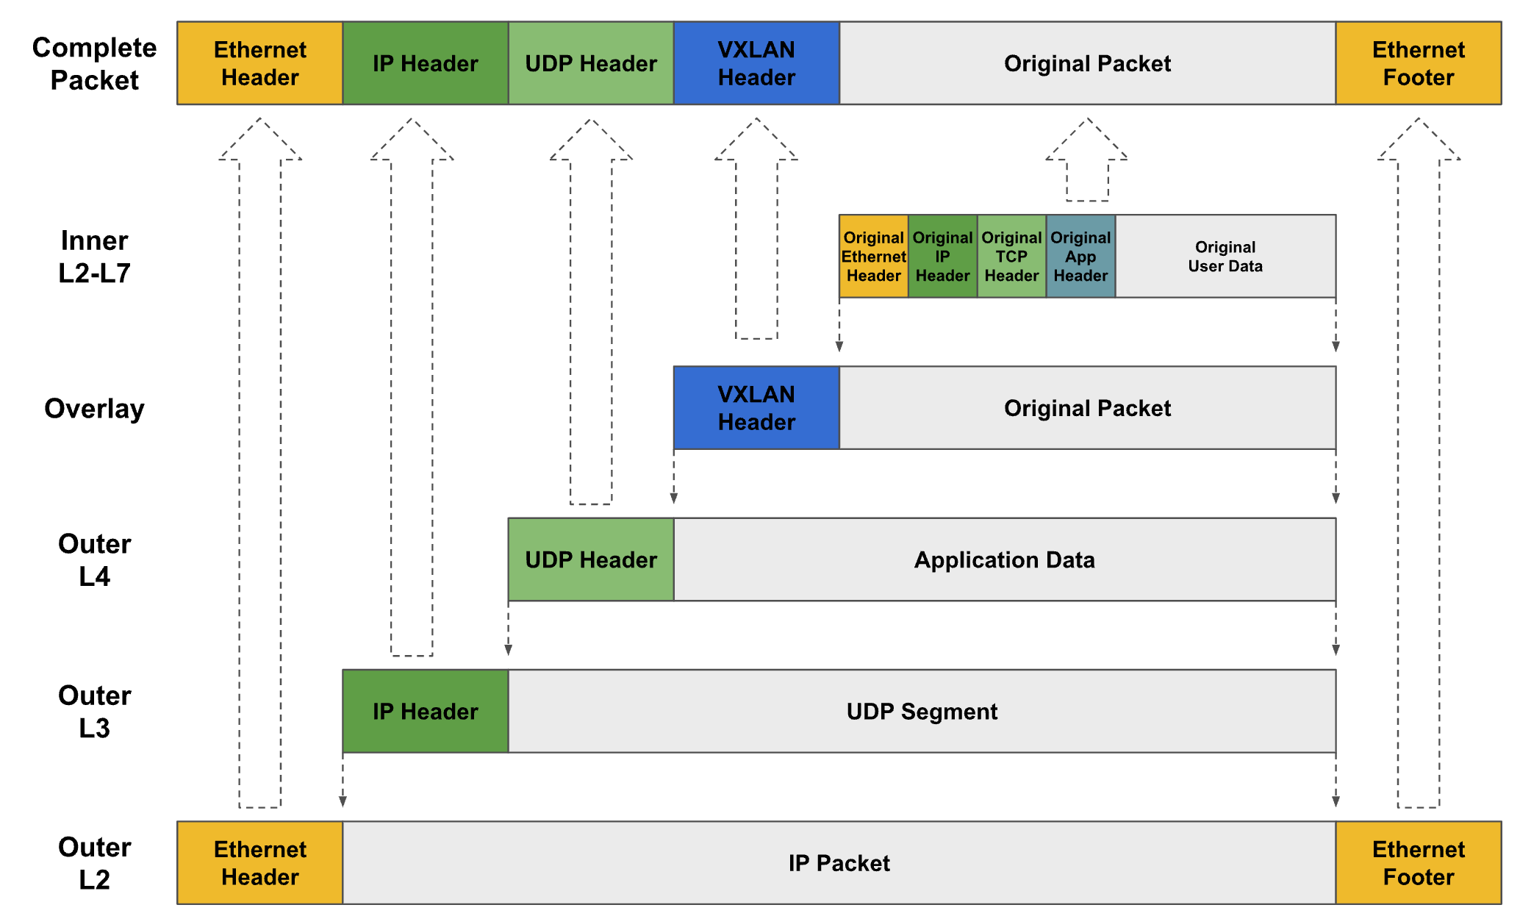
Network Packet & Overlay Networks
Networking
Overlay Network

Slide 11
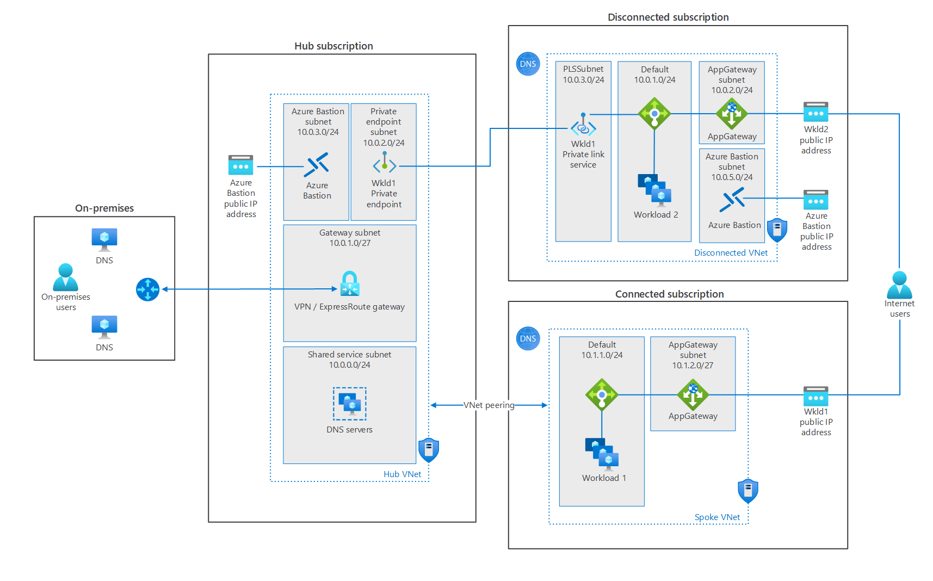
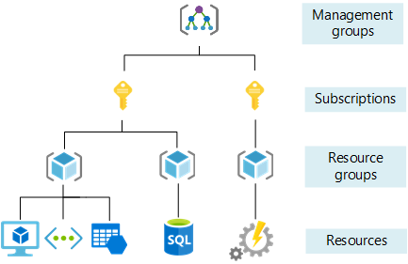
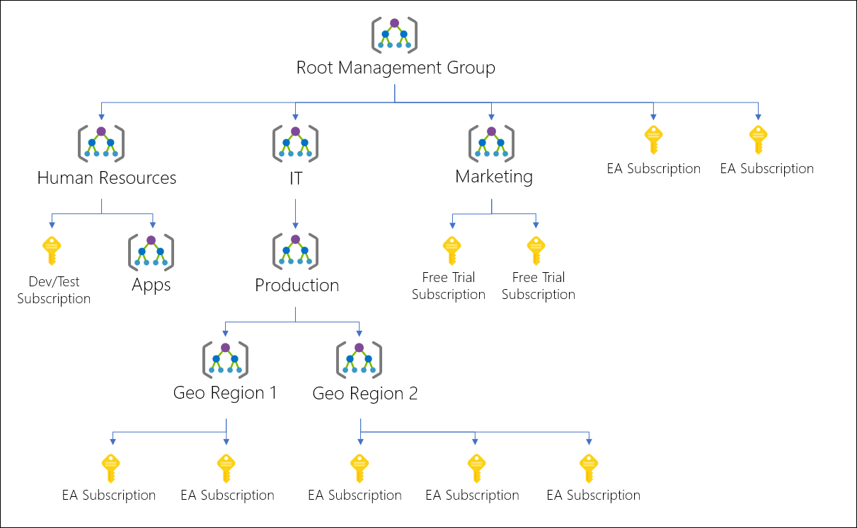
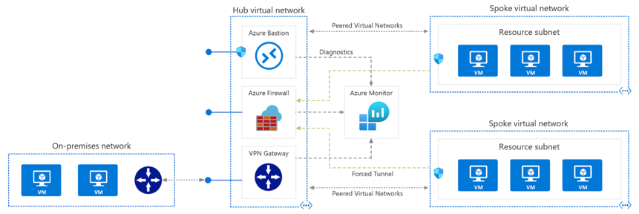
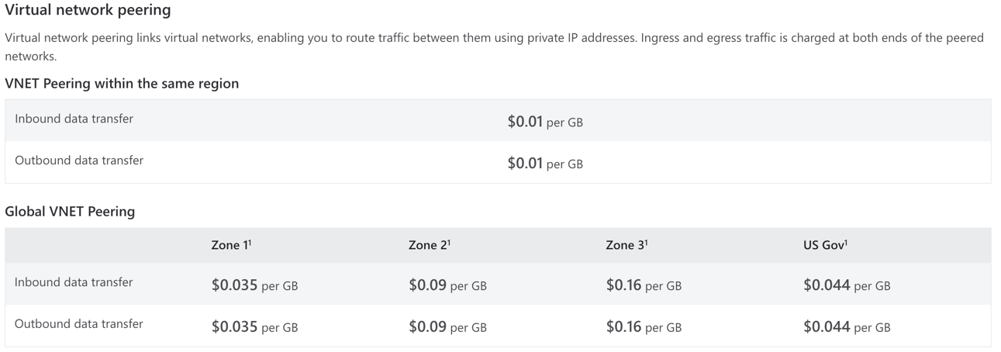
Subscriptions & Resource Groups
https://docs.microsoft.com/en-us/azure/cloud-adoption-framework/ready/azure-setup-guide/organize-resources?tabs=AzureManagementGroupsAndHierarchy
https://docs.microsoft.com/en-us/azure/cloud-adoption-framework/ready/enterprise-scale/management-group-and-subscription-organization
https://docs.microsoft.com/en-us/azure/azure-resource-manager/management/overview
https://docs.microsoft.com/en-us/azure/cloud-adoption-framework/ready/azure-best-practices/plan-for-ip-addressing
https://docs.microsoft.com/en-us/azure/cloud-adoption-framework/ready/azure-best-practices/define-an-azure-network-topology
https://docs.microsoft.com/en-us/azure/cloud-adoption-framework/ready/azure-best-practices/virtual-wan-network-topology
https://docs.microsoft.com/en-us/azure/cloud-adoption-framework/ready/azure-best-practices/traditional-azure-networking-topology
https://docs.microsoft.com/en-us/azure/cloud-adoption-framework/ready/azure-best-practices/connectivity-to-azure
https://docs.microsoft.com/en-us/azure/cloud-adoption-framework/ready/azure-best-practices/private-link-and-dns-integration-at-scale
https://docs.microsoft.com/en-us/azure/cloud-adoption-framework/ready/azure-best-practices/limit-cross-tenant-private-endpoint-connections
https://docs.microsoft.com/en-us/azure/cloud-adoption-framework/ready/azure-best-practices/plan-for-inbound-and-outbound-internet-connectivity
https://docs.microsoft.com/en-us/azure/cloud-adoption-framework/ready/azure-best-practices/plan-for-app-delivery
https://docs.microsoft.com/en-us/azure/cloud-adoption-framework/ready/azure-best-practices/plan-for-landing-zone-network-segmentation
https://docs.microsoft.com/en-us/azure/cloud-adoption-framework/ready/azure-best-practices/define-network-encryption-requirements
https://docs.microsoft.com/en-us/azure/cloud-adoption-framework/ready/azure-best-practices/plan-for-traffic-inspection
https://docs.microsoft.com/en-us/azure/cloud-adoption-framework/ready/azure-best-practices/connectivity-to-other-providers
https://docs.microsoft.com/en-us/azure/architecture/hybrid/hybrid-dns-infra

Slide 12
Tagging & Naming
Resource management: Your IT teams need to quickly locate resources associated with specific workloads, environments, ownership groups, or other important information. Organizing resources is critical to assigning organizational roles and access permissions for resource management.
Cost management and optimization: Making business groups aware of cloud resource consumption requires IT to understand the resources and workloads each team is using. Operations management: Visibility for the operations management team about business commitments and SLAs is an important aspect of ongoing operations. For operations to be managed well, tagging for mission criticality is required.
Security: Classification of data and security impact is a vital data point for the team, when breaches or other security issues arise. To operate securely, tagging for data classification is required.
Governance and regulatory compliance: Maintaining consistency across resources helps identify changes from agreed-upon policies. Prescriptive guidance for resource tagging demonstrates how one of the following patterns can help when deploying governance practices. Similar patterns are available to evaluate regulatory compliance using tags.
Automation: A proper organizational scheme allows you to take advantage of automation as part of resource creation, operational monitoring, and the creation of DevOps processes. It also makes resources easier for IT to manage.
Workload optimization: Tagging can help identify patterns and resolve broad issues. Tag can also help identify the assets required to support a single workload. Tagging all assets associated with each workload enables deeper analysis of your mission-critical workloads to make sound architectural decisions.
Functional | app = catalogsearch1 | Categorize resources by their purpose within a workload, what environment they've been deployed to, or other functionality and operational details.
 | tier = web
 | webserver = apache
 | env = prod
 | env = staging
 | env = dev
Classification | confidentiality = private | Classifies a resource by how it's used and what policies apply to it.
 | SLA = 24hours
Accounting | department = finance | Allows a resource to be associated with specific groups within an organization for billing purposes.
 | program = business-initiative
 | region = northamerica
Partnership | owner = jsmith | Provides information about what people (outside of IT) are related or otherwise affected by the resource.
 | contactalias = catsearchowners
 | stakeholders = user1;user2;user3
Purpose | businessprocess = support | Aligns resources to business functions to better support investment decisions.
 | businessimpact = moderate
 | revenueimpact = high
https://docs.microsoft.com/en-us/azure/cloud-adoption-framework/decision-guides/resource-tagging/

Slide 13
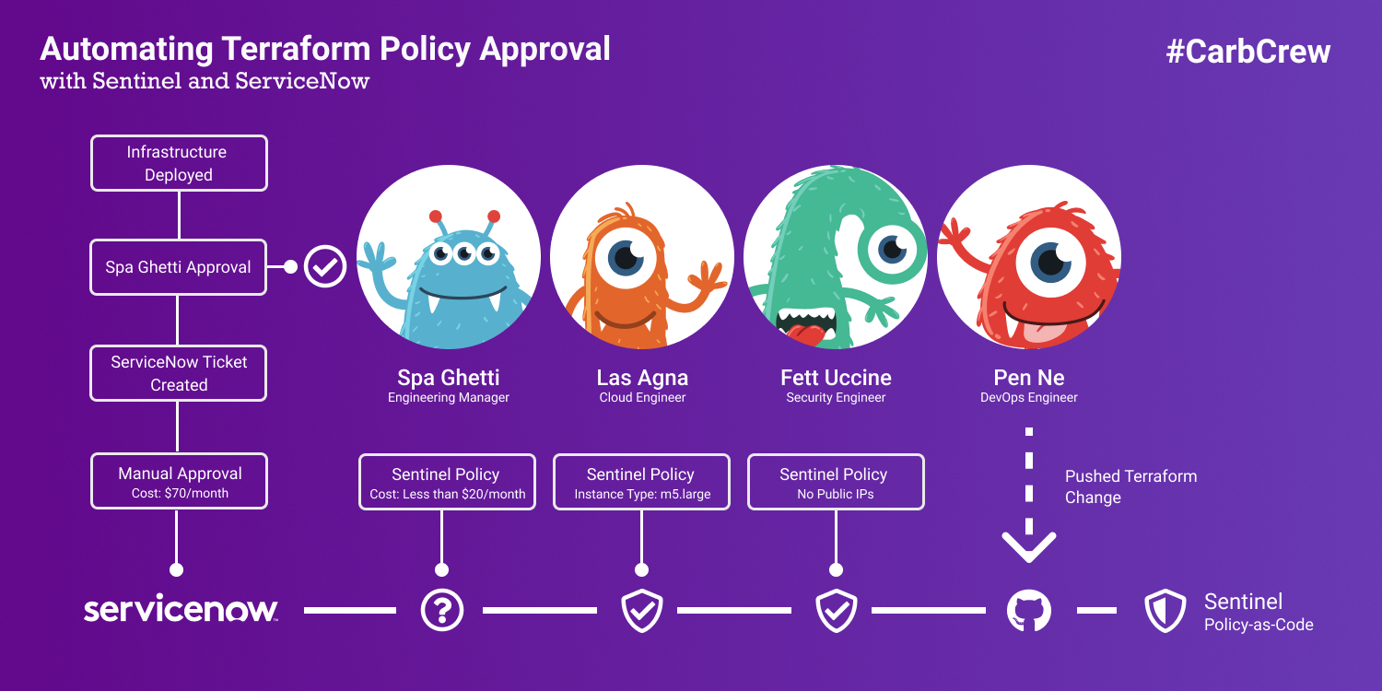
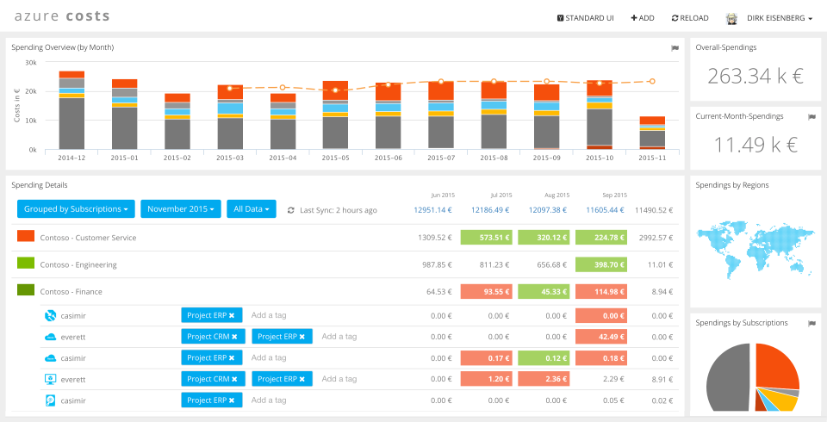
Policy Enforcement & Monitoring
https://medium.com/hashicorp-engineering/automating-terraform-policy-enforcement-with-sentinel-and-servicenow-830fad580bfa

Slide 14
Limits
https://docs.microsoft.com/en-us/azure/azure-resource-manager/management/azure-subscription-service-limits#networking-limits
Resource | Limit
Virtual networks | 1,000
Subnets per virtual network | 3,000
Virtual network peerings per virtual network | 500
Virtual network gateways (VPN gateways) per virtual network | 1
Virtual network gateways (ExpressRoute gateways) per virtual network | 1
DNS servers per virtual network | 20
Private IP addresses per virtual network | 65,536
Private IP addresses per network interface | 256
Private IP addresses per virtual machine | 256
Public IP addresses per network interface | 256
Public IP addresses per virtual machine | 256
Concurrent TCP or UDP flows per NIC of a virtual machine or role instance | 500,000
Network interface cards | 65,536
Network Security Groups | 5,000
NSG rules per NSG | 1,000
IP addresses and ranges specified for source or destination in a security group | 4,000
Application security groups | 3,000
Application security groups per IP configuration, per NIC | 20
IP configurations per application security group | 4,000
Application security groups that can be specified within all security rules of a network security group | 100
User-defined route tables | 200
User-defined routes per route table | 400
Point-to-site root certificates per Azure VPN Gateway | 20
Point-to-site revoked client certificates per Azure VPN Gateway | 300
Virtual network TAPs | 100
Network interface TAP configurations per virtual network TAP | 100

Slide 15
 | AWS | Azure
Subnet | For effective design and control of resources deployed on the cloud, both Azure VNet and AWS VPC segregate the networks with subnets.
 | An AWS VPC spans all the Availability Zones (AZs) in that region, hence, subnets in AWS VPC are mapped to Availability Zones (AZs). A subnet must only belong to one AZ and cannot span AZs. | Azure VNet subnets are defined by the IP Address block assigned to it.
Peering | VPC Peering: You can create a VPC peering connection between your own VPCs, or with a VPC in another AWS account. The VPCs can be in different regions (also known as an inter-region VPC peering connection). | VNET Peering: VNet peering is a mechanism that connects two virtual networks (VNets) in the same region through the Azure backbone network. Once peered, the two virtual networks appear as one for all connectivity purposes. To connect VNETs in different regions, you can use Global VNET Peering.
IP Addresses | Both AWS VPC and Azure VNET use non-globally routable CIDR from the private IPv4 address ranges as specified in RFC 1918 — addresses from this RFC are not globally routable — but customers can still use other public IP addresses.
 | AWS allows IP addresses from the same RFC 1918 or publicly routable IP blocks. Currently, AWS does not support direct access to the internet from publicly routable IP blocks, hence they are not reachable from the internet even through the Internet gateway (IGW). They are only reachable via the Virtual Private Gateway. | Azure VNet assigns resources connected and deployed to the VNet a private IP address from the CIDR block specified. In Azure VNet, the smallest subnet supported is /29 and the largest is a /8.
Routing Table | AWS uses the route table to specify the allowed routes for outbound traffic from the subnet. All subnets created in a VPC is automatically associated with the main routing table, hence, all subnets in a VPC can allow traffic from other subnets unless explicitly denied by security rules. | In Azure VNet, all resources in the VNet allow the flow of traffic by using the system route. You don’t have to configure and manage routes because by default, Azure VNet provides routing between subnets, VNets, and on-premises networks.
Security Groups | Azure and AWS supports Network Access control list. ACLs allow users to selectively permit or deny traffic to your Networks. It as an enhancement or an optional security mechanism on top of security groups belows and other security mechanisms.
 | AWS Security Group (SG): The Security Group is a stateful object that is applied at the EC2 instance level — technically, the rule is applied at the Elastic Network Interface (ENI) level. The response traffic is automatically allowed once a traffic is allowed. | Azure Network Security Groups (NSGs): Azure VNet provides Network Security Groups (NSGs) and it combines the functions of the AWS SGs and NACLs. NSGs are stateful and can be applied at the subnet or NIC level. Only one NSG can be applied to a NIC.
 | AWS Network Access Control (NACL): NACLs are stateless filtering rules that are applied at the subnet level and applies to every resource deployed to the subnet. It’s stateless because if an ingress traffic is allowed, the response is not automatically allowed unless explicitly allowed in the rule for the subnet. | n/a
Gateways | Inernet Gateway (IGW): AWS allows one Internet Gateway (IGW) to provide connectivity to the internet via IPv4 and Egress-only Internet Gateway for internet connectivity to resources with IPv6. | VPN Gateway: The VPN Gateway allows encrypted traffic for VNet to VNet or VNet to on-premises location across a public connection or across Microsoft’s backbone in the case of VNet to VNet VPN.
 | Virual Private Gateway (VPG): Virtual Private Gateway allows AWS to provide connectivity from AWS to other networks via VPN or Direct Connect. | Express Route Gateway: To send network traffic on a private connection, you use the gateway type 'ExpressRoute'. This is also referred to as an ExpressRoute gateway and is the type of gateway used when configuring ExpressRoute.
 | Customer Gateway (CGW): On the non-AWS network, AWS requires Customer Gateway (CGW) on the customer side to connect to AWS VPC. | n/a
connect | Both AWS VPC and Azure VNet allow hybrid connections using VPN and/or Direct Connect and ExpressRoute respectively. With Direct Connect or ExpressRoute, connections of up to 10Gbps are available.
Load Balancer | Elastic Load Balancing automatically distributes your incoming traffic across multiple targets, such as EC2 instances, containers, and IP addresses, in one or more Availability Zones. It monitors the health of its registered targets, and routes traffic only to the healthy targets. Elastic Load Balancing scales your load balancer as your incoming traffic changes over time. It can automatically scale to the vast majority of workloads. | Azure Load Balancer load balances traffic at layer 4 (TCP or UDP). Standard Load Balancer also supports cross-region or global load balancing.
DNS | Amazon Route 53 effectively connects user requests to infrastructure running in AWS – such as Amazon EC2 instances, Elastic Load Balancing load balancers, or Amazon S3 buckets – and can also be used to route users to infrastructure outside of AWS. You can use Amazon Route 53 to configure DNS health checks, then continuously monitor your applications’ ability to recover from failures and control application recovery with Route 53 Application Recovery Controller. | Azure DNS can be used to host your Domain Name System (DNS) domains in Azure. Manage your DNS records using the same credentials, and billing and support contract, as your other Azure services. Azure DNS uses a global network of name servers to provide fast responses to DNS queries. They use Anycast networking, so DNS queries automatically route to the closest name servers to give you the best possible performance.
Network Monitoring | VPC Flow Logs: VPC Flow Logs is a feature that enables you to capture information about the IP traffic going to and from network interfaces in your VPC. Flow log data can be published to Amazon CloudWatch Logs or Amazon S3. After you've created a flow log, you can retrieve and view its data in the chosen destination. | Azure Network Watcher: Azure Network Watcher provides tools to monitor, diagnose, view metrics, and enable or disable logs for resources in an Azure virtual network. Network Watcher is designed to monitor and repair the network health of IaaS (Infrastructure-as-a-Service) products which includes Virtual Machines, Virtual Networks, Application Gateways, Load balancers, etc. Note: It is not intended for and will not work for PaaS monitoring or Web analytics.

