Slide 1
How AWS Bedrock AgentCore
Actually Works
From one JSON file to a running, observable agent
AgentCore in Action · measured in us-east-1
xiongpin.dev

Slide 2
AGENDA
One walkthrough, three acts
ACT I · KNOW IT
ACT II · RUN IT
ACT III · SEE THROUGH IT
What AgentCore is, and the three layers you own
Environment, then five hands-on steps with real output
The mechanisms behind the steps, and what broke
· What it is / what it is not
· Environment checklist
· HTTP contract, trace anatomy
· Three layers, one direction
· Step 1-5: scaffold, contract, deploy, local, invoke
· Four failures, four takeaways
AgentCore in Action · Article 0
02

Slide 3
HOOK
The usual story ends with a Dockerfile and a prayer
The usual story
AgentCore
Write a Dockerfile
Pick an instance size
Hand-roll an IAM role
Hope the YAML is right
One JSON file
One command
A running, observable endpoint
One JSON file replaces all of it.
AgentCore in Action · Article 0
03

Slide 4
What AgentCore is (and is not)
a family of managed runtimes, 9 managed services
ACT I
Three layers, one direction
you write code + JSON; the CLI generates the rest
Know it

Slide 5
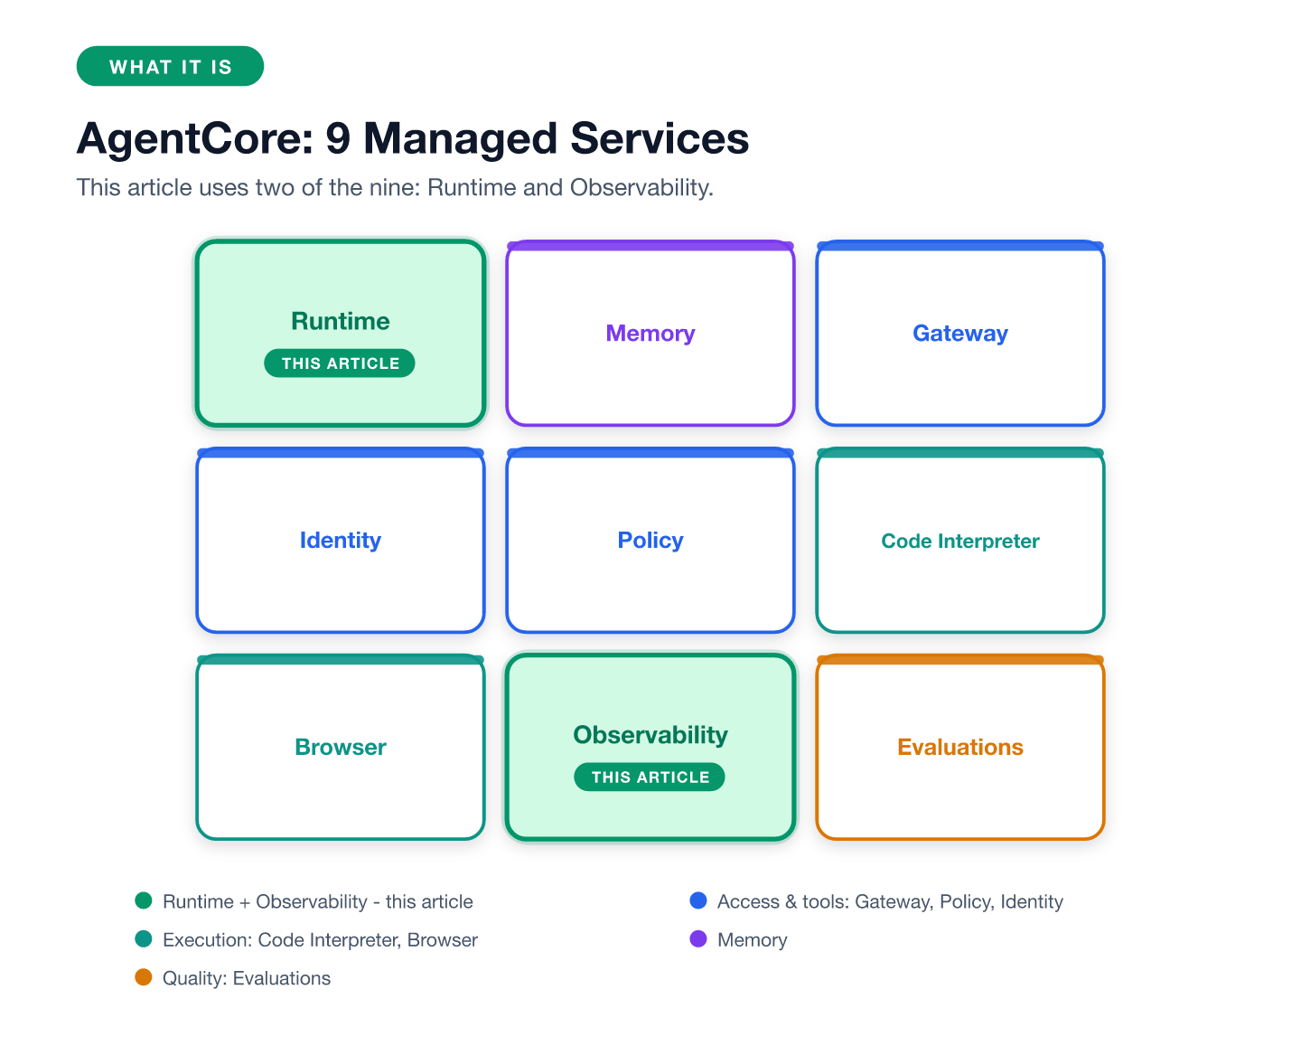
WHAT IT IS
A family of managed runtimes, not a new framework
Not a framework · not container orchestration · not a model router. Serverless microVM per session.
AgentCore in Action · Article 0
05

Slide 6
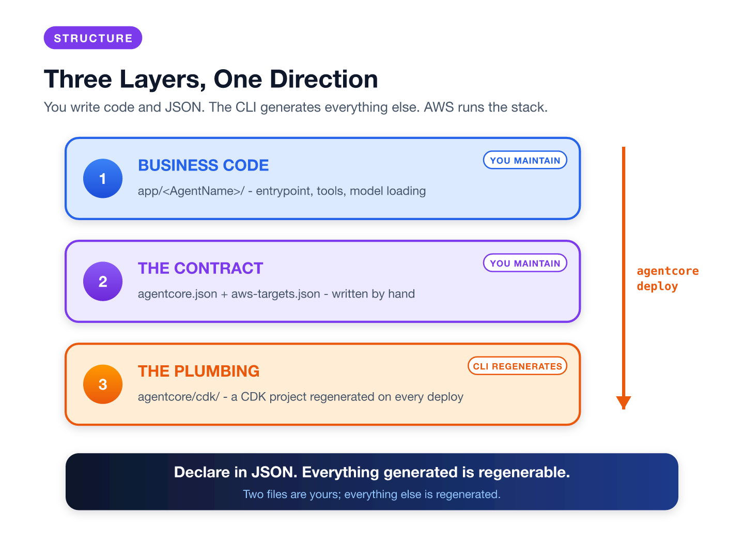
STRUCTURE
You write code and JSON. The CLI generates the rest.
AgentCore in Action · Article 0
06

Slide 7
Environment checklist
versions, permissions, one shadowing trap
ACT II
Step 1 · Scaffold
agentcore create
Run it
Step 2 · The contract
two JSON files you own
Step 3 · Deploy
one command, six steps, four resources
Step 4-5 · Run local, invoke cloud
same routes, same contract

Slide 8
ENVIRONMENT
Before step 1: align the toolchain
Versions
Runtime IAM role
Node.js
24.x (CLI needs 20+)
The CLI generates the runtime role: bedrock:InvokeModel* + logs:* + xray:PutTraceSegments. A least-privilege template for free.
AgentCore CLI
0.31.1
AWS CLI
2.x
uv
0.11.9 (template agents)
Git
2.39 (create runs git init)
Python
3.12 app venv, CodeZip allows 3.10-3.14
Region
us-east-1 (whole series)
Trap: old Python CLI shadows npm one - pip uninstall it
Docker
not needed - CodeZip builds
AgentCore in Action · Article 0
08
Notes:
SCREENSHOT 1
Run: node --version && uv --version && git --version && agentcore --version && aws sts get-caller-identity --query '[Account,Arn]' --output text && aws configure get region && aws bedrock list-foundation-models --region us-east-1 --query 'modelSummaries[?modelId==`deepseek.v3.2`].modelId' --output text
Capture: One full terminal screen showing the prompt, all version-check commands, their output, and the clock
Replace on this slide: This screenshot is optional for the deck; the version table above already conveys the information

Slide 9
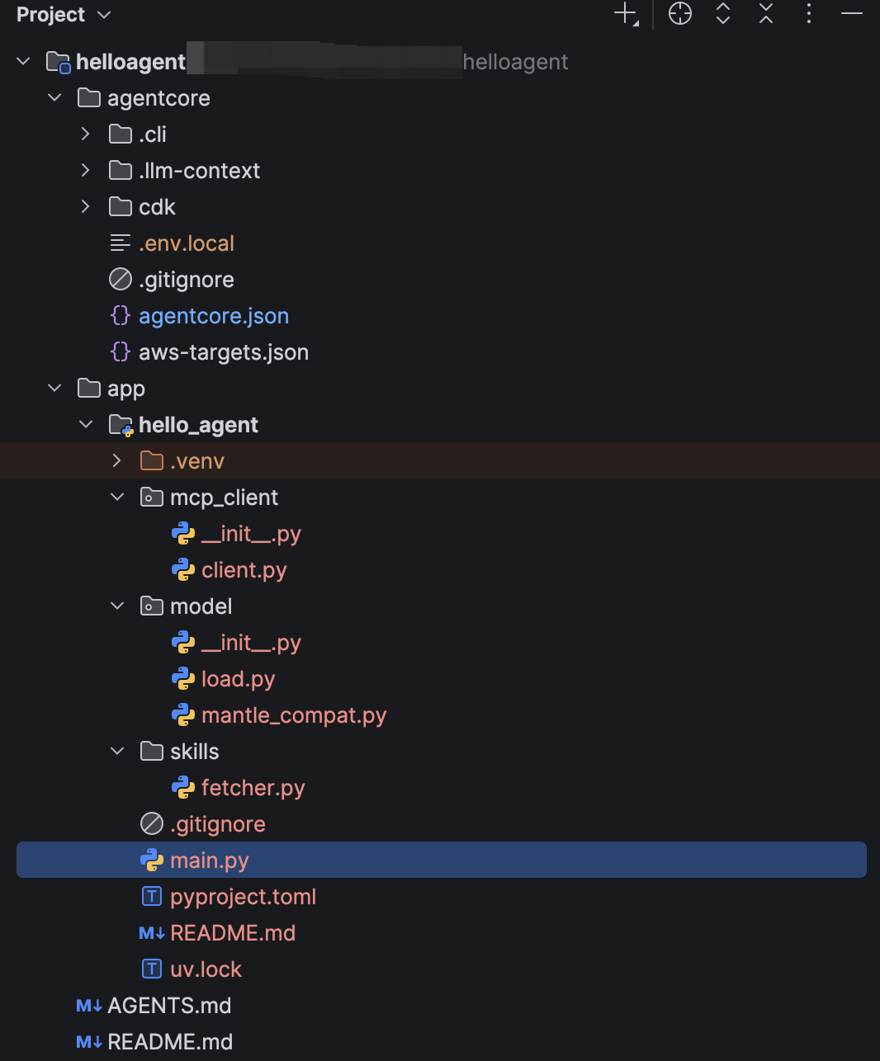
STEP 1 · SCAFFOLD
1
agentcore create builds the skeleton
create writes three things:
the project root, the
agentcore/ tree, and a
starter agent in
app/<AgentName>/.
codeLocation points there.
That folder is what gets
zipped, deployed and
dev-started.
AgentCore in Action · Article 0
09

Slide 10
STEP 2 · THE CONTRACT
2
Two JSON files you own
agentcore.json
{
"name": "helloagent",
"managedBy": "CDK",
"runtimes": [{
"build": "CodeZip",
"entrypoint": "main.py",
"codeLocation": "app/hello_agent/",
"runtimeVersion": "PYTHON_3_14",
"protocol": "HTTP",
"envVars": [{ "name": "MODEL_ID",
"value": "deepseek.v3.2" }]
}]
}
$ agentcore validate # -> Valid
aws-targets.json
[{ "name": "default", "account": "...",
"region": "us-east-1" }]
create writes an empty array.
The first deploy calls STS
and fills account + region in.
No --region flag exists.
The file is the only truth.
AgentCore in Action · Article 0
10

Slide 11
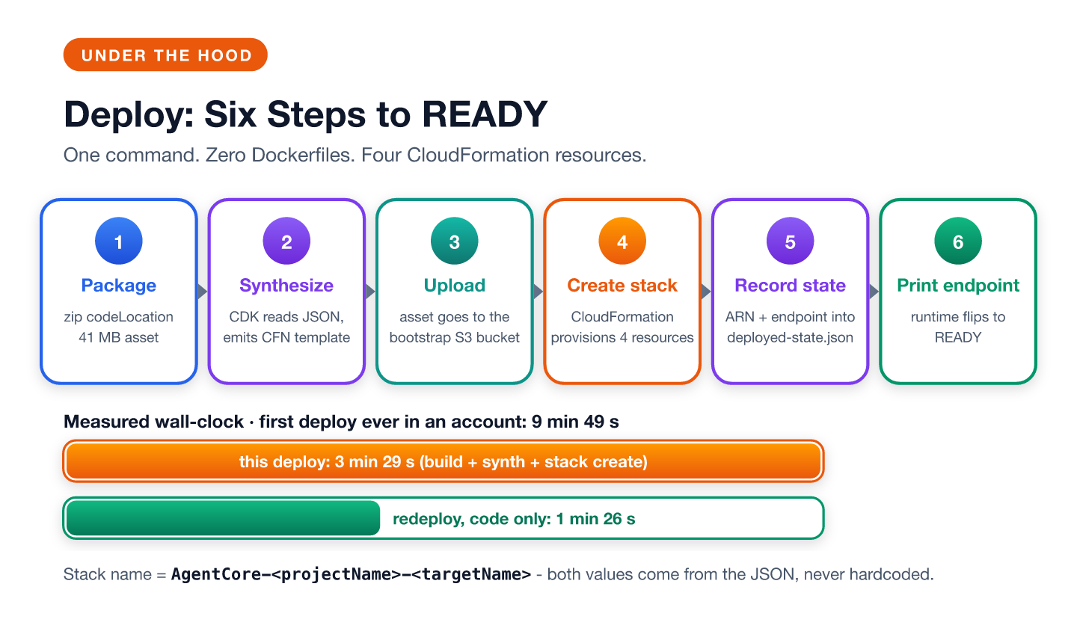
STEP 3 · DEPLOY
3
One command, six steps, four cloud resources
AgentCore in Action · Article 0
11

Slide 12
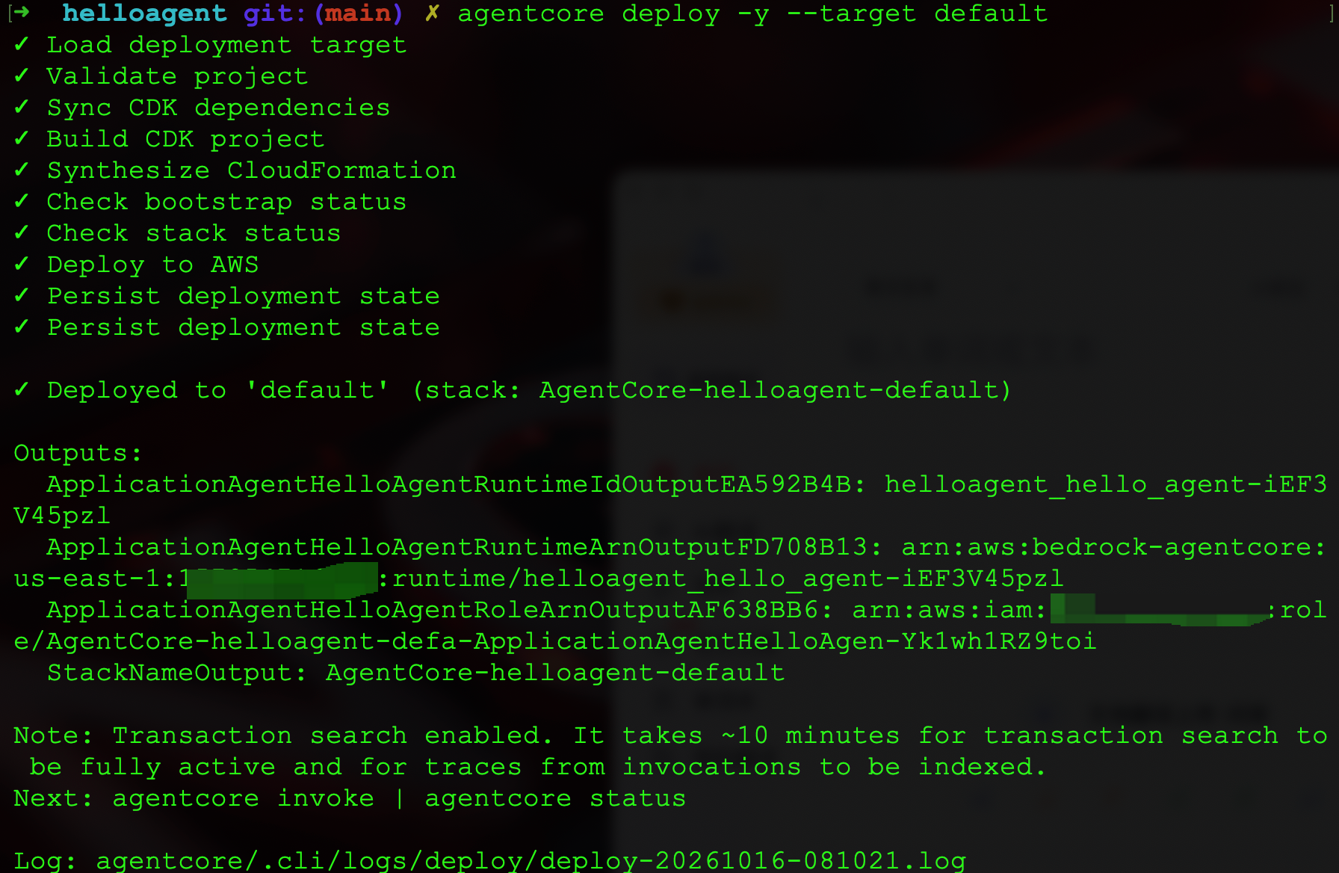
STEP 3 · DEPLOY
What success looks like
▶ LIVE DEMO
this deploy 3 min 29 s · code-only redeploy 1 min 26 s · first ever in account 9 min 49 s
AgentCore in Action · Article 0
12

Slide 13
SCHEMA-FIRST
cdk/ is a compiler. agentcore.json is the program.
// agentcore/cdk/bin/cdk.ts (generated)
const configRoot = path.resolve(process.cwd(), '..');
const configIO = new ConfigIO({ baseDir: configRoot });
const spec = await configIO.readProjectSpec();
const targets = await configIO.readAWSDeploymentTargets();
Same TypeScript,
different JSON
→ different stack.
Change the schema,
not the plumbing.
That is what
schema-first means
in practice.
The CDK app reads agentcore.json and aws-targets.json by path.
No project-specific logic: a compiler driven by the two files.
AgentCore in Action · Article 0
13

Slide 14
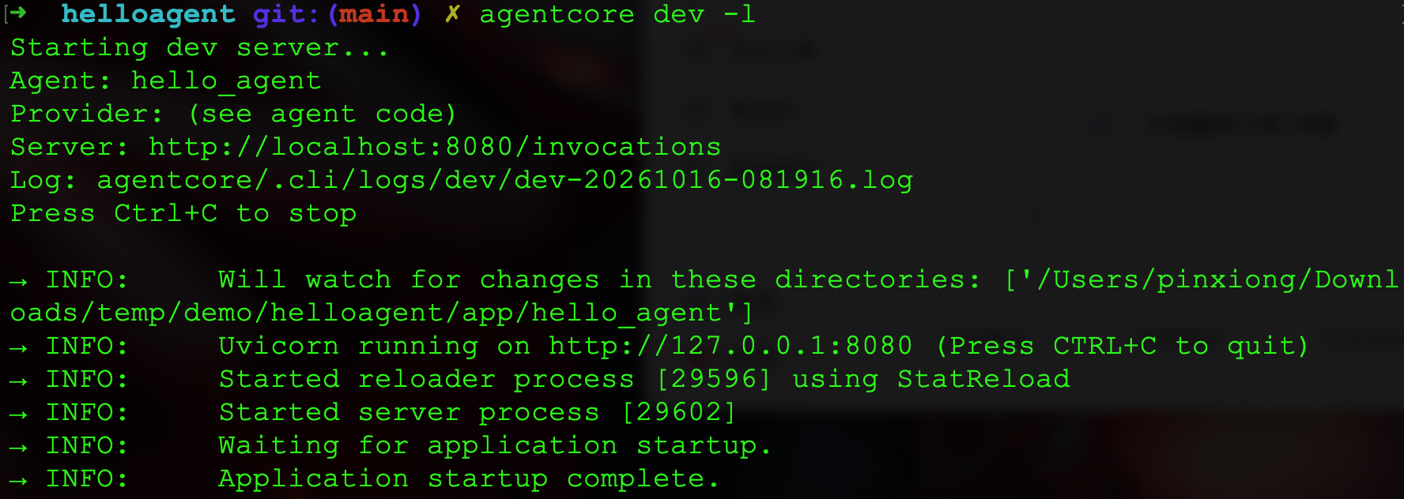
STEP 4 · RUN IT LOCALLY
4
Same app, same routes, no deployment
▶ LIVE DEMO
$ agentcore dev -l
Server: http://localhost:8080/invocations
(GET /ping + POST /invocations - same two routes)
Local server on localhost:8080.
Model calls still go to Bedrock:
credentials needed, deployment not.
Edit main.py while it runs:
the reloader picks it up
without a restart.
AgentCore in Action · Article 0
14

Slide 15
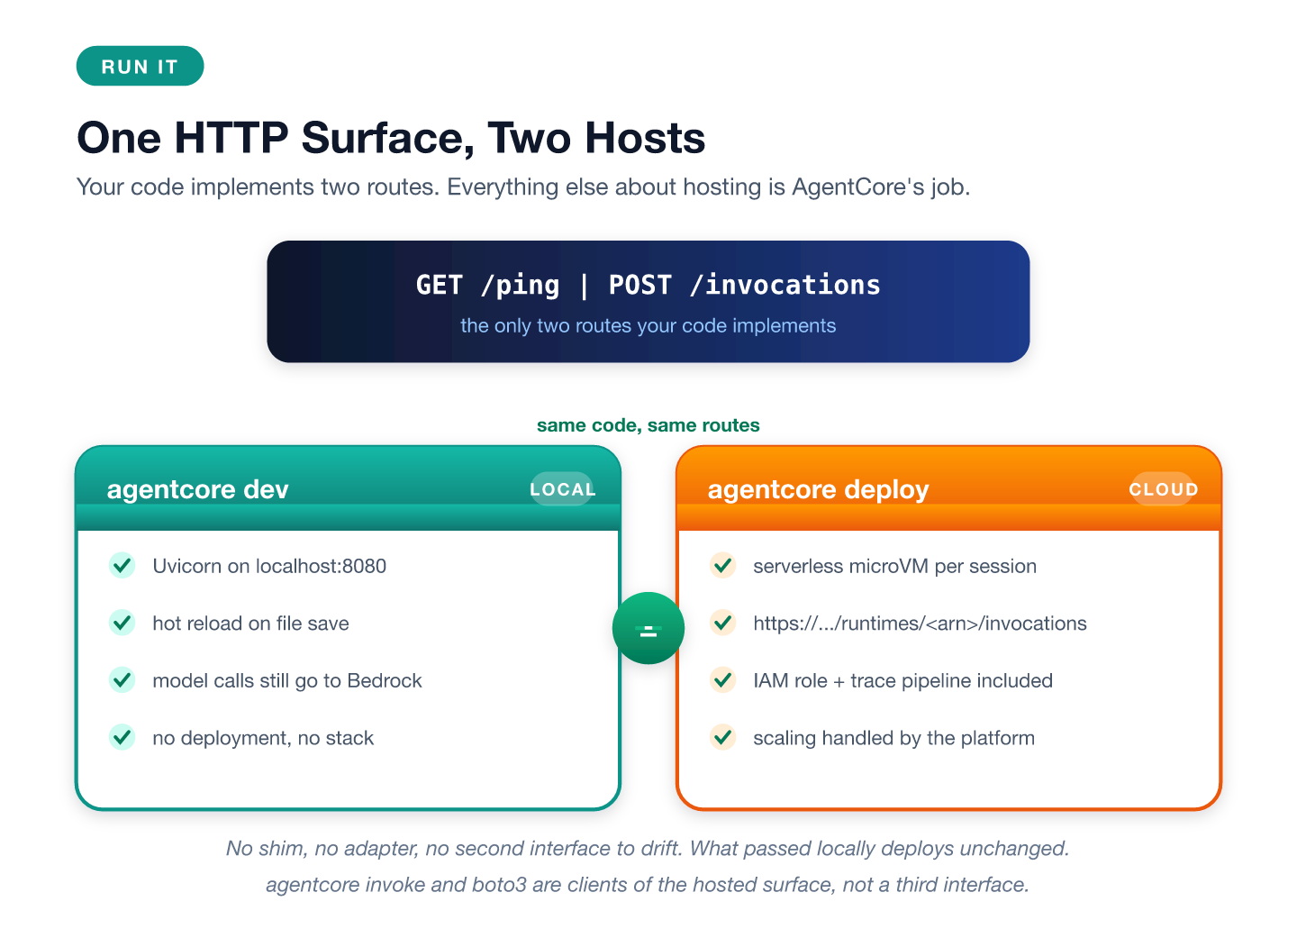
STEP 5 · INVOKE
📷 SCREENSHOT 5
5
The deployed runtime answers through the data plane
▶ LIVE DEMO
agentcore invoke = a CLI client for the hosted /invocations endpoint, not a third interface.
AgentCore in Action · Article 0
15
Notes:
SCREENSHOT 5
Run: agentcore invoke --prompt "What is 17 plus 25? Use the tool."
Capture: The invoke screen with runtime ARN and session ID visible, confirming this hit the deployed endpoint
Replace on this slide: This screenshot can be added as a small inset or replace the F5 figure on the right side

Slide 16
COST
One invoke costs about $0.0009
$0.0007
$0.0002
3m29s / 1m26s
model tokens
runtime compute
deploy / code-only redeploy
846 in + 82 out
deepseek.v3.2 @$0.62/$1.85 per M
≈ 7 s active compute
idle sessions are free
first ever in an account: 9m49s
(cdk bootstrap + first npm install)
The infrastructure bill rounds to zero. The engineering cost is reading the trace.
AgentCore in Action · Article 0
16

Slide 17
The HTTP contract
two requests, an async generator
ACT III
The trace
what observability records, and when
See through it
Four failures
and what each one taught
Takeaways
four sentences to keep

Slide 18
UNDER THE HOOD I
Two requests. That is the whole platform contract.
@app.entrypoint
async def invoke(payload, context):
session_id = getattr(
context, "session_id", "default-session")
agent = get_or_create_agent(session_id)
async for event in agent.stream_async(prompt):
yield event
GET /ping
POST /invocations
yield → one SSE event
session_id = your
state key. The platform
handles the microVMs.
MODEL_ID = an env var
from agentcore.json.
AgentCore in Action · Article 0
18

Slide 19
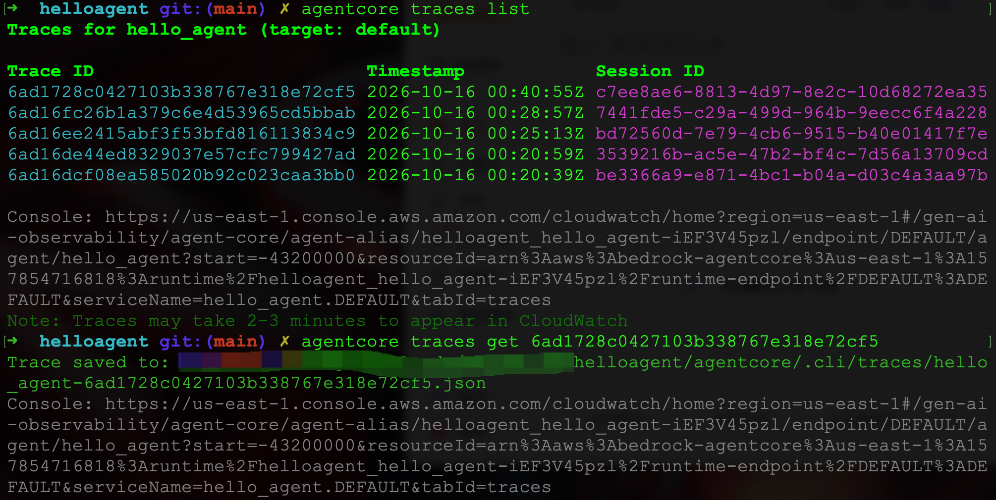
UNDER THE HOOD II
The trace teaches the agent loop without reading source
Caveats: spans need ~10 min to query · local dev records no tool span - assert against the deployment.
AgentCore in Action · Article 0
19

Slide 20
WHAT BROKE
Common failures
Stale cdk.out fails the next deploy
Renaming is destroying
CLI deletes it before synth; leftover state kills synth. rm -rf agentcore/cdk/cdk.out fixes it.
name = CloudFormation logical ID. Rename = delete old runtime + create new.
Models leak scaffolding into text
Region is not a flag
DSML markers, <thinking> blocks. Verified with Strands removed. Stream-safe filter at the entrypoint.
--region = unknown option. The targets file decides; it fills itself in on first deploy.
Model fallback triggers geo-restriction
SDK defaults to Claude if MODEL_ID isn't loaded. Unsupported regions see Anthropic access error. Check envVars + model/load.py.
AgentCore in Action · Article 0
20

Slide 21
SUMMARY
Four takeaways
1
The JSON file is the interface
everything else is regenerable plumbing driven by it
2
CDK appears as a vendored compiler
you never write constructs; same code, different JSON, different stack
3
Local and deployed share one HTTP contract
code that passed locally deploys without a shim
4
Observability is real but asynchronous
the tool call gets its own span; give tests minutes, not seconds
Your infrastructure is not code you maintain. It is code that compiles.
AgentCore in Action · Article 0
21

Slide 22
Your infrastructure is not code
you maintain. It is code that compiles.
AgentCore in Action · Article 0 · xiongpin.dev

