Slide 1

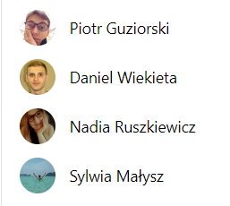
Get a
of inspirations now!
By #LoBoszeTeam:

Slide 2



How to capture customers travel imagination?
New ways to relax…
Iconic locations to discover…
Amazing landscapes yet to enjoy…

Slide 3
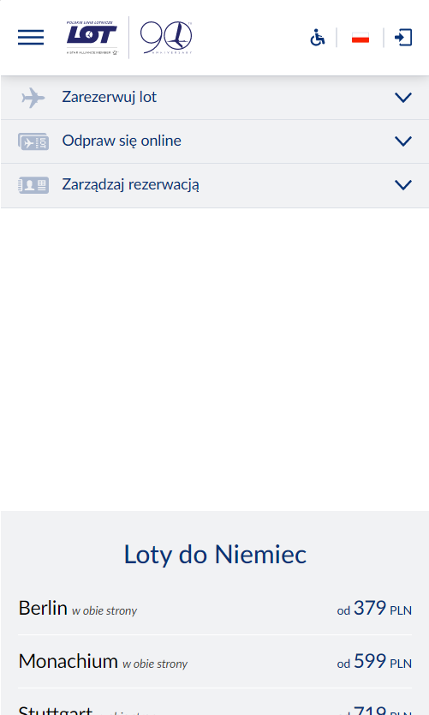

Application entry points | Main page
Get a
of inspirations now!

Slide 4
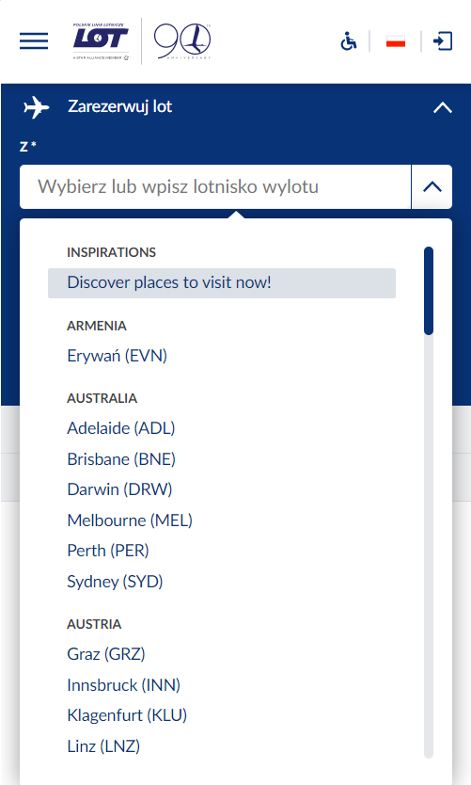
Application entry points | Main page
Get a
of inspirations now!

Slide 5
Inspiration categories
Get a
of inspirations now!

Slide 6





Inspiration categories | discover destinations
Get a
of inspirations now!
France
Nice
Marseille
Greece
Crete
Rodos
Korfu
Spain
Barcelona
Sevilla
Attractions
Knossos Palace
Elafonisi monastery
Balos beach
Currency and time zone
Euro | GMT+3
Tourist information
Visa detials
Power plugs
Consulate information
Weather
Jan 14°C / 7 °C | 3 °C
Feb 14°C / 7 °C | 3 °C
March 15°C / 7 °C | 3 °C
Events
Free style zorba competition | 01-10-2019
Pita bread throwing contest | 12-10-2019
Select

Slide 7


Inspiration categories | pick your dates
Get a
of inspirations now!
Select departure airport and dates!
Barcelona
Crete
Nice
r
r
r
Departure airport
Departure date
Return date
5
Travellers
1
6
Go back
Find offers now!

Slide 8

Inspiration categories | display flights offers
Get a
of inspirations now!
Select departure airport and dates!
Warsaw [WAW] → Barcelona [BCN]
Barcelona [BCN] ← Warsaw [WAW]
Total cost per passanger: 1 325 PLN
Total flight duration: 1h 35min / 1h 25min
Plane: Embrayer: 175 / Embrayer: 175
Warsaw [WAW] → Nice [NCE]
Nice [NCE] ← Warsaw [WAW]
Total cost per passanger: 1 625 PLN
Total flight duration: 1h 45min / 1h 45min
Plane: Embrayer: 175 / Embrayer: 175
Go to booking
Go to booking
Go back

Slide 9


What we achieved so far
Seamless integration with existing LOT booking system (via API / Web app)
Inspire to travel and discover new places (via Google Places API)
Improved user experience of booking system
(using pure awesomeness of our frontend developers)

Slide 10



