Slide 1
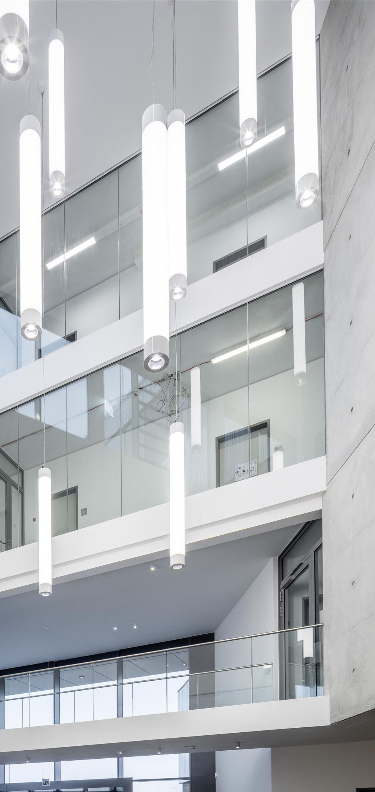

SSoLDAC
Hackathon Challenge
It’s not my fault!
Stephen Sabaa, Piotr Smolira, Sebastian Blechmann, Zuzan Azad

Slide 2
Motivation
Energy waste in commercial buildings
Role of heating, ventilation and airconditioning
system is crucial
Faults lead to high energy waste
Building Data often follows proprietary naming
Semantic interoperability
Machine-actionable knowledge to prevent energy waste and maintain system performance

Slide 3
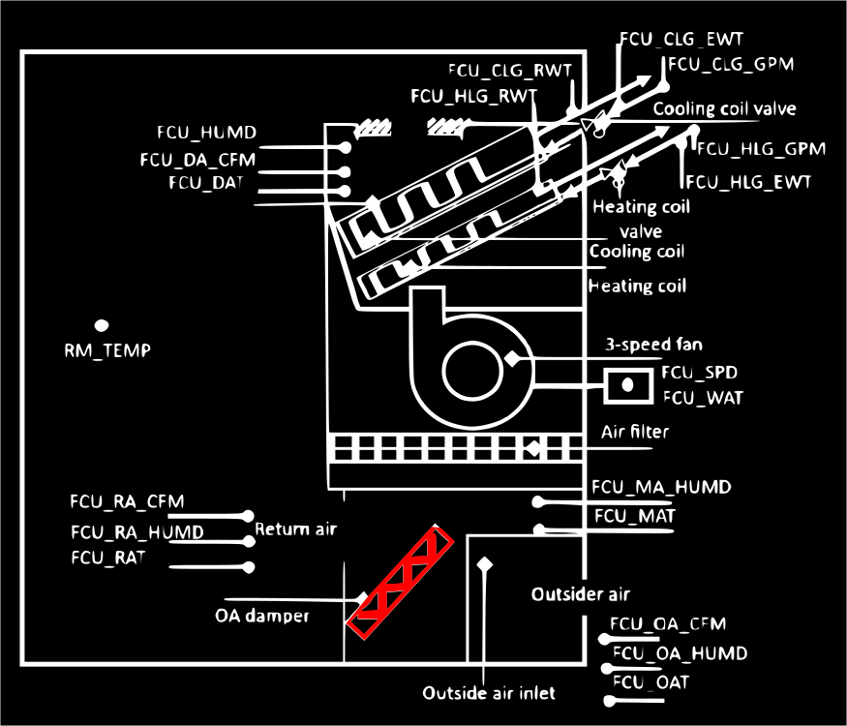
Use Case

Slide 4
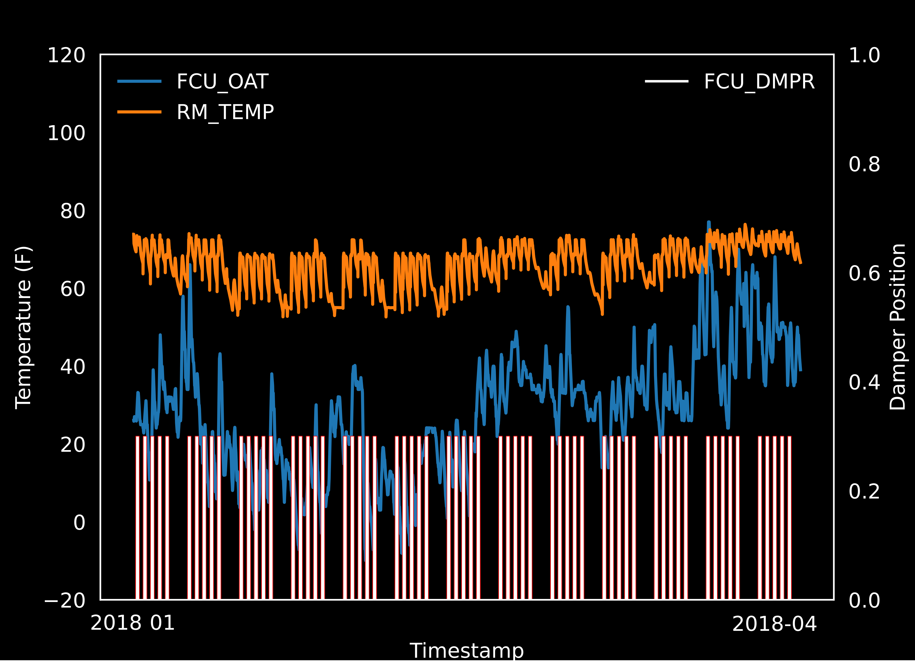

Slide 5
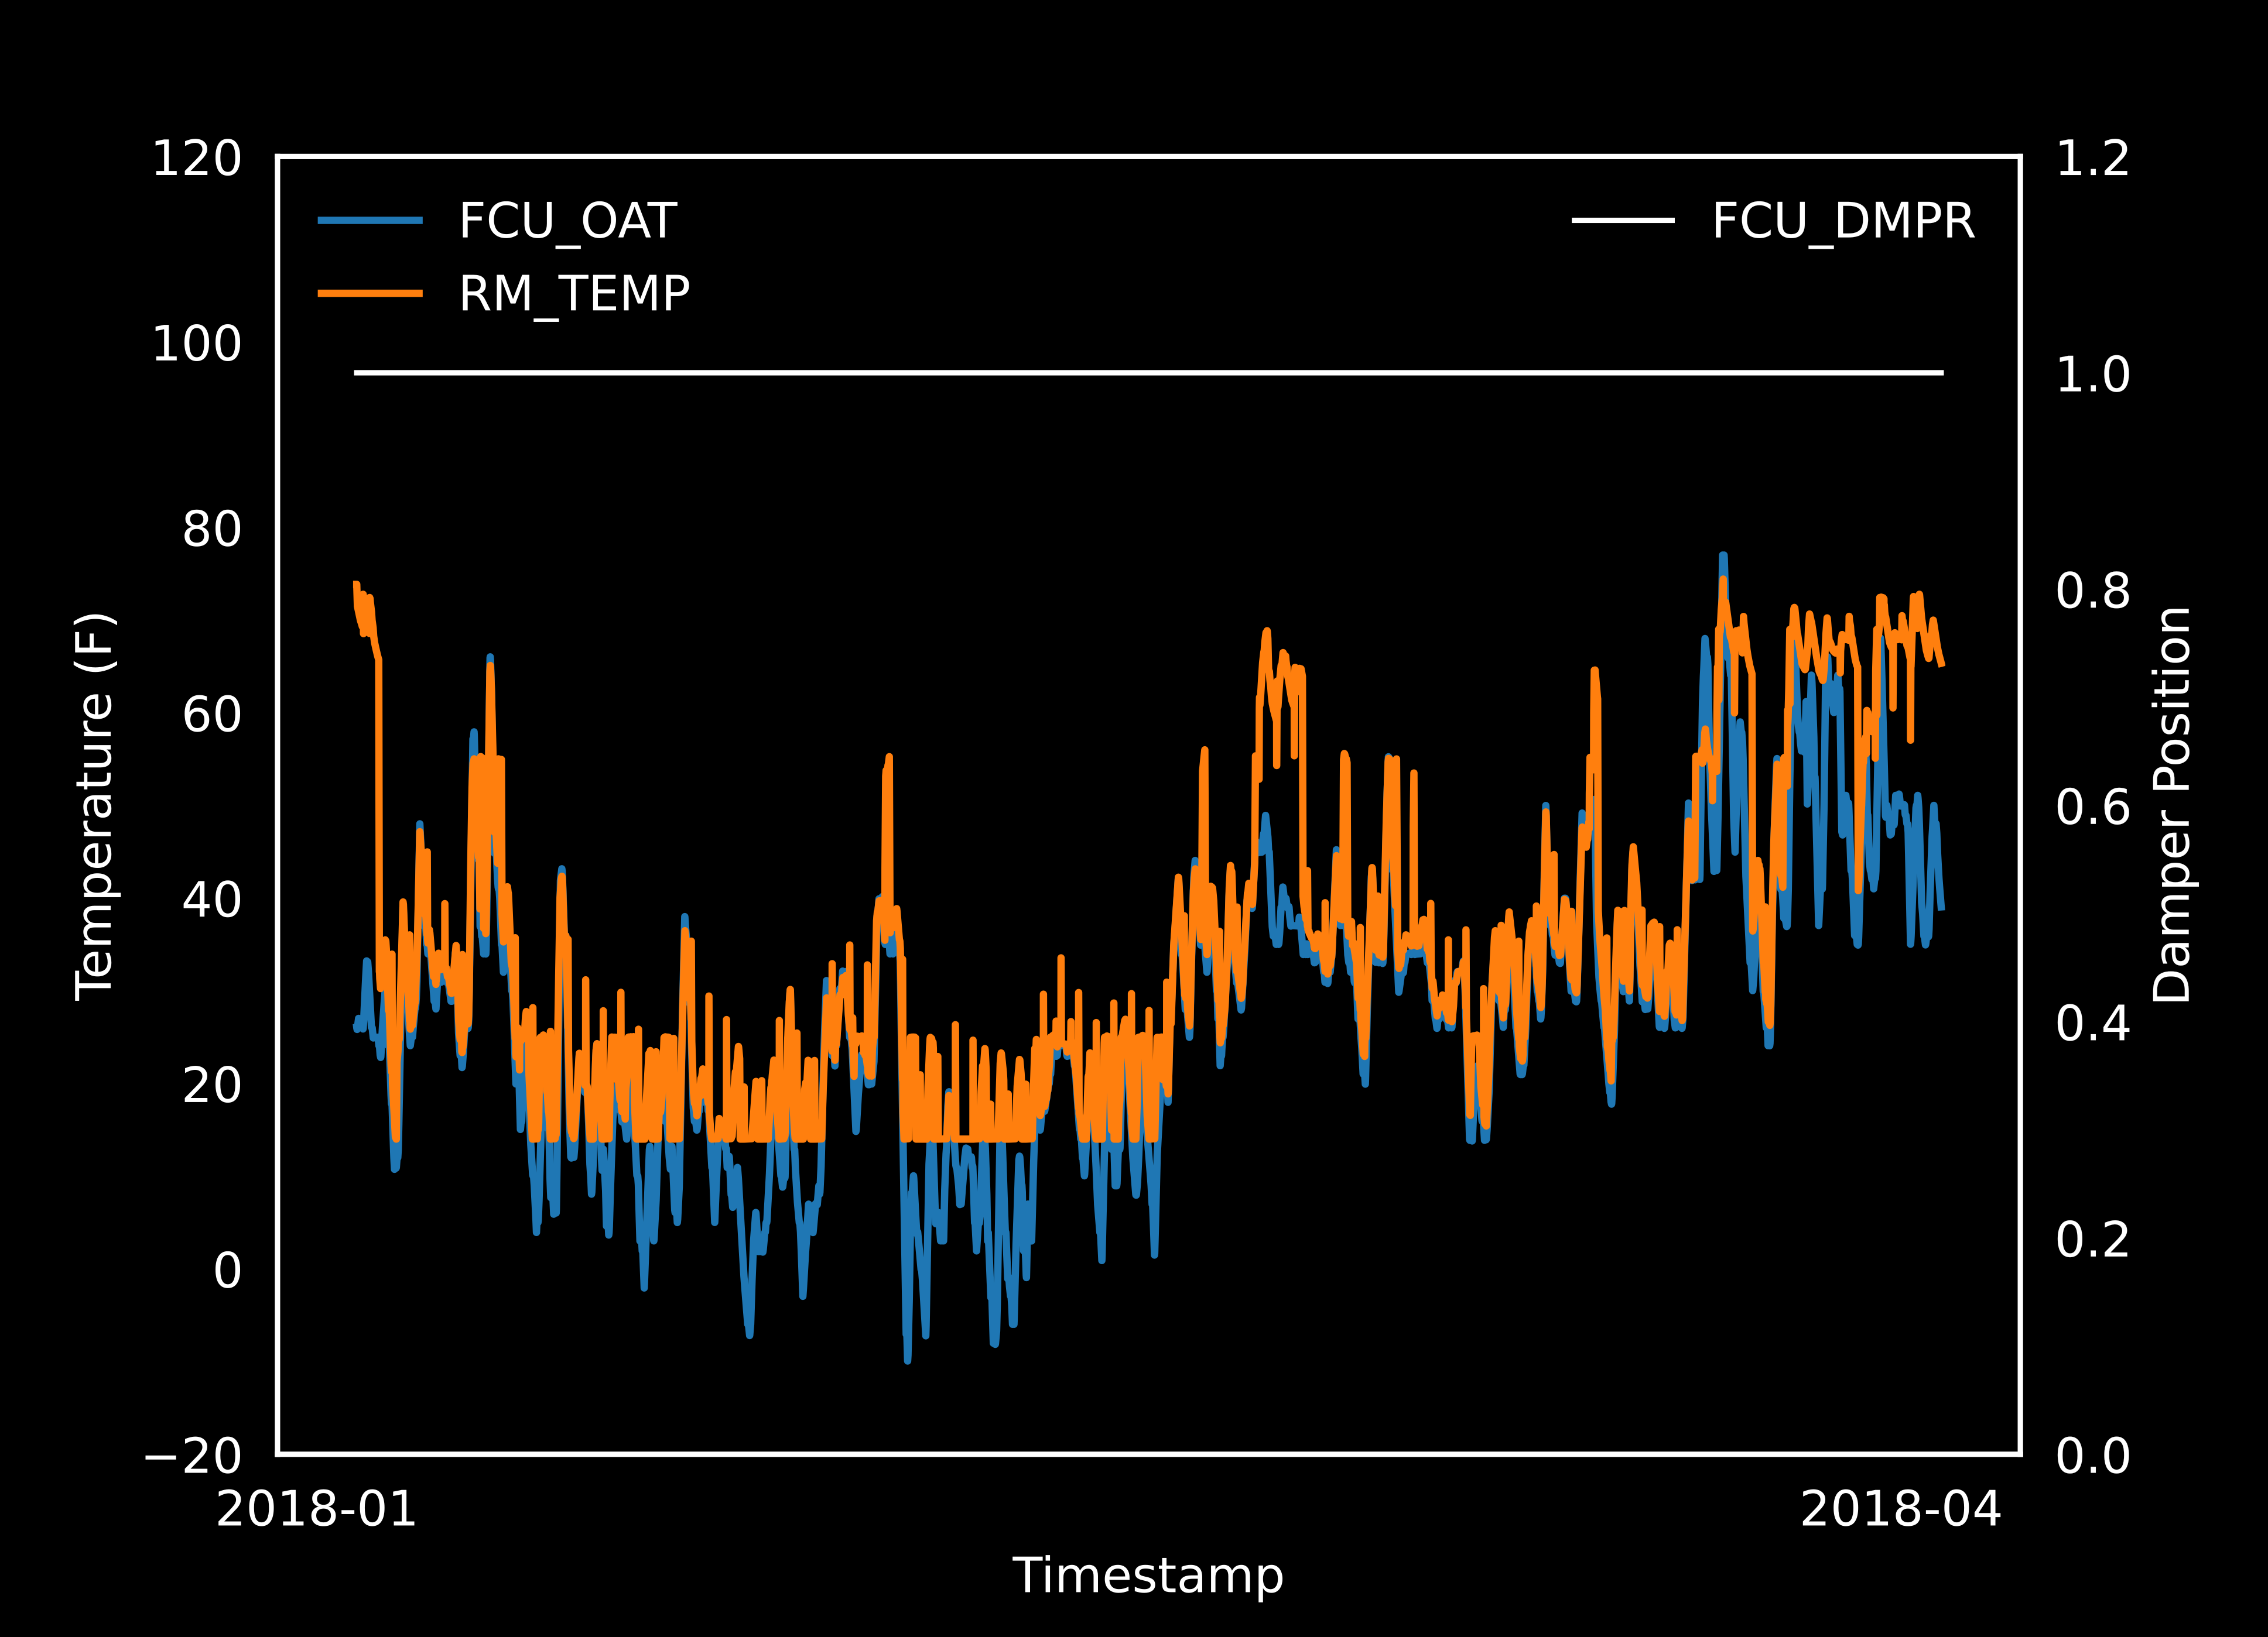

Slide 6
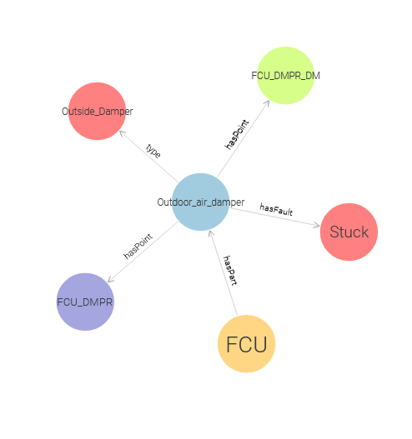
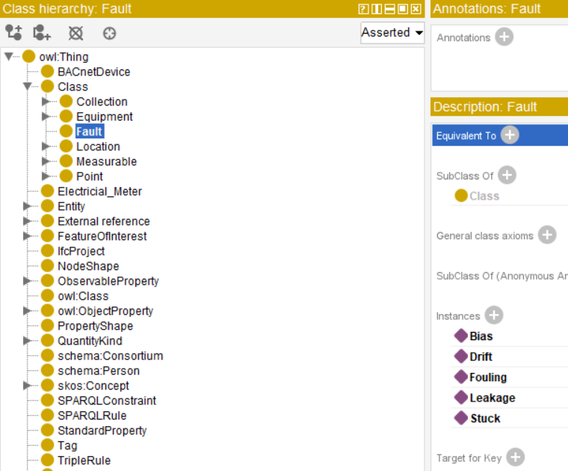
Concept
Sementically enrich KG
& visualize faults
Model faults
Detect & classify faults

Slide 7
Thank you for your attention!
And it is your fault!

