Slide 1
Adaptive Data Compression in Modern Databases: Optimising Analytical Access Patterns for Enhanced Performance - Research Proposal
Piotr Sieminski
October 2023

Slide 2
INTRODUCTION

Slide 3


Icons credit:
DBMS icon: <a href="https://www.flaticon.com/free-icons/dbms" title="dbms icons">Dbms icons created by Vectors Tank - Flaticon</a>
Access icon: <a href="https://www.flaticon.com/free-icons/access-control" title="access control icons">Access control icons created by Uniconlabs - Flaticon</a>
References:
Galindo, Makoto Takizawa and R Traunmüller, 2004, pp.528–538

Slide 4
RESEARCH QUESTION

Slide 5
How can analytical access patterns in modern databases be effectively optimised for use with adaptive data compression storage in order to achieve enhanced query performance?

Slide 6
SIGNIFICANCE

Slide 7


Icons credit:
Database icon: <a href="https://www.flaticon.com/free-icons/big-data" title="big data icons">Big data icons created by The Chohans Brand - Flaticon</a>
Binoculars icon: <a href="https://www.flaticon.com/free-icons/binoculars" title="binoculars icons">Binoculars icons created by Freepik - Flaticon</a>
References:
Gordon, 2016

Slide 8
AIMS AND OBJECTIVES

Slide 9
Aims and objectives
Review and analysis
Literature review
Methodologies
Access Patterns
Common access patterns
Data retrieval efficiency
Development
Enhancement framework
Test implementation
Performance evaluation
Efficiency
Performance benchmarking

Slide 10
Aims and objectives
Comparative analysis
Common patterns vs improvements
Scalability assessment
Large data volumes
Flexibility
Recommendations
Best practices
Enhancement framework
Future directions
Further research & applications

Slide 11
KEY LITERATURE
References:
Ziv and Lempel, 1977
Melnik et al., 2011
Herberts, 2021
Graefe and Shapiro, 2002
Kimball and Ross, 2013, pp.443–496

Slide 12
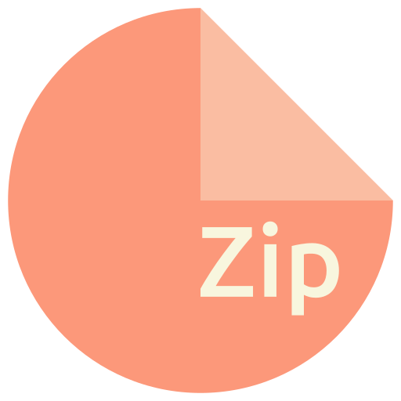

Key literature
Compression Techniques
DB Storage & Design
Access Patterns
Icons credit:
Technique icon: <a href="https://www.flaticon.com/free-icons/technique" title="technique icons">Technique icons created by amoghdesign - Flaticon</a>
Database icons: <a href="https://www.flaticon.com/free-icons/database" title="database icons">Database icons created by phatplus - Flaticon</a>
Access icon: <a href="https://www.flaticon.com/free-icons/access-control" title="access control icons">Access control icons created by Uniconlabs - Flaticon</a>
References:
Popenoe et al., 2021

Slide 13
Figure 1: Thematic classification table of the key literature.
Theme | Title | Year | Keywords | Category
Access Patterns | Access path selection in a relational database management system | 1979 | R, access paths, DBMS, IBM | Conference Paper
Access Patterns | What's Really New with NewSQL? | 2016 | NewSQL, access patterns, DBMS, transactional workloads, analytical workloads | Journal Article
Access Patterns | Real-Time Workload Pattern Analysis for Large-Scale Cloud Databases | 2023 | cloud database workloads, workload pattern discovery, sql query patterns, access patterns, high-dimensional feature embedding | Conference Paper
Compression Techniques | A universal algorithm for sequential data compression | 1977 | LZ77, compression, sequential data, algorithm, foundational | Journal Article
Compression Techniques | Database compression | 1991 | Database, compression, optimization, storage, analytics | Journal Article

Slide 14
Figure 1: Thematic classification table of the key literature - continued.
Compression Techniques | Integrating Compression and Execution in Column-Oriented Database Systems | 2006 | Compression, execution, columnar databases, integration, challenges | Conference Paper
Compression Techniques | Super-scalar RAM-CPU cache compression | 2006 | Compression, RAM, CPU cache, super-scalar, technique | Conference Paper
Compression Techniques | Column-Stores vs. Row-Stores: How Different Are They Really? | 2008 | Column-stores, row-stores, comparison, database, design | Journal Article
Compression Techniques | Dremel: Interactive Analysis of Web-Scale Datasets | 2010 | Dremel, columnar storage, Web-Scale, analytics, Google | Journal Article
Compression Techniques | Rethinking SIMD vectorization for in-memory databases | 2015 | SIMD, vectorization, in-memory, databases, compression | Journal Article

Slide 15
Figure 1: Thematic classification table of the key literature - continued.
Compression Techniques | SIMD compression and the intersection of sorted integers | 2016 | SIMD, compression, sorted integers, intersection, algorithms | Journal Article
Database Storage and Design | The implementation and performance of compressed databases | 2000 | Compression, database performance, adaptive, usage patterns | Journal Article
Database Storage and Design | How to Barter Bits for Chronons: Compression and Bandwidth Trade-Offs for Database Scans | 2008 | Compression, bandwidth, trade-offs, database scans, chronons | Conference Paper
Database Storage and Design | MonetDB: Two decades of research in column-oriented database architectures | 2009 | MonetDB, column-oriented, database architectures, research, compression | Journal Article
Database Storage and Design | The Starfish project: Adaptive self-tuning storage systems for the cloud | 2011 | Starfish, adaptive, self-tuning, storage, cloud | Journal Article

Slide 16
Figure 1: Thematic classification table of the key literature - continued.
Database Storage and Design & Access Patterns | The Data Warehouse Toolkit | 2013 | Data warehouse, toolkit, design, star schema, best practices | Book
Database Storage and Design & Access Patterns | Columnar storage and list-based processing for graph database management systems | 2021 | GDBMS, column-oriented storage, access patterns, list-based query processor\ | Conference Paper

Slide 17
RESEARCH DESIGN
References:
Wickham, 2019
George, 2023

Slide 18

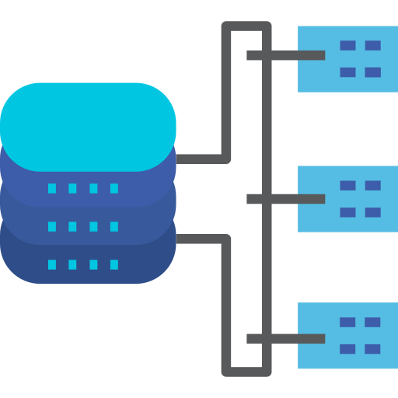
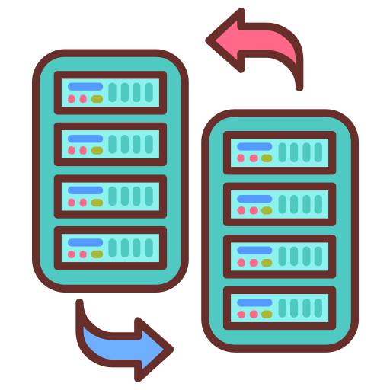
Experiment setup
Testing environment
Constant parameters
DB instances
Icons credit:
Testing environment icon: <a href="https://www.flaticon.com/free-icons/customer-experience" title="customer experience icons">Customer experience icons created by Rmpp - Flaticon</a>
Constant parameters icon: <a href="https://www.flaticon.com/free-icons/load-balancer" title="load balancer icons">Load balancer icons created by small.smiles - Flaticon</a>
DB instances icon: <a href="https://www.flaticon.com/free-icons/replicate" title="replicate icons">Replicate icons created by Vectors Tank - Flaticon</a>
References:
Song et al., 2013

Slide 19

Testing
Stress testing
Metrics analysed:
Runtime
CPU
GPU
Bytes
I/O
Partitions accessed
Query parsing
Icons credit:
Stress icon: <a href="https://www.flaticon.com/free-icons/stress" title="stress icons">Stress icons created by Freepik - Flaticon</a>
References:
Song et al., 2013
Batista and Silva, 2013

Slide 20



Data Analysis
Distribution
Statistical tests
Descriptive metrics
Icons credit:
Normal distribution icon: <a href="https://www.flaticon.com/free-icons/normal-distribution" title="Normal Distribution icons">Normal Distribution icons created by orvipixel - Flaticon</a>
Statistical test icon: <a href="https://www.flaticon.com/free-icons/decision" title="decision icons">Decision icons created by judanna - Flaticon</a>
Descriptive metrics icon: <a href="https://www.flaticon.com/free-icons/metrics" title="metrics icons">Metrics icons created by Uniconlabs - Flaticon</a>
References:
SHAPIRO and WILK, 1965
Ross and Willson, 2017
Rey and Neuhäuser, 2011
Lix and Keselman, 2018
Sheldon et al., 1996

Slide 21
ETHICAL CONSIDERATIONS

Slide 22




Ethical considerations
Data Privacy
Intellectual Property
Transparency in reporting
Environmental impact
Icons credit:
Data privacy icon: <a href="https://www.flaticon.com/free-icons/privacy-policy" title="privacy policy icons">Privacy policy icons created by Flat Icons - Flaticon</a>
Intellectual property icon: <a href="https://www.flaticon.com/free-icons/intellectual" title="intellectual icons">Intellectual icons created by Eucalyp - Flaticon</a>
Environmental impact icon: <a href="https://www.flaticon.com/free-icons/transparency" title="transparency icons">Transparency icons created by Wichai.wi - Flaticon</a>
Transparency in reporting icon: <a href="https://www.flaticon.com/free-icons/esg" title="esg icons">Esg icons created by kmg design - Flaticon</a>
References:
Abeydeera et al., 2019

Slide 23
RISK ASSESSMENT

Slide 24
Risk assessment
Figure 2: Risk assessment analysis table
Risk | Mitigation
Data Breach | Public data, no PII
Data Corruption | Spot checks, original copies
Dialect specific optimisations | Exclusion from general findings
Dependence on proprietary tools | Open source tools, license
Outdated technology | Latest developments used
References:
Burns and Koh, 1996

Slide 25
TIMELINE

Slide 26
Figure 3: Proposed activities timeline - table.
Activity | Start | End
Project Set Up/Supervisor consultation | 13/11/2023 | 11/12/2023
Secondary research | 11/12/2023 | 05/02/2024
Database Selection | 05/02/2024 | 12/02/2024
Data Partitioning | 12/02/2024 | 19/02/2024
Stress Testing | 19/02/2024 | 11/03/2024
Access Patterns Modifications | 11/03/2024 | 08/04/2024
Data Analysis | 08/04/2024 | 22/04/2024
Final Analysis and Reporting | 22/04/2024 | 06/05/2024
Feedback gathering | 06/05/2024 | 20/05/2024
Conclusion and Documentation | 20/05/2024 | 03/06/2024

Slide 27
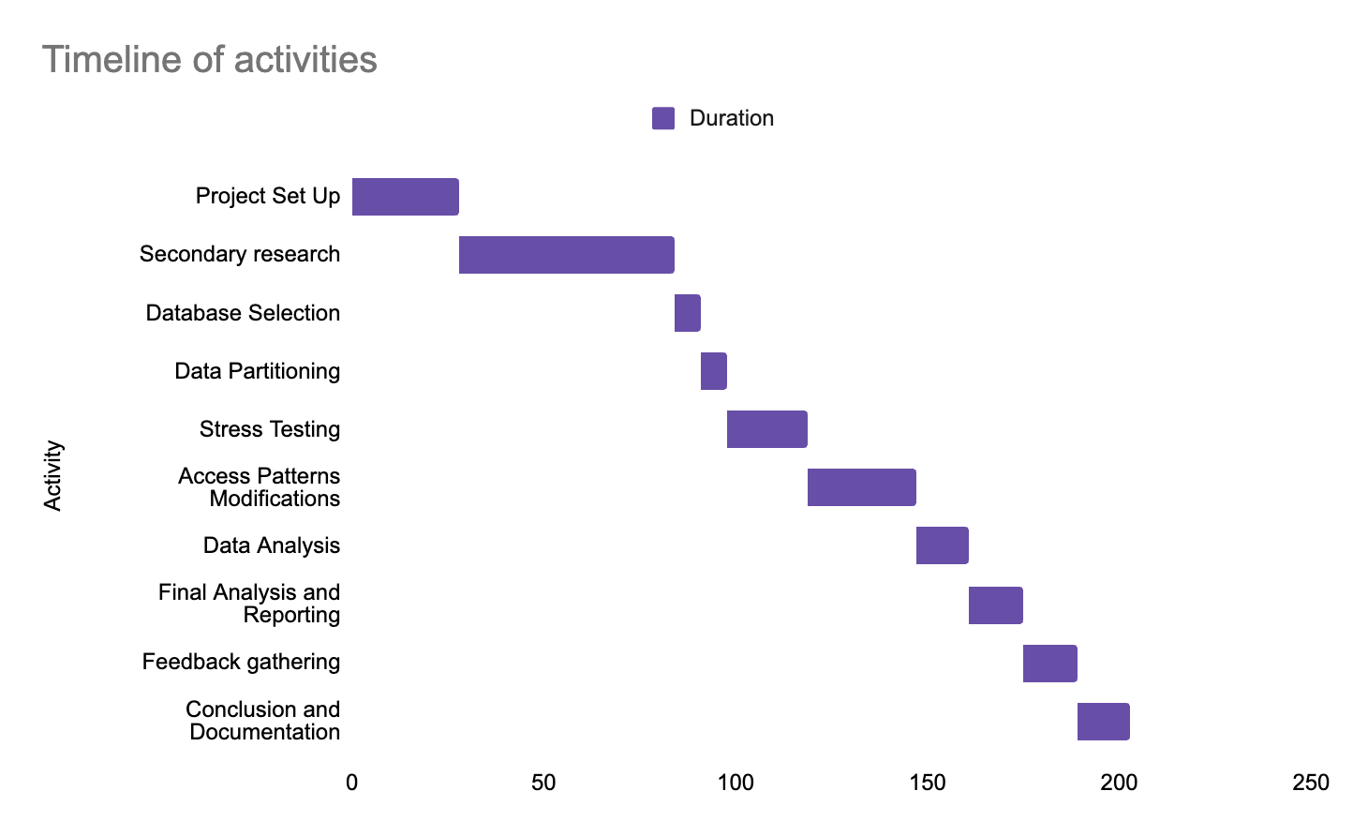
Figure 4: Gantt chart visualising the duration of each of the proposed activities in days.

Slide 28
SUMMARY
References:
Stahl et al., 2016

Slide 29
References
Abadi, D.J., Madden, S. and Ferreira, M. (2006). Integrating compression and execution in column-oriented database systems. International Conference on Management of Data. [online] doi:https://doi.org/10.1145/1142473.1142548.
Abadi, D.J., Madden, S.R. and Hachem, N. (2008). Column-stores vs. row-stores. Proceedings of the 2008 ACM SIGMOD international conference on Management of data, pp.967–980. doi:https://doi.org/10.1145/1376616.1376712.
Batista, E. and Silva, M.B. (2013). Influential Parameters to the Database Performance — A Study by Means of Design of Experiments (DoE). In: M.B. Silva, ed., Design of Experiments - Applications. [online] IntechOpen. doi:https://doi.org/10.5772/56546.
Burns, R.K. and Koh, Y. (1996). A comparison of multilevel structured query language (SQL) implementations. In: Proceedings 12th Annual Computer Security Applications Conference. [online] 12th Annual Computer Security Applications Conference. Available at: 10.1109/CSAC.1996.569698 [Accessed 11 Oct. 2023].
Galindo, F., Makoto Takizawa and R Traunmüller (2004). Database and expert systems applications : 15th international conference, DEXA 2004, Zaragoza, Spain, August 30-September 3, 2004 : proceedings. Berlin ; London: Springer, pp.528–538.
George, T. (2023). What is Secondary Research? | Definition, Types, & Examples. [online] Scribbr. Available at: https://www.scribbr.com/methodology/secondary-research/.
Gordon, R. (2016). Evolution in Databases to Meet Changing Business Needs. [online] Mainline. Available at: https://mainline.com/evolution-databases-meet-changing-business-needs/ [Accessed 13 Oct. 2023].
Graefe, G. and Shapiro, L.P. (2002). Data compression and database performance. CiteSeer X (The Pennsylvania State University). doi:https://doi.org/10.1109/soac.1991.143840.

Slide 30
References
Gupta, P., Mhedhbi, A. and Salihoglu, S. (2021). Columnar storage and list-based processing for graph database management systems. Proceedings of the VLDB Endowment, 14(11), pp.2491–2504. doi:https://doi.org/10.14778/3476249.3476297.
Herberts, M. (2021). Demystifying the use of the Parquet file format for time series. [online] SenX. Available at: https://blog.senx.io/demystifying-the-use-of-the-parquet-file-format-for-time-series/ [Accessed 11 Oct. 2023].
Herodotou, H. (2011). Starfish: A Self-tuning System for Big Data Analytics. In: CIDR 2011, Fifth Biennial Conference on Innovative Data Systems Research, Asilomar, CA, USA, January 9-12, 2011, Online Proceedings. [online] Available at: https://www.researchgate.net/publication/220988112_Starfish_A_Self-tuning_System_for_Big_Data_Analytics [Accessed 11 Oct. 2023].
Holloway, A.L., Raman, V., Swart, G. and DeWitt, D.J. (2007). How to barter bits for chronons: compression and bandwidth trade offs for database scans. In: SIGMOD ’07: Proceedings of the 2007 ACM SIGMOD international conference on Management of data. [online] pp.389–400. Available at: https://doi.org/10.1145/1247480.1247525 [Accessed 11 Oct. 2023].
Idreos, S., Groffen, F., Nes, N., Manegold, S., Mullender, S. and Kersten, M. (2012). MonetDB: Two Decades of Research in Column-oriented Database Architectures. Bulletin of the Technical Committee on Data Engineering, [online] 35. Available at: https://hdl.handle.net/11245/1.380005 [Accessed 11 Oct. 2023].
Kimball, R. and Ross, M. (2013). The data warehouse toolkit : the definitive guide to dimensional modeling. 3rd ed. John Wiley & Sons, Inc., pp.443–496.
Lemire, D., Boytsov, L. and Kurz, N. (2015). SIMD compression and the intersection of sorted integers. Software: Practice and Experience, 46(6), pp.723–749. doi:https://doi.org/10.1002/spe.2326.

Slide 31
References
Lix, L.M. and Keselman, H.J. (2018). Analysis of Variance. The Reviewer’s Guide to Quantitative Methods in the Social Sciences, pp.15–28. doi:https://doi.org/10.4324/9781315755649-2.
Melnik, S., Gubarev, A., Long, J.J., Romer, G., Shivakumar, S., Tolton, M. and Vassilakis, T. (2011). Dremel. Communications of the ACM, 54(6), pp.114–123. doi:https://doi.org/10.1145/1953122.1953148.
Pavlo, A. and Aslett, M. (2016). What’s Really New with NewSQL? ACM SIGMOD Record, [online] 45(2), pp.45–55. doi:https://doi.org/10.1145/3003665.3003674.
Polychroniou, O., Raghavan, A. and Ross, K.A. (2015). Rethinking SIMD Vectorization for In-Memory Databases. In: SIGMOD ’15: Proceedings of the 2015 ACM SIGMOD International Conference on Management of Data. [online] pp.1493–1508. Available at: https://doi.org/10.1145/2723372.2747645 [Accessed 11 Oct. 2023].
Popenoe, R., Langius-Eklöf, A., Stenwall, E. and Jervaeus, A. (2021). A practical guide to data analysis in general literature reviews. Nordic Journal of Nursing Research, [online] 41(4), pp.175–186. doi:https://doi.org/10.1177/2057158521991949.
Ramaiah, R. (2022). Parquet file format, its Dremel connection and how it gets along with Google ProtoBuf. [online] Medium. Available at: https://medium.com/@ramu.ramaiah/parquet-file-format-its-dremel-connection-and-how-it-gets-along-with-google-protobuf-7b1f221ddcdf [Accessed 11 Oct. 2023].
Rey, D. and Neuhäuser, M. (2011). Wilcoxon-Signed-Rank Test. International Encyclopedia of Statistical Science, [online] pp.1658–1659. doi:https://doi.org/10.1007/978-3-642-04898-2_616.
Ross, A. and Willson, V.L. (2017). Basic and Advanced Statistical Tests. [online] Rotterdam Sensepublishers. Available at: https://doi.org/10.1007/978-94-6351-086-8_4 [Accessed 11 Oct. 2023].

Slide 32
References
Selinger, P.G., Atrahan, M.M., Chamberlin, D.D., Lorie, R.A. and Price, T.G. (1979). Access path selection in a relational database management system. In: SIGMOD ’79: Proceedings of the 1979 ACM SIGMOD international conference on Management of data. [online] Available at: https://doi.org/10.1145/582095.582099 [Accessed 11 Oct. 2023].
SHAPIRO, S.S. and WILK, M.B. (1965). An analysis of variance test for normality (complete samples). Biometrika, [online] 52(3-4), pp.591–611. doi:https://doi.org/10.1093/biomet/52.3-4.591.
Sheldon, M.R., Fillyaw, M.J. and Thompson, W.D. (1996). The use and interpretation of the Friedman test in the analysis of ordinal-scale data in repeated measures designs. Physiotherapy Research International, 1(4), pp.221–228. doi:https://doi.org/10.1002/pri.66.
Song, F., Hooper, L. and Loke, Y. (2013). Publication bias: what is it? How do we measure it? How do we avoid it? Open Access Journal of Clinical Trials, p.71. doi:https://doi.org/10.2147/oajct.s34419.
Stahl, B.C., Timmermans, J. and Mittelstadt, B.D. (2016). The Ethics of Computing. ACM Computing Surveys, 48(4), pp.1–38. doi:https://doi.org/10.1145/2871196.
Udara Willhelm Abeydeera, L.H., Wadu Mesthrige, J. and Samarasinghalage, T.I. (2019). Global Research on Carbon Emissions: A Scientometric Review. Sustainability, 11(14), p.3972. doi:https://doi.org/10.3390/su11143972.
Wang, J., Li, T., Wang, A., Liu, X., Lu, C., Chen, J., Liu, J., Wu, J., Li, F. and Gao, Y. (2023). Real-Time Workload Pattern Analysis for Large-Scale Cloud Databases. Proceedings of the VLDB Endowment, 16(12), pp.3689–3701. doi:https://doi.org/10.14778/3611540.3611557.

Slide 33
References
Westmann, T., Kossmann, D., Helmer, S. and Moerkotte, G. (2000). The implementation and performance of compressed databases. ACM SIGMOD Record, 29(3), pp.55–67. doi:https://doi.org/10.1145/362084.362137.
Wickham, R. (2019). Secondary Analysis Research. Journal of the Advanced Practitioner in Oncology, [online] 10(4), pp.395–400. doi:https://doi.org/10.6004/jadpro.2019.10.4.7.
Ziv, J. and Lempel, A. (1977). A universal algorithm for sequential data compression. IEEE Transactions on Information Theory, 23(3), pp.337–343. doi:https://doi.org/10.1109/tit.1977.1055714.
Zukowski, M., Heman, S., Nes, N. and Boncz, P. (2006). Super-Scalar RAM-CPU Cache Compression. In: ICDE ’06: Proceedings of the 22nd International Conference on Data Engineering. [online] Available at: https://doi.org/10.1109/ICDE.2006.150 [Accessed 11 Oct. 2023].

Slide 34
Icons credits section
This section is created in line with the requested referencing style of the website from which the icons were downloaded (https://www.flaticon.com/).
DBMS icon: <a href="https://www.flaticon.com/free-icons/dbms" title="dbms icons">Dbms icons created by Vectors Tank - Flaticon</a>
Access icon: <a href="https://www.flaticon.com/free-icons/access-control" title="access control icons">Access control icons created by Uniconlabs - Flaticon</a>
Database icon: <a href="https://www.flaticon.com/free-icons/big-data" title="big data icons">Big data icons created by The Chohans Brand - Flaticon</a>
Binoculars icon: <a href="https://www.flaticon.com/free-icons/binoculars" title="binoculars icons">Binoculars icons created by Freepik - Flaticon</a>
Technique icon: <a href="https://www.flaticon.com/free-icons/technique" title="technique icons">Technique icons created by amoghdesign - Flaticon</a>
Database icons: <a href="https://www.flaticon.com/free-icons/database" title="database icons">Database icons created by phatplus - Flaticon</a>
Access icon: <a href="https://www.flaticon.com/free-icons/access-control" title="access control icons">Access control icons created by Uniconlabs - Flaticon</a>
Testing environment icon: <a href="https://www.flaticon.com/free-icons/customer-experience" title="customer experience icons">Customer experience icons created by Rmpp - Flaticon</a>
Constant parameters icon: <a href="https://www.flaticon.com/free-icons/load-balancer" title="load balancer icons">Load balancer icons created by small.smiles - Flaticon</a>
DB instances icon: <a href="https://www.flaticon.com/free-icons/replicate" title="replicate icons">Replicate icons created by Vectors Tank - Flaticon</a>
Stress icon: <a href="https://www.flaticon.com/free-icons/stress" title="stress icons">Stress icons created by Freepik - Flaticon</a>
Normal distribution icon: <a href="https://www.flaticon.com/free-icons/normal-distribution" title="Normal Distribution icons">Normal Distribution icons created by orvipixel - Flaticon</a>
Statistical test icon: <a href="https://www.flaticon.com/free-icons/decision" title="decision icons">Decision icons created by judanna - Flaticon</a>
Descriptive metrics icon: <a href="https://www.flaticon.com/free-icons/metrics" title="metrics icons">Metrics icons created by Uniconlabs - Flaticon</a>
Data privacy icon: <a href="https://www.flaticon.com/free-icons/privacy-policy" title="privacy policy icons">Privacy policy icons created by Flat Icons - Flaticon</a>
Intellectual property icon: <a href="https://www.flaticon.com/free-icons/intellectual" title="intellectual icons">Intellectual icons created by Eucalyp - Flaticon</a>
Environmental impact icon: <a href="https://www.flaticon.com/free-icons/transparency" title="transparency icons">Transparency icons created by Wichai.wi - Flaticon</a>
Transparency in reporting icon: <a href="https://www.flaticon.com/free-icons/esg" title="esg icons">Esg icons created by kmg design - Flaticon</a>

