Slide 1
Dependency Injection by example
How dependency injection containers enhance agile programmer’s workshop

Slide 2
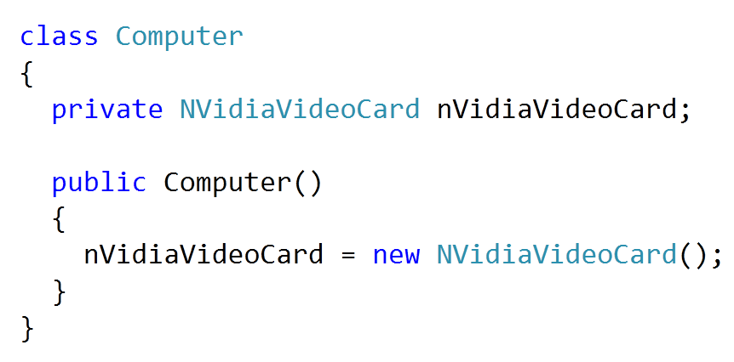
The problem

Slide 3
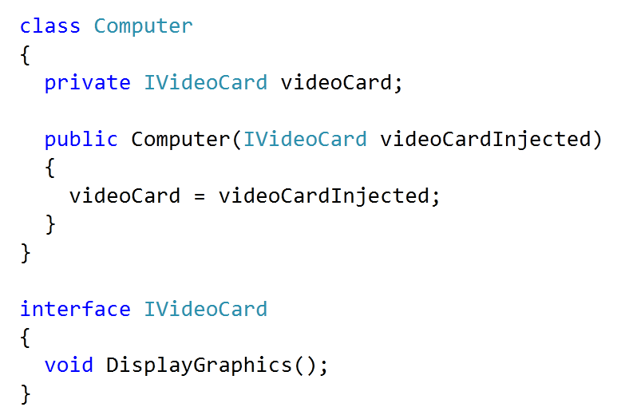
Dependency Injection

Slide 4

Interfaces
Source: Dependency Injection in .NET Mark Seemann

Slide 5
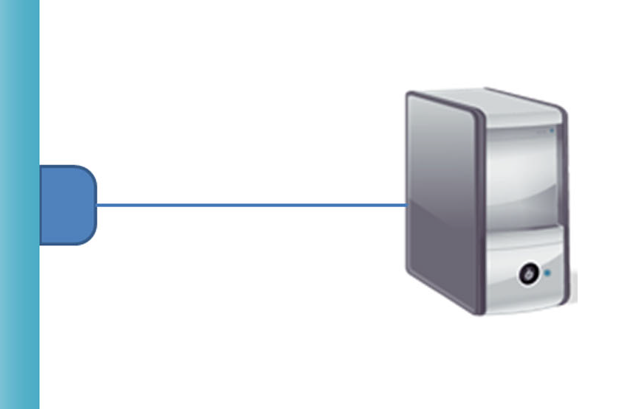
Interfaces – providing implementation
Source: Dependency Injection in .NET Mark Seemann

Slide 6
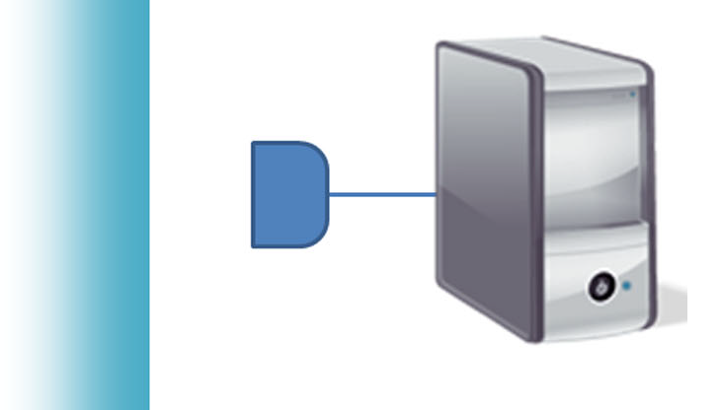
Interfaces – null object
Source: Dependency Injection in .NET Mark Seemann

Slide 7
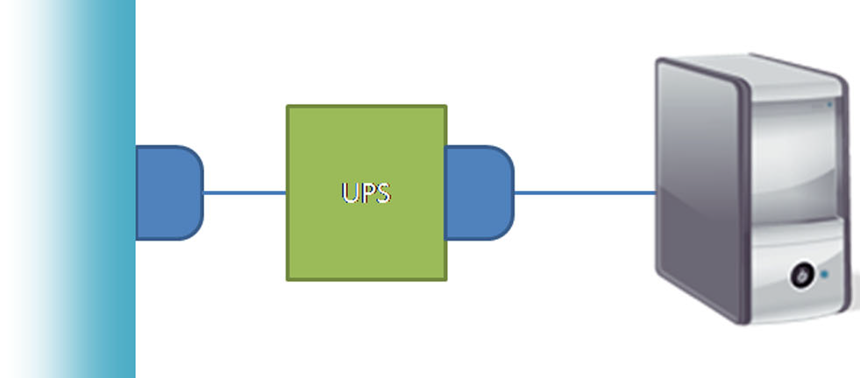
Interfaces - decorator
Source: Dependency Injection in .NET Mark Seemann

Slide 8
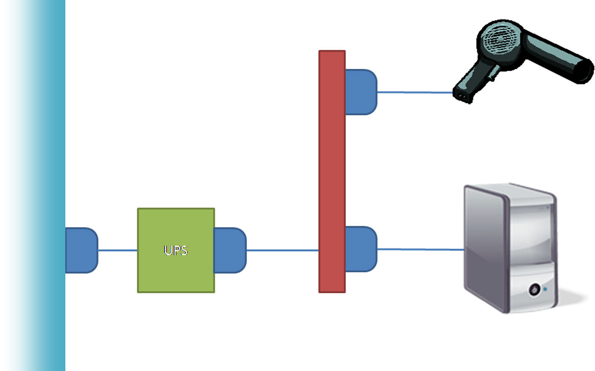
Interfaces - composite
Source: Dependency Injection in .NET Mark Seemann

Slide 9
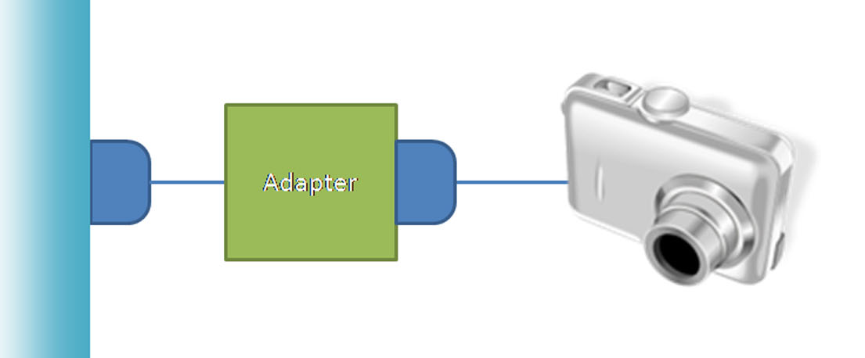
Interfaces - adapter
Source: Dependency Injection in .NET Mark Seemann

Slide 10
Show me the code...

Slide 11
Sources
https://github.com/piotrcierpich/DependencyInjectionByExample
https://github.com/piotrcierpich/DependencyInjectionByExample
https://github.com/piotrcierpich/PoorMansDependencyInjection

Slide 12
Thank you

