Slide 1
dependency injection by example
In .NET with Autofac

Slide 2
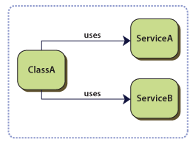
The problem
classes that have dependencies on services or components whose concrete type is specified at design time
to replace or update the dependencies, you need to change your classes' source code
the concrete implementations of the dependencies have to be specified and available at compile time
classes are difficult to test in isolation because they have direct references to dependencies
classes contain repetitive code for creating, locating, and managing their dependencies

Slide 3
In terms of SOLID
Dependency-inversion principle
High level modules should not depend on low level modules. Both should depend on abstractions
Abstractions should not depend upond details. Details should depend upon abstractions
Self creating dependencies is rigid, immobile...

Slide 4
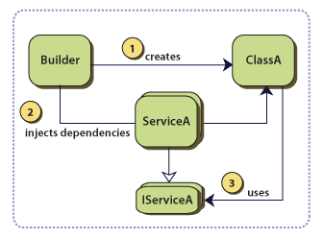
Dependency injection
express dependencies in your class definition
use a builder object to obtain valid instances of your object's dependencies and pass them to your object during the object's creation and/or initialization

Slide 5
Dependency injection
Show me the code...

Slide 6
Constructor injection
express dependencies in the form of constructor parameters
typically dependencies are expressed as interfaces instead of concrete classes. This enables easy replacement of the dependency concrete implementation without modifying classes' source code
autowiring is the process of creating components by selecting a constructor according to the services available in the container

Slide 7
Dependency injection
Advantages
classes are decoupled from their dependencies so that these dependencies can be replaced or updated with minimal or no changes to the classes' source code
classes dependencies may be not known at compile time
classes may be decoupled from logic responsible for lifetime management of the dependencies
Disadvantages
complexity

Slide 8
Dependency Injection
classes are difficult to test in isolation because they have direct references to dependencies
to replace or update the dependencies, you need to change your classes' source code
the concrete implementations of the dependencies have to be specified and available at compile time
classes contain repetitive code for creating, locating, and managing their dependencies

Slide 9
Containers
Handle configuration / infrastructure code

Slide 10
Deterministic disposal
Container is disposable and disposes it’s children- let it handle it
LifetimeScope

Slide 11
XML configuration
Show me the XML...

Slide 12
Delegate factories
Func<T>
IFactory
+ Create : T

Slide 13
Modules, assembly scanning, scoping..
Show me the code...

