Slide 1
Architecture concepts

Slide 2
Architecture
Subjective system’s vision, common definition of components and their interconnections, also:
Practices that define software design and decomposition into structures

Slide 3
Architecture Patterns
Architecture patterns are general, reusable solution to commonly occuring problem
Help make decisions about architecture
Not out-of the box solutions, frequently adjusted to context
Dictionary of typical problem-solution or software structures

Slide 4
Tiers and layers
Two-tiers architecture = client + SQL
No place for business logic, validation, rules, computation etc. UI? Db?
(Logical) layers are a way of organizing code
(Physical) tiers are only about where the code runs. Tiers are places where layers are deployed

Slide 5

Three tier architecture

Slide 6
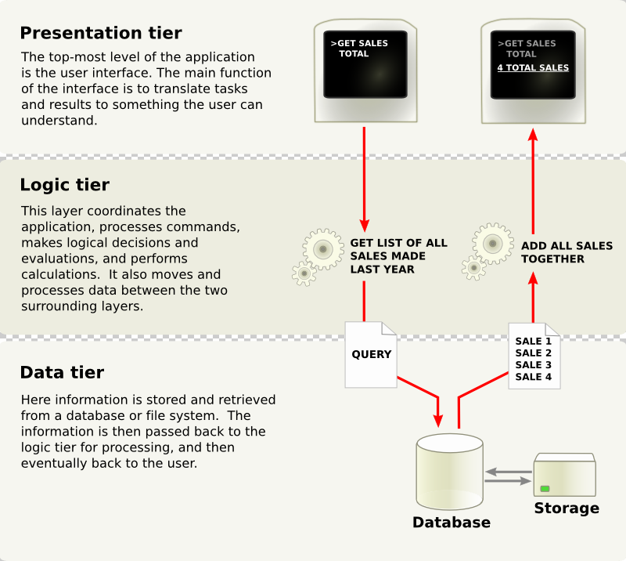
Three tier architecture
http://en.wikipedia.org/wiki/Multitier_architecture

Slide 7
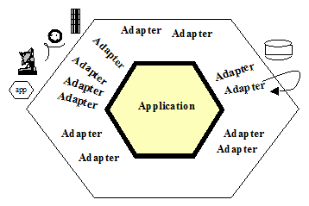
Hexagonal architecture
avoid layer-to-layer dependencies usually associated with the N-tier architecture approach by placing all infrastructure, including databases, outside the problem domain
http://alistair.cockburn.us/Hexagonal+architecture

Slide 8
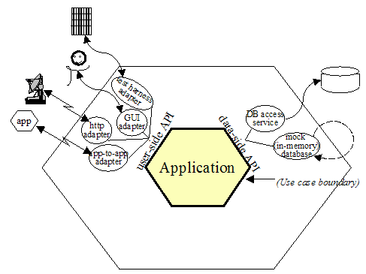
Hexagonal architecture
http://alistair.cockburn.us/Hexagonal+architecture

Slide 9
Independent domain layering
Presentation
Domain
Infrastructure

Slide 10
Independent domain layering
Presentation
Domain
Infrastructure

Slide 11
Layers implementation
Layers are:
Scripts / functions
Classes
Packages
Layer affiliation, replacement test

Slide 12
Layers distribution
Layers enable physical distribution
Clear mapping between functionality and corresponding code
Emphasis on coarse grained, non-distributed domain layer
Non-splitted layers between nodes – physical and logical, complexity boosters

Slide 13
Domain logic
Computations, data processing, rules, decision making

Slide 14
Transaction script
Implemented as set of (sub)procedures which
Correspond to single user activity / use case
Good for simple business logic

Slide 15
Transaction script
Pros:
Simplicity
Defining beggining and end of transaction is easy
Usage of Table Data Gateway and Row Data Gateway is easy
Cons:
Good only for simple logic, complex logic is overly complexed...
Code repetition, difficult to avoid and eliminate

Slide 16
Domain Model
Object-oriented design applied for domain logic
Addresses complexed business logic

Slide 17
Domain Model
Pros:
All advantages of OOD
Extensibility
Better testability
Design patterns
Guidelines for tackling complexity
Cons:
Complexity

