Slide 2

Three tier architecture

Slide 3
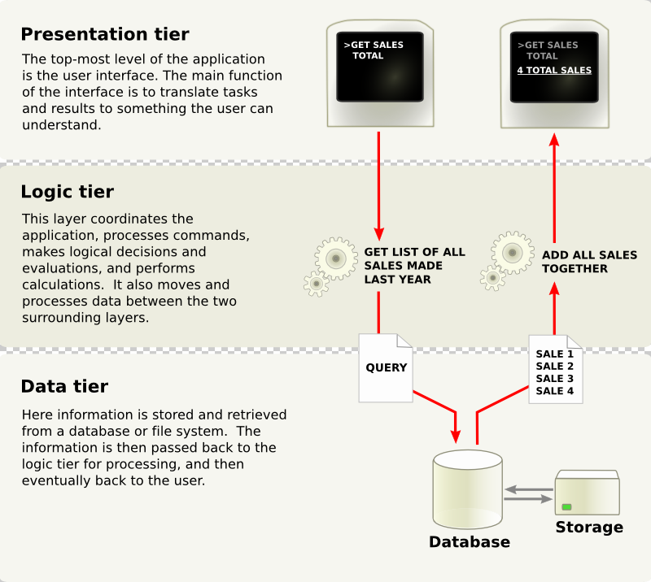
Three tier architecture

