Slide 1
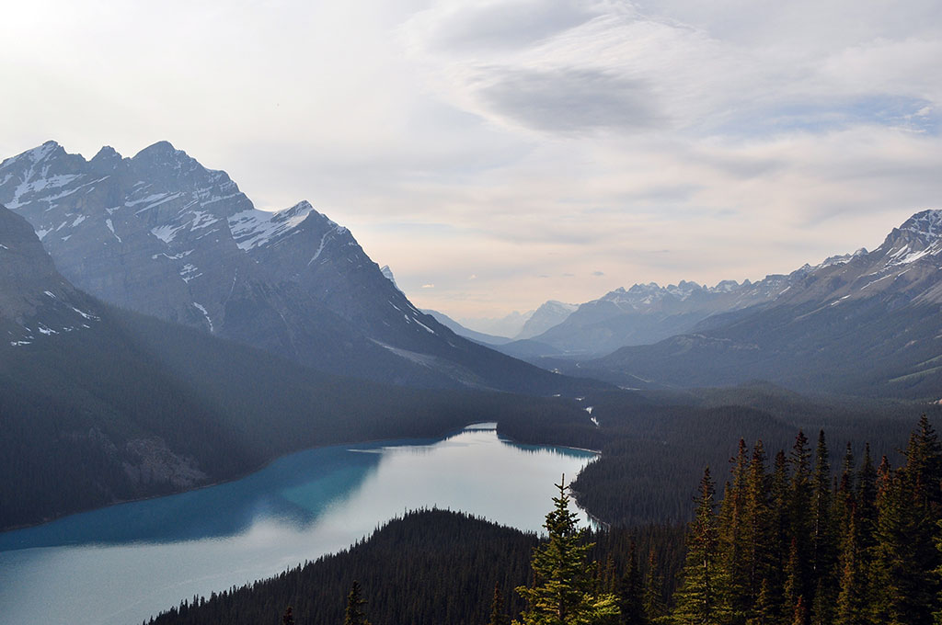

GREEPAM
CSR Initiative
OCTOBER 25, 2017

Slide 2
AGENDA
1
Problem description
2
Project objectives
3
Milestones
4
Risks
5
Nulla et facilisis arcu praesent eget ornare risus
6
Nulla et facilisis arcu praesent eget ornare risus

Slide 3
PROBLEM DESCRIPTION
Krakow is established one of Europe’s top tourist destinations, attracting millions of visitors every year, though majority of them come here during the summer…
540% OF AIR QUALITY STANDARDS
DURING THE WINTER IS NO EXTRAORDINARY VALUE, PEOPLE PAY MORE ATTENTION TO THAT THAN TO THE WEATHER
HIGH POLLUTION WITH PARTICULATES CAN CAUSE DISEASES OF RESPIRATORY, CIRCULATORY AND NERVOUS SYSTEMS, AFFECTS PEOPLES CONCENTRATION AND MEMORY, CAUSE DEPRESSIONS AND OVERALL BAD STATE OF BEING.
POLLUTED AIR MAKES OUTDOOR ACTIVITIES IMPOSSIBLE FOR MAJOR PART OF THE YEAR, WHICH IS PARTICULARLY UNFAVORABLE FOR THOSE WHO WORK SEATED FOR MOST OF THE DAY
Notes:
Reading on world view:
http://www.forbes.com/sites/oracle/2015/10/29/larry-ellisons-world-view-7-observations-straight-from-the-hip/#bb79fdc60800
https://hbr.org/2014/09/your-companys-purpose-is-not-its-vision-mission-or-values
To bring strong ability to support high level of competitiveness to our clients to navigate successfully constantly changing word of information technology and software.
To be a trusted partner to our clients to help them staying highly competitive in their own respective markets…and, sometimes, to open new horizons for them to make the world better….by bringing to life new business solutions driven by constantly evolving software and information technology capabilities.
To be a partner of choice for our clients to insure their cutting edge competitiveness in their own respective markets and to expand their horizons with new opportunities to change the world….by bringing to life new business solutions driven by constantly evolving software and information technology capabilities and delivered with best-in-class engineering practices by multidiscipline teams of designers, analysts, and engineers

Slide 4
PROJECT OBJECTIVES
Well established in Kraków for years
Over 1500 people with a goal can make a difference
STRENGHTEN EPAM IMAGE OF SOCIALLY RESPONSIBLE
1
Price of square meter in Kraków ~= 1kPLN
Estimates are 15-25% of parking places unused
TO OPTIMIZE OFFICE RESOURCES
2
Up to 550% of acceptable air polution
3
TO PROTECT ENVIRONMENT

Slide 5
MILESTONES
SEVEN STAGES ON THE WAY TO CONTRIBUTE TO SUSTAINABLE DEVELOPMENT OF LOCAL SOCIETY BY PROMOTING ECOLOGICAL MEANS OF TRANSPORT
NOV 2017
JAN 2018
Jul 2018
Aug 2018
PROJECT START
Approval from management
INITIATION
Hardware, software, office, PEOPLE
INITIAL DESIGN
Physics, public information, external API integration
RESEARCH
And observations
FULL AND STABLE
and deployed
PROOF OF CONCEPT
Software prototype
OPENING AND CAMPAIGN
Party event, presentation to media, support for software

Slide 6
RISKS
1
2
3
4
LEGAL
Technical issues
Staffing
Outdoor condition
Driving, riding a bike, walks across Cracow…
Pair of EPAMers in a car
Bike road maps, tram stops maps, bus schedules?
Car park data sharing
Partial involvement of specialists
Non-core project
Budget cuts
Accidents
Delays
Notes:
Pillars slide

Slide 7
Q & A

