Slide 1
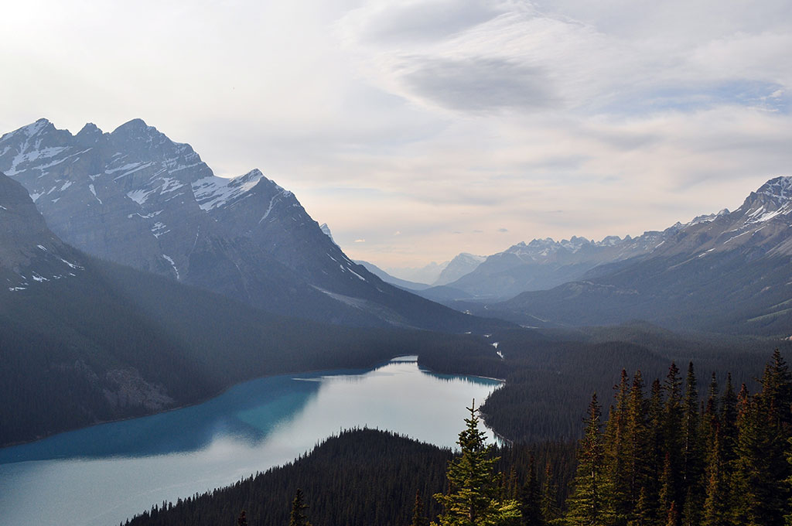

GREEPAM
CSR Initiative
OCTOBER 25, 2017

Slide 2
AGENDA
1
Problem description
2
Motivation
3
Project objectives
4
Milestones
5
Risks
6
Resources
7
Budget

Slide 3
PROBLEM DESCRIPTION
Krakow is established one of Europe’s top tourist destinations, attracting millions of visitors every year, though majority of them come here during the summer…
540% OF AIR QUALITY STANDARDS
DURING THE WINTER IS NO EXTRAORDINARY VALUE, PEOPLE PAY MORE ATTENTION TO THAT THAN TO THE WEATHER
HIGH POLLUTION WITH PARTICULATES CAN CAUSE DISEASES OF RESPIRATORY, CIRCULATORY AND NERVOUS SYSTEMS, AFFECTS PEOPLES CONCENTRATION AND MEMORY, CAUSE DEPRESSIONS AND OVERALL BAD STATE OF BEING.
POLLUTED AIR MAKES OUTDOOR ACTIVITIES IMPOSSIBLE FOR MAJOR PART OF THE YEAR, WHICH IS PARTICULARLY UNFAVORABLE FOR THOSE WHO WORK SEATED FOR MOST OF THE DAY
Notes:
Reading on world view:
http://www.forbes.com/sites/oracle/2015/10/29/larry-ellisons-world-view-7-observations-straight-from-the-hip/#bb79fdc60800
https://hbr.org/2014/09/your-companys-purpose-is-not-its-vision-mission-or-values
To bring strong ability to support high level of competitiveness to our clients to navigate successfully constantly changing word of information technology and software.
To be a trusted partner to our clients to help them staying highly competitive in their own respective markets…and, sometimes, to open new horizons for them to make the world better….by bringing to life new business solutions driven by constantly evolving software and information technology capabilities.
To be a partner of choice for our clients to insure their cutting edge competitiveness in their own respective markets and to expand their horizons with new opportunities to change the world….by bringing to life new business solutions driven by constantly evolving software and information technology capabilities and delivered with best-in-class engineering practices by multidiscipline teams of designers, analysts, and engineers

Slide 4
PROBLEM DESCRIPTION
At December 2016, a pollution tracking agency in Skala in the country’s south detected air pollutants of 979 micrograms (one millionth of a gram) per cubic metre of air, far exceeding Beijing’s 737 and almost 20 times higher than EU limits. Public transport in the capital Warsaw was also made free one day for this month for the first time due to poor air quality..
Air pollution problem in Poland has a national significance.
A staggering 33 out of the 50 most polluted cities in Europe are in Poland, according to the World Health Organization; people in the industrial south of the country have been living in dangerous levels of smog for years
“For years Polish cities have been the most polluted, which makes Poland a disgraceful leader — the red spot on the map of Europe. The situation has not been changing as we lack relevant regulations which would efficiently limit emissions of dangerous substances,” - Ewa Lutomska of Polski Alarm Smogowy, a pollution watchdog.
Notes:
Reading on world view:
http://www.forbes.com/sites/oracle/2015/10/29/larry-ellisons-world-view-7-observations-straight-from-the-hip/#bb79fdc60800
https://hbr.org/2014/09/your-companys-purpose-is-not-its-vision-mission-or-values
To bring strong ability to support high level of competitiveness to our clients to navigate successfully constantly changing word of information technology and software.
To be a trusted partner to our clients to help them staying highly competitive in their own respective markets…and, sometimes, to open new horizons for them to make the world better….by bringing to life new business solutions driven by constantly evolving software and information technology capabilities.
To be a partner of choice for our clients to insure their cutting edge competitiveness in their own respective markets and to expand their horizons with new opportunities to change the world….by bringing to life new business solutions driven by constantly evolving software and information technology capabilities and delivered with best-in-class engineering practices by multidiscipline teams of designers, analysts, and engineers

Slide 5
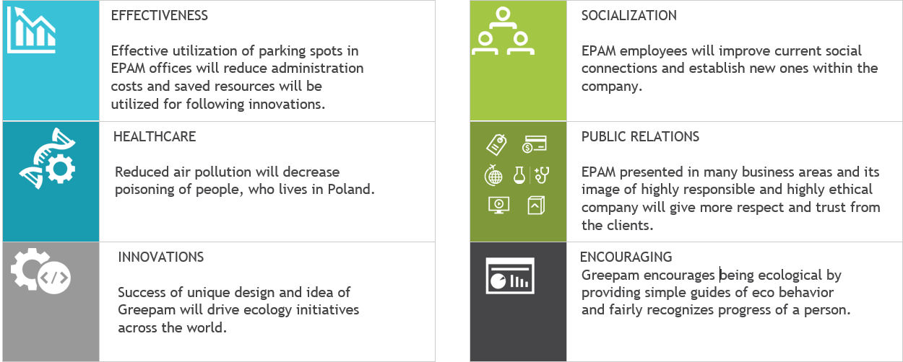
MOTIVATION

Slide 6
PROJECT OBJECTIVES
Well established in Kraków for years
Over 1500 people with a goal can make a difference
STRENGHTEN EPAM IMAGE OF SOCIALLY RESPONSIBLE
1
Price of square meter in Kraków ~= 1kPLN
Estimates are 15-25% of parking places unused
TO OPTIMIZE OFFICE RESOURCES
2
Up to 550% of acceptable air polution
3
TO PROTECT ENVIRONMENT

Slide 7
MILESTONES
SEVEN STAGES ON THE WAY TO CONTRIBUTE TO SUSTAINABLE DEVELOPMENT OF LOCAL SOCIETY BY PROMOTING ECOLOGICAL MEANS OF TRANSPORT
NOV 2017
JAN 2018
Jul 2018
Aug 2018
PROJECT START
Approval from management
INITIATION
Hardware, software, office, PEOPLE
DESIGN
Physics, public information, external API integration
RESEARCH
And observations
FULL AND STABLE
and deployed
SOFTWARE IMPLEMENTATION
Software prototype
RELEASE AND CAMPAIGN
Party event, presentation to media, support for software

Slide 8
RISKS
1
2
3
4
LEGAL
Technical issues
Staffing
Outdoor condition
Driving, riding a bike, walks across Cracow…
Pair of EPAMers in a car
Bike road maps, tram stops maps, bus schedules?
Car park data sharing
Partial involvement of specialists
Non-core project
Budget cuts
Accidents
Delays
Notes:
Pillars slide

Slide 9
RESOURCES
Initiators
Project Manager
Architect, UX Designer
Development Team Lead
Backend, Mobile, Web Developer
Quality Assurance Specialist
Public Relations Specialist

Slide 10
BUDGET
Software costs: 20 000 PLN
Labor costs: 962 120 PLN
Hardware costs: 39 900 PLN
TOTAL: 1 320 220 PLN
Contingency reserve: 57 400 PLN
Logistics costs: 127 000 PLN
Management Reserve: 114 800 PLN

Slide 11
Q & A

