Slide 1

Vue.js
Piotr Dominiak
Internet engineering
Wimip 2020

Slide 2
Summary
Vue.js is an open-source Model–view–viewmodel JavaScript framework for building user interfaces and single-page applications.
It was created by Evan You, and is maintained by him and the rest of the active core team members coming from various companies such as Netlify and Netguru.
Vue.js features an incrementally adoptable architecture that focuses on declarative rendering and component composition. Advanced features required for complex applications such as routing, state management and build tooling are offered via officially maintained supporting libraries and packages, with Nuxt.js as one of the most popular solutions.

Slide 3
Summary continued
Vue is a progressive framework for building user interfaces. Unlike other monolithic frameworks, Vue is designed from the ground up to be incrementally adoptable. The core library is focused on the view layer only and is easy to pick up and integrate with other libraries or existing projects. On the other hand, Vue is also perfectly capable of powering sophisticated Single-Page Applications when used in combination with modern tooling and supporting libraries.

Slide 4
History
Vue was created by Evan You after working for Google using AngularJS in several projects. The first source code commit to the project was dated July 2013, and Vue was first released the following February, in 2014.
First release (v0.6): Feb 2014
v1.0.0 Evangelion: Oct 2015
V2.0.0 Ghost in the Shell: Sep 2016
Latest Macross: Feb 2019

Slide 5
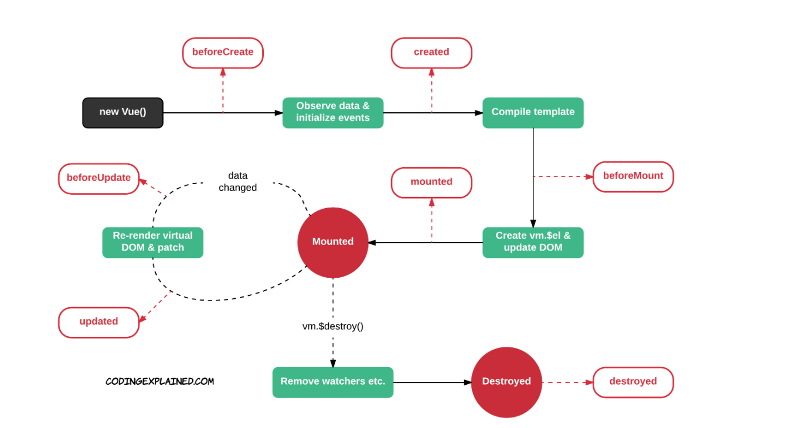
Lifecycle

Slide 6
Features
Components
Templates
Reactivity
Transitions
Routing

Slide 7
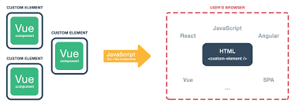
Components
Vue components extend basic HTML elements to encapsulate reusable code. At a high level, components are custom elements to which the Vue’s compiler attaches behavior. In Vue, a component is essentially a Vue instance with pre-defined options

Slide 8
Templates
Vue uses an HTML-based template syntax that allows binding the rendered DOM to the underlying Vue instance's data. All Vue templates are valid HTML that can be parsed by specification-compliant browsers and HTML parsers. Vue compiles the templates into virtual DOM render functions. A virtual Document Object Model (or “DOM”) allows Vue to render components in its memory before updating the browser. Combined with the reactivity system, Vue is able to calculate the minimal number of components to re-render and apply the minimal amount of DOM manipulations when the app state changes.

Slide 9
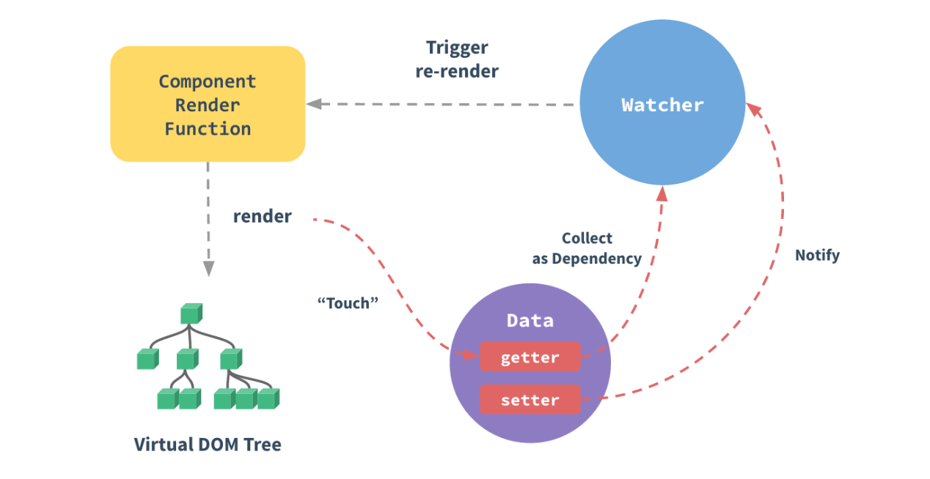
Reactivity
Vue features a reactivity system that uses plain JavaScript objects and optimized re-rendering. Each component keeps track of its reactive dependencies during its render, so the system knows precisely when to re-render, and which components to re-render.

Slide 10
Transitions
Vue provides a variety of ways to apply transition effects when items are inserted, updated, or removed from the DOM. This includes tools to:
Automatically apply classes for CSS transitions and animations
Integrate third-party CSS animation libraries, such as Animate.css
Use JavaScript to directly manipulate the DOM during transition hooks
Integrate third-party JavaScript animation libraries, such as Velocity.js

Slide 11
Routing
Vue provides an interface to change what is displayed on the page based on the current URL path -- regardless of how it was changed (whether by emailed link, refresh, or in-page links). Additionally, using a front-end router allows for the intentional transition of the browser path when certain browser events (i.e. clicks) occur on buttons or links. Vue itself doesn’t come with front-end hashed routing. But the open source "vue-router" package provides an API to update the application's URL, supports the back button (navigating history), and email password resets or email verification links with authentication URL parameters. It supports mapping nested routes to nested components and offers fine-grained transition control. With Vue, developers are already composing applications with small building blocks building larger components. With vue-router added to the mix, components must merely be mapped to the routes they belong to, and parent/root routes must indicate where children should render.

Slide 12
ADVANTAGES
Size
Easy to learn and use
Smooth integration
Thorough documentation
Flexibility

Slide 13
Size

Slide 14
Easy to learn and use
Hello Vue!
var app = new Vue({
el: '#app’ ,
data: {
message: 'Hello Vue!’
}
})

Slide 15
Smooth integration
tag script
Webpack
Web components
Browserify
requeirejs

Slide 16
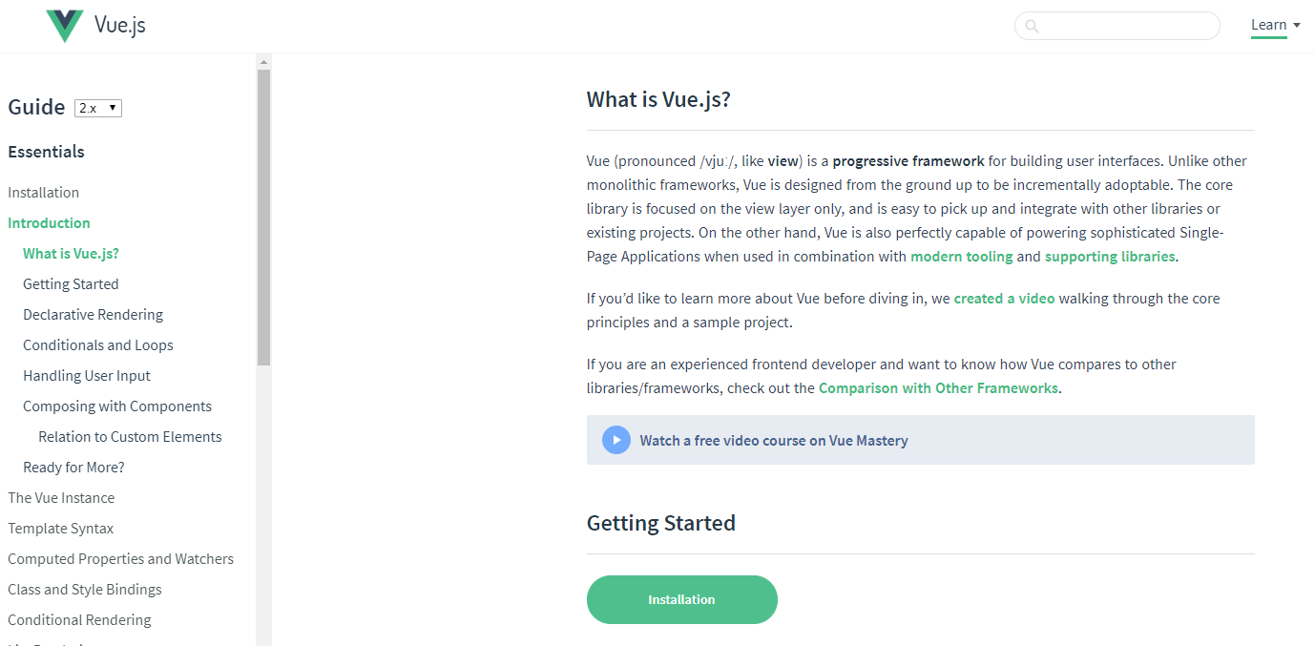
Thorough documentation

Slide 17
Flexibility
Write a template in a HTML file
Use JSX in a Javascript file
Write a template in JS using virtual nodes
Familiar design to react / angular environments

Slide 18
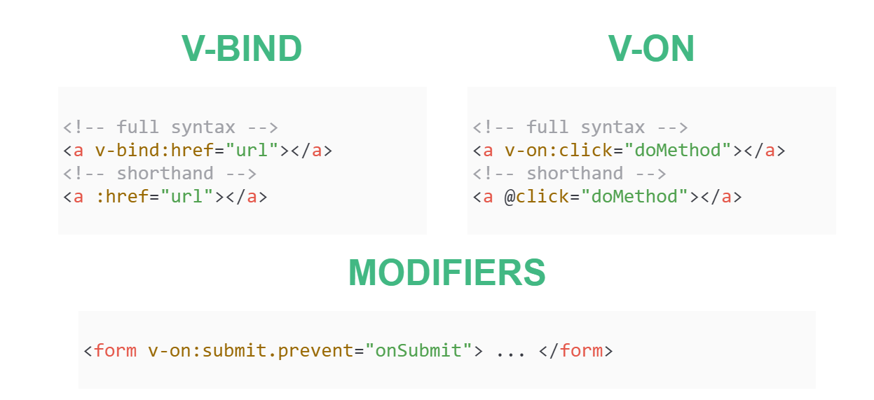
Directives

Slide 19
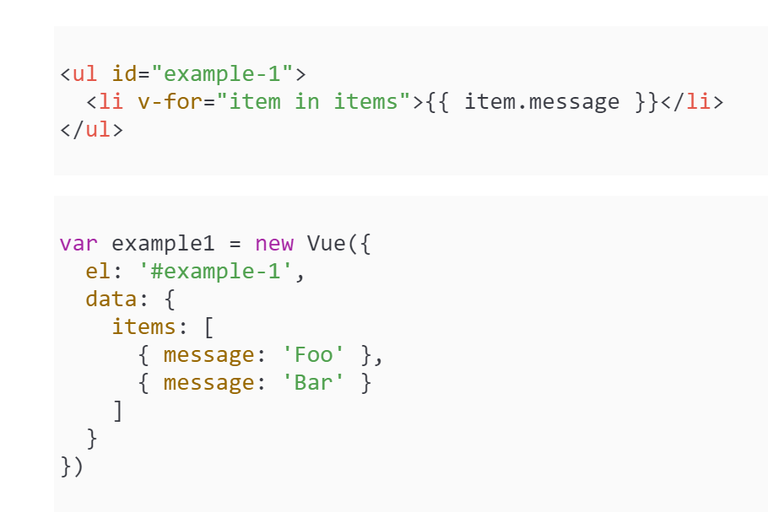
Loops

Slide 20
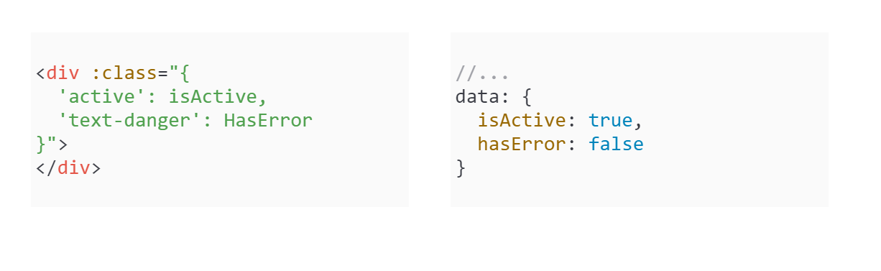
Binding HTML Classes

Slide 21
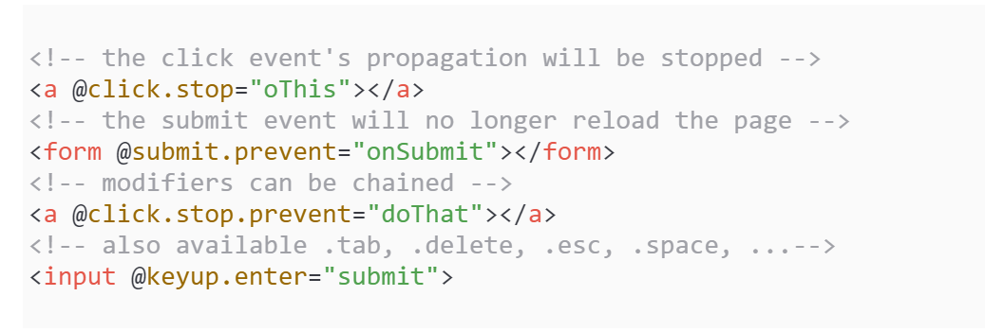
EVENT and KEY modifiers

Slide 22
Who is using Vue.js
GitLab
Netflix
Xiaomi
Alibaba
WizzAir
Facebook
Alibaba

Slide 23
Układ Dwa elementy zawartości z tabelą
Tutaj dodaj pierwszy punktor
Tutaj dodaj drugi punktor
Tutaj dodaj trzeci punktor
Klasa | Grupa 1 | Grupa 2
Klasa 1 | 82 | 95
Klasa 2 | 76 | 88
Klasa 3 | 84 | 90

Slide 24
References
https://en.wikipedia.org/wiki/Vue.js
https://vuejs.org/v2/guide/
https://robinck.github.io/

Slide 25
Thank you for your attention
Piotr Dominiak
Internet engineering
Wimip 2020

