Slide 1
C++ software automated testing

Slide 2
Revisions
08.11.2017 initial revision – Piotr Górecki

Slide 3
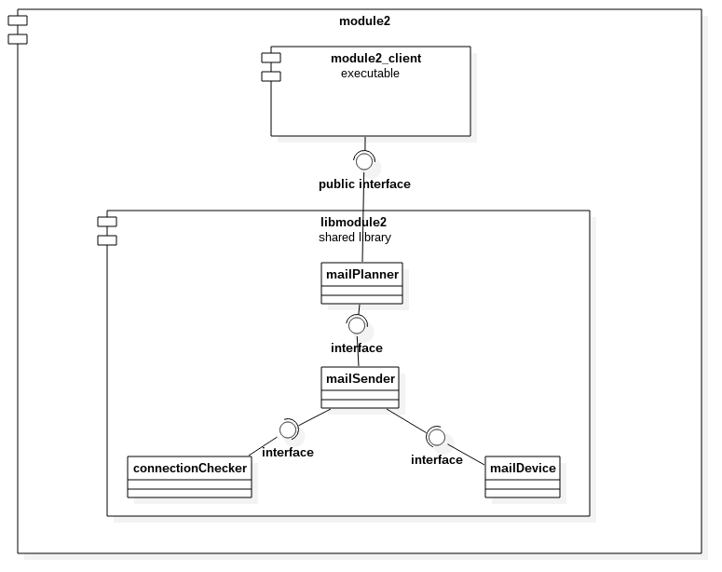
Investigation in tested object

Slide 4
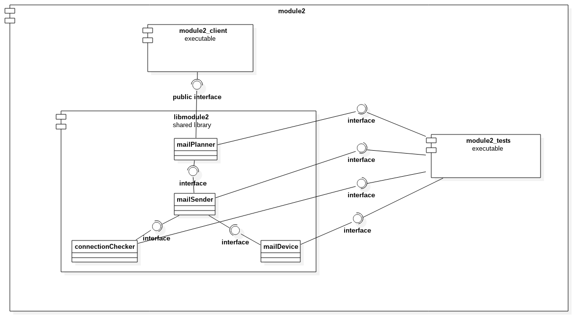
Investigation in tested object

Slide 5
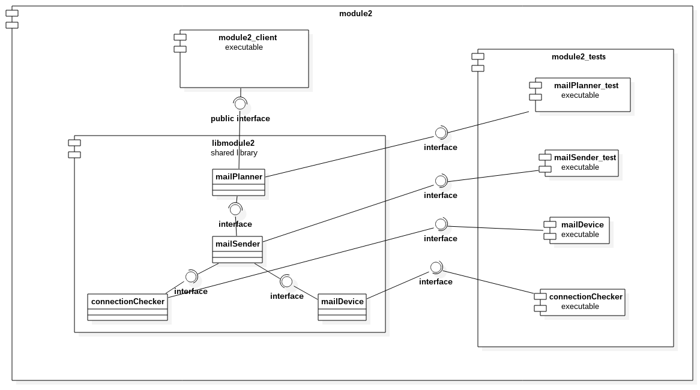
Investigation in tested object

Slide 6
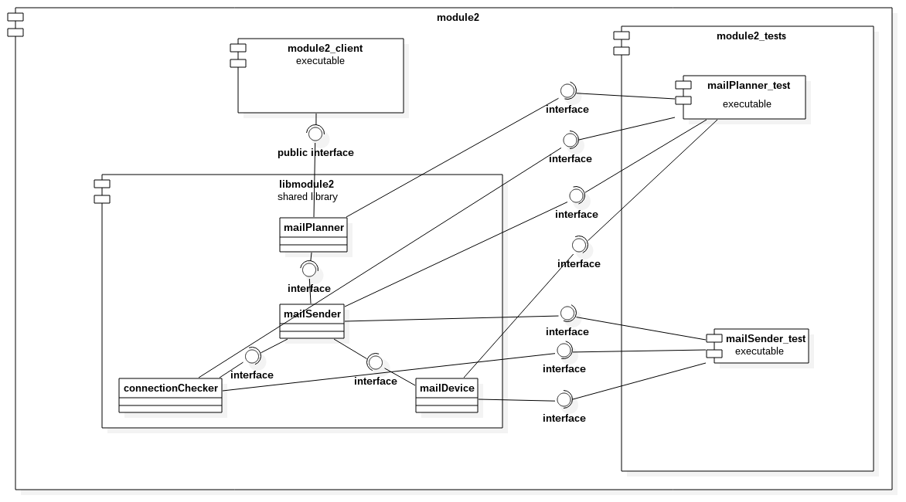
Investigation in tested object

Slide 7
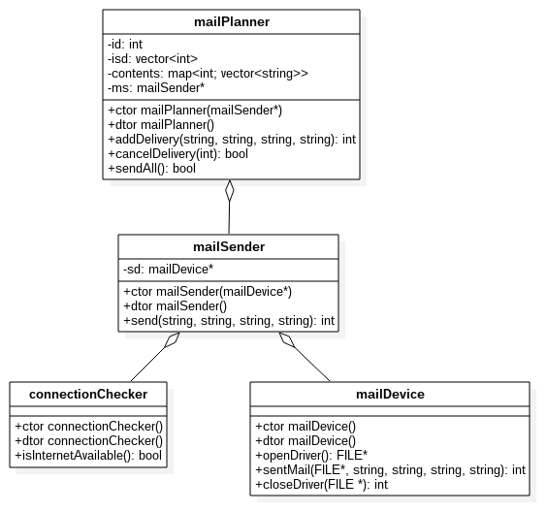
Investigation in tested object

Slide 8
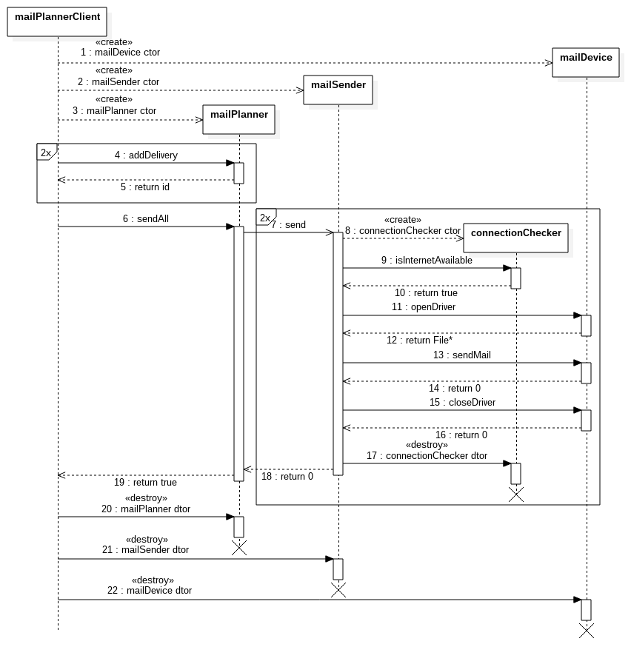
Investigation in tested object

Slide 9
Writing automated tests
bottom up, white box:
1) UT for mailDevice
2) fake mailDevice object
3) UT for connectionChecker
4) fake connectionChecker
5) UT for mailSender with fake mailDevice and connectionChecker objects
6) IT for mailSender with real mailDevice and
connectionChecker objects
7) fake mailSender object
8) UT for mailPlanner with fake mailSender object
9) IT for mailPlanner with real mailSender object

Slide 10
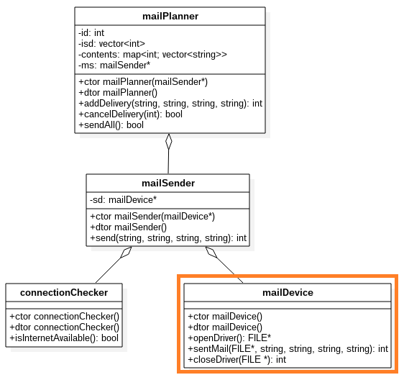
Writing automated tests
bottom up, white box:
1) UT for mailDevice
2) fake mailDevice object
3) UT for connectionChecker
4) fake connectionChecker
5) UT for mailSender with fake mailDevice and connectionChecker objects
6) IT for mailSender with real mailDevice and
connectionChecker objects
7) fake mailSender object
8) UT for mailPlanner with fake mailSender object
9) IT for mailPlanner with real mailSender object

Slide 11
UT for mailDevice
openDriverSuccess

Slide 12
UT for mailDevice
closeDriverSucces

Slide 13
UT for mailDevice
closeDriverFail

Slide 14
UT for mailDevice
sendMailSuccess

Slide 15
UT for mailDevice
sendMailFail

Slide 16
Writing automated tests
bottom up, white box:
1) UT for mailDevice
2) fake mailDevice object
3) UT for connectionChecker
4) fake connectionChecker
5) UT for mailSender with fake mailDevice and connectionChecker objects
6) IT for mailSender with real mailDevice and
connectionChecker objects
7) fake mailSender object
8) UT for mailPlanner with fake mailSender object
9) IT for mailPlanner with real mailSender object

Slide 17
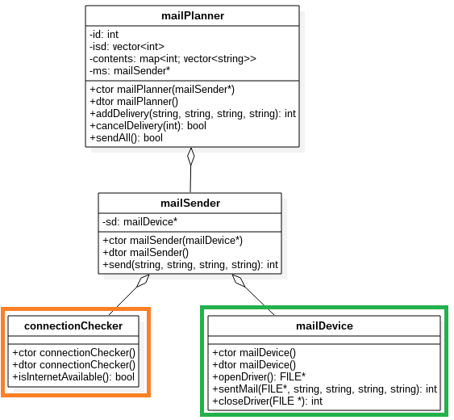
Writing automated tests
bottom up, white box:
1) UT for mailDevice
2) fake mailDevice object
3) UT for connectionChecker
4) fake connectionChecker
5) UT for mailSender with fake mailDevice and connectionChecker objects
6) IT for mailSender with real mailDevice and
connectionChecker objects
7) fake mailSender object
8) UT for mailPlanner with fake mailSender object
9) IT for mailPlanner with real mailSender object

Slide 18
UT for connectionChecker
internetAccesible

Slide 19
UT for connectionChecker
internetInaccesible

Slide 20
Writing automated tests
bottom up, white box:
1) UT for mailDevice
2) fake mailDevice object
3) UT for connectionChecker
4) fake connectionChecker
5) UT for mailSender with fake mailDevice and connectionChecker objects
6) IT for mailSender with real mailDevice and
connectionChecker objects
7) fake mailSender object
8) UT for mailPlanner with fake mailSender object
9) IT for mailPlanner with real mailSender object

Slide 21
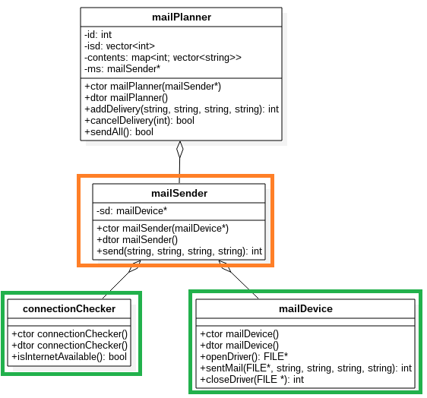
Writing automated tests
bottom up, white box:
1) UT for mailDevice
2) fake mailDevice object
3) UT for connectionChecker
4) fake connectionChecker
5) UT for mailSender with fake mailDevice and connectionChecker objects
6) IT for mailSender with real mailDevice and
connectionChecker objects
7) fake mailSender object
8) UT for mailPlanner with fake mailSender object
9) IT for mailPlanner with real mailSender object

Slide 22
UT for mailSender
sendValidatedMail_UT

Slide 23
Writing automated tests
bottom up, white box:
1) UT for mailDevice
2) fake mailDevice object
3) UT for connectionChecker
4) fake connectionChecker
5) UT for mailSender with fake mailDevice and connectionChecker objects
6) IT for mailSender with real mailDevice and
connectionChecker objects
7) fake mailSender object
8) UT for mailPlanner with fake mailSender object
9) IT for mailPlanner with real mailSender object

Slide 24
Writing automated tests
bottom up, white box:
1) UT for mailDevice
2) fake mailDevice object
3) UT for connectionChecker
4) fake connectionChecker
5) UT for mailSender with fake mailDevice and connectionChecker objects
6) IT for mailSender with real mailDevice and
connectionChecker objects
7) fake mailSender object
8) UT for mailPlanner with fake mailSender object
9) IT for mailPlanner with real mailSender object

Slide 25
IT for mailSender
sendValidatedMail_ITBB
sendValidatedMail_ITWBLogs
sendValidatedMail_ITBBMocks
sendValidatedMail_ITBBMocksLogs

Slide 26
Writing automated tests
bottom up, white box:
1) UT for mailDevice
2) fake mailDevice object
3) UT for connectionChecker
4) fake connectionChecker
5) UT for mailSender with fake mailDevice and connectionChecker objects
6) IT for mailSender with real mailDevice and
connectionChecker objects
7) fake mailSender object
8) UT for mailPlanner with fake mailSender object
9) IT for mailPlanner with real mailSender object

Slide 27
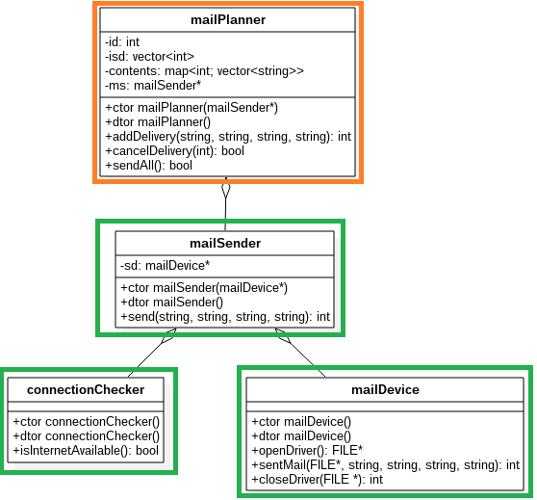
Writing automated tests
bottom up, white box:
1) UT for mailDevice
2) fake mailDevice object
3) UT for connectionChecker
4) fake connectionChecker
5) UT for mailSender with fake mailDevice and connectionChecker objects
6) IT for mailSender with real mailDevice and
connectionChecker objects
7) fake mailSender object
8) UT for mailPlanner with fake mailSender object
9) IT for mailPlanner with real mailSender object

Slide 28
UT for mailPlanner
addDeliveryNoError_UT

Slide 29
UT for mailPlanner
addDeliveryRetDiffId_UT

Slide 30
UT for mailPlanner
cancelDeliveries_UT

Slide 31
UT for mailPlanner
sendAllSuccess_UT

Slide 32
Writing automated tests
bottom up, white box:
1) UT for mailDevice
2) fake mailDevice object
3) UT for connectionChecker
4) fake connectionChecker
5) UT for mailSender with fake mailDevice and connectionChecker objects
6) IT for mailSender with real mailDevice and
connectionChecker objects
7) fake mailSender object
8) UT for mailPlanner with fake mailSender object
9) IT for mailPlanner with real mailSender object

Slide 33
IT for mailPlanner
sendAllSuccess_ITBB
sendAllSuccess_ITWBLogs
sendAllSuccess_ITWBMocks
sendAllSuccess_ITWBMocksLogs

Slide 34
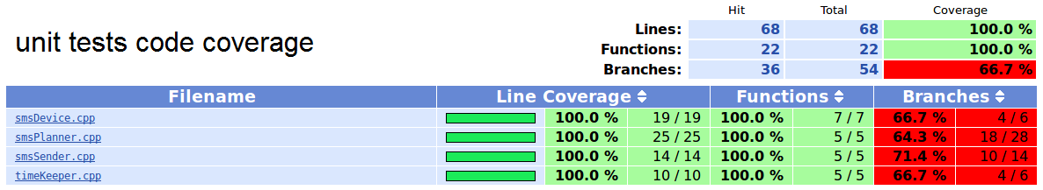
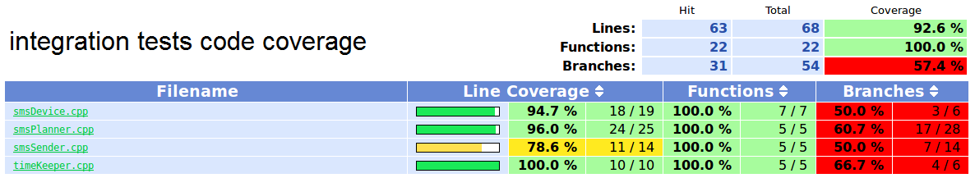
Summary

Slide 35
Summary
class name | unit tests quantity | integration tests quantity | unit tests code coverage lines/functions/branches[%] | Integration tests code coverage lines/functions/branches[%]
mailPlanner | 4 | 1
mailSender | 1 | 1
mailDevice | 5 | 0
connectionChecker | 2 | 0

