Slide 1
C++ software automated testing

Slide 2
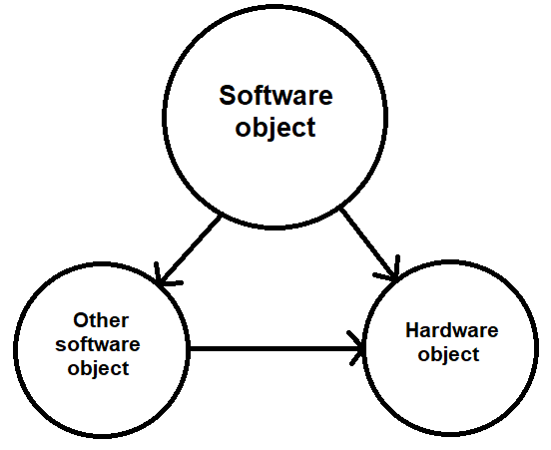
Introduction

Slide 3
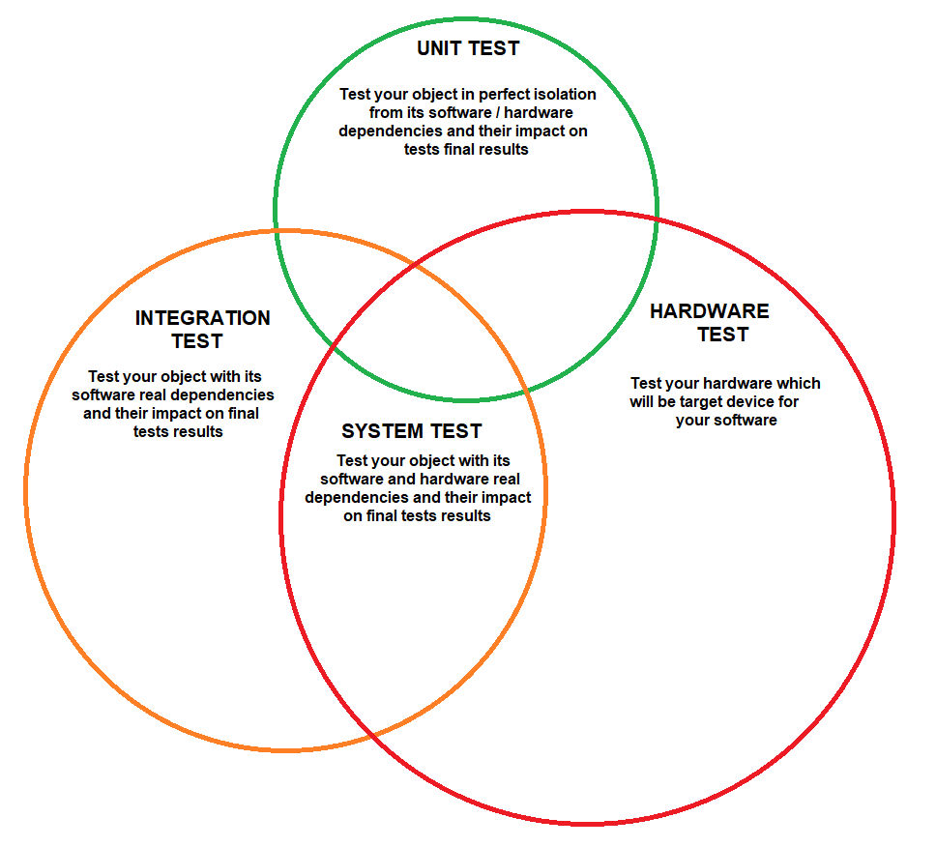
Introduction

Slide 4
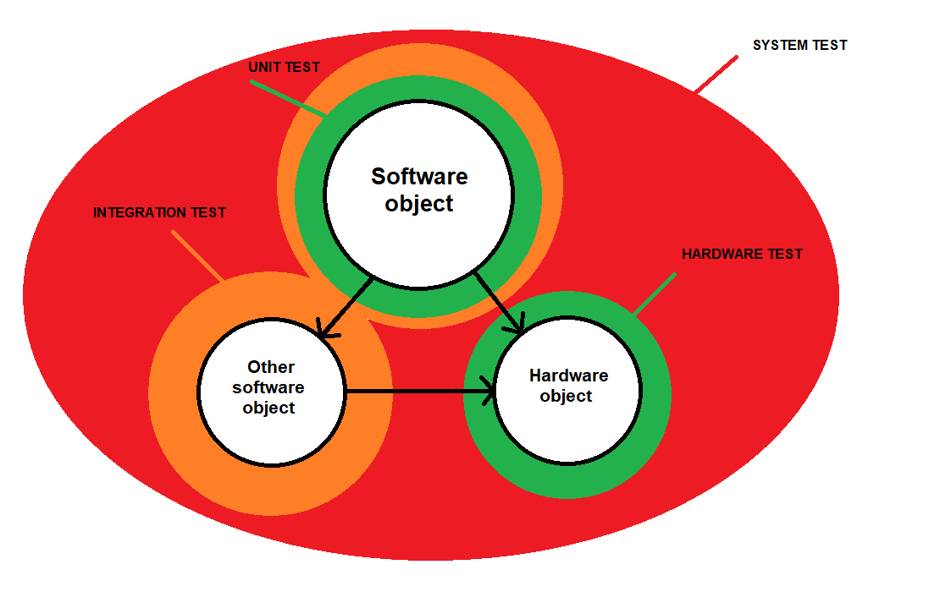
Introduction

Slide 5
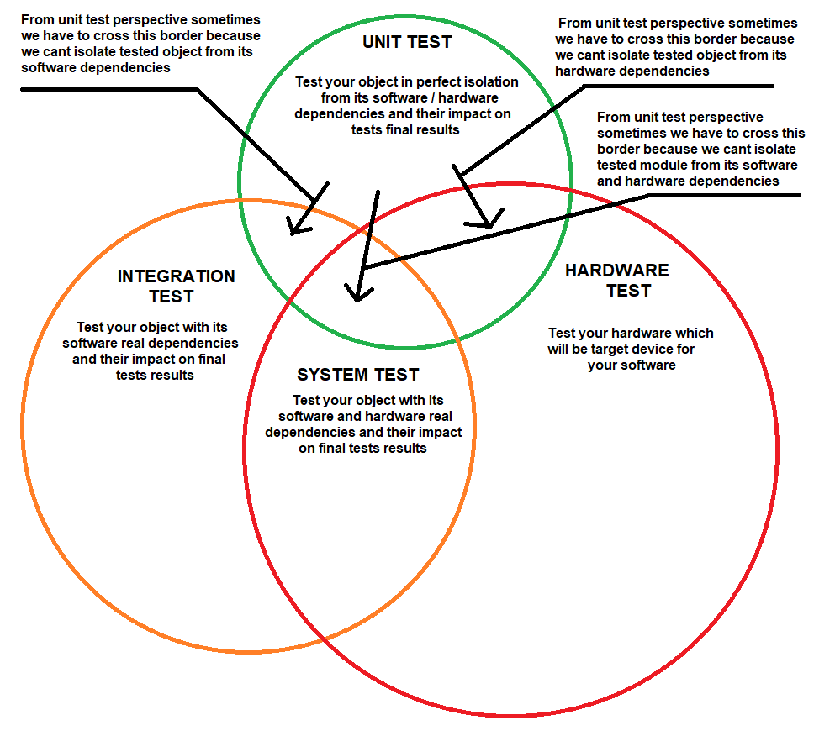
Introduction

Slide 6
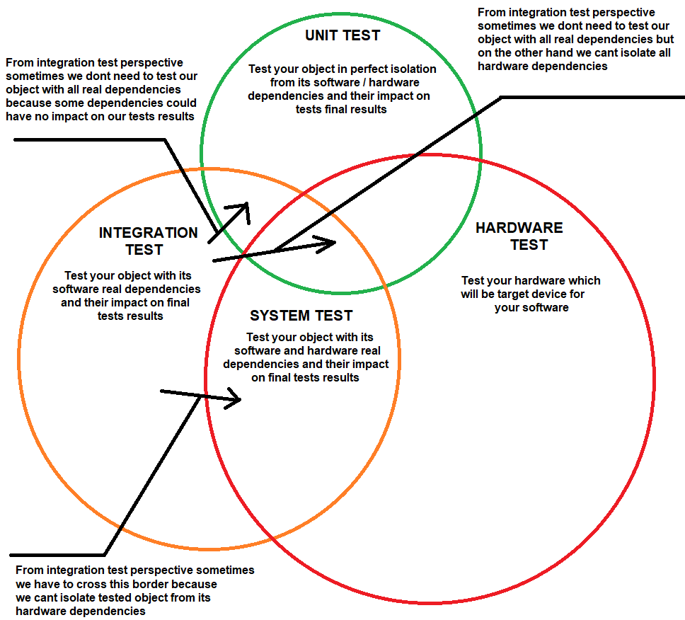
Introduction

Slide 7
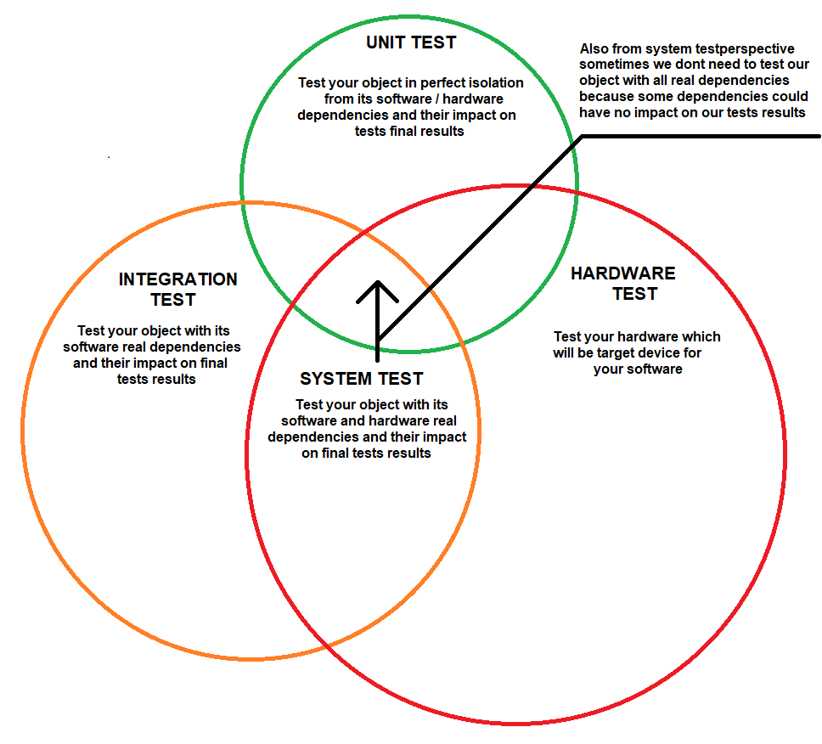
Introduction

Slide 8
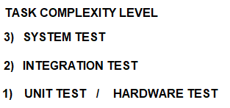
Introduction

Slide 9
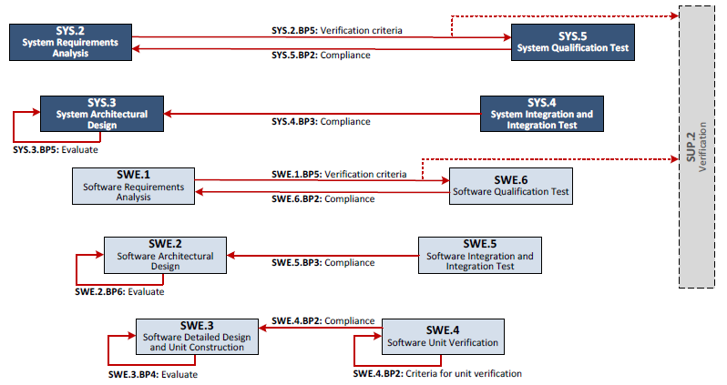
V model
http://www.automotivespice.com/

Slide 10
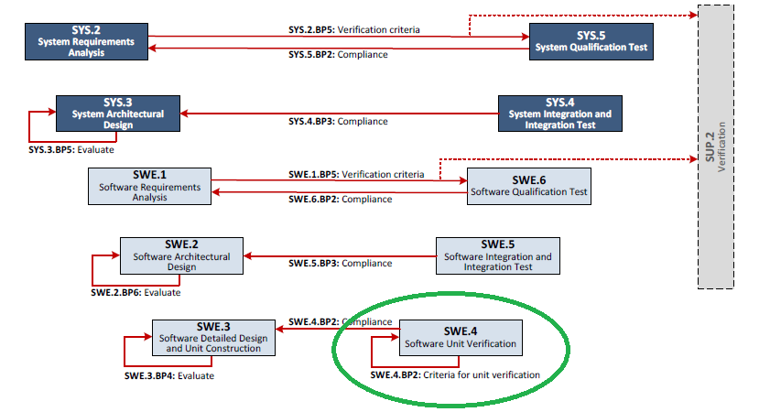
Unit tests

Slide 11
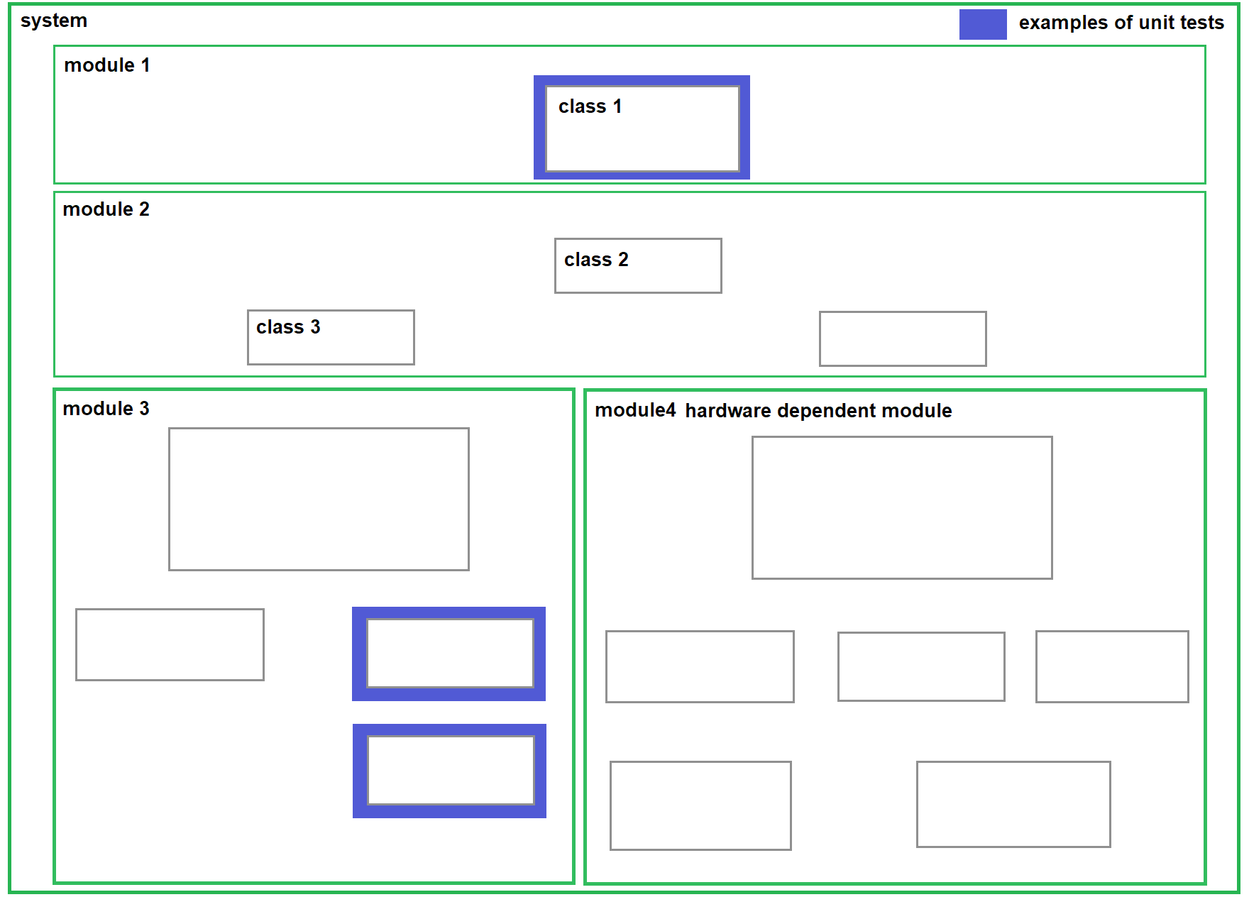
Class diagram - unit tests

Slide 12
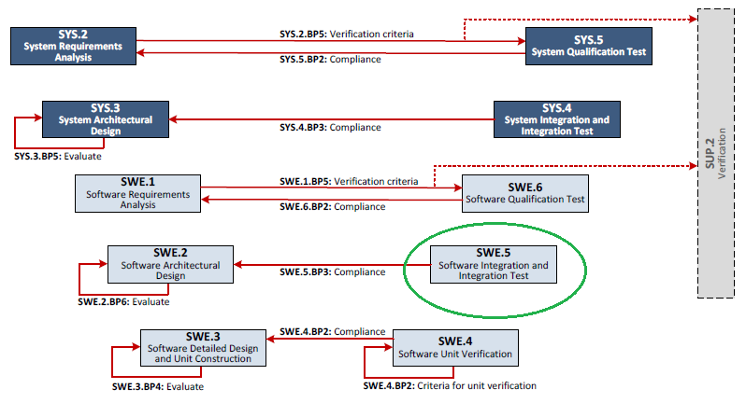
Integration tests

Slide 13
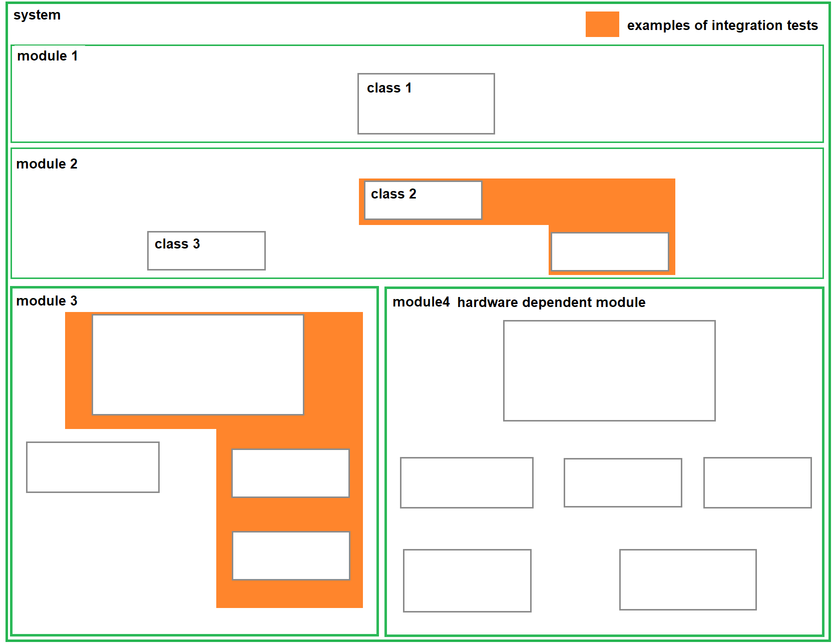
Class diagram – integration tests

Slide 14
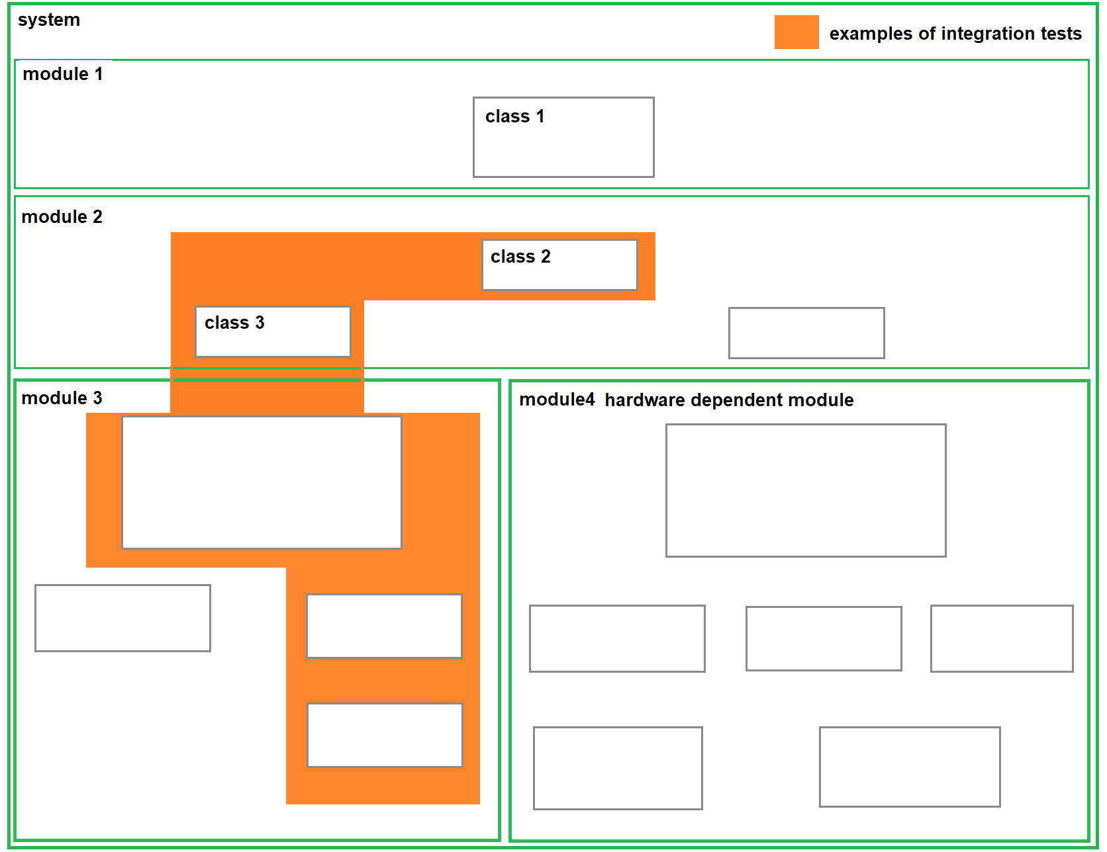
Class diagram – integration tests

Slide 15
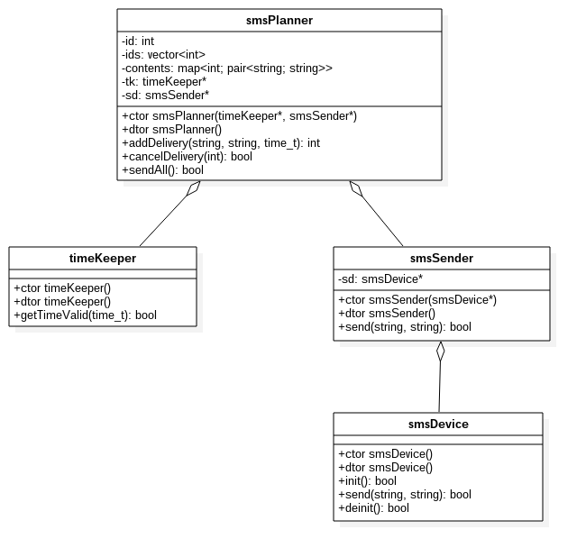
Unit tests vs. Integration tests

Slide 16
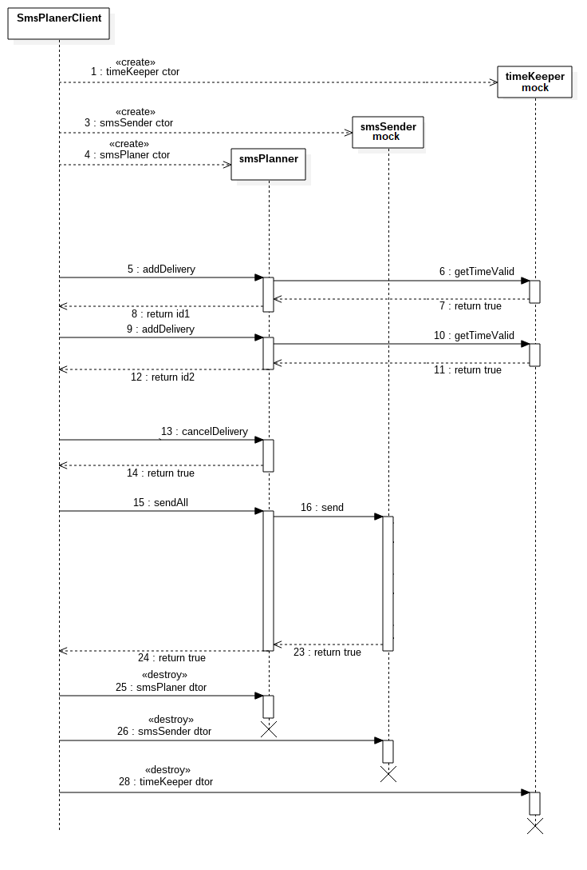
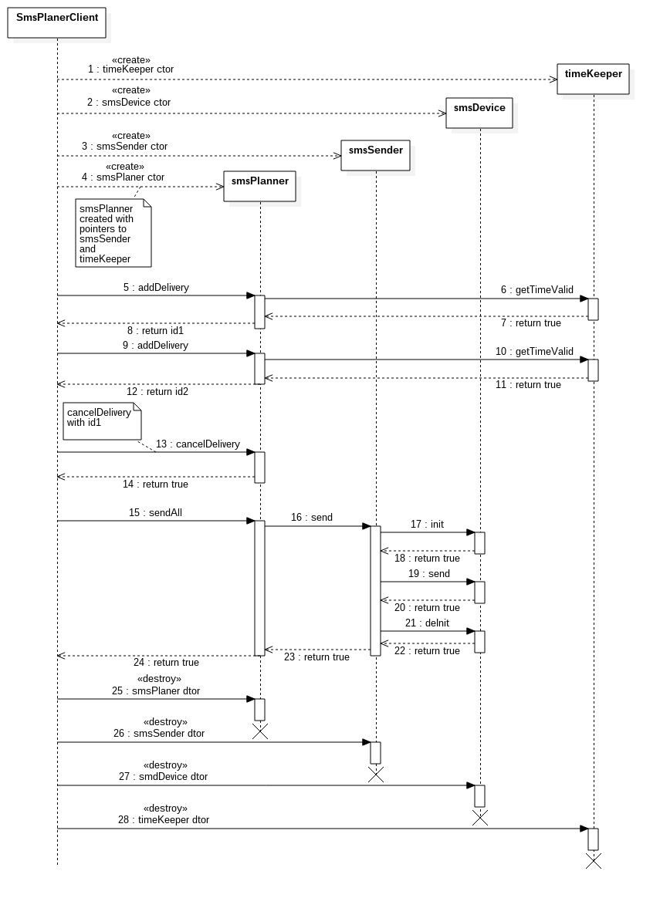
Unit tests vs Integration tests

Slide 17
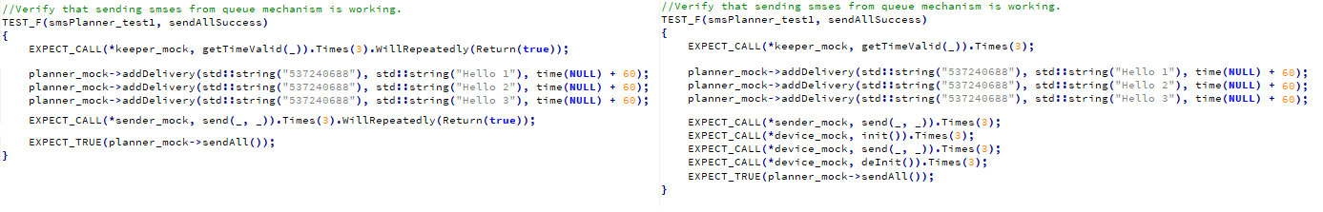
Unit tests vs Integration tests

Slide 18
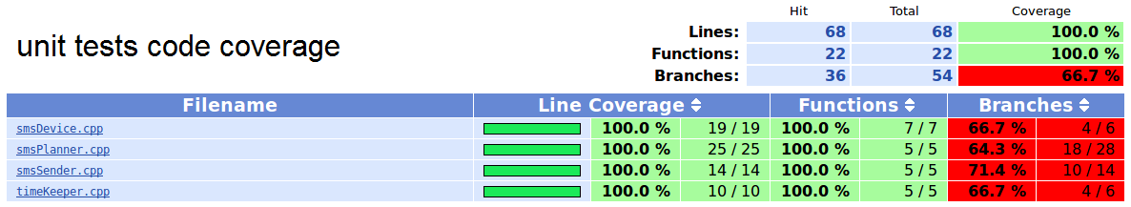
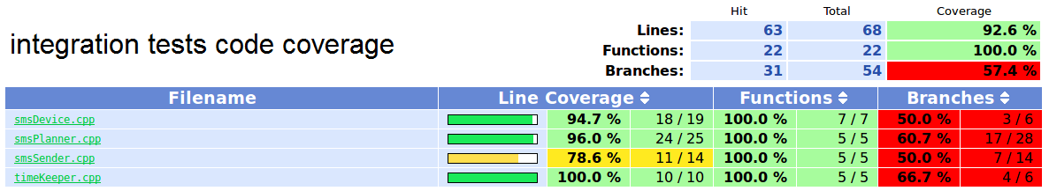
Unit tests vs Integration tests

Slide 19
Unit tests vs Integration tests
class name | unit tests quantity | integration tests quantity | unit tests code coverage lines/functions/branches[%] | Integration tests code coverage lines/functions/branches[%]
smsPlanner | 9 | 8 | 100/100/66.7 | 100/100/66.7
smsSender | 4 | 1 | 100/100/71.4 | 78.6/100/50
timeKeeper | 2 | 0 | 100/100/66.7 | 94.7/100/50
smsDevice | 5 | 0 | 100/100/64.3 | 96/100/60.7

Slide 20
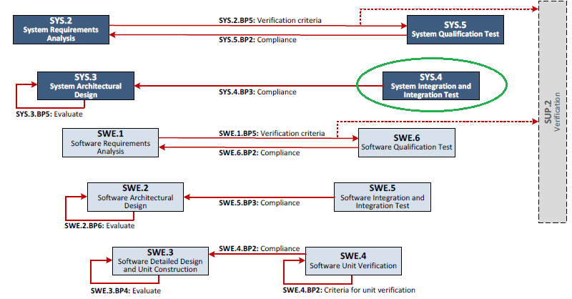
System tests

Slide 21
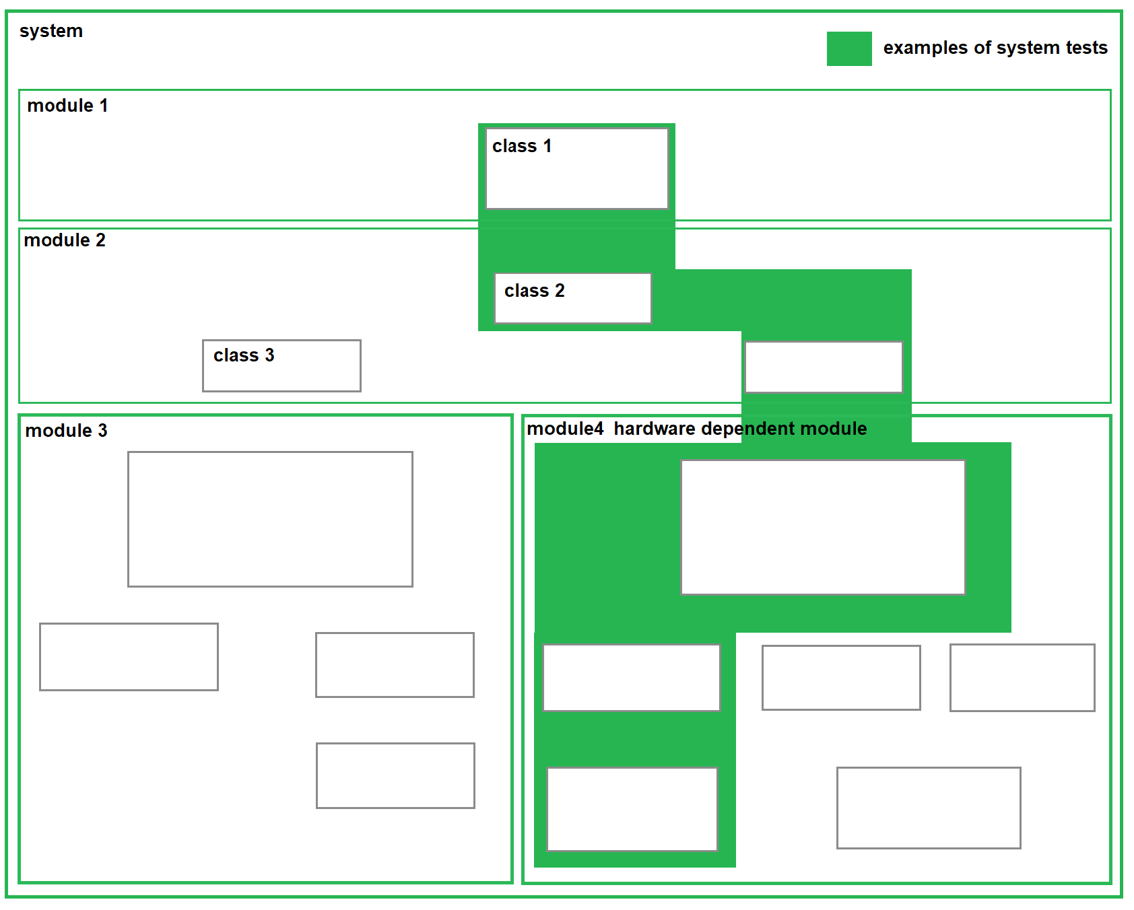
Class diagram - system tests

Slide 22
Unit tests vs integration tests vs system tsts
unit tests and integration test can be executed on host / build server and also real target device
system tests have to be executed on real target device beacuse of hardware dependencies

Slide 23
Unit tests workflow
Module owner is providing module to company responsible for unit testing
Company responsible for unit testing is verifying if module is buildable and ready for tests
Company responsible for unit testing is splitting module to separated classes tested in parrallel by separated software engineers
Company responsible for unit testing is reporting issues (bugs, blockers etc.) to module owner
Company responsible for unit testing is not changing anything in tested module source code
Company responsible for unit testing is providing unit tests delivery to module owner
Module owner is doing delivery review and accepting it or sending it back to for further improvements

Slide 24
Integration tests workflow
Module owner is providing module to company responsible for integration testing
Module owner is providing module documentation, component communication workflow (top -> down and back)
Module owner is providing integration tests scenarios (prefered form - sequence diagrams)
If module owner doesnt provide tests scenarios (sequence diagrams) to company responsible for integration testing for created task, company responsible for integration testing will do this based on provided informations from module owner to verify if there is everything available and understood to start
Company responsible for integration testing is sending tests scenarios (sequence diagrams) to module owner to be accepted
Module owner is accepting / improving tests scenarios and providing feedback to company responsible for integration testing
Company responsible for integration testing is verifying if module is buildable and ready to be tested
Company responsible for integration testing is splitting whole task into subtasks connected with integration tests implementation so whole team is involved (uml documentation, white box concept, mocks, stubs, capturing logs etc.)
Company responsible for integration testing is reporting issues (bugs, blockers etc.) to module owner
Company responsible for integration testing may add integration logs to tested module source code
Company responsible for integration testing is providing integration tests delvery to module owner
Module owner is doing delivery review and accepting it or sending it back to for further improvement

Slide 25
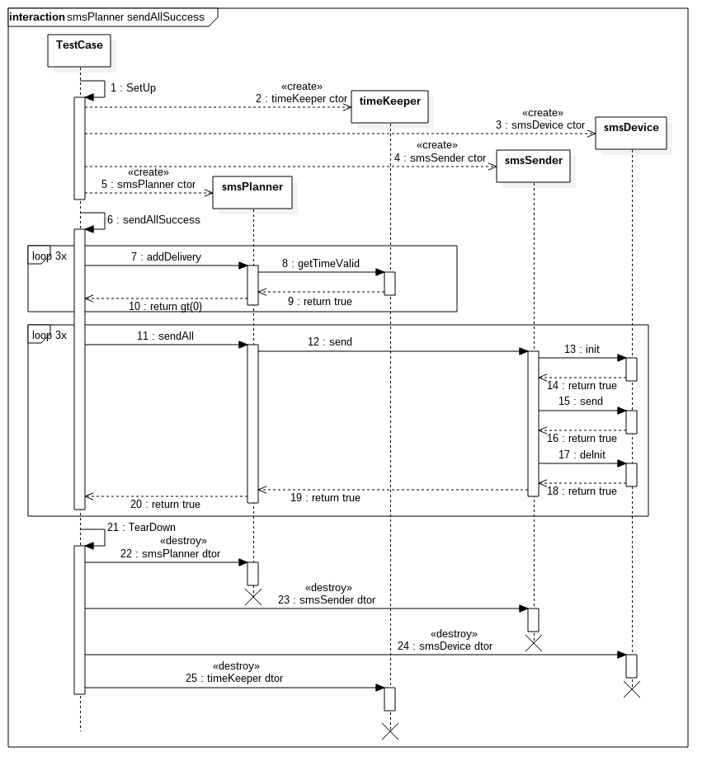
Example tests scenarios

Slide 26
Integration tests vs System tests

Slide 27
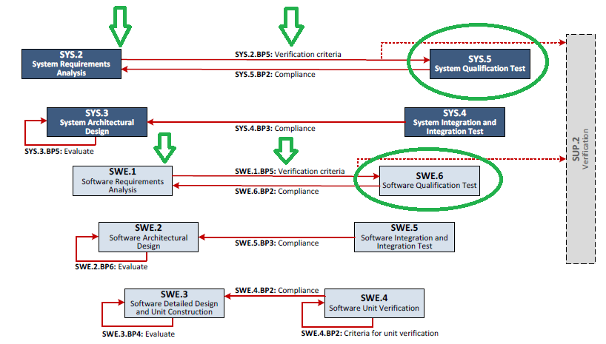
Software/System qualification tests

