Slide 1
C++ software automated testing

Slide 2
Revisions
1.08.2017 initial revision – Piotr Górecki

Slide 3
Open source project example
https://github.com/piotrek24061988/AutomaticTesting
- public repository with the project documentation,
implementation, unit and integration tests
https://circleci.com/gh/piotrek24061988/AutomaticTesting
- public build server compiling project and executing
unit and integration tests for all public repository
updates (continuous tests integration)

Slide 4
Dependencies
ubuntu linux – os
c++11
git - cvs
cmake – build tool
autotools – build tool for cppunit
googletest – unit test framework
cppunit – unit
googlemock – mock and integration test framework
lcov – coverage testing tool and gcov extension

Slide 5
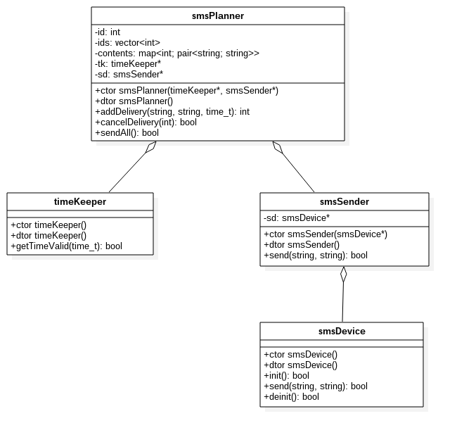
Investigation in tested object
https://github.com/piotrek24061988/AutomaticTesting/blob/master/module1/module1/doc/modue1_classDiagram.png

Slide 6
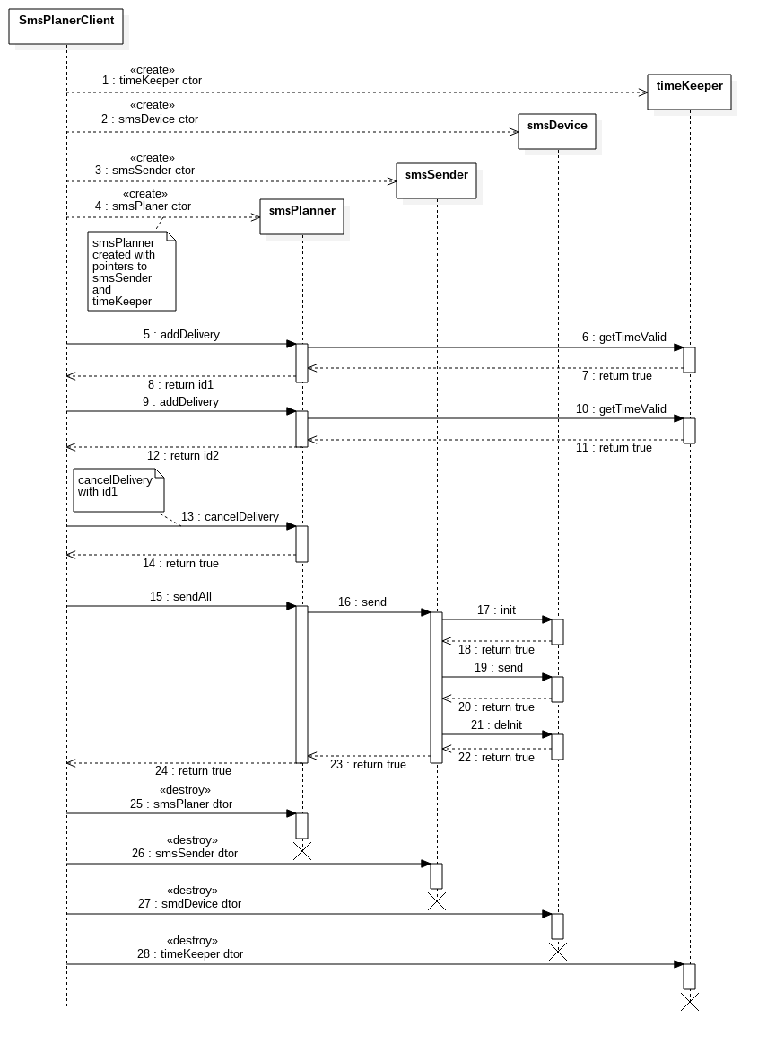
Investigation in tested object
https://github.com/piotrek24061988/AutomaticTesting/blob/master/module1/module1/doc/modue1_sequenceDiagram.png

Slide 7
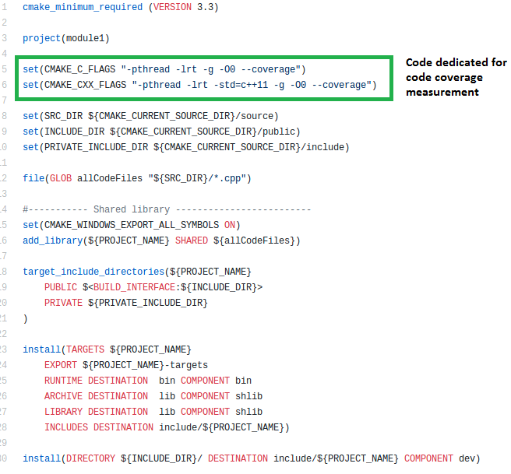
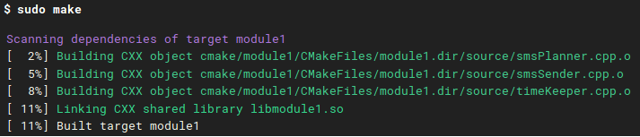
Building tested object
Is object ready for automated tests ?
https://github.com/piotrek24061988/AutomaticTesting/blob/master/module1/module1/CMakeLists.txt
https://circleci.com/gh/piotrek24061988/AutomaticTesting/138

Slide 8
Aim of automated tests
defining proper behaviour of tested module
finding bugs in tested code
code maintanance verification
high code coverage in tests

Slide 9
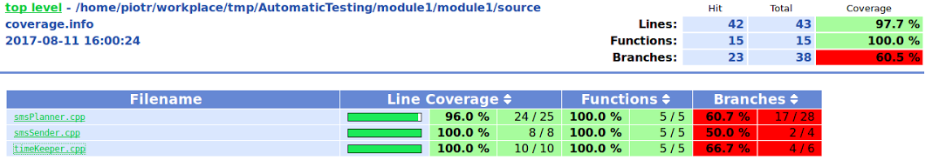
Code coverage measurement
What Is behind these numbers ?
What is the difference between lines, functions and branches code coverage?

Slide 10
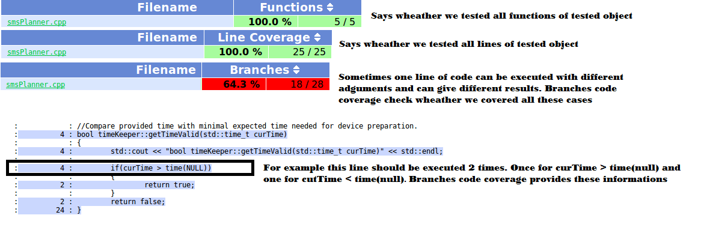
Code coverage measurement

Slide 11
Writing autometed tests
1) black box / white box
2) unit tests / integration tests
3) bottom up / top down

Slide 12
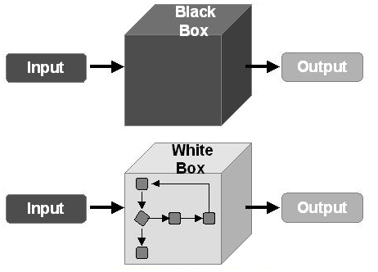
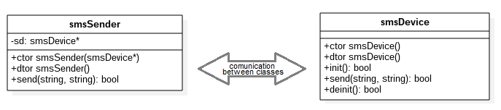
black box / white box in real live

Slide 13
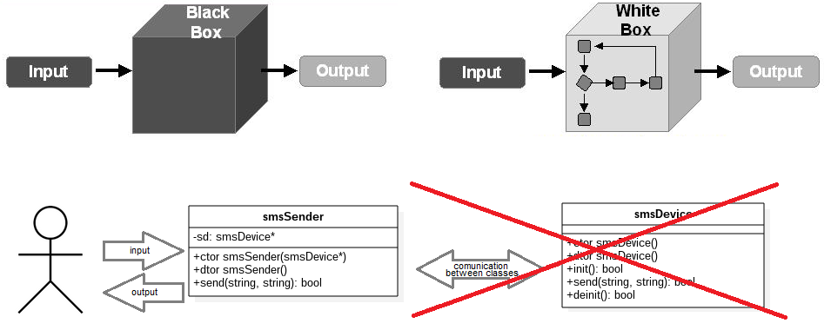
Unit tests

Slide 14
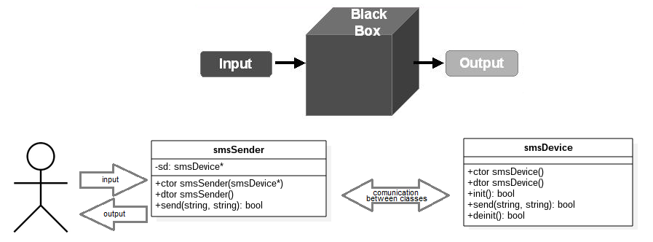
Black box integration test

Slide 15
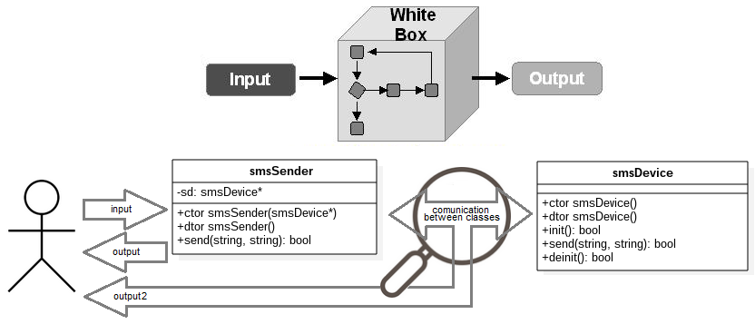
White box integration test

Slide 16
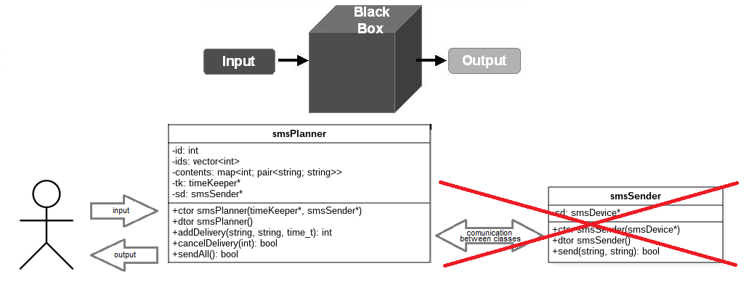
Black box unit test

Slide 17
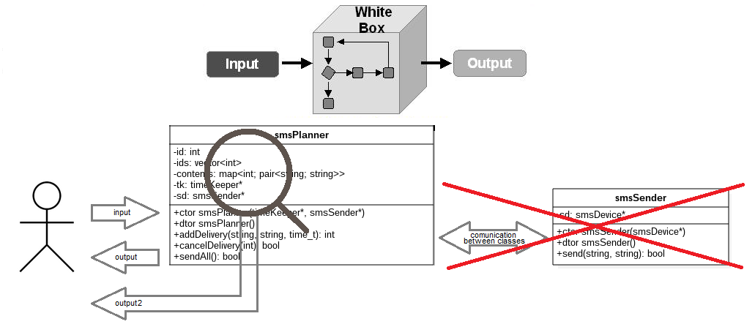
White box unit test

Slide 18
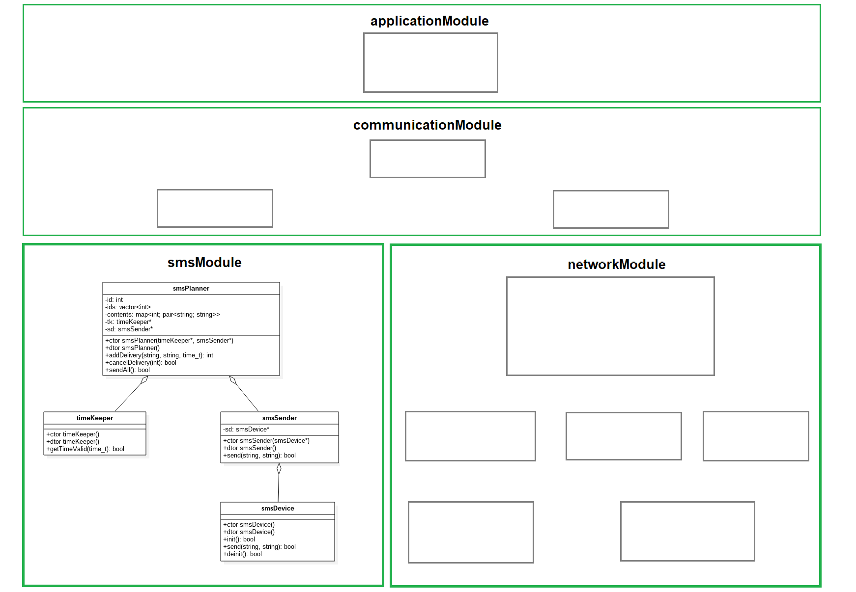
Tested component other perspective

Slide 19
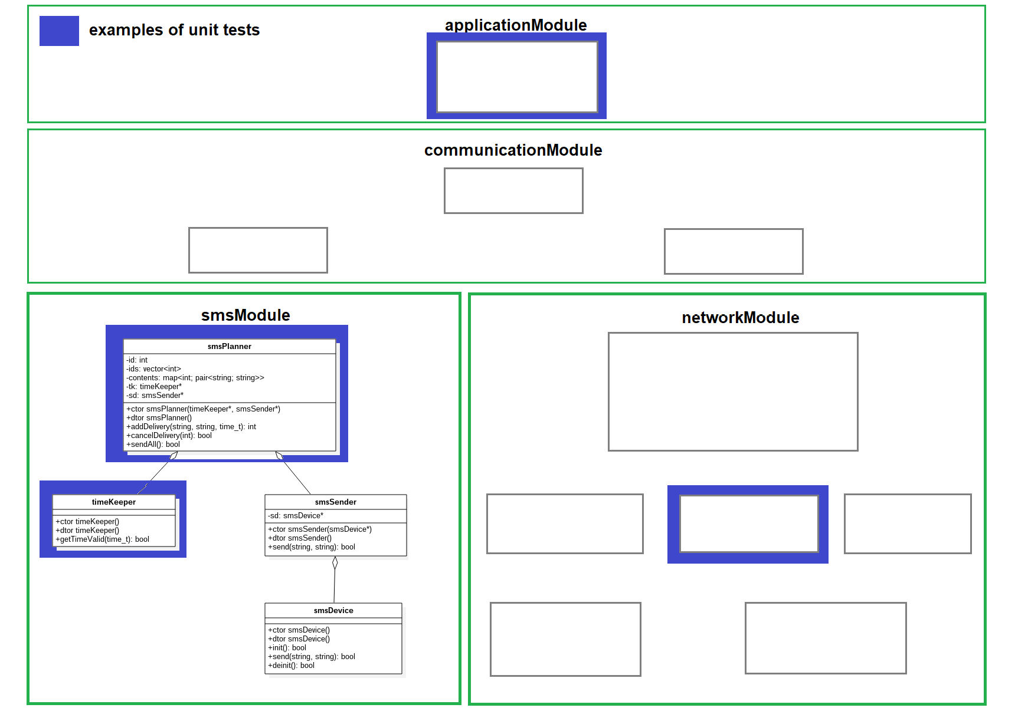
Unit tests other perspective

Slide 20
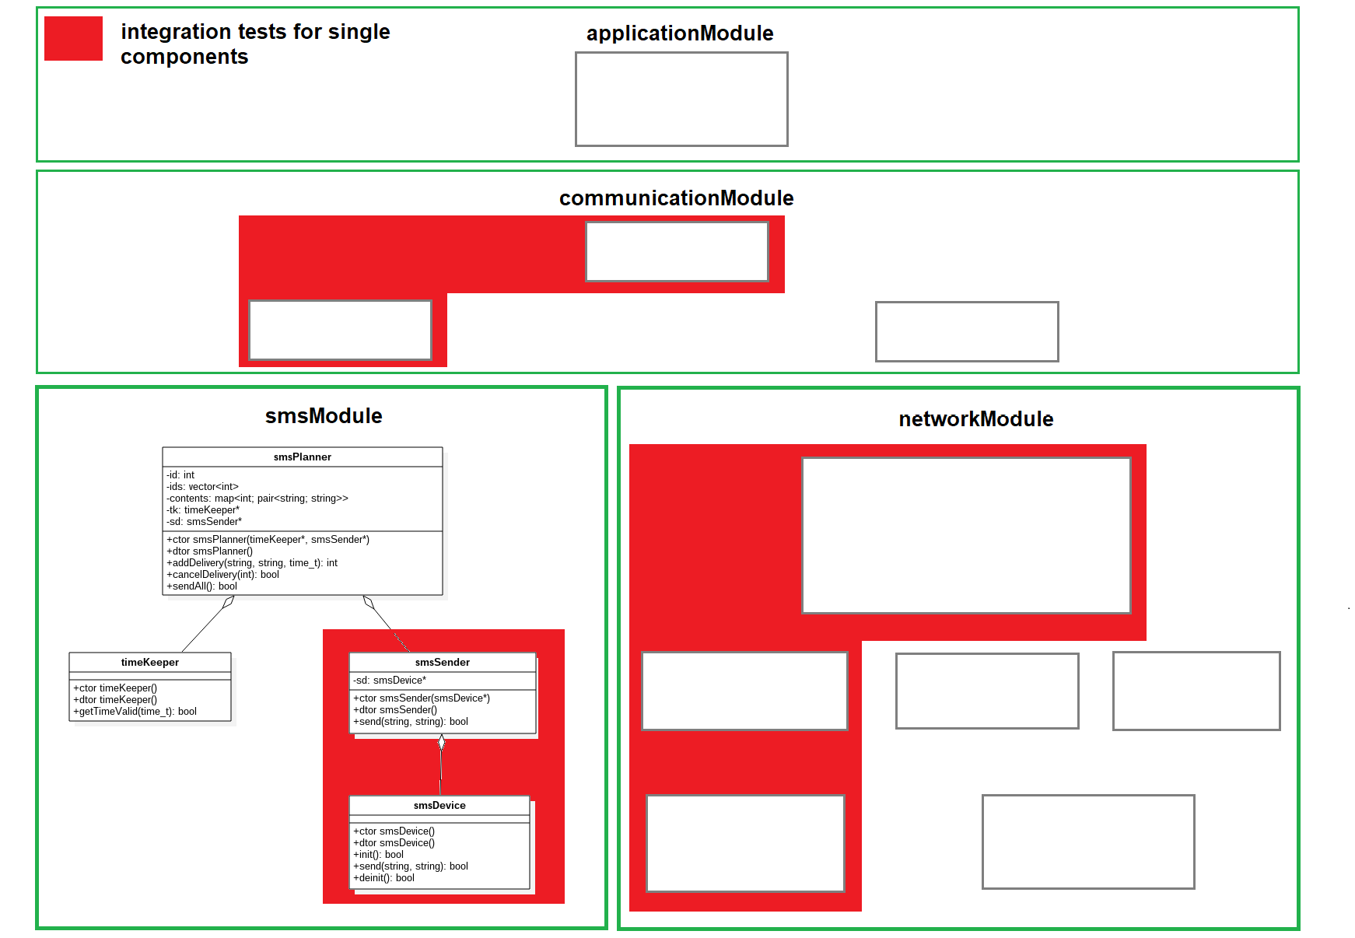
Integration tests other perspective

Slide 21
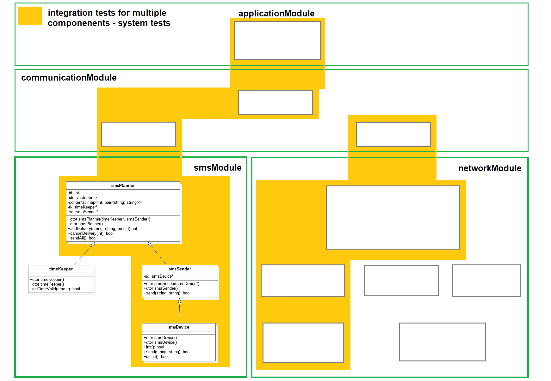
Integration tests other perspective

Slide 22
Writing autometed tests
bottom up, white box:
1) UT for smsDevice
2) fake smsDevice object
3) UT for smsSender with fake smsDevice object
4) IT for smsSender with real smsDevice object
5) fake smsSender object
6) UT for timeKeeper
7) fake timeKeeper object
8) UT for smsPlanner with fake timeKeeper and smsSender
9) IT for smsPlanner with real timeKeeper and real smsSender and then real smsDevice

Slide 23
Before we start to write tests

Slide 24
Test cases scenarios
Unit tests scenarios
Integration tests scenarios

Slide 25
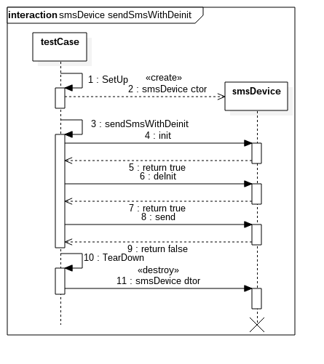
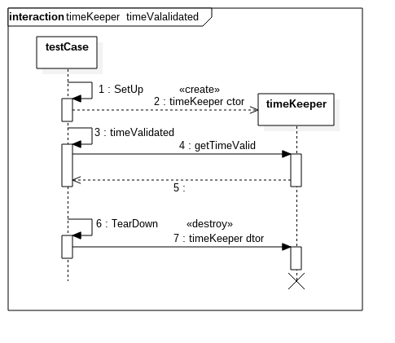
Unit test scenarios

Slide 26
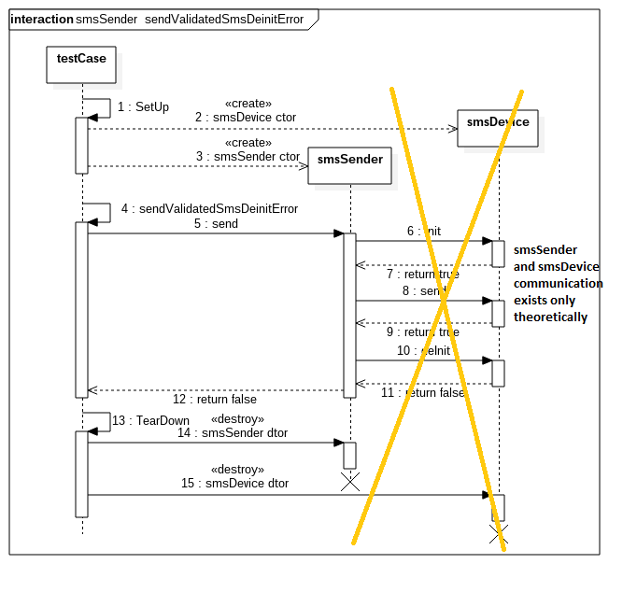
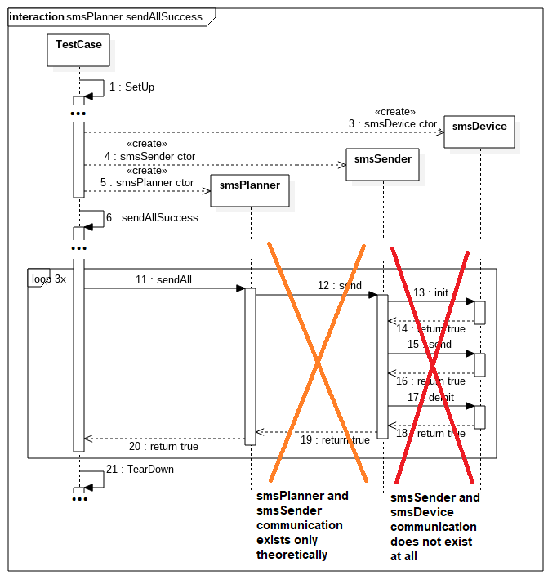
Unit test scenarios

Slide 27
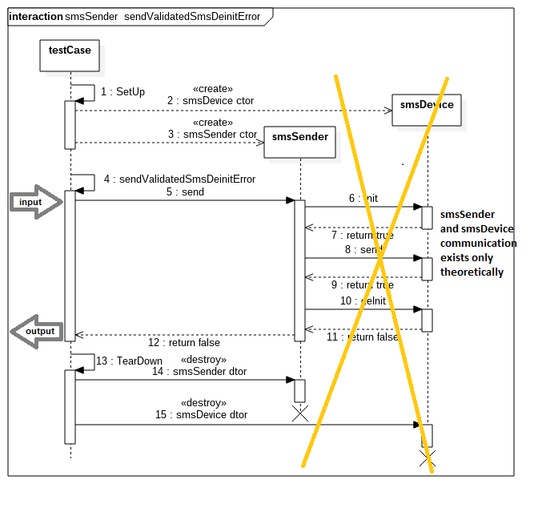
Unit test scenarios

Slide 28
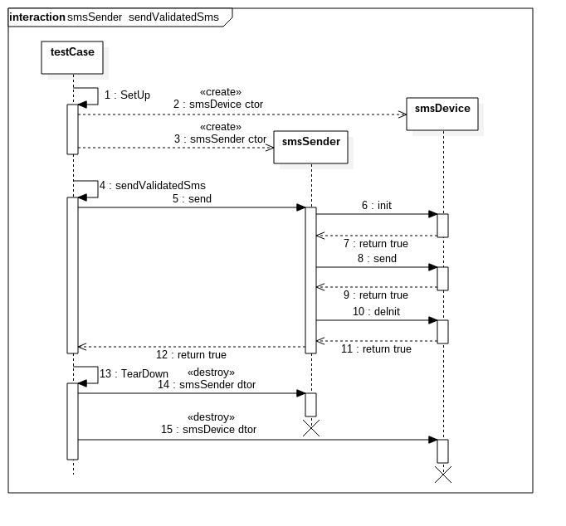
Integration tests scenarios

Slide 29
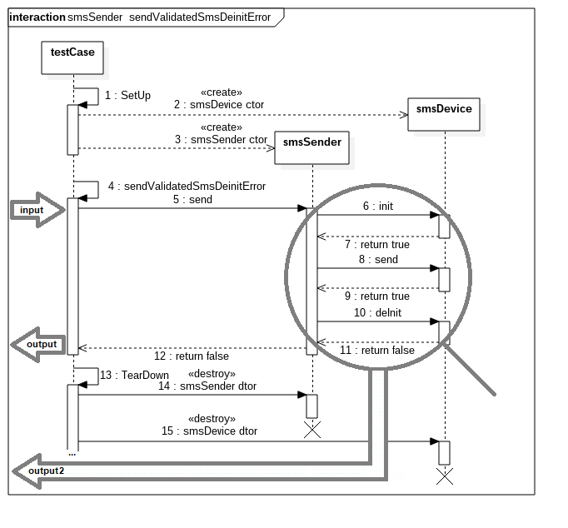
Integration tests scenarios

Slide 30
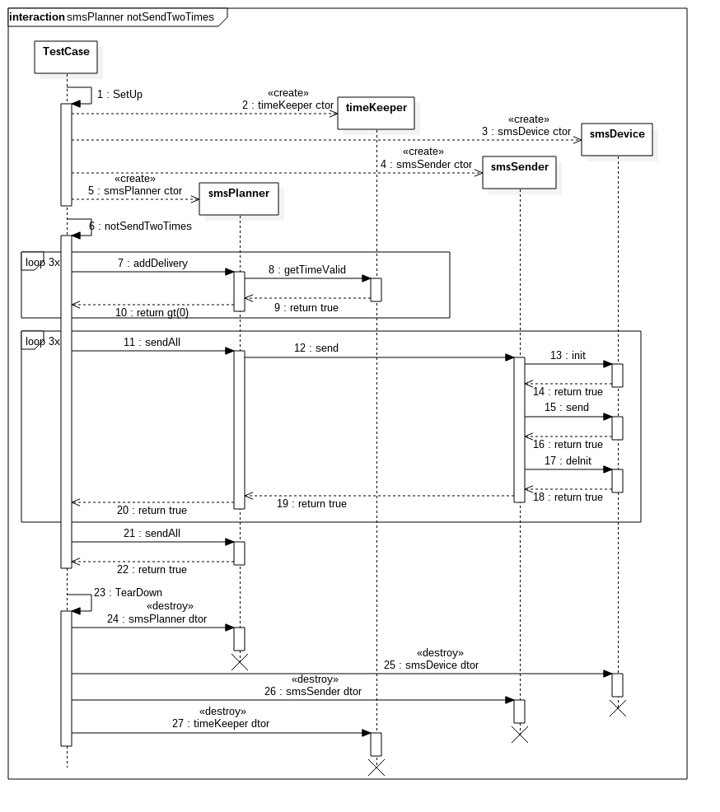
Integration tests scenarios

Slide 31
How to write tests in practise
Complete framework:
- testing mechanism
- mocking mechanism

Slide 32
Testing mechanism
Google Test framework
https://github.com/google/googletest
and how to use it (Simple Tests):
https://github.com/google/googletest/blob/master/googletest/docs/Primer.md
CppUnit framework
https://www.freedesktop.org/wiki/Software/cppunit/

Slide 33
Mocking mechanism
GoogleTests/GoogleMock framework
https://github.com/google/googletest/blob/master/googlemock/README.md
and how to use it (A Case for Mock Turtles):
https://github.com/google/googletest/blob/master/googlemock/docs/ForDummies.md

Slide 34
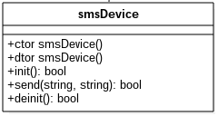
So lets start practise part
bottom up, white box:
1) UT for smsDevice
2) fake smsDevice object
3) UT for smsSender with fake smsDevice object
4) IT for smsSender with real smsDevice object
5) fake smsSender object
6) UT for timeKeeper
7) fake timeKeeper object
8) UT for smsPlanner with fake timeKeeper and smsSender
9) IT for smsPlanner with real timeKeeper and real smsSender and then real smsDevice

Slide 35
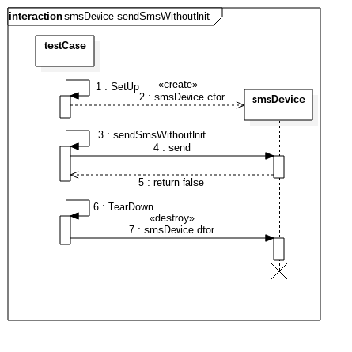
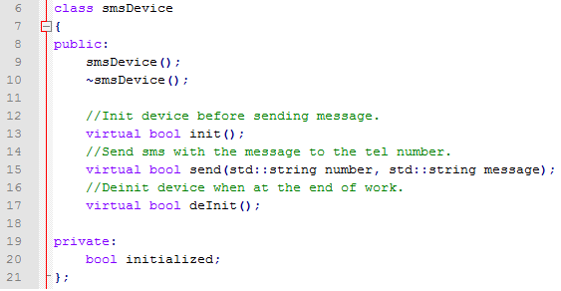
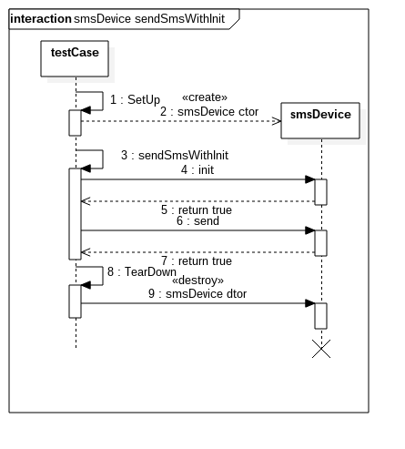
UT for smsDevice

Slide 36
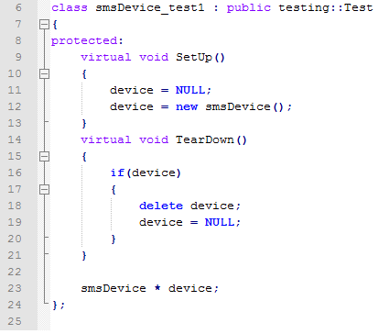
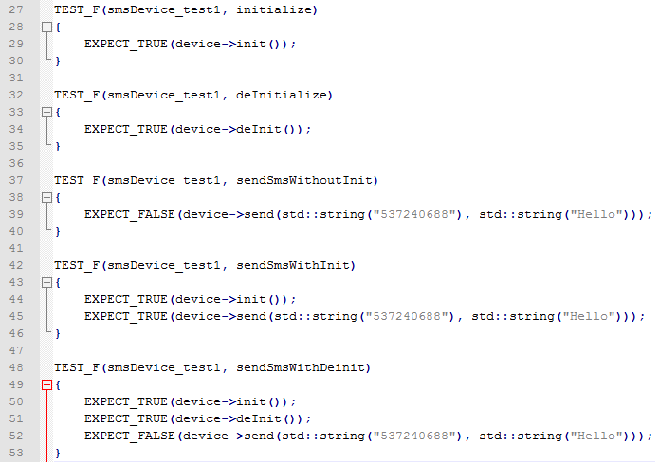
UT for smsDevice

Slide 37
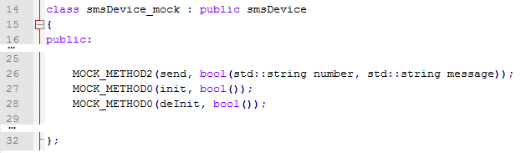
Fake SmsDeviceObject
bottom up, white box:
1) UT for smsDevice
2) fake smsDevice object
3) UT for smsSender with fake smsDevice object
4) IT for smsSender with real smsDevice object
5) fake smsSender object
6) UT for timeKeeper
7) fake timeKeeper object
8) UT for smsPlanner with fake timeKeeper and smsSender
9) IT for smsPlanner with real timeKeeper and real smsSender and then real smsDevice

Slide 38
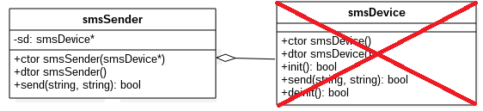
UT for smsSender
bottom up, white box:
1) UT for smsDevice
2) fake smsDevice object
3) UT for smsSender with fake smsDevice object
4) IT for smsSender with real smsDevice object
5) fake smsSender object
6) UT for timeKeeper
7) fake timeKeeper object
8) UT for smsPlanner with fake timeKeeper and smsSender
9) IT for smsPlanner with real timeKeeper and real smsSender and then real smsDevice

Slide 39
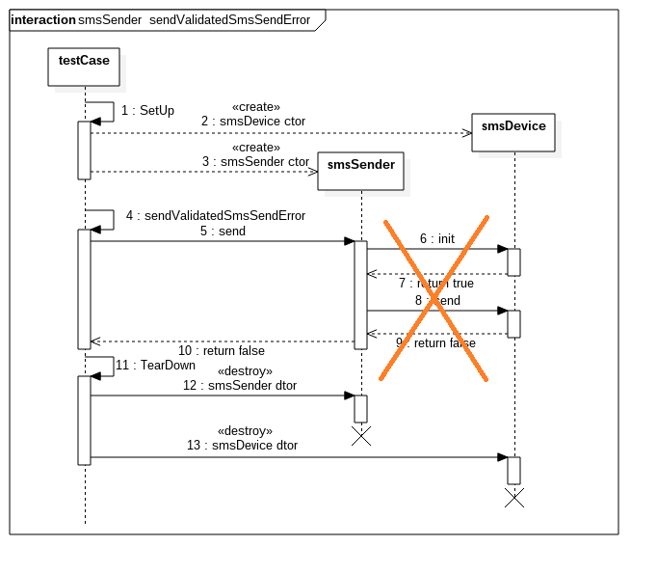
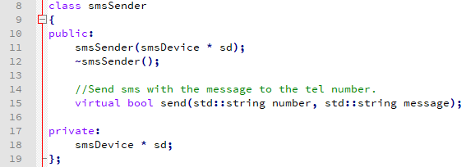
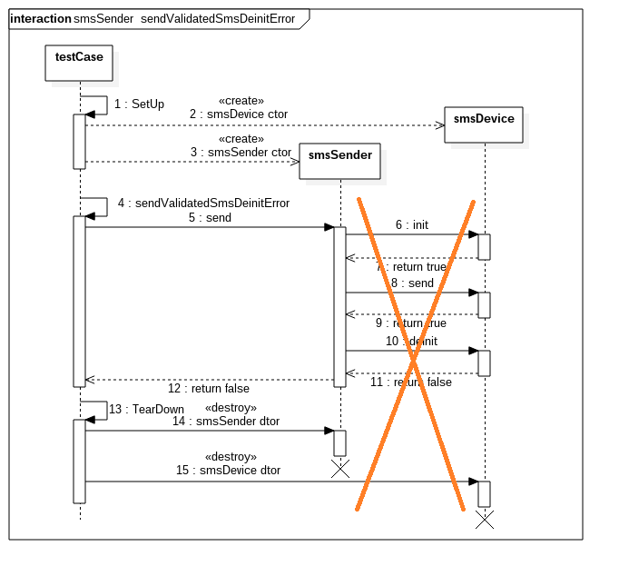
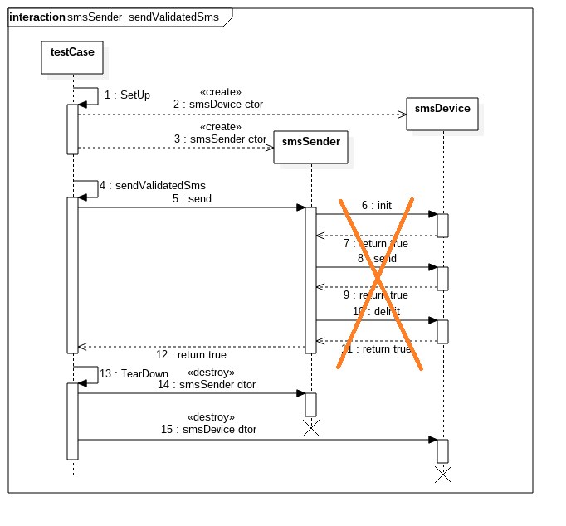
UT for smsSender

Slide 40
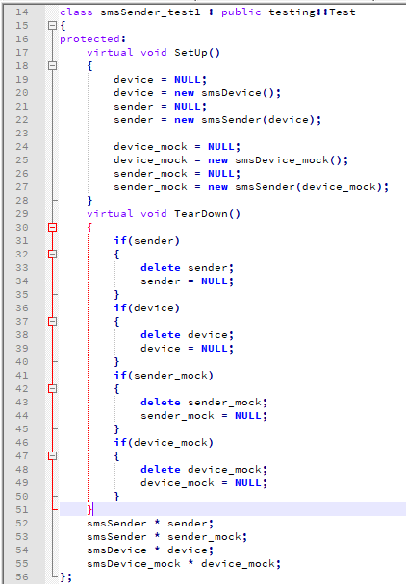
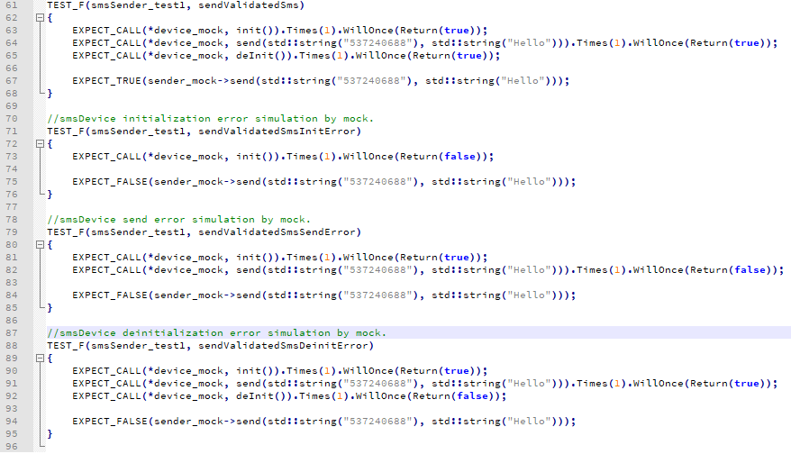
UT for smsSender

Slide 41
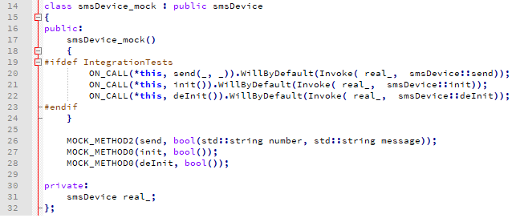
IT for smsSender with real smsDevice object
bottom up, white box:
1) UT for smsDevice
2) fake smsDevice object
3) UT for smsSender with fake smsDevice object
4) IT for smsSender with real smsDevice object
5) fake smsSender object
6) UT for timeKeeper
7) fake timeKeeper object
8) UT for smsPlanner with fake timeKeeper and smsSender
9) IT for smsPlanner with real timeKeeper and real smsSender and then real smsDevice

Slide 42

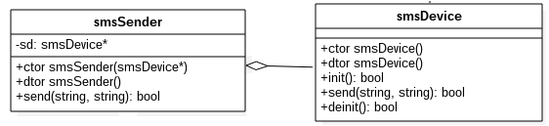
IT for smsSender with real smsDevice object

Slide 43

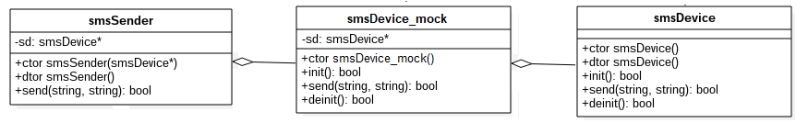
IT for smsSender with real smsDevice object

Slide 44
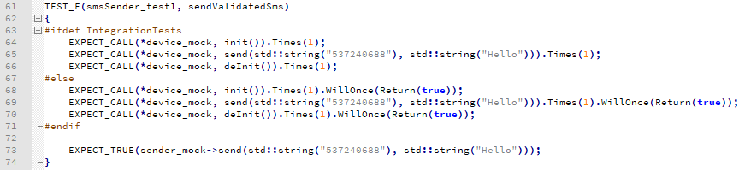
IT for smsSender with real smsDevice object

Slide 45
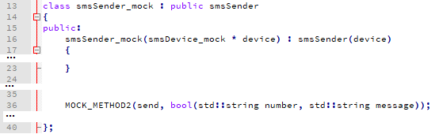
Fake smsSender Object
bottom up, white box:
1) UT for smsDevice
2) fake smsDevice object
3) UT for smsSender with fake smsDevice object
4) IT for smsSender with real smsDevice object
5) fake smsSender object
6) UT for timeKeeper
7) fake timeKeeper object
8) UT for smsPlanner with fake timeKeeper and smsSender
9) IT for smsPlanner with real timeKeeper and real smsSender and then real smsDevice

Slide 46

UT for timeKeeper
bottom up, white box:
1) UT for smsDevice
2) fake smsDevice object
3) UT for smsSender with fake smsDevice object
4) IT for smsSender with real smsDevice object
5) fake smsSender object
6) UT for timeKeeper
7) fake timeKeeper object
8) UT for smsPlanner with fake timeKeeper and smsSender
9) IT for smsPlanner with real timeKeeper and real smsSender and then real smsDevice

Slide 47
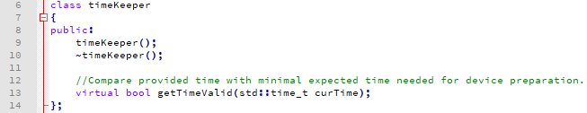
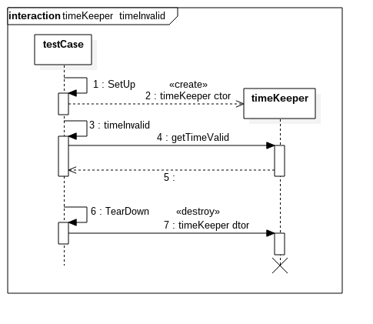
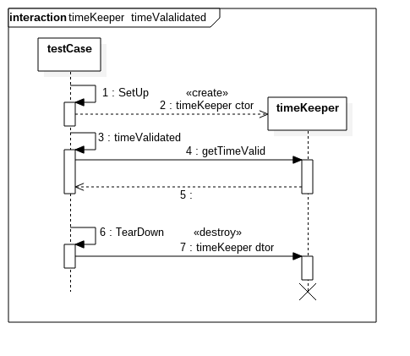
UT for timeKeeper

Slide 48
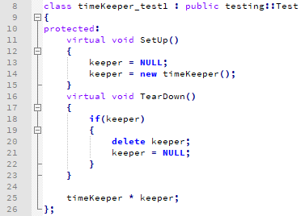
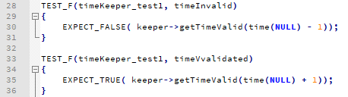
UT for timeKeeper

Slide 49
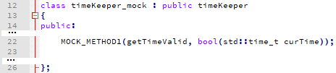
Fake timeKeeper Object
bottom up, white box:
1) UT for smsDevice
2) fake smsDevice object
3) UT for smsSender with fake smsDevice object
4) IT for smsSender with real smsDevice object
5) fake smsSender object
6) UT for timeKeeper
7) fake timeKeeper object
8) UT for smsPlanner with fake timeKeeper and smsSender
9) IT for smsPlanner with real timeKeeper and real smsSender and then real smsDevice

Slide 50

UT for smsPlanner
bottom up, white box:
1) UT for smsDevice
2) fake smsDevice object
3) UT for smsSender with fake smsDevice object
4) IT for smsSender with real smsDevice object
5) fake smsSender object
6) UT for timeKeeper
7) fake timeKeeper object
8) UT for smsPlanner with fake timeKeeper and smsSender
9) IT for smsPlanner with real timeKeeper and real smsSender and then real smsDevice

Slide 51



UT for smsPlanner

Slide 52


UT for smsPlanner

Slide 53


UT for smsPlanner

Slide 54


UT for smsPlanner

Slide 55

UT for smsPlanner

Slide 56


UT for smsPlanner

Slide 57

UT for smsPlanner

Slide 58

UT for smsPlanner

Slide 59

UT for smsPlanner

Slide 60

IT for smsPlanner
bottom up, white box:
1) UT for smsDevice
2) fake smsDevice object
3) UT for smsSender with fake smsDevice object
4) IT for smsSender with real smsDevice object
5) fake smsSender object
6) UT for timeKeeper
7) fake timeKeeper object
8) UT for smsPlanner with fake timeKeeper and smsSender
9) IT for smsPlanner with real timeKeeper and real smsSender and then real smsDevice

Slide 61

IT for smsPlanner
bottom up, white box:
1) UT for smsDevice
2) fake smsDevice object
3) UT for smsSender with fake smsDevice object
4) IT for smsSender with real smsDevice object
5) fake smsSender object
6) UT for timeKeeper
7) fake timeKeeper object
8) UT for smsPlanner with fake timeKeeper and smsSender
9) IT for smsPlanner with real timeKeeper and real smsSender and then real smsDevice

Slide 62

IT for smsPlanner
bottom up, white box:
1) UT for smsDevice
2) fake smsDevice object
3) UT for smsSender with fake smsDevice object
4) IT for smsSender with real smsDevice object
5) fake smsSender object
6) UT for timeKeeper
7) fake timeKeeper object
8) UT for smsPlanner with fake timeKeeper and smsSender
9) IT for smsPlanner with real timeKeeper and real smsSender and then real smsDevice

Slide 63




IT for smsPlanner

Slide 64




IT for smsPlanner

Slide 65


IT for smsPlanner

Slide 66


IT for smsPlanner

Slide 67


IT for smsPlanner

Slide 68


IT for smsPlanner

