Slide 1
API FOOTBALL ETL PROJECT
PANDAS | AIRFLOW | ORACLE
PRESENTED BY PIOTR SZEWCZUL

Slide 2




OPIS PROJEKTU

Slide 3
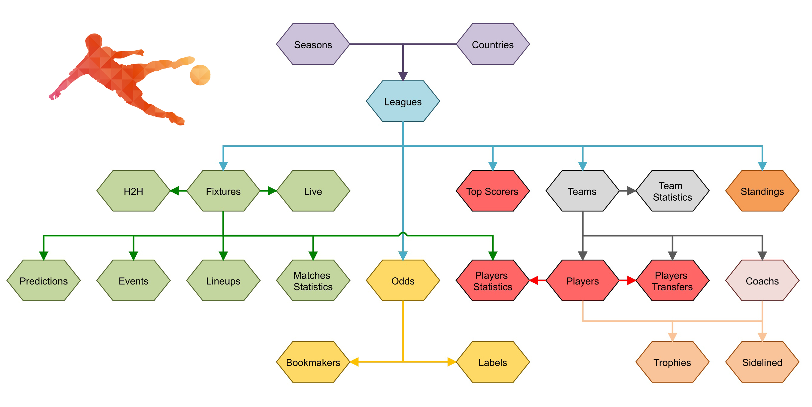
API-FOOTBALL

Slide 4
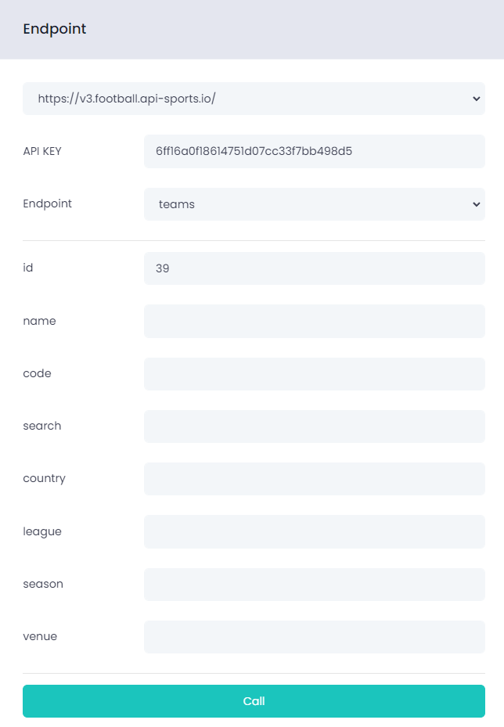
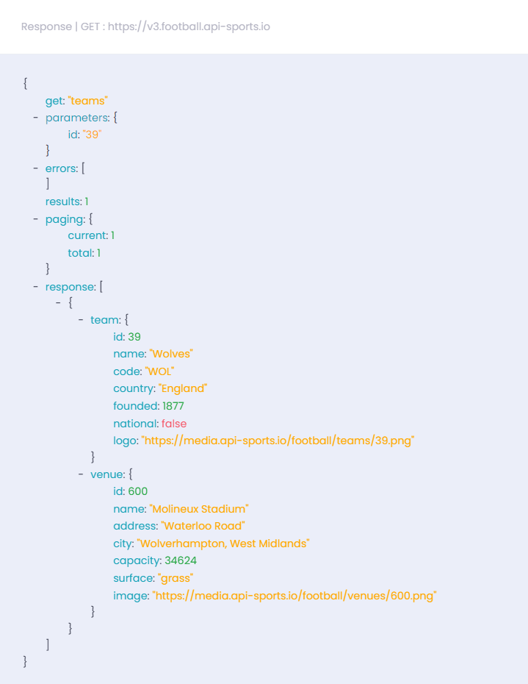
API-FOOTBALL c.d.

Slide 5
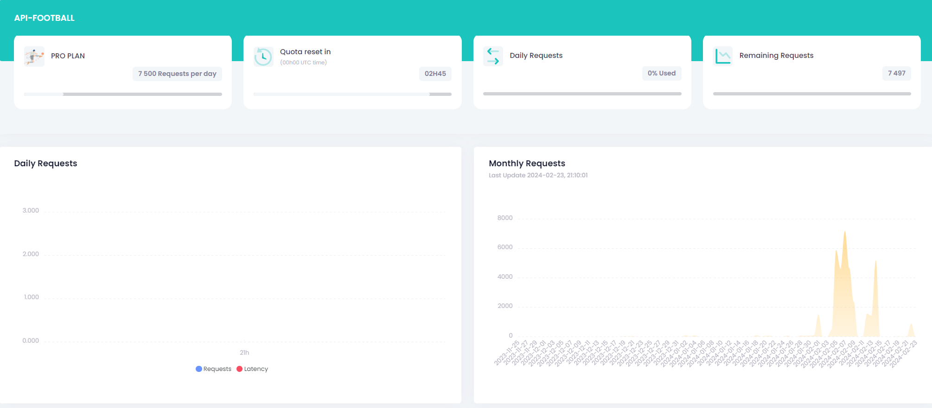
API-FOOTBALL c.d.

Slide 6
PYTHON - FUNKCJE
CALL_API
GET_ALL_PLAYERS_DATA
BUILD_PLAYERS_HISTORY
GET_ALL_LEAGUES
GET_TEAMS_DATA
CREATE_SQL_INSERT
GET_PLAYERS_SEASONED_DATA
SAVE_RETRIEVED_DATA
LOG_RUNS
GET_ACT_SQUADS
COLLECT_PLAYERS_DATA
READ_LOGS

Slide 7
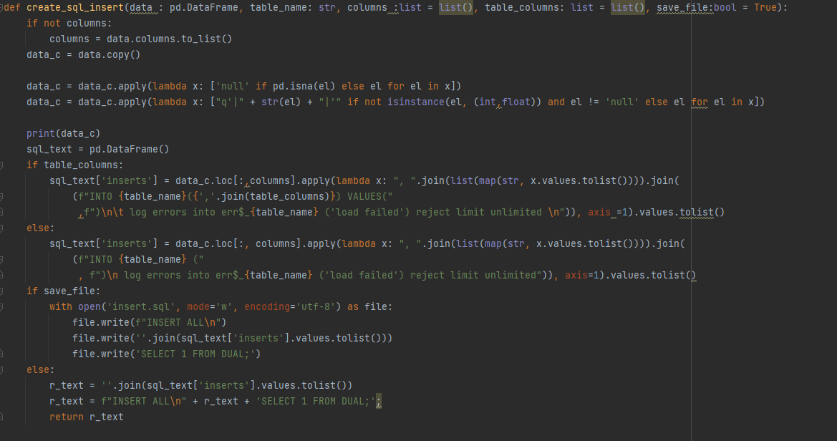
Create_sql insert kod

Slide 8
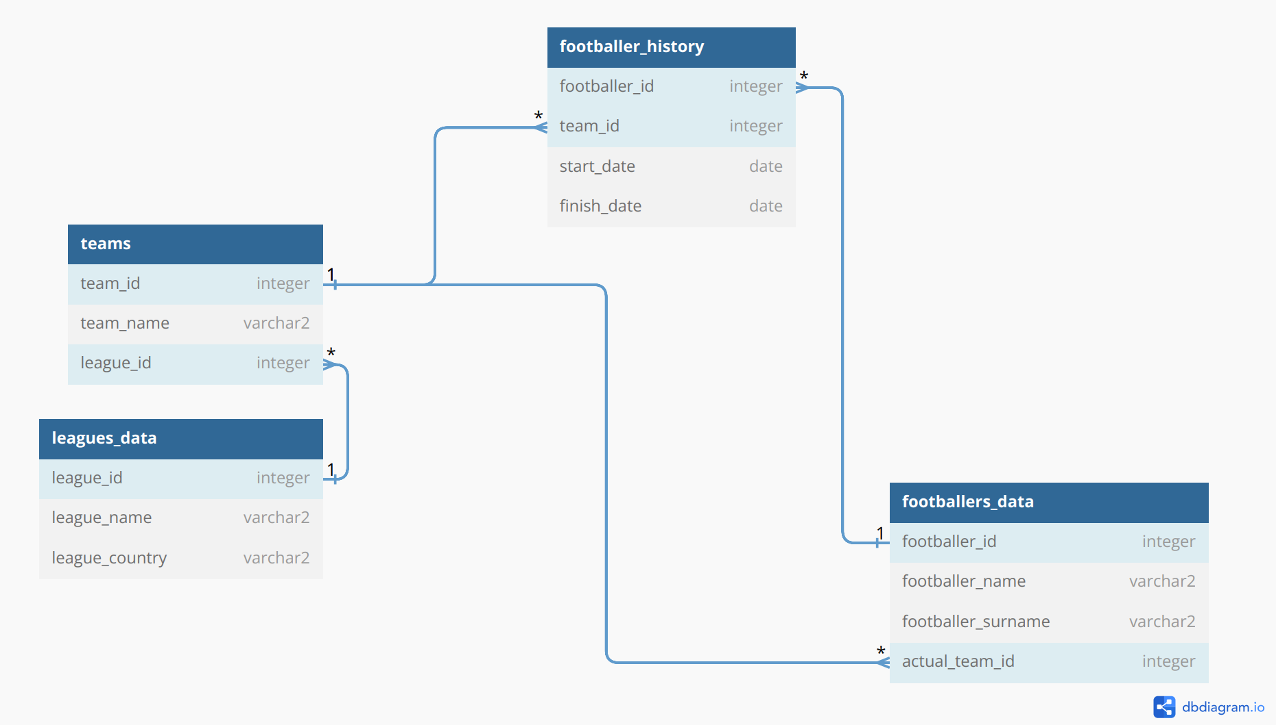
Oracle erd

Slide 9
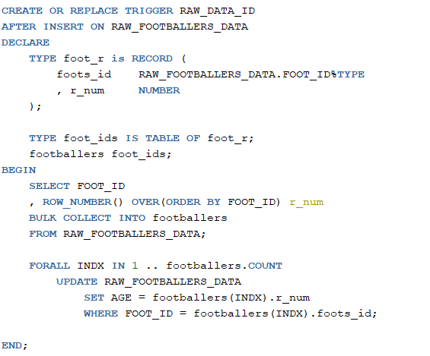
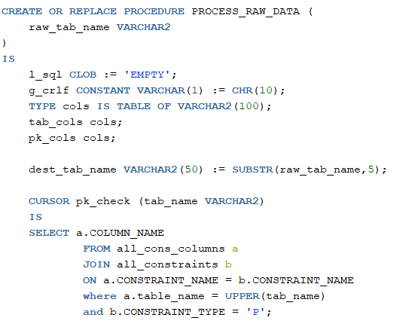
Oracle procedurA/trigger
TRIGGER RAW_DATA_ID
PROCEDURA PROCESS_RAW_DATA

Slide 10
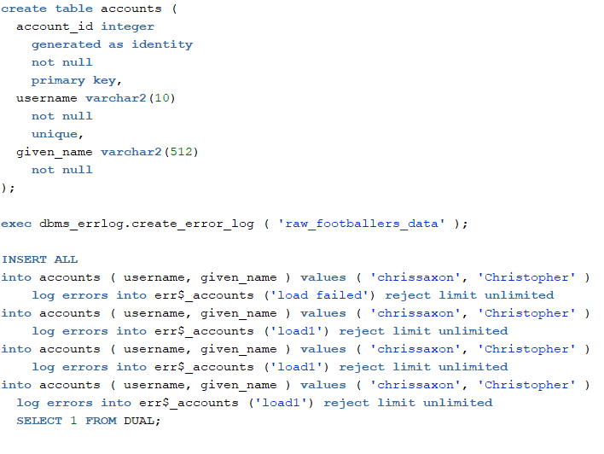
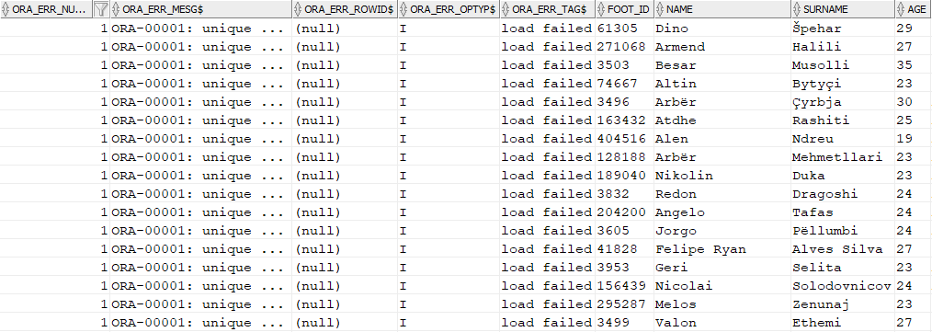
Oracle RAPORTOWANIE BŁĘDÓW
ERR$_TABLE_NAME
DANE ERR$_TABLE_NAME

Slide 11
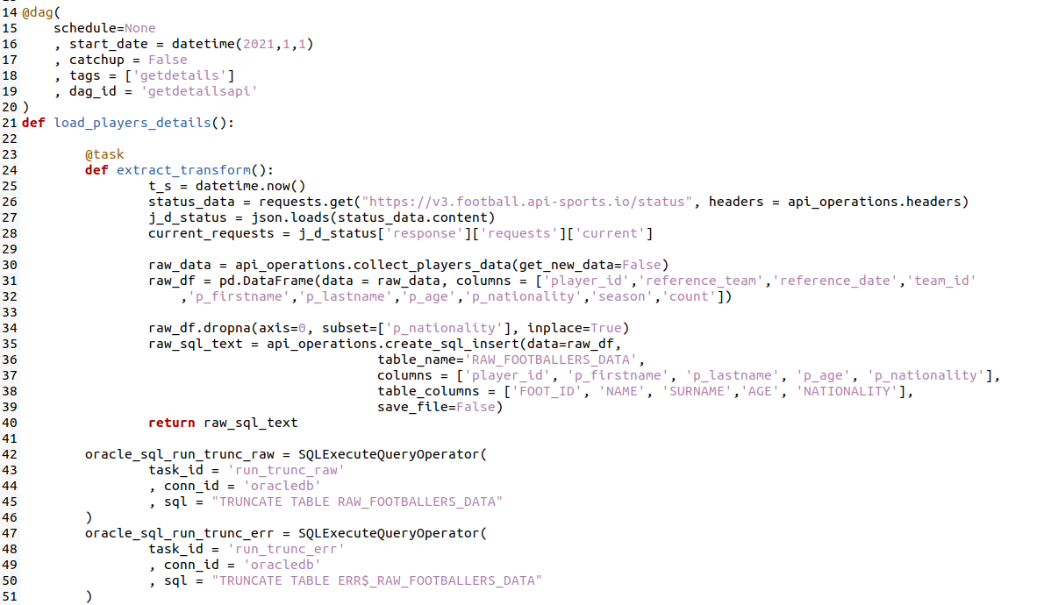
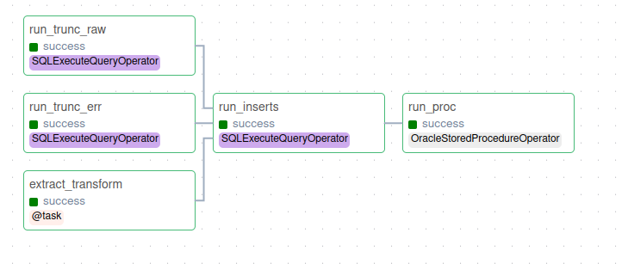
APACHE AIRFLOW DAG/TASKS/KOD
DAG getdails KOD
DAG getdails GRAPH

Slide 12
DZIĘKUJE ZA UWAGĘ ☺

