Slide 1
Hindsight Experience Replay
Marcin Andrychowicz, Filip Wolski, Alex Ray, Jonas Schneider, Rachel Fong, Peter Welinder, Bob McGrew, Josh Tobin, Pieter Abbeel, Wojciech Zaremba

Slide 2
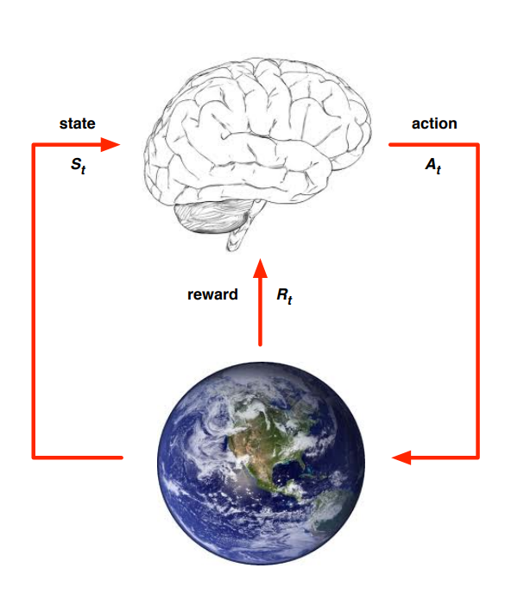
Reinforcement Learning
MDPs
Rewards
Policy
Episode
Value function (action/state)

Slide 3
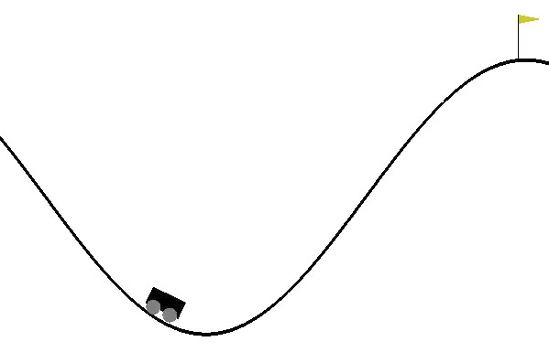
Sparse Rewards
Often rewards are so sparse, they’re too hard to reach, e.g.:
- Random string of bits
- MountainCar
- Robotics

Slide 4
Sparse Rewards – typical solution
Reward shaping:
- Creating dense rewards that somehow guide the agent.
Problematic for many reasons:
- hard to craft, needs domain knowledge
- model can learn undesired behaviour

Slide 5
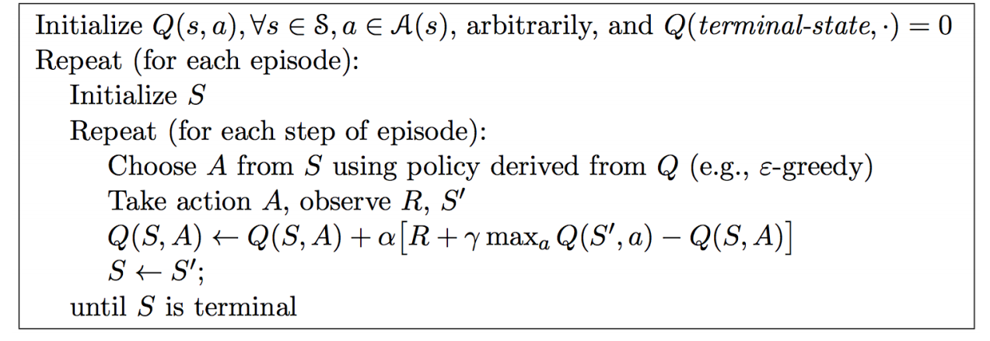
Example algorithm: Q-learning

Slide 6

On policy/off policy
SARSA (On policy)
Q-Learning (Off policy)

Slide 7
Multi-Goal RL
Standard Action-Value function
Universal Value function Approximators (UVFA)

Slide 8
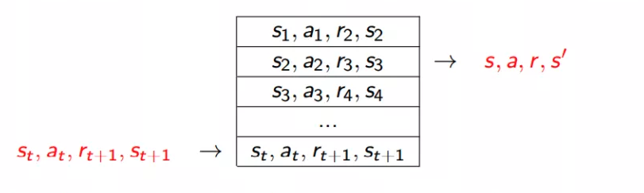
Experience Replay

Slide 9

Hindsight Experience Replay
Goals:
- we don’t want to engineer our reward function
- but still we want agent to learn from unsuccessful episodes

Slide 10
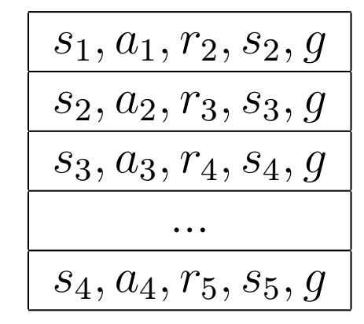
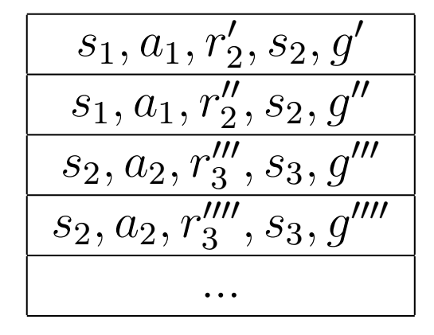
Hindsight Experience Replay
+

Slide 11
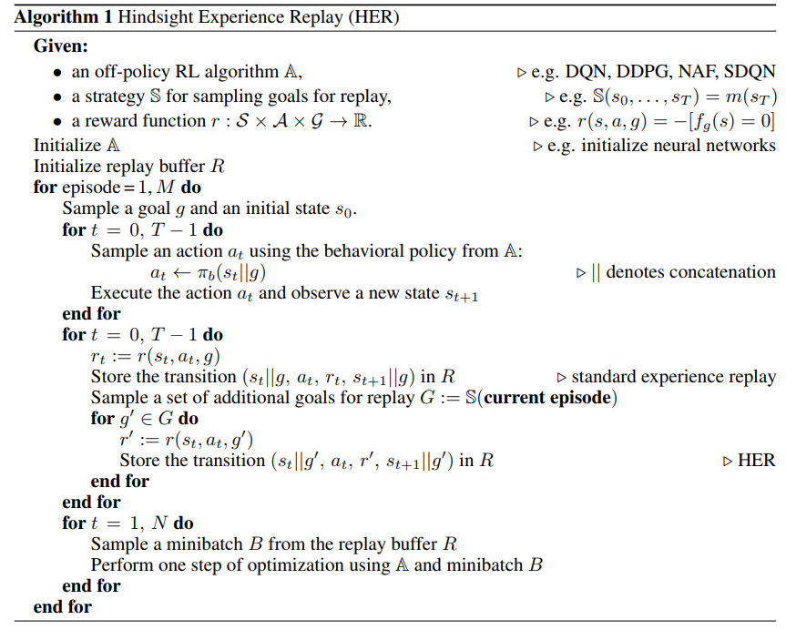
Hindsight Experience Replay

Slide 12
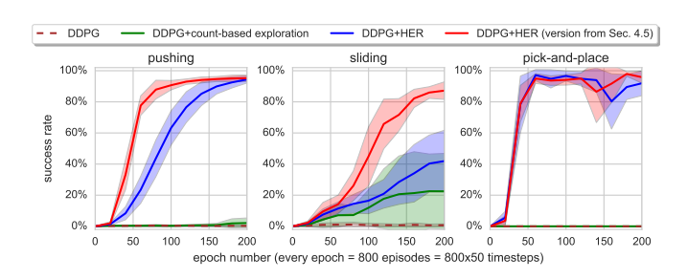
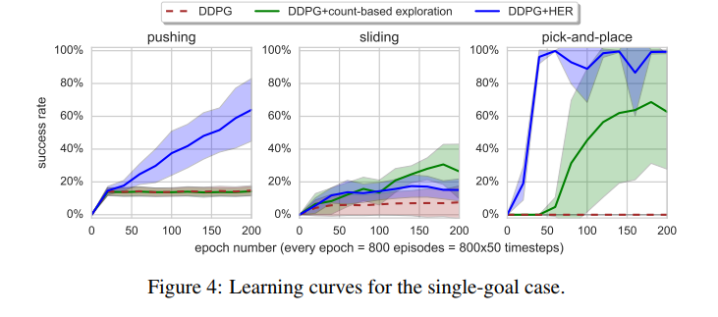
Experiments
DEMO

Slide 13
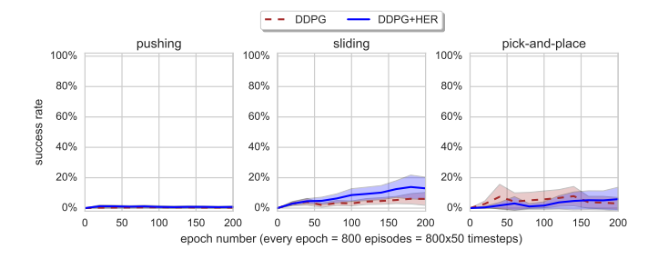
HER with Reward Shaping

Slide 14
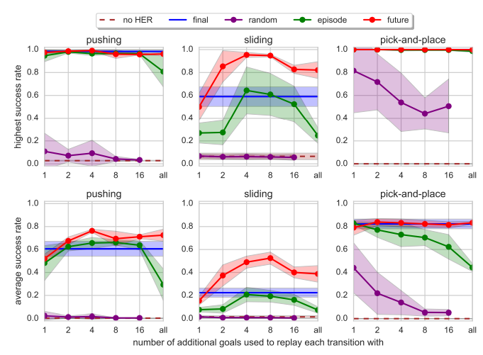
Strategies for choosing goals

Slide 15
Thank you

