Slide 1
VHER
Himanshu Sahni, Toby Buckley, Pieter Abbeel, Ilya Kuzovkin

Slide 2
Motivation
- HER depended on a the fact that for every state there was an easy way to find a goal that is satisfied in this state
- In Visual environment we want to have goals in the form of “find the beacon” etc.
- can’t use HER in a straightforward way keeping the constraints

Slide 3
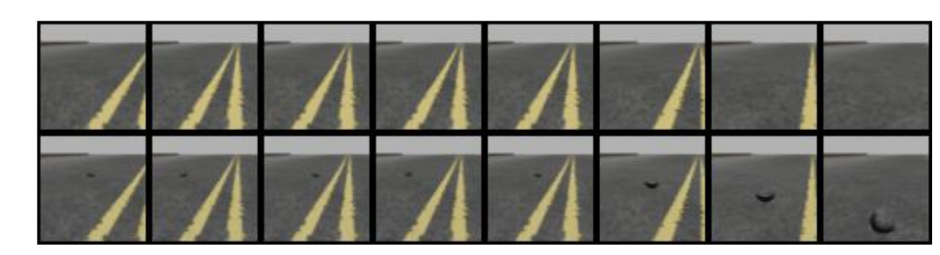
Example

Slide 4
Pipeline
- Train GAN to generate goal images (differences between real images, and the images we’d like to see)
- Run episodes, add halucinated goals to random batches of failed attemps
( NO MULTI-GOAL: Because author hallucinate their primary goals in their experience replay there’s no need for multi-goal RL)

Slide 5
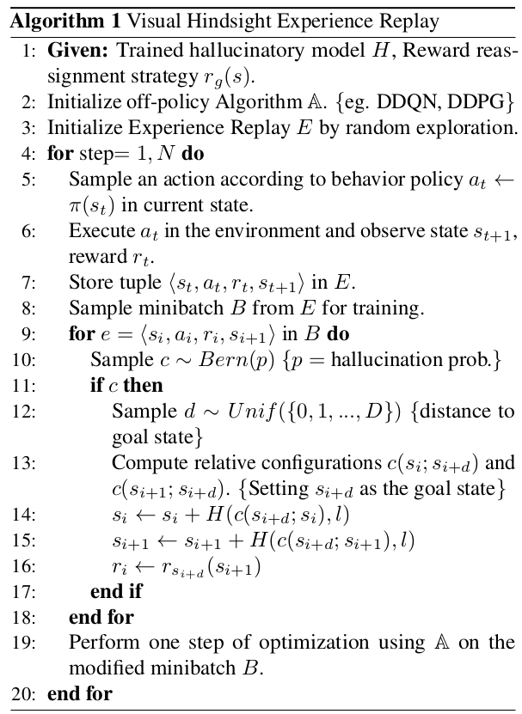
Algorithm

Slide 6
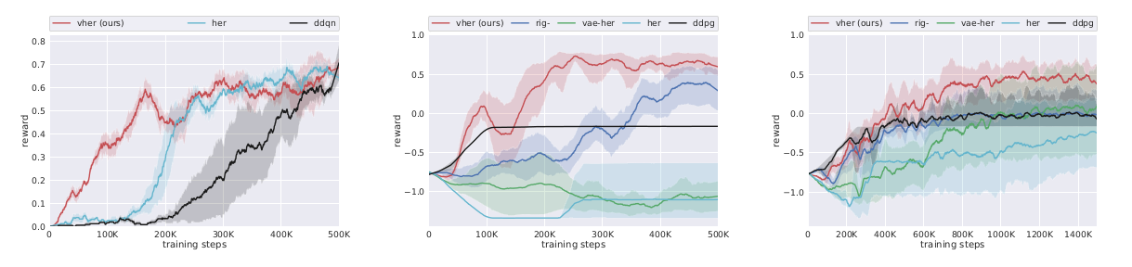
Results
TurtleBot
(collecting coins)
MiniWorld navigate
Pick and place

Slide 7
Thank you

