Slide 1





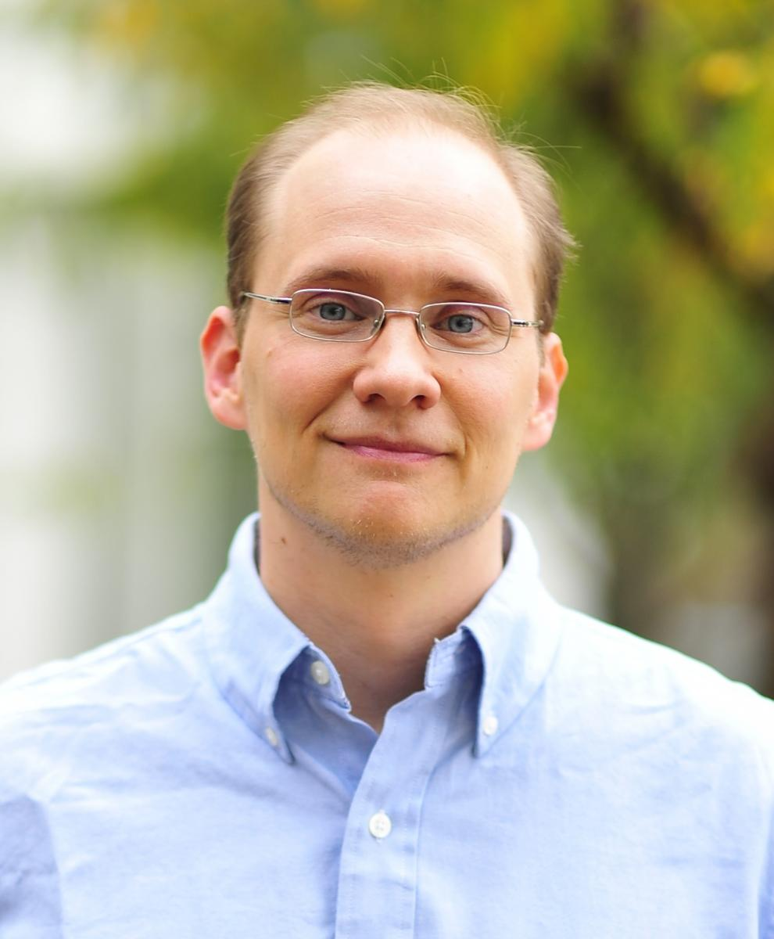

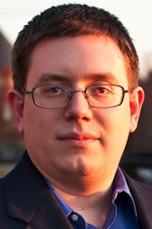
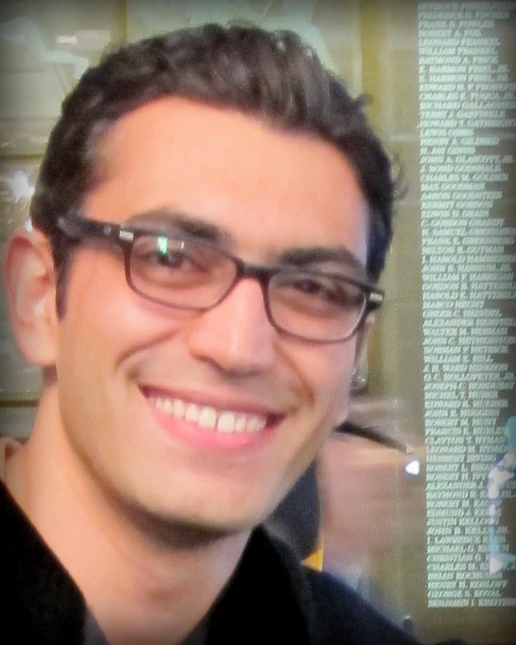

Models and Games for Quantifying Vulnerability of Secret Information
Piotr (Peter) Mardziel
University of Maryland, College Park
Stephen Magill
Galois
Michael Hicks
UMD
Mudhakar Srivatsa
IBM TJ Watson
Jonathan Katz
UMD
Mário Alvim
UFMG, Brazil
Michael Clarkson
Cornell
Arman Khouzani
Queen Mary
Carlos Cid
Royal Holloway

Slide 2

Information flow
Channel
Control
/ low input
observation
/ low output
Secret
/ high input

Slide 3
Information flow
Channel
low
obs
high
?

Slide 4


Information flow
Channel
low
obs
high

Slide 5

Quantitative Information flow
Channel C
l
o
h
C_{worst}(l,h):= h
C_{bad}(l,h) := h & 0xFF
C_{ok}(l,h) := l+42

Slide 6
Examples
Channel C
l
o
h
Example | Highs | Channel | Lows | Observations
authentication | password | Login interface | Password guess | Login OK/Fail
ASLR | memory offset | Injection attempt | Offset guess | Payload success/Crash
Encryption | key | Encryption | Plaintext | Ciphertext
Encryption timing | key | Encryption runtime model | Plaintext | Runtime of encryption
Sensor | Bogey location | Sensor/World model | N/A | Sensor reading
Sensor | Sensor location | Sensor/World model | N/A | Sensor reading
quantify
modeling
information
theoretic
more than
input/output

Slide 7
QIF metrics
Channel C
l
o
h
C_{worst}(l,h):= h
C_{bad}(l,h) := h & 0xFF
C_{ok}(l,h) := l+42

Slide 8
Quantified gain
C
Exploit e
l
Gain Model
o
gain g
h
h

Slide 9

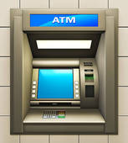

Quantified gain
(online) PIN guess
C := “runtime of strcmp(l,h)”
Exploit e
l
Gain Model
o
gain g
h
h
PIN
G(h,e) := if h == e
then £100-£0.00001
else -£0.00001

Slide 10
Basic setup
Formalism
Iteration
Computational considerations
Models for …
Adaptive adversaries
Time-varying secrets
Non-zero-sum games
Active defenders

Slide 11
Formalism
“prior knowledge”
“posterior knowledge”
H
H’
“consistent with”
C
Exploit e
l
Gain Model
o
gain g
h
h

Slide 12
Formalism
“prior knowledge”
“posterior knowledge”
H
H’
“consistent with”
C
Exploit e
l
Gain Model
o
gain g
h
h

Slide 13
Probabilistic Formalism
“prior knowledge”
“posterior knowledge”
“consistent with”
“conditioned on”
C
Exploit e
l
Gain Model
o
gain g
h
h

Slide 14
Basic setup
Formalism
Iteration
Computational considerations
Models for …
Adaptive adversaries
Time-varying secrets
Non-zero-sum games
Active defenders

Slide 15
Iteration
C
Exploit e
l
Gain Model
o
gain g
h
h

Slide 16
Iteration
e
l₁
l₂
o₁
o₂
…
Gain Model
g
h
h
h

Slide 17
Basic setup
Formalism
Iteration
Computational considerations
Models for …
Adaptive adversaries
Time-varying secrets
Non-zero-sum games
Active defenders

Slide 18
Channel → Program
int main ( … ) {
…
rand() …
l
o
h

Slide 19
Probabilistic programming
Program P
l
o
h
Inference / “conditioning”

Slide 20
Program → Channel
System running program P
l
o
h
Inference / “conditioning”

Slide 21
“PL”
Undecidable
System running program P
l
o
h
Undecidable
Inference / “conditioning”
Undecidable

Slide 22
Approximation
System running program P
l
o
h
approximate inference
over-approximation of gain
g

Slide 23
Basic setup
Formalism
Iteration
Computational considerations
Models for …
Adaptive adversaries
Time-varying secrets
Non-zero-sum games
Active defenders

Slide 24
Adaptive adversary choice
e
l₁
l₂
o₁
o₂
…
Gain Model
g
h
h
h

Slide 25
Backward inference
e
l₁
l₂
o₁
o₂
…
Gain Model
g
h
h
h

Slide 26
Adaptive power
l
// bit select
BSelect(h,l):= h & (0x1 << l)
o
h
l
// binary search
BSearch(h,l):= h <= l
o
h
H := uniform {0,…,7}
Gain = probability of
guessing in one try
expected gain with binary search

Slide 27
Basic setup
Formalism
Iteration
Computational considerations
Models for …
Adaptive adversaries
Time-varying secrets
Non-zero-sum games
Active defenders

Slide 28
Uncertainty: non-renewable resource
e
l₁
l₂
o₁
o₂
…
Gain Model
g
h
h
h

Slide 29
Uncertainty: non-renewable resource
☹
☺
H := uniform {0,…,7}
C(h,l) := h == l
Gain = probability of
guessing in one try

Slide 30
Evolving secrets
e
l₁
l₂
o₁
o₂
…
Gain Model
g
h₁
h₂
Δ
Δ:Pr[H_{i+1}|H_{i}]
h_{i}

Slide 31
Uncertainty: renewable resource?
☹
☺
H := uniform {0,…,7}
C(h,l) := h == l
Gain = probability of
guessing in one try
h_{i+1} = Δ(h_{i}) :=
if (i+1) % 4 == 0
then uniform {0,7}
else h_{i}

Slide 32
Adaptive exploitation
e
l₁
l₂
o₁
o₂
…
Gain Model
g
h₁
h₂
Δ
Δ:Pr[H_{i+1}|H_{i}]
h
h_{i}

Slide 33
Adaptive exploitation power
☹
☺
H := uniform {0,…,7}
C(h,l) := h == l
Gain = probability of
guessing in one try
h_{i+1} = Δ(h_{i}) :=
if (i+1) % 4 == 0
then uniform {0,7}
else h_{i}

Slide 34
Belief in Δ
e
l₁
l₂
o₁
o₂
…
Gain Model
g
h₁
h₂
Δ
Δ:Pr[H_{i+1}|H_{i}]
h
h

Slide 35
Vulnerability of H vs. Vulnerability of Δ
Site 1
Change your password every 6 months.
Site 2
Change your password every month.
Jan: password42
Feb: password42
Mar: password42
vs.
Jan: password42
Feb: password43
Mar: password44
Adversary know a lot about H,
little about Δ
Adversary knows a lot about Δ (and H).

Slide 36
Basic setup
Formalism
Iteration
Computational considerations
Models for …
Adaptive adversaries
Time-varying secrets
Non-zero-sum games
Active defenders

Slide 37
Generalizing gain model
e
l₁
l₂
o₁
o₂
…
Gain Model
g
h₁
h₂
Δ
Δ:Pr[H_{i+1}|H_{i}]
h
h_{i}
L:={observe, not-observe,…}
G(…):= … - cost * #obs
if h == e then £100 - £0.00001*#obs
else -£0.00001 * #obs

Slide 38
Gain with costly observation
☹
☺
H := uniform {0,…,7}
C(h,obs_{l}) := h == l
C(h,no-obs) := nothing
Gain = 1*(correct guess?) – c*#obs
h_{i+1} = Δ(h_{i}) :=
if (i+1) % 4 == 0
then uniform {0,7}
else h_{i}

Slide 39
Gain = reward_{adv}
Our loss = Adversary gain
Gain = reward_{adv} - costs_{adv}
Our loss =? Adversary gain

Slide 40
Gain vs. Loss
e_{i}
l₁
l₂
o₁
o₂
…
Gain Model
g_{i}
s_{i}
h₁
h₂
Δ
Δ:Pr[H_{i+1}|H_{i}]
h
h_{i}
L:={observe, not-observe,…}
G(…):= g = reward_{adv} - cost_{adv}
s = reward_{adv}

Slide 41
Gain vs. Loss
☹
☺
H := uniform {0,…,7}
C(h,obs_{l}) := h == l
C(h,no-obs) := nothing
Gain = 1*(correct guess?) – c*#obs
Loss = 1*(correct guess?)
h_{i+1} = Δ(h_{i}) :=
if (i+1) % 4 == 0
then uniform {0,7}
else h_{i}

Slide 42
Basic setup
Formalism
Iteration
Computational considerations
Models for …
Adaptive adversaries
Time-varying secrets
Non-zero-sum games
Active defenders

Slide 43
Passive defender
e
l₁
l₂
maximize gain
o₁
o₂
…
Gain Model
g
s
h
h

Slide 44

Active defender: simultaneous actions
e
l₁
l₂
maximize gain
o₁
o₂
…
Gain Model
g
s
h
h
minimize loss
???

Slide 45
Active defender: (Nash) equilibrium
e
l₁
l₂
o₁
o₂
…
Gain Model
g
s
h
h
Low strategy γ*
High strategy λ*
Gain (γ*,λ*) ≥ Gain (γ, λ*)
Loss (γ*,λ*) ≤ Loss (γ*,λ)

Slide 46

Picking vs. Guessing Passwords / Keys
Picker picks password (or cryptographic key)
Stronger (longer keys) passwords cost more
Guesser tries to guess
Online Game: cap of K guesses
Offline Game: no cap, but each guess incurs cost σ
Picker loses λ if their secret is guessed (guesser gains γ)

Slide 47
Password cost model

Slide 48
Password equilibria (capped guesses)
Picker strategy:
Uniformly pick password from J least costly passwords
Guesser strategy:
Guess in range of J least costly passwords, with probability inversely proportional to (picker’s) cost.

Slide 49
Password (costly guesses)

Slide 50
Key cost model

Slide 51
Key equilibria (capped guesses)
λ=10000
Picker strategy:
Uniformly pick keys from J least costly ones.
Guesser strategy:
Guess in range of J least costly keys, with probability inversely proportional to (picker’s) cost.

Slide 52
Key (costly guesses)

Slide 53
Basic setup
Formalism
Iteration
Computational considerations
Models for …
Adaptive adversaries
Time-varying secrets
Non-zero-sum games
Active defenders
Future

Slide 54
Models for …
[S&P14] Adaptive adversaries, time-varying secrets
[FCS14] Non-zero-sum games
[CSF15]* Active defenders, equilibrium
_{[CSF11,PLAS12,JCS13]}
_{Mechanism via gain bounds}
Probabilistic abstract interpretation
Simulatable enforcement mechanism
http://piotr.mardziel.com
piotrm@gmail.com
Michael Hicks
UMD
Mário Alvim
UFMG, Brazil
Michael Clarkson
Cornell
Mudhakar Srivatsa
IBM TJ Watson
Arman Khouzani
Queen Mary
Carlos Cid
Royal Holloway
Stephen Magill
Galois
Michael Hicks
UMD
Mudhakar Srivatsa
IBM TJ Watson

Slide 55
Probabilistic Abstract Interpretation
Abstract prior
abstract inference
δ
δ’’
prior
δ’’’
inference
δ'
all distributions over S
Vulnerability

Slide 56
Concrete Interpretation
(Program) States σ : Variables → Integers
Concrete semantics: [[ Stmt ]] : States → States
y
[[ if y >= 2 then x := x + 1 ]]
{x→1,y→2}
{x→2,y→2}
x
[[ y := x + y ]]
{x→1,y→1}
All states over {x,y}

Slide 57
Abstract Interpretation
Abstract Program States AbsStates
Concretization: γ(P) := { σ s.t. P(σ) }
Abstract Semantics: << Stmt >> : AbsStates → AbsStates
Example: intervals
Predicate P is a closed interval on each variable
γ(1≤x≤2, 1≤y≤1) = all states that assign x between 1 and 2, and y = 1
<< if y >= 4 then x := x + 1 >>
y
(1≤x≤2,3≤y≤4)
(1≤x≤3,3≤y≤4)
<< y := x + 2*y >>
x
(1≤x≤2,1≤y≤1)
All states over {x,y}

Slide 58
Abstract Interpretation
Abstract Program States AbsStates
Concretization: γ(P) := { σ s.t. P(σ) }
Abstract Semantics: << Stmt >> : AbsStates → AbsStates
Example: intervals
Predicate P is a closed interval on each variable
γ(1≤x≤2, 1≤y≤1) = all states that assign x between 1 and 2, and y = 1
<< if y >= 4 then x := x + 1 >>
y
(1≤x≤2,3≤y≤4)
(1≤x≤3,3≤y≤4)
σ'
<< y := x + 2*y >>
[[ y := x + 2*y ]]
x
(1≤x≤2,1≤y≤1)
σ
All states over {x,y}

Slide 59
Probabilistic Interpretation
Concrete
Abstraction
Abstract semantics

Slide 60
Concrete Probabilistic Semantics
(sub)distributions δ : States → [0,1]
Semantics
⟦skip⟧δ = δ
⟦S₁; S₂⟧δ = ⟦S₂⟧ (⟦S₁⟧δ)
⟦if B then S₁ else S₂⟧δ = ⟦S₁⟧(δ ∧ B) + ⟦S₂⟧(δ ∧ ¬B)
⟦pif p then S₁ else S₂⟧δ = ⟦S₁⟧(p*δ) + ⟦S₂⟧((1-p)*δ)
⟦x := E⟧δ = δ[x ⟼ E]
⟦while B do S⟧ = lfp (λF. λδ. F(⟦S⟧(δ | B)) + (δ | ¬B))
p*δ – scale probabilities by p
p*δ := λσ. p*δ(σ)
δ ∧ B – remove mass inconsistent with B
δ ∧ B := λσ. if ⟦B⟧σ = true then δ(σ) else 0
δ₁ + δ₂ – combine mass from both
δ₁ + δ₂ := λσ. δ₁(σ) + δ₂(σ)
δ[x ⟼ E] – transform mass

Slide 61
Subdistribution operations
δ ∧ B – remove mass inconsistent with B
δ ∧ B = λσ. if ⟦B⟧σ = true then δ(σ) else 0
δ₁ + δ₂ – combine mass from both
δ₁ + δ₂ = λσ. δ₁(σ) + δ₂(σ)
δ
B = x ≥ y
δ ∧ B
δ₁
δ₂
δ₁+ δ₂
⟦if x ≤ 5 then y := y + 3 else y := y - 3⟧δ
= ⟦y := y + 3⟧(δ ∧ x ≤ 5)
+ ⟦y := y – 3⟧(δ ∧ x > 5)
δ ∧ x ≤ 5
⟦y := y + 3⟧(δ ∧ x ≤ 5)
δ
⟦S⟧δ
δ ∧ x > 5
⟦y := y – 3⟧(δ ∧ x > 5)

Slide 62
Subdistribution Abstraction

Slide 63
Subdistribution Abstraction: Probabilistic Polyhedra
P
V(δ) = max_{σ} δ(σ)
Region of program states (polyhedron)
+ upper bound on probability of each possible state in region
+ upper bound on the number of (possible) states
+ upper bound on the total probability mass (useful)
+ also lower bounds on the above
Pr[A | B] = Pr[A ∩ B] / Pr[B]
Notes:
the number of points and the seemingly redundant total mass we found useful for performing some operations in some cases

Slide 64
Abstraction imprecision
exact
abstract
P₁
P₂

Slide 65
Probabilistic Abstract Interpretation
Define
<<S>> P
Soundness: if δ ∈ γ(P) then ⟦S⟧δ ∈ γ (<<S>>P)
Abstract versions of subdistribution operations
P₁ + P₂
P ∧ B
p*P
Abstract prior P
abstract inference
δ
δ’’
prior
δ’’’
inference
δ'
all distributions over S

Slide 66
Example abstract operation
δ₁(σ)
δ₂(σ)
p₁^{max}
+
δ₁
p₁^{min}
p₂^{max}
δ₂
p₂^{min}
σ(x)
σ(x)
δ₃(σ)
δ₃ := δ₁ + δ₂
{P_{3,}P_{4,}P₅} = {P₁} + {P₂}
σ(x)

Slide 67
Conditioning
Conditioning
Concrete
Abstract:
Lower bound on total mass

Slide 68
Simplify representation
Limit number of probabilistic polyhedra
P₁ ± P₂ - merge two probabilistic polyhedra into one
Convex hull of regions, various counting arguments

Slide 69
Add and simplify
δ₁(σ)
δ₂(σ)
p₁^{max}
±
δ₁
p₁^{min}
p₂^{max}
δ₂
p₂^{min}
σ(x)
σ(x)
δ₃(σ)
δ₃ := δ₁ + δ₂
{P₃} = {P₁} ± {P₂}
σ(x)

Slide 70

Primitives for operations
Need to
Linear Model Counting: count number of integer points in a convex polyhedra
Integer Linear Programming: maximize a linear function over integer points in a polyhedron

Slide 71
Probabilistic Abstract Interpretation
P’’
Abstract prior
P
abstract inference
P’’’
δ
δ’’
prior
δ’’’
inference
δ'
P’
all distributions over S
Vulnerability
Conservative (sound) vulnerability bounds

