Slide 1



Probabilistic Computation for Information Security
Piotr (Peter) Mardziel (UMD) Kasturi Raghavan (UCLA)

Slide 2
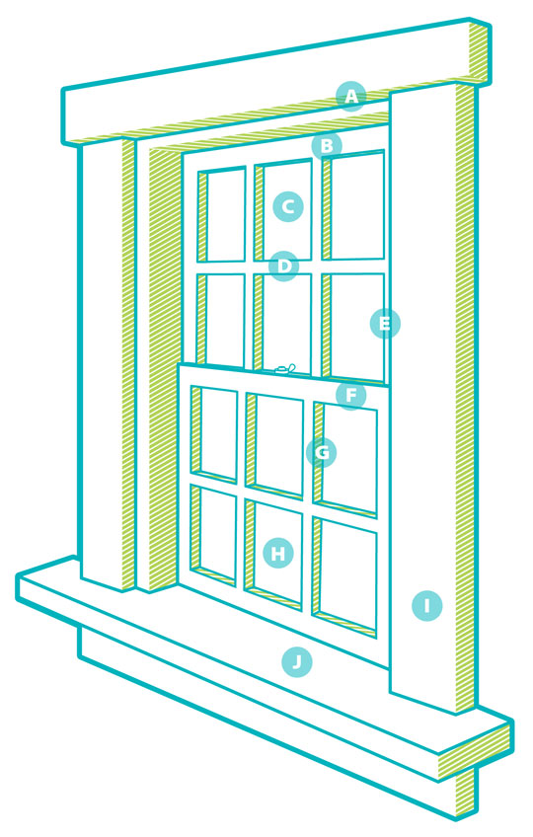




Convenience
params
~params
prior
secret
Alice’s secret
B₁~secret
Bob’s belief about secret
~sample = model(~params)
B₁~visible = sys(B₁~secret)
~params | [ model(~params) == sample ]
posterior
B₁~secret | [ sys(B₁~secret) == sys(secret) ]
= B₂~secret
Bob’s revised belief

Slide 3

Convenience
B₁~secret
Bob’s belief about secret
secret = (age, gender, engaged?)
Alice’s secret
B₂~visible = fun₁(B₁~secret)
Photography
B₁~visible = special-offer(B₁~secret)
B₂~secret | [ sys(B₂~secret) == fun₂(secret) ]
= B₃~secret
B₁~secret | [ sys(B₁~secret) == special-offer(secret) ]
= B₂~secret
Bob’s revised belief
special-offer(age, gender, engaged?) =
return (24 <= age <= 30 and
gender == ‘female and
engaged?)

Slide 4
Protection
B₁~secret
secret = (age, gender, engaged?)
Alice’s secret
B₁~visible = fun₀(B₁~secret)
Photography
B₂~secret
Assumptions

Slide 5
Information flow
Information flow / Non-interference:
Does information flow?
B₂~secret =? B₁~secret
Quantified information flow:
How much information flows?
H(B₂~secret) – H(B₁~secret)
Yes?
No?
B₃~secret
B₂~secret
B₁~secret
0
∞
Entropy / Min-entropy / Guessing entropy / etc..

Slide 6
Information flow
Information flow / Non-interference: Does information flow?
Quantified information flow: How much information flows?
Knowledge tracking / “semantic” information flow
What information flows?
distributions over secret
B₃~secret
B₂~secret
B₁~secret
Entropy / Min-entropy / Guessing entropy / etc..

Slide 7

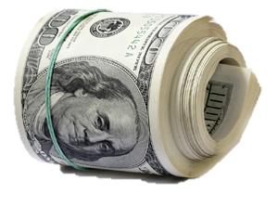



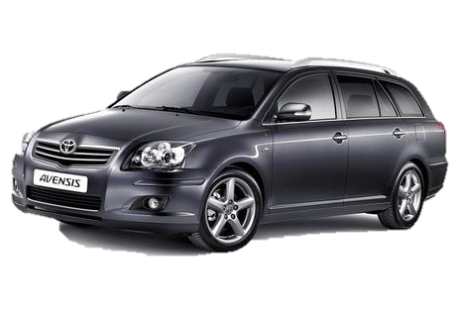


Worse: they have your data
advertisers
query/filter
Photography
page + ads
your data
you

Slide 8
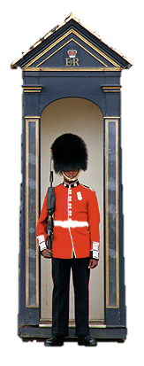
Alternative: Take back control
advertisers
Photography
query/filter
content+
query/filter
query
responses
your data
you

Slide 9
Simpler model (for exposition)
Question: when (or how) should you answer a query to balance privacy and utility?
query
response
Photography
querier
you

Slide 10
Useful and non-revealing
out = 24 ≤ Age ≤ 30
& Female?
& Engaged? *
true
Photography
querier
* real query used by a facebook advertiser
you

Slide 11
Reveals too much!
out =
(gender,
zip-code,
birth-date) *
reject
* - age, zip-code, birth-date can be used to uniquely identify 63% of Americans

Slide 12
(Non)-answer: Access control policies?
Example
Birth day: friends, advertisers, third-party apps
Birth year: friends (only)
Limitations
Only can express policies at the level of nameable items
Should I separate bday = (month,day) and protect each individually?
Forces (unnecessary) utility tradeoff
To prevent (zip-code,birthdate,gender) query, I have to make at least one of these completely inaccessible
Or: must pick, in advance, to make byear or bday inaccessible
Our solution: quantitative, knowledge-based policies

Slide 13

Idea: base policy on information content of the query
Q1
Q2
Q3
out := 24 ≤ age ≤ 30
& female?
& engaged?
out :=
(gender,
zip-code,
birth-date)
out := age
?
Notes:
----- Meeting Notes (4/7/11 16:18) -----
we need some way to evaluate these queries, to determine whether we should answer them

Slide 14
Approach
Maintain a representation of each querier’s belief about secret’s possible values
Each query result revises the belief; reject if actual secret becomes too likely
Cannot let rejection defeat our protection.
Belief ≜
probability
distribution
…
…
Q1
Q2
Q3
Bayesian reasoning
to revise
belief
OK (answer)
Reject
OK (answer)
time
Notes:
trying to set the stage better for what we decide is the way to decide good/bad queries

Slide 15
Contributions
Knowledge-based security policies
Threshold for deciding when an answer reveals too much
Means to avoid rejection of query revealing information
Implementing checking and belief revision efficiently
Foundations due to Clarkson
We use abstract interpretation, defining a novel probabilistic polyhedra domain
Originally published at Computer Security Foundations Symposium 2011
extended version under review

Slide 16
Example: Bob and his birthday
Bob (born September 24, 1980)
bday = 267
byear = 1980
Secret
=
0 ≤ bday ≤ 364
1956 ≤ byear ≤ 1992
preB :
Assumption: this is accurate
byear
each equally likely
1992
1956
bday
0
364
Notes:
we use some sloppy notation here. By Pr[bday] we actually mean Pr[bday = 270] according to the belief.

Slide 17

1992
bday-query1
today := 260;
if bday ≤ today && bday < (today + 7)
then out := 1
else out := 0
1956
0
364
1992
|
(out = 0)
: postB
=
1956
0
259
267
364

Slide 18
bday-query1
today := 260;
if bday ≤ today && bday < (today + 7)
then out := 1
else out := 0
Problem
Policy: Is this acceptable?
1992
|
(out = 0)
=
=
1956
0
259
267
364

Slide 19
Policy = knowledge threshold
Answer a query if, for querier’s revised belief, Pr[my secret] < t
Call t the knowledge threshold
“my secret” can be a single data item, a tuple, even a predicate
Choice of t depends on the risk of revelation

Slide 20
Bob’s policy
P
Bob (born September 24, 1980)
bday = 267
byear = 1980
Secret
=
0 ≤ bday ≤ 364
1956 ≤ byear ≤ 1992
Pr[bday = 267] …
each equally likely
byear
1992
Policy
Pr[bday] < 0.2
Pr[bday,byear] < 0.05
Currently
Pr[bday] = 1/365
Pr[bday,byear] = 1/(365*37)
1956
bday
0
364
Notes:
we use some sloppy notation here. By Pr[bday] we actually mean Pr[bday = 270] according to the belief.

Slide 21
Bob’s policies
Policy
Pr[bday] < 0.2
bday specifically should never be certainly known
Notes:
we use some sloppy notation here. By Pr[bday] we actually mean Pr[bday = 270] according to the belief.

Slide 22
Bob’s policies
Policy
Pr[bday,byear] < 0.05
the pair of bday,byear should never be certainly known
doesn’t commit to protecting bday or byear alone
allows queries that need high precision in one, or low precision in both
Notes:
we use some sloppy notation here. By Pr[bday] we actually mean Pr[bday = 270] according to the belief.

Slide 23
1992
bday-query1
today := 260;
if bday ≤ today && bday < (today + 7)
then out := 1
else out := 0
1956
0
364
1992
|
(out = 0)
=
1956
0
259
267
364

Slide 24
bday-query1
today := 260;
if bday ≤ today && bday < (today + 7)
then out := 1
else out := 0
Potentially
Pr[bday] = 1/358 < 0.2
Pr[bday,byear] = 1/(358*37) < 0.05
1992
|
(out = 0)
=
=
1956
0
259
267
364

Slide 25
Next day …
P
1992
bday-query2
today := 261;
if bday ≤ today && bday < (today + 7)
then out := 1
else out := 0
1956
0
259
267
364
1992
|
(out = 1)
=
1956
0
267
Pr[bday] = 1
So reject?

Slide 26
Querier’s perspective
Assume querier knows policy
if bday ≠ 267
if bday = 267
1992
1992
1956
1956
0
259
268
364
0
267
will get answer
will get reject

Slide 27
Rejection problem
|
reject
=
Policy: Pr[bday = 267 | out = o] < t
Rejection, intended to protect secret, reveals secret!

Slide 28
Rejection revised
Policy: Pr[bday = 267 | out = o] < t
Solution?
Decide policy independently of secret
Revised procedure
for every possible output o,
for every possible bday b,
Pr[bday = b | out = o] < t
So the real bday in particular

Slide 29
bday-query1
today := 260;
if bday ≤ today && bday < (today + 7)
then out := 1
else out := 0
accept
initial belief

Slide 30
(after bday-query1)
bday-query2
today := 261;
if bday ≤ today && bday < (today + 7)
then out := 1
else out := 0
reject
(regardless of what bday actually is)

Slide 31
(after bday-query1)
bday-query3
today := 266;
if bday ≤ today && bday < (today + 7)
then out := 1
else out := 0
accept
This is acceptable since it is five days after the last accept, keeping the probability within t = 0.2; i.e., Pr[266 ≤ bday ≤ 270] = 1/5 if out =1, Pr[bday] = 1/353 otherwise

Slide 32

Implementation by abstract interpretation
We can use (general purpose) probabilistic languages to model attacker knowledge and how it changes due to query results.
prob-scheme (MIT), IBAL (Harvard), Church (MIT), etc.
Exact (e.g., sampling-based) interpretation is too slow
Time taken is proportional to the size of the state space
Other approaches are approximate in an unspecified manner
Would like to ensure soundness of policy decisions
Can address the both problems using abstract interpretation

Slide 33
Three slides on abstract interpretation
Given a programming language
e ::= x | n | e * e
The concrete interpretation is its actual semantics
Concrete domain is natural numbers
Concrete interpretation Eval(e) is multiplication
1 * (2 * 3) = 6, etc.
An abstract interpretation approximates the semantics
Abstract domain is intervals of natural numbers [n₁,n₂]
Abstract interpretation Aeval(e): [n₁,n₂] * [n₃,n₄] = [n₁*n₃, n₂*n₄]
[1,4] * ([2,2] * [3,6])
= [1,4] * [6,12]
= [6,48]

Slide 34
Relating abstract and concrete
Concretization function γ relates the abstract domain A to the concrete one C
γ : A ⟶ C
γ ([n₁,n₂]) = { n | n₁ ≤ n ≤ n₂ } – here, C is the powerset of naturals
Abstraction function α relates the concrete domain C to the abstract one A
α : C ⟶ A
α(S) = [n₁,n₂] where n ∈ S implies n₁ ≤ n and n ≤ n₂
Galois insertion: S ⊆ γ(α(S)) and α(γ(A)) = A

Slide 35
Soundness
Aeval(e) (where x appears in e) is sound iff
Aeval(e)[x=A] = A’
forall n ∈ γ(A), Eval(e)[x=n] = n’ implies n’ ∈ γ(A’)
(With obvious generalization to multiple variables)
Suppose e is x * 5
Abstract interpretation, assuming x=[1,3]
Aeval(e)[x=[1,3]] = [5,15]
Concrete interpretation, assuming x=2 ∈ γ([1,3])
Eval(e)[x=2] = 10
Notice that 10 ∈ γ([5,15])

Slide 36
Concrete domain: probability distributions
Distributions δ : States ⟶ Real numbers
A state σ is a map from variables to integers
Semantics of a statement S under distribution δ is written ⟦S⟧δ. Informally, concrete interpretation is:
For each state σ in the support of δ, let p be its probability
Execute S in that state, producing σ’ with probability mass p
Add to it the probability mass of all other input states that produce σ’

Slide 37
Implementation by sampling
1992
=
input state
bday-query1
today := 260;
if bday ≤ today && bday < (today + 7)
then out := 1
else out := 0
1956
0
364
output state
out = 1
1992
out = 0
| (out = 0) *
1956
0
259
267
364
* δ | (out = 0) = normalize(δ | (out = 0))

Slide 38
Probabilistic Interpretation
Semantics (cf. Kozen)
⟦skip⟧δ = δ
⟦S₁; S₂⟧δ = ⟦S₂⟧ (⟦S₁⟧δ)
⟦if B then S₁ else S₂⟧δ = ⟦S₁⟧(δ | B) + ⟦S₂⟧(δ | ¬B)
⟦pif p then S₁ else S₂⟧δ = ⟦S₁⟧(p*δ) + ⟦S₂⟧((1-p)*δ)
⟦x := E⟧δ = δ[x ⟼ E]
⟦while B do S⟧ = lfp (λF. λδ. F(⟦S⟧(δ | B)) + (δ | ¬B))
Operations
p*δ – scale probabilities by p
δ | B – remove mass inconsistent with B
δ₁ + δ₂ – combine mass from both
δ[x ⟼ E] – transform mass

Slide 39
Subdistribution operations
δ | B – remove mass inconsistent with B
δ | B = λσ. if ⟦B⟧σ = true then δ(σ) else 0
δ₁ + δ₂ – combine mass from both
δ₁ + δ₂ = λσ. δ₁(σ) + δ₂(σ)
δ
B = x ≥ y
δ | B
δ₁
δ₂
δ₁+ δ₂
⟦if x ≤ 5 then y := y + 3 else y := y - 3⟧δ = ⟦y := y + 3⟧(δ | x ≤ 5) + ⟦y := y – 3⟧(δ | x > 5)
δ | x ≤ 5
⟦y := y + 3⟧(δ | x ≤ 5)
δ
⟦S⟧δ
δ | x > 5
⟦y := y – 3⟧(δ | x > 5)

Slide 40
Abstract domain: probabilistic polyhedra
out = 1
1992
1992
out = 0
P₃
P₁
P₁
P₂
1956
1956
0
364
0
259
267
364
P₁: 0 ≤ bday ≤ 364, 1956 ≤ byear ≤ 1992
p = 0.000074
P₁: 0 ≤ bday ≤ 259, 1956 ≤ byear ≤ 1992, out = 0
p = 0.000074
P₂: 267 ≤ bday ≤ 364, 1956 ≤ byear ≤ 1992, out = 1
p = 0.000074
…
Key elements of Prob. Poly. P:
Constraints describing polygons C_{i}
Probability p per point within the polygon (assumes discrete distributions)
Notes:
this is a small part of our actual abstraction but should demonstrate some features aptly

Slide 41
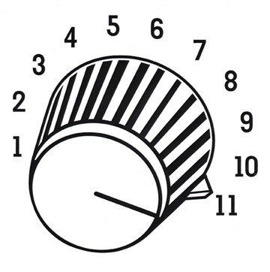
Performance / precision tradeoff
(Sets of) polyhedra are a standard abstract domain, so we can reuse (parts of) existing tools to operate on them directly
Can end up with many small regions
May be expensive to manipulate
Approach
Collapse regions: specify the “boundary” of a region and bounds on the number and probability of the points within it
Nonuniform regions hurt precision but fewer regions improve performance

Slide 42

Too many regions
1992
1991
1981
1971
1961
1956
nasty-query1
… many disjuncts …
age := 2011 – byear;
if age = 20 || … || age = 60
then out := true
else out := false;
0
259
267
364
| (out = false)
Let = belief after bday-query1

Slide 43
Approximation
exact
approximate
1992
P₁
1992
P₂
1991
1981
1981
1971
1971
P₁
P₂
1961
1961
1956
1956
0
259
267
364
0
259
267
364
P₁: 0 ≤ bday ≤ 259, 1992 ≤ byear ≤ 1992
p = 0.000067
P₂: 0 ≤ bday ≤ 259, 1982 ≤ byear ≤ 1990
p = 0.000067
… (ten total)
P₁₀
P₁: 0 ≤ bday ≤ 259, 1956 ≤ byear ≤ 1992
p = 0.000067
s = 8580 ( < true size = 9620)
P₂: 267 ≤ bday ≤ 364, 1956 ≤ byear ≤ 1992
p = 0.000067
s = 3234 ( < true size = 3626)
p,s refer to possible (non-zero probability) points in region

Slide 44
Abstraction imprecision
exact
abstract
1992
1992
1991
1981
1981
1971
1971
P₁
P₂
1961
1961
1956
1956
0
259
267
364
0
259
267
364
1992
1992
1981
1981
1971
1971
1961
1961
1956
1956
0
259
267
364
0
259
267
364

Slide 45
Non-uniform regions
| out = true
1992
P₁
P₂
1981
nasty-query-2
… many disjuncts …
… probabilistic choice:
age := 2011 – byear;
if age = 20 || … || age = 60
then out := true
else out := false;
pif 0.1 then out := true
1971
1961
1956
0
259
267
364
Takes the true branch one time out of ten
Thus, out = true implies age is a decade
or the coin flipped in our favor; former more likely

Slide 46
Approximation
approximate
1992
P₁
1992
P₂
1991
1981
1981
1971
P₁
P₂
1971
1961
1961
1956
1956
0
259
267
364
0
259
267
364
P₁: 0 ≤ bday ≤ 259, 1992 ≤ byear ≤ 1992
p = 0.0000074
P₂: 0 ≤ bday ≤ 259, 1991 ≤ byear ≤ 1991
p = 0.000074
… (18 total)
P₁₈
P₁: 0 ≤ bday ≤ 259, 1956 ≤ byear ≤ 1992
p ≤ 0.000074
s = 9620
P₂: 267 ≤ bday ≤ 364, 1956 ≤ byear ≤ 1992
p ≤ 0.000074
s = 3626
for policy check
Pr[bday = b | out = o] < t

Slide 47
Final abstraction
1992
1991
1981
1971
P₁
P₂
1961
1956
0
259
267
364
For each P_{i}, store
region (polyhedron)
p: upper bound on probability of each possible point
s: upper bound on the number of (possible) points
m: upper bound on the total probability mass (useful)
Also store
lower bounds on the above
Probabilistic
Polyhedron
Pr[A | B] = Pr[A ∩ B] / Pr[B]
Notes:
the number of points and the seemingly redundant total mass we found useful for performing some operations in some cases

Slide 48
Relating abstract and concrete
δ₁
δ₂
∈ γ(
)
p_{i}^{min}, p_{i}^{max}
s_{i}^{min}, s_{i}^{max}
m_{i}^{min}, m_{i}^{max}
δ₃
C_{i}
…
δ ∈ γ(P) iff
support(δ) ⊆ γ(C)
p^{min} ≤ δ(σ) ≤ p^{max} for every σ ∈ support(δ)
s^{min} ≤ |support(δ)| ≤ s^{max}
m^{min} ≤ mass(δ) ≤ m^{max}
δ ∈ γ({P₁,P₂}) iff
δ = δ₁ + δ₂ with δ₁ ∈ γ(P₁) and δ₂ ∈ γ(P₂)
similarly for more than two
support(δ) = {σ | δ(σ) > 0}

Slide 49
Abstract Semantics
Define
⟦S⟧P
Soundness: if δ ∈ γ(P) then ⟦S⟧δ ∈ γ (⟦S⟧P)
Need Abstract operations
P₁ + P₂
if δ_{i} ∈ γ(P_{i}) for i = 1,2 then δ₁ + δ₂ ∈ γ(P₁ + P₂)
P | B
if δ ∈ γ(P) then δ | B ∈ γ(P | B)
p*P
if δ ∈ γ(P) then p * δ ∈ γ(p*P)
…
(and likewise for sets of P)

Slide 50

Abstract operations
δ
P
P₃ = P₁ + P₂
C₃ – convex hull of C₁, C₂
s₃^{max} – what is the smallest overlap?
s₃^{min} – what is the largest overlap?
p₃^{max} – is overlap possible?
p₃^{min} – is overlap impossible?
m₃^{max} – simple sum m₁^{max} + m₂^{max}
m₃^{min} – simple sum m₁^{min} + m₂^{min}
Other operations: similar, complicated formulas abound
Need to
count number of integer points in a convex polyhedra
Latte
maximize a linear function over integer points in a polyhedron
Latte
convex hull, intersection, affine transform
Parma
PPL

Slide 51
Abstract operation example
P₁
P₂
δ₁ + δ₂ – combine mass from both
δ₁ + δ₂ = λσ. δ₁(σ) + δ₂(σ)
| C₁ | = 100
C₂
| C₂ | = 40
δ₁
δ₂
δ₁+δ₂
C₁
s₁^{max} = 100
s₂^{max} = 30
P₃ = P₁ + P₂
s₃^{max} ≤ s₁^{max +} s₂^{max} = 130
What is the maximum number of possible points in the sum?
determine minimum overlap (10)
20
20
80
| C₁ ⋂ C₂ | = 20
s₃^{max} = 120

Slide 52
Implementation and experiments
Interpreter written in Objective Caml for a simple imperative language
Calling out to LattE and Parma, as mentioned
In addition to full-precision polyhedra, implemented probabilistic versions of two other domains
Intervals – constraints have form c₁ ≤ x ≤ c₂
Can implement counting without LattE
Octagons – constraints have form ax + by ≤ c with a,b ∈ {-1,0,1}
Experiments on several queries
Results for a Mac Pro with two 2.26 GHz quad-core Xeon processors using 16 GB of RAM

Slide 53
Queries
Birthday query 1
Birthday query 1+2
Birthday query 1+2+special
Pizza
User in particular age range, in college, lives within 2 mile square
Photo
User in particular age range, female, engaged
Travel
Lives in particular country, speaks English, over 21, completed high school

Slide 54
Scales better than enumeration
1 pp
=
0 ≤ bday ≤ 364
1956 ≤ byear ≤ 1992
each equally likely
bday1 small
> 1 pp
=
0 ≤ bday ≤ 364
1910 ≤ byear ≤ 2010
each equally likely
bday 1 large

Slide 55
Performance/precision tradeoff
Birthday query
1+2+special

Slide 56
Intervals very fast generally
Query | Intervals | Octagons | Polyhedra
Bday1 (small) | 0.01 | 1.87 | 2.81
Bday1+2 (small) | 0.01 | 2.9 | 5.25
Bday1+2+spec | 0.47 | 17.8 | 23.0
Bday1 (large) | 0.01 | 2.1 | 2.48
Bday1+2 (large) | 0.02 | 3.02 | 4.52
Bday1+2+spec | 0.58 | 33.6 | 46.5
Pizza | 0.26 | 92.7 | 125.5
Photo | 0.02 | 5.47 | 7.98
Travel | 0.48 | 126.9 | 154.5
Times in seconds
All achieve maximum precision when given unlimited polyhedra

Slide 57
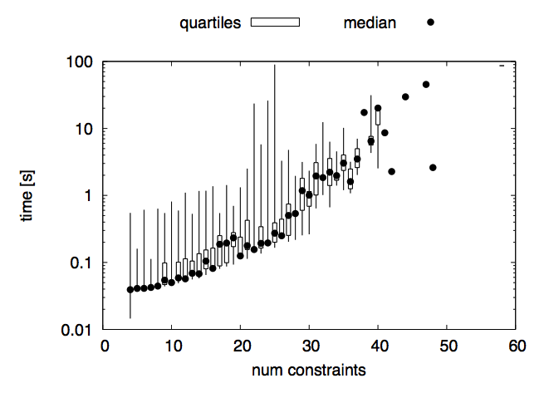
LattE is the performance bottleneck

Slide 58
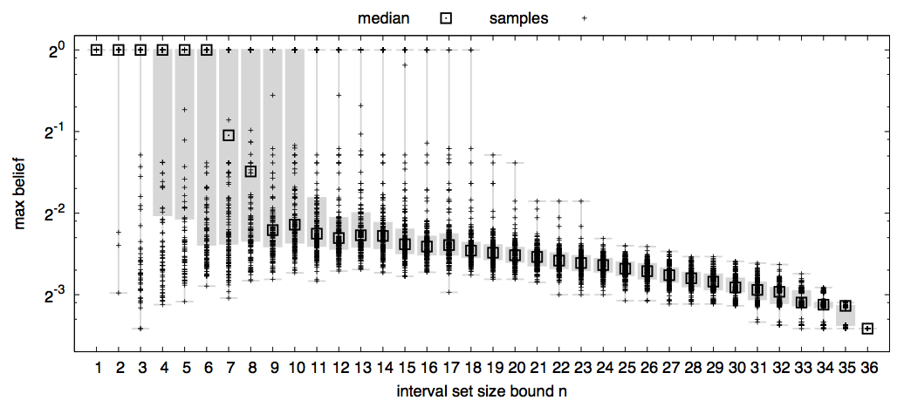
Merging order matters for precision
Each point represents a different merging order for the given bound
Median precision point depicted as a box
Semi-interquartile range given in gray
Best precision possible is at the very bottom (about 3.8 * 10⁻⁴)

Slide 59
Follow-on work: application to SMC
SMC = Secure Multiparty Computation
Party P_{i} has secret S_{i}, all want to compute Q(S₁,…,S_{n})
Uses clever protocol to do this without a trusted third party
All that is learned about inputs is what is implied by the output
Adapt our approach to this setting
Model each remote party’s belief
Make sure that no party will learn too much about my secret
Details in PLAS’12 paper
Interesting future question:
Can we use game theory to determine how subsequent query expressions are influenced by prior results (and thus secrets)?

Slide 60
Generalizing to multiple parties
Multiple principals, each with secret s₁…s_{n}, respectively, want to compute f(s₁…s_{n}) = out
Can do this with a crypto community technique called secure multiparty computation
Question: If each sees out, will one learn too much?
Solution: knowledge threshold calculation as part of SMC
Paper appeared at PLAS’12

Slide 61

Secure multi-party computation
Multiple parties have secrets to protect.
Want to compute some function over their secrets without revealing them.
x₁
Q₁(x₁,x₂)
x₂
True / False
Q₁ =
if x₁ ≥ x₂ then
out := True else
out := False

Slide 62
Secure multi-party computation
Use trusted third party.
T
x₂
x₁
Q₁(x₁,x₂)
True
Q₁ =
if x₁ ≥ x₂ then
out := True else
out := False

Slide 63
Secure multi-party computation
SMC lets the participants compute this without a trusted third party.
T
x₂
x₁
Q₁(x₁,x₂)
True
Q₁ =
if x₁ ≥ x₂ then
out := True else
out := False

Slide 64
Secure multi-party computation
Nothing is learned beyond what is implied by the query output.
Assume it is publicly known that 10 ≤ x₁,x₂ ≤ 100
x₁
Q₁(10,x₂)
x₂
True
implies x₂ = 10
Q₁ =
if x₁ ≥ x₂ then
out := True else
out := False

Slide 65

Our goal
Make sure what is implied is not too much.
Model knowledge.
Model inference.
x₁
Q₁(x₁,x₂)
x₂
True
Q₁ =
if x₁ ≥ x₂ then
out := True else
out := False

Slide 66
Knowledge in the SMC setting
Assumption: common knowledge/belief.
δ(x₁,x₂) = 1/91²
10 ≤ x₁,x₂ ≤ 100
x₁=80
x₂=60
A₁
A₂

Slide 67
Knowledge in the SMC setting
Assumption: initial belief is derived from common knowledge, revised by secret value.
δ | (x₁ = 80)
=
δ₁⁸⁰(x₂) = 1/91
10 ≤ x₂ ≤ 100
δ | (x₂ = 60)
=
δ₂⁶⁰(x₁) = 1/91
10 ≤ x₁ ≤ 100
x₁=80
x₂=60
A₁
A₂

Slide 68
Belief sets
A₂ considers all possible values of x₁
δ₁¹⁰ = δ | (x₁ = 10)
δ₁¹¹ = δ | (x₁ = 11)
δ₁¹⁰⁰ = δ | (x₁ = 100)
x₁=10
x₁=11
…
x₁=100
A₁
10 ≤ x₁ ≤ 100
A₂
x₂=60

Slide 69
Belief sets
A₂ considers all possible values of x₁
Δ = { δ₁^{x} }
A₁
A₂
x₂=60

Slide 70
Belief sets
A₂ conservatively enforces max belief threshold.
Q
δ₁¹⁰ → δ’₁¹⁰
δ₁¹¹ → δ’₁¹¹
x₁=10
x₁=11
…
A₁
A₁
x₁=80
max belief ≤ t
max belief ≤ t
A₂
x₂=60

Slide 71
Belief sets
A₂ maintains belief set.
A₁ does similarly.
Δ₁ = { δ₁^{x} }_{x}
10 ≤ x₁ ≤ 100
A₁
Δ₂
T
policy P₁
policy P₂
Q₁(x₁,x₂)
TIME
x₁
x₂
A₂
A₁
x₂=60
True
Δ’₁ = { δ₁^{x} | (out = True) }_{x}
Δ’₂
A₁

Slide 72
Alternative: Knowledge tracking via SMC
SMC: “trusted third party” – keeps secrets safe
T
x₂
x₁
A₁
A₂
Q₁(x₁,x₂)
True
Q₁ =
if x₁ ≥ x₂ then
out := True else
out := False

Slide 73
Knowledge tracking via SMC
Use trusted third party for knowledge tracking and policy checking.
Policy check on actual belief, instead conservatively over all plausible beliefs.
δ
x₁=80
δ | (x₁ = 80)
δ | (x₂ = 60)
x₂=60
T
policy
Q₁(x₁,x₂)
A₁
A₂
δ₁
δ₂
P₁(δ_{2, …})
TIME
∧
P₂(δ_{1, …})
True
True
δ’₁
δ’₂

Slide 74
Knowledge tracking via SMC
Problem 2: policy decision leaks information.
δ
x₁=80
T
policy
Q₁(x₁,x₂)
x₂=60
δ | (x₁ = 80)
δ | (x₂ = 60)
A₂
A₁
δ₂
δ₁
P₁(δ_{2, …})
TIME
∧
Reject
P₂(δ_{1, …})
Reject
δ₁
δ₂

Slide 75
Knowledge tracking via SMC
Agents trust the “trusted third party” to enforce their policies.
δ
x₁=80
T
policy
Q₁(x₁,x₂)
x₂=60
δ | (x₁ = 80)
δ | (x₂ = 60)
A₂
A₁
δ₂
δ₁
TIME
Reject
P₂(δ_{1, …})
P₁(δ_{2, …})
Accept
True
δ₁
δ’₂

Slide 76
Knowledge tracking via SMC
Knowledge tracking within SMC
More permissive than belief sets.
Unsatisfying uncertainty about one’s own policy decisions.
“SMC is 1000 times slower than normal computation”
Active research area (getting better).
T
policy
Q₁(x₁,x₂)
δ | (x₂ = 60)
x₂=60
δ₁
δ₂
Reject
P₂(δ_{1, …})
P₁(δ_{2, …})
Accept
True
δ₁
δ’₂

Slide 77
Ask me later about …
Empirical analysis about the two approaches
Generalizing to support location privacy
Key: need to allow probabilities to depend on program variables
… and more

Slide 78
Alternative: Differential privacy
Query must be provably differentially private, or data owner can add noising function himself
Query-to-query knowledge (the “brain”) is the privacy budget
Benefits
Stronger privacy definition: makes far fewer assumptions about the adversary’s prior knowledge
More efficient in space (of remembered knowledge) and time
Predictable
Drawbacks
Per-query utility is (severely) compromised
E.g., boolean query with ε = 0.1 returns right answer 52% of the time
Aggregate utility is (severely) compromised
Fixed number of total queries, even if not capturing new information
Not safe if data is correlated (which it always is)
Relative, rather than absolute, guarantee
When applied to databases, often requires trusted third party

Slide 79
Middle ground
Model adversary belief as a set of distributions, rather than a single distribution
Our abstract interpretation already does this for performance reasons
More expensive in space and time, but potentially safer
Idea: Use our system to try to discover distributions, or the set thereof, that could cause a query to reveal too much

Slide 80
Relation to quantitative info flow
Program analysis can determine how much information (e.g., in bits) released by a program
Typical: expressed as change in certainty about possible secrets, given the program output
Certainty could be expressed as entropy, min-entropy, guessing entropy…
McCamant and Ernst built a tool that tracks channel capacity
Our security definition is like min-entropy, but
We use the belief-based approach, due to Clarkson et al
Our definition is stronger: If there exists any secret that exceeds the threshold, we reject
Min-entropy is an expectation over all possible secrets
Special case of Kostas’ gain functions, from yesterday (I think); and measure proposed by Koepf and Basin

Slide 81
(General) open question: Collusion
Queries from P1
What is your age? OK: responds 27
What is your birthday? REJECT
Queries from P2
What is your birthday? OK: responds July 27
What is your age? REJECT
If P1 and P2 share their knowledge, violates policy
Observation: this problem not unique to us
Access control, differential privacy, etc. all have it
Can track global knowledge, to be conservative
Or multiple distributions according the probability of collusion

Slide 82
Open question: setting threshold
How to decide what the knowledge threshold should be?
Really depends on the value of information
This is rarely easy to determine
Observation: access control policies simplify the question of valuation
Is it sensitive/valuable or not?
Quantitative metric, based on knowledge, requires more nuanced assessment

Slide 83
Summary of contributions
Knowledge-based security policies
Based on Clarkson’s belief-based approach to quantifying information flow
Implementation of belief tracking using abstract interpretation
Performance results using intervals are promising

Slide 84
BACKUP

Slide 85
Creating dependency
strange-query
if bday – 1956 ¸ byear - 5 Æ
bday – 1956 · byear + 5
then out := 1
else out := 0
Dependencies can be created.
1992
1992
P₁
P₁
1956
1956
0
364
0
364
* not to scale and/or shape
Notes:
*** this slide is just something to go to if someone asks about differential privacy ***

Slide 86
Setting, Known Secret
Measures of badness that weigh their values by the distribution of the secret (or the distribution of the outputs of a query) can be problematic.
An unlikely user could theorize a query is safe, but know it is not safe for them
Consider conditional min-entropy
(see Information-theoretic Bounds for Differentially Private Mechanisms)
H₁(X | Y) = -log₂ ∑_{y} P_{Y}(y) max_{x} P_{X|Y}(x,y) > - log₂ t
probability of certain query output
Our policy:
-log₂ max_{y} max_{x} P_{X|Y}(x,y) > - log₂ t
so that -log₂ max_{x} P_{X|Y}(x,yreal) > - log₂ t
Notes:
*** this slide is just something to go to if someone asks about composability and/or collusion ***

Slide 87
Abstract Conditioning
1992
1981
1971
1961
1956
0
259
267
364
1992
1981
1971
1961
1956
0
259
267
364

Slide 88
Abstract Conditioning
approximate
1992
1992
1991
1981
1981
1971
1971
P₁
P₂
1961
1961
1956
1956
0
259
267
364
0
259
267
364
1992
1992
1981
1981
1971
1971
1961
1961
1956
1956
0
259
267
364
0
259
267
364

Slide 89
Initial distribution
byear
1992
P₁
1956
bday
0
364
1/(37*365) - ² · probability · 1/(37*365) + ²
37*365 · # of points · 37*365
Need attacker’s actual belief to be represented by this P₁
Much easier task than knowing the exact querier belief.
Notes:
we use some sloppy notation here. By Pr[bday] we actually mean Pr[bday = 270] according to the belief.

