Slide 1




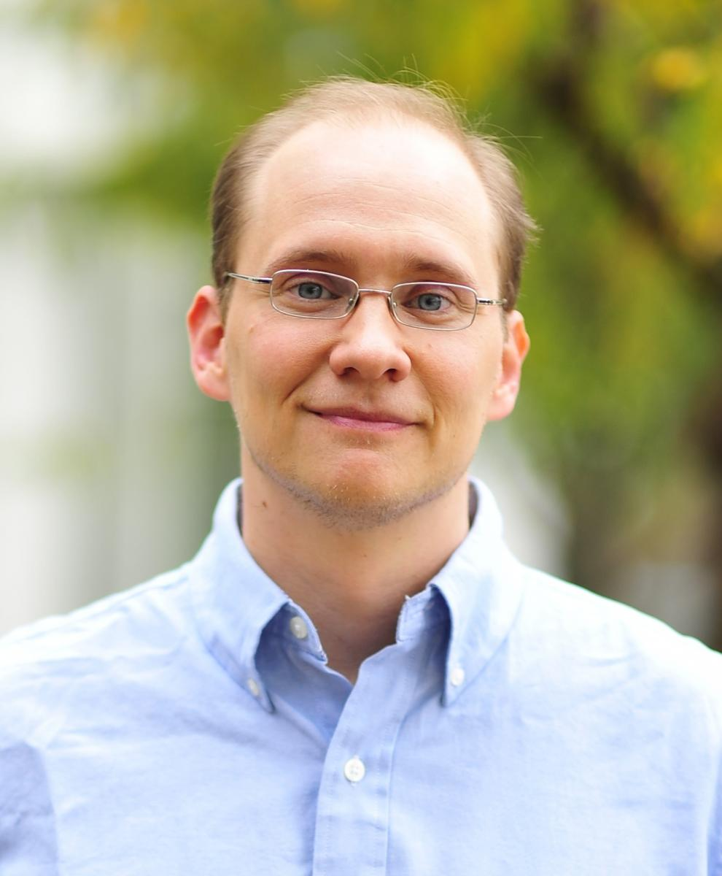




Probabilistic Programming for Security
Michael Hicks Piotr (Peter) Mardziel
University of Maryland, College Park
☹
Stephen Magill
Galois
Michael Hicks
UMD
Mudhakar Srivatsa
IBM TJ Watson
Jonathan Katz
UMD
Mário Alvim
UFMG
Michael Clarkson
Cornell
Arman Khouzani
Royal Holloway
Carlos Cid
Royal Holloway

Slide 2
Part 1
Machine learning ≈ Adversary learning
Part 2
Probabilistic Abstract Interpretation
Part 3
~1 minute summary of our other work

Slide 3
Part 1
Machine learning ≈ Adversary learning
Part 2
Probabilistic Abstract Interpretation
Part 3
~1 minute summary of our other work

Slide 4


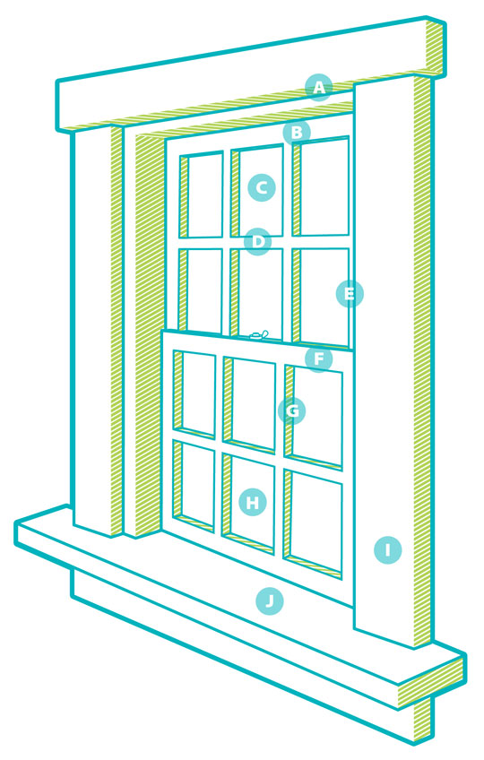
“Machine Learning”
“Forward” Model
0.55 : Outlook = sunny
0.45 : Outlook = overcast
weather
Today = not-raining

Slide 5
“Machine Learning”
Prior
“Forward” Model
weather
0.5 : Today = not-raining
0.5 : Today = raining

Slide 6
“Machine Learning”
Prior
Observation
“Forward” Model
Outlook = sunny
weather
0.5 : Today = not-raining
0.5 : Today = raining
inference
0.82 : Today = not-raining
0.18 : Today = raining
“Backward” Inference
Posterior

Slide 7
“Machine Learning”
Prior
Observation
“Forward” Model
Outlook = sunny
weather
0.5 : Today = not-raining
0.5 : Today = raining
inference*
Samples:
Today = not-raining
Today = not-raining
Today = not-raining
Today = raining
…
“Backward” Inference
Posterior Samples

Slide 8
“Machine Learning”
Prior
Observation
“Forward” Model
Outlook = sunny
weather
0.5 : Today = not-raining
0.5 : Today = raining
inference*
0.82 : Today = not-raining
0.18 : Today = raining
“Backward” Inference
Posterior

Slide 9


“Machine Learning”
Prior
Observation
“Forward” Model
Outlook = sunny
weather
0.5 : Today = not-raining
0.5 : Today = raining
inference*
0.82 : Today = not-raining
0.18 : Today = raining
“Backward” Inference
Classification
Posterior
Today=not-raining

Slide 10
“Machine Learning”
Prior
Observation
“Forward” Model
Outlook = sunny
weather
0.5 : Today = not-raining
0.5 : Today = raining
inference*
0.82 : Today = not-raining
0.18 : Today = raining
“Backward” Inference
Classification
Posterior
Today=not-raining
Reality
Accuracy/Error

Slide 11


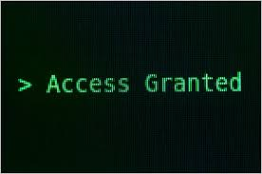
Adversary learning
Prior
Observation
“Forward” Model
Login=failed
0.200000 : Pass = “password”
0.100000 : Pass = “12345”
0.000001 : Pass = “!@#$#@”
…
Auth(“password”)
inference
0.999 : Pass = “12345”
“Backward” Inference
Exploitation
$$
Posterior
Pass=“12345”
Vulnerability
Reality

Slide 12
Different but Same
PPL for machine learning | PPL for security
Model/program of prior | Model/program of prior
Model/program of observation | Model/program of observation
Inference + can be approximate + can be a sampler | Inference - cannot be approximate + can be sound - cannot be a sampler
Classification | Exploitation
Accuracy/Error + compare inference algorithms | Vulnerability measures + compare observation functions (with/without obfuscation, …)
Deploy classifier | Deploy protection mechanism

Slide 13
Different but Same
PPL for machine learning | PPL for security
Model/program of prior | Model/program of prior
Model/program of observation | Model/program of observation
Inference + can be approximate + can be a sampler | Inference - cannot be approximate + can be sound - cannot be a sampler
Classification | Exploitation
Accuracy/Error + compare inference algorithms | Vulnerability measures + compare observation functions (with/without obfuscation, …)
Deploy classifier | Deploy protection mechanism

Slide 14
Inference visualized
Distributions δ : S → [0,1]
δ
δ’’
inference
δ’’’
prior
δ'
all distributions over S
Accuracy

Slide 15
Inference visualized
Distributions δ : S → [0,1]
δ
δ’’
inference
δ’’’
prior
δ'
all distributions over S
Vulnerability

Slide 16




Vulnerability scale
δ
δ'
δ’’
δ’’’
inference
Vulnerability
prior

Slide 17
Information flow
information “flow”
δ
δ'
δ’’
δ’’’
inference
Vulnerability
prior

Slide 18
Issue: Approximate inference
Approximate inference
δ
δ'
δ’’
δ’’’
inference
exact
inference
Vulnerability
prior

Slide 19
Sound inference
Approximate, but sound inference
δ
δ'
δ’’
δ’’’
inference
exact
inference
Vulnerability
prior

Slide 20
Issue: Complexity
δ’’’
δ’’
δ'
δ
inference
Vulnerability
prior

Slide 21
Issue: Prior
δ
prior
Vulnerability

Slide 22
Worst-case prior
worst-case prior
δ_{wc}
δ’_{wc}
w.c. information “flow”
information “flow”
δ
δ'
inference
Vulnerability
actual prior

Slide 23
Issue: Prior
δ
prior
Vulnerability

Slide 24
Differential Privacy
δ
prior
Vulnerability

Slide 25
Issue: Prior
δ
prior
Vulnerability

Slide 26
Part 1
Machine learning ≈ Adversary learning
Part 2
Probabilistic Abstract Interpretation
Part 3
~1 minute summary of our other work

Slide 27
Probabilistic Abstract Interpretation
Abstract prior
abstract inference
δ
δ’’
prior
δ’’’
inference
δ'
all distributions over S
Vulnerability

Slide 28
Part 2: Probabilistic Abstract Interpretation
Standard PL lingo
Concrete Semantics
Abstract Semantics
Concrete Probabilistic Semantics
Abstract Probabilistic Semantics

Slide 29
Concrete Interpretation
(Program) States σ : Variables → Integers
Concrete semantics: [[ Stmt ]] : States → States
y
[[ if y >= 2 then x := x + 1 ]]
{x→1,y→2}
{x→2,y→2}
x
[[ y := x + y ]]
{x→1,y→1}
All states over {x,y}

Slide 30
Abstract Interpretation
Abstract Program States AbsStates
Concretization: γ(P) := { σ s.t. P(σ) }
Abstract Semantics: << Stmt >> : AbsStates → AbsStates
Example: intervals
Predicate P is a closed interval on each variable
γ(1≤x≤2, 1≤y≤1) = all states that assign x between 1 and 2, and y = 1
<< if y >= 4 then x := x + 1 >>
y
(1≤x≤2,3≤y≤4)
(1≤x≤3,3≤y≤4)
<< y := x + 2*y >>
x
(1≤x≤2,1≤y≤1)
All states over {x,y}

Slide 31
Abstract Interpretation
Abstract Program States AbsStates
Concretization: γ(P) := { σ s.t. P(σ) }
Abstract Semantics: << Stmt >> : AbsStates → AbsStates
Example: intervals
Predicate P is a closed interval on each variable
γ(1≤x≤2, 1≤y≤1) = all states that assign x between 1 and 2, and y = 1
<< if y >= 4 then x := x + 1 >>
y
(1≤x≤2,3≤y≤4)
(1≤x≤3,3≤y≤4)
σ'
<< y := x + 2*y >>
[[ y := x + 2*y ]]
x
(1≤x≤2,1≤y≤1)
σ
All states over {x,y}

Slide 32
Probabilistic Interpretation
Concrete
Abstraction
Abstract semantics

Slide 33
Concrete Probabilistic Semantics
(sub)distributions δ : States → [0,1]
Semantics
⟦skip⟧δ = δ
⟦S₁; S₂⟧δ = ⟦S₂⟧ (⟦S₁⟧δ)
⟦if B then S₁ else S₂⟧δ = ⟦S₁⟧(δ ∧ B) + ⟦S₂⟧(δ ∧ ¬B)
⟦pif p then S₁ else S₂⟧δ = ⟦S₁⟧(p*δ) + ⟦S₂⟧((1-p)*δ)
⟦x := E⟧δ = δ[x ⟼ E]
⟦while B do S⟧ = lfp (λF. λδ. F(⟦S⟧(δ | B)) + (δ | ¬B))
p*δ – scale probabilities by p
p*δ := λσ. p*δ(σ)
δ ∧ B – remove mass inconsistent with B
δ ∧ B := λσ. if ⟦B⟧σ = true then δ(σ) else 0
δ₁ + δ₂ – combine mass from both
δ₁ + δ₂ := λσ. δ₁(σ) + δ₂(σ)
δ[x ⟼ E] – transform mass

Slide 34
Subdistribution operations
δ ∧ B – remove mass inconsistent with B
δ ∧ B = λσ. if ⟦B⟧σ = true then δ(σ) else 0
δ₁ + δ₂ – combine mass from both
δ₁ + δ₂ = λσ. δ₁(σ) + δ₂(σ)
δ
B = x ≥ y
δ ∧ B
δ₁
δ₂
δ₁+ δ₂
⟦if x ≤ 5 then y := y + 3 else y := y - 3⟧δ
= ⟦y := y + 3⟧(δ ∧ x ≤ 5)
+ ⟦y := y – 3⟧(δ ∧ x > 5)
δ ∧ x ≤ 5
⟦y := y + 3⟧(δ ∧ x ≤ 5)
δ
⟦S⟧δ
δ ∧ x > 5
⟦y := y – 3⟧(δ ∧ x > 5)

Slide 35
Subdistribution Abstraction

Slide 36
Subdistribution Abstraction: Probabilistic Polyhedra
P
V(δ) = max_{σ} δ(σ)
Region of program states (polyhedron)
+ upper bound on probability of each possible state in region
+ upper bound on the number of (possible) states
+ upper bound on the total probability mass (useful)
+ also lower bounds on the above
Pr[A | B] = Pr[A ∩ B] / Pr[B]
Notes:
the number of points and the seemingly redundant total mass we found useful for performing some operations in some cases

Slide 37
Abstraction imprecision
exact
abstract
P₁
P₂

Slide 38
Probabilistic Abstract Interpretation
Define
<<S>> P
Soundness: if δ ∈ γ(P) then ⟦S⟧δ ∈ γ (<<S>>P)
Abstract versions of subdistribution operations
P₁ + P₂
P ∧ B
p*P
Abstract prior P
abstract inference
δ
δ’’
prior
δ’’’
inference
δ'
all distributions over S

Slide 39
Example abstract operation
δ₁(σ)
δ₂(σ)
p₁^{max}
+
δ₁
p₁^{min}
p₂^{max}
δ₂
p₂^{min}
σ(x)
σ(x)
δ₃(σ)
δ₃ := δ₁ + δ₂
{P_{3,}P_{4,}P₅} = {P₁} + {P₂}
σ(x)

Slide 40
Conditioning
Conditioning
Concrete
Abstract:
Lower bound on total mass

Slide 41
Simplify representation
Limit number of probabilistic polyhedra
P₁ ± P₂ - merge two probabilistic polyhedra into one
Convex hull of regions, various counting arguments

Slide 42
Add and simplify
δ₁(σ)
δ₂(σ)
p₁^{max}
±
δ₁
p₁^{min}
p₂^{max}
δ₂
p₂^{min}
σ(x)
σ(x)
δ₃(σ)
δ₃ := δ₁ + δ₂
{P₃} = {P₁} ± {P₂}
σ(x)

Slide 43

Primitives for operations
Need to
Linear Model Counting: count number of integer points in a convex polyhedra
Integer Linear Programming: maximize a linear function over integer points in a polyhedron

Slide 44
Probabilistic Abstract Interpretation
P’’
Abstract prior
P
abstract inference
P’’’
δ
δ’’
prior
δ’’’
inference
δ'
P’
all distributions over S
Vulnerability
Conservative (sound) vulnerability bounds

Slide 45
Part 3
[CSF11,JCS13]
Limit vulnerability and computational aspects of probabilistic semantics
[PLAS12]
Limit vulnerability for symmetric cases
[S&P14,FCS14]
Measure vulnerability when secrets change over time
[CSF15] onwards
Active defense → game theory
See http://piotr.mardziel.com

Slide 46
Abstract Conditioning
1992
1981
1971
1961
1956
0
259
267
364
1992
1981
1971
1961
1956
0
259
267
364

Slide 47
Abstract Conditioning
approximate
1992
1992
1991
1981
1981
1971
1971
P₁
P₂
1961
1961
1956
1956
0
259
267
364
0
259
267
364
1992
1992
1981
1981
1971
1971
1961
1961
1956
1956
0
259
267
364
0
259
267
364

