Slide 1


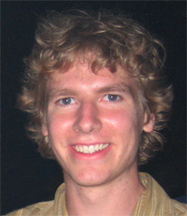


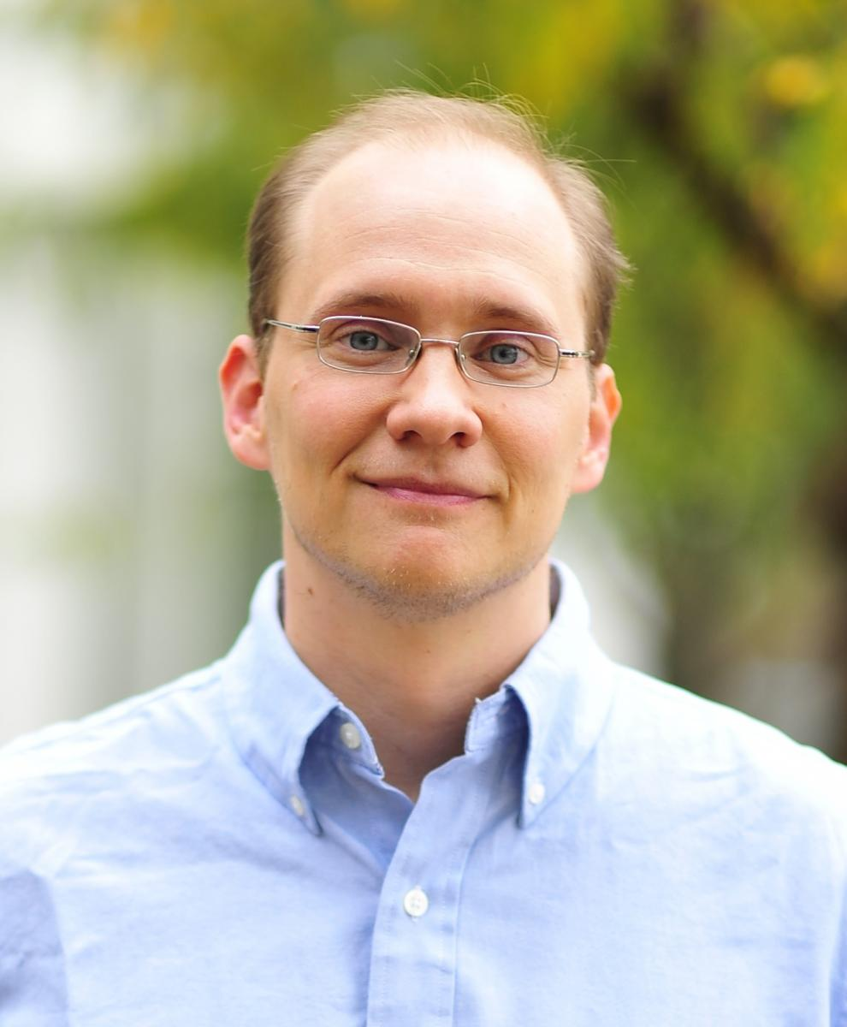
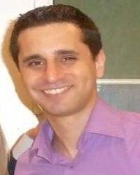
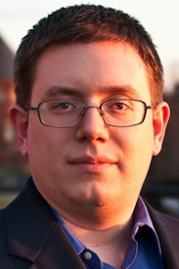
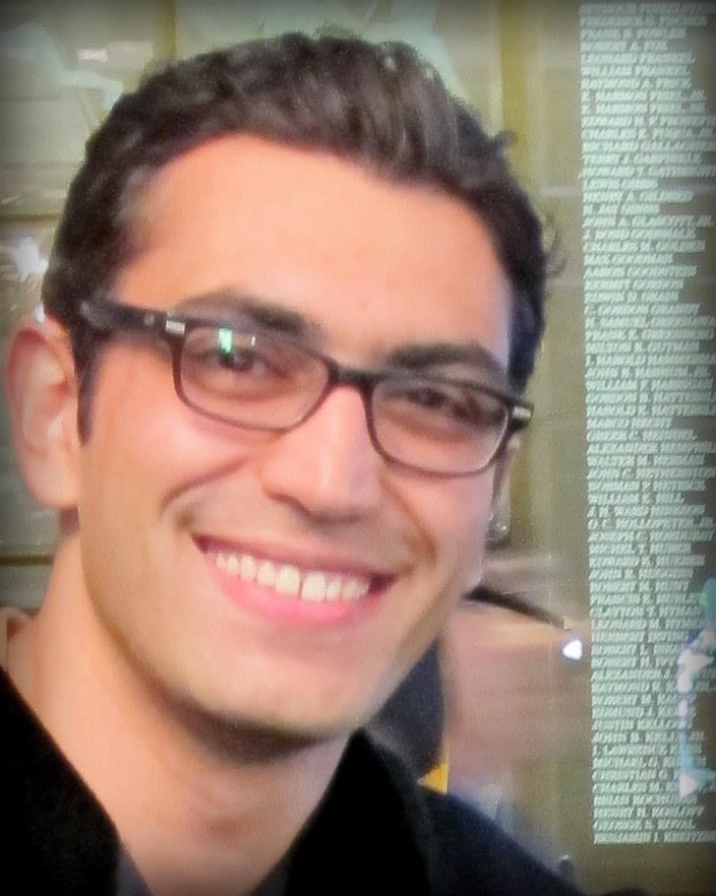

Models and Games for Quantifying Vulnerability of Secret Information
Piotr (Peter) Mardziel
University of Maryland, College Park
Stephen Magill
Galois
Michael Hicks
UMD
Mudhakar Srivatsa
IBM TJ Watson
Jonathan Katz
UMD
Mário Alvim
UFMG, Brazil
Michael Clarkson
Cornell
Arman Khouzani
Queen Mary
Carlos Cid
Royal Holloway

Slide 2
Information flow
Control
/ low input
Channel
observation
/ low output
Secret
/ high input

Slide 3
Information flow
low
Channel
obs
high
?

Slide 4


Information flow
low
Channel
obs
high

Slide 5


Quantitative Information flow
l
o
h
C
C_{worst}(l,h) := h
C_{bad}(l,h) := h & 0xFF
C_{ok}(l,h) := l+42

Slide 6
QIF Examples
l
C
o
h
Example | High | Channel | Low | Observation
authentication | password | Login interface | Password guess | Login OK/Fail
ASLR | memory offset | Injection attempt | Offset guess | Payload success/Crash
Encryption | key | Encryption | Plaintext | Ciphertext
Encryption timing | key | Encryption runtime model | Plaintext | Runtime of encryption
modeling
Information
theoretic
More than
input/output

Slide 7


QIF Metrics
l
o
h
…
C
C_{worst}(l,h) := h
C_{bad}(l,h) := h & 0xFF
C_{ok}(l,h) := l+42

Slide 8
Quantified vulnerability
Exploit e
l
o
Gain Model
g
h
C
h
G(h,e) := 1 if h == e
0 o/w

Slide 9
Formalism
H
H’
Exploit e
l
o
Gain Model
g
h
h

Slide 10
Probabilistic Formalism
Exploit e
l
o
Gain Model
g
h
h

Slide 11
Iteration
e_{i}
l₁
l₂
o₁
o₂
…
Gain Model
g_{i}
h
h
h

Slide 12
Basics
Channels as programs
Programs as channels
Models for …
Adaptive adversaries
Time-varying secrets
Non-zero-sum games
Active defenders, equilibrium

Slide 13
Channel → Program
low
int main ( … ) {
…
rand() …
obs
high

Slide 14
Probabilistic programming
low
Program P
obs
high
inference

Slide 15
Program → Channel
low
existing program
obs
high
inference

Slide 16
“PL”
Undecidable
low
existing program
obs
high
Undecidable
inference
Undecidable

Slide 17
Approximation
low
existing program
obs
high
approximate inference
over-approximation of vulnerability
g

Slide 18
Basics
Channels as programs
Programs as channels
Models for …
Adaptive adversaries
Time-varying secrets
Non-zero-sum games
Active defenders, equilibrium

Slide 19
Basics
Channels as programs
Programs as channels
Models for …
Adaptive adversaries
Time-varying secrets
Non-zero-sum games
Active defenders, equilibrium

Slide 20
Adaptive adversary choice
e_{i}
l₁
l₂
o₁
o₂
…
Gain Model
g_{i}
h
h
h

Slide 21
Backward inference
e_{i}
l₁
l₂
o₁
o₂
…
Gain Model
g_{i}
h
h
h

Slide 22
Adaptive power
l
// bit select
BS(h,l):= h & (0x1 << l)
o
h
l
// binary search
BS(h,l):= h <= l
o
h

Slide 23
Basics
Channels as programs
Programs as channels
Models for …
Adaptive adversaries
Time-varying secrets
Non-zero-sum games
Active defenders, equilibrium

Slide 24
Entropy: non-renewable resource
e_{i}
l₁
l₂
o₁
o₂
…
Gain Model
g_{i}
h
h
h

Slide 25
Entropy: non-renewable resource

Slide 26
Evolving secrets
e_{i}
l₁
l₂
o₁
o₂
…
Gain Model
g_{i}
h₁
h₂
Δ
Δ:Pr[H_{i+1}|H_{i}]
h_{i}

Slide 27
Entropy: renewable resource?

Slide 28
Adaptive exploitation
e_{i}
l₁
l₂
o₁
o₂
…
Gain Model
g_{i}
h₁
h₂
Δ
Δ:Pr[H_{i+1}|H_{i}]
h
h_{i}

Slide 29

Adaptive exploitation power

Slide 30
Belief in Δ
e_{i}
l₁
l₂
o₁
o₂
…
Gain Model
g_{i}
h₁
h₂
Δ
Δ:Pr[H_{i+1}|H_{i}]
h
h_{i}

Slide 31
Entropy of H vs. Entropy of Δ
password42
password42
password42

Slide 32
Entropy of H vs. Entropy of Δ
password42
password42
password42
vs.
password42
password43
password44

Slide 33
Basics
Channels as programs
Programs as channels
Models for …
Adaptive adversaries
Time-varying secrets
Non-zero-sum games
Active defenders, equilibrium

Slide 34
Generalizing gain model
e_{i}
l₁
l₂
o₁
o₂
…
Gain Model
g_{i}
h₁
h₂
Δ
Δ:Pr[H_{i+1}|H_{i}]
h
h_{i}
L:={observe, not-observe,…}
G(…):= … - 0.1 * observations

Slide 35
Gain with costly observation

Slide 36
Gain vs. Loss
e_{i}
l₁
l₂
o₁
o₂
…
Gain Model
g_{i}
s_{i}
h₁
h₂
Δ
Δ:Pr[H_{i+1}|H_{i}]
h
h_{i}
L:={observe, not-observe,…}
G(…):= g = … - 0.1 * observations
s = …

Slide 37
Gain vs. Loss

Slide 38
Basics
Channels as programs
Programs as channels
Models for …
Adaptive adversaries
Time-varying secrets
Non-zero-sum games
Active defenders, equilibrium

Slide 39
Passive defender
e
l₁
l₂
maximize gain
o₁
o₂
…
Gain Model
g
s
h
h

Slide 40
Active defender: simultaneous actions
e
l₁
l₂
maximize gain
o₁
o₂
…
Gain Model
g
s
h
h
minimize loss
???

Slide 41
Active defender: (Nash) equilibrium
e
l₁
l₂
o₁
o₂
…
Gain Model
g
s
h
h
Low strategy γ*
High strategy λ*
Gain (γ*,λ*) ≥ Gain (γ,λ*)
Loss (γ*,λ*) ≤ Loss (γ*,λ)

Slide 42

Picking vs. Guessing Passwords / Keys
Picker picks password (or cryptographic key)
Stronger (longer keys) passwords cost more
Guesser tries to guess
Online Game: cap of K guesses
Offline Game: no cap, but each guess incurs cost σ
Picker loses λ if their secret is guessed (guesser gains γ)

Slide 43
Password cost model

Slide 44
Password equilibria (capped guesses)
Picker strategy:
Uniformly pick password from J least costly passwords
Guesser strategy:
Guess in range of J least costly passwords, with probability inversely proportional to (picker’s) cost.

Slide 45
Password (costly guesses)

Slide 46
Key cost model

Slide 47
Key equilibria (capped guesses)
λ=10000
Picker strategy:
Uniformly pick keys from J least costly ones.
Guesser strategy:
Guess in range of J least costly keys, with probability inversely proportional to (picker’s) cost.

Slide 48
Key (costly guesses)

Slide 49
Basics
Channels as programs
Programs as channels
Models for …
Adaptive adversaries
Time-varying secrets
Non-zero-sum games
Active defenders, equilibrium

Slide 50
Models for …
[S&P14] Adaptive adversaries, time-varying secrets
[FCS14] Non-zero-sum games
[CSF15]* Active defenders, equilibrium
[CSF11,PLAS12,JCS13] Mechanism via bounding vulnerability
Probabilistic abstract interpretation
Simulatable enforcement mechanism
http://piotr.mardziel.com
piotrm@gmail.com
Michael Hicks
UMD
Mário Alvim
UFMG, Brazil
Michael Clarkson
Cornell
Mudhakar Srivatsa
IBM TJ Watson
Arman Khouzani
Queen Mary
Carlos Cid
Royal Holloway
Stephen Magill
Galois
Michael Hicks
UMD
Mudhakar Srivatsa
IBM TJ Watson

Slide 51
Probabilistic Abstract Interpretation
Abstract prior
abstract inference
δ
δ’’
prior
δ’’’
inference
δ'
all distributions over S
Vulnerability

Slide 52
Concrete Interpretation
(Program) States σ : Variables → Integers
Concrete semantics: [[ Stmt ]] : States → States
y
[[ if y >= 2 then x := x + 1 ]]
{x→1,y→2}
{x→2,y→2}
x
[[ y := x + y ]]
{x→1,y→1}
All states over {x,y}

Slide 53
Abstract Interpretation
Abstract Program States AbsStates
Concretization: γ(P) := { σ s.t. P(σ) }
Abstract Semantics: << Stmt >> : AbsStates → AbsStates
Example: intervals
Predicate P is a closed interval on each variable
γ(1≤x≤2, 1≤y≤1) = all states that assign x between 1 and 2, and y = 1
<< if y >= 4 then x := x + 1 >>
y
(1≤x≤2,3≤y≤4)
(1≤x≤3,3≤y≤4)
<< y := x + 2*y >>
x
(1≤x≤2,1≤y≤1)
All states over {x,y}

Slide 54
Abstract Interpretation
Abstract Program States AbsStates
Concretization: γ(P) := { σ s.t. P(σ) }
Abstract Semantics: << Stmt >> : AbsStates → AbsStates
Example: intervals
Predicate P is a closed interval on each variable
γ(1≤x≤2, 1≤y≤1) = all states that assign x between 1 and 2, and y = 1
<< if y >= 4 then x := x + 1 >>
y
(1≤x≤2,3≤y≤4)
(1≤x≤3,3≤y≤4)
σ'
<< y := x + 2*y >>
[[ y := x + 2*y ]]
x
(1≤x≤2,1≤y≤1)
σ
All states over {x,y}

Slide 55
Probabilistic Interpretation
Concrete
Abstraction
Abstract semantics

Slide 56
Concrete Probabilistic Semantics
(sub)distributions δ : States → [0,1]
Semantics
⟦skip⟧δ = δ
⟦S₁; S₂⟧δ = ⟦S₂⟧ (⟦S₁⟧δ)
⟦if B then S₁ else S₂⟧δ = ⟦S₁⟧(δ ∧ B) + ⟦S₂⟧(δ ∧ ¬B)
⟦pif p then S₁ else S₂⟧δ = ⟦S₁⟧(p*δ) + ⟦S₂⟧((1-p)*δ)
⟦x := E⟧δ = δ[x ⟼ E]
⟦while B do S⟧ = lfp (λF. λδ. F(⟦S⟧(δ | B)) + (δ | ¬B))
p*δ – scale probabilities by p
p*δ := λσ. p*δ(σ)
δ ∧ B – remove mass inconsistent with B
δ ∧ B := λσ. if ⟦B⟧σ = true then δ(σ) else 0
δ₁ + δ₂ – combine mass from both
δ₁ + δ₂ := λσ. δ₁(σ) + δ₂(σ)
δ[x ⟼ E] – transform mass

Slide 57
Subdistribution operations
δ ∧ B – remove mass inconsistent with B
δ ∧ B = λσ. if ⟦B⟧σ = true then δ(σ) else 0
δ₁ + δ₂ – combine mass from both
δ₁ + δ₂ = λσ. δ₁(σ) + δ₂(σ)
δ
B = x ≥ y
δ ∧ B
δ₁
δ₂
δ₁+ δ₂
⟦if x ≤ 5 then y := y + 3 else y := y - 3⟧δ
= ⟦y := y + 3⟧(δ ∧ x ≤ 5)
+ ⟦y := y – 3⟧(δ ∧ x > 5)
δ ∧ x ≤ 5
⟦y := y + 3⟧(δ ∧ x ≤ 5)
δ
⟦S⟧δ
δ ∧ x > 5
⟦y := y – 3⟧(δ ∧ x > 5)

Slide 58
Subdistribution Abstraction

Slide 59
Subdistribution Abstraction: Probabilistic Polyhedra
P
V(δ) = max_{σ} δ(σ)
Region of program states (polyhedron)
+ upper bound on probability of each possible state in region
+ upper bound on the number of (possible) states
+ upper bound on the total probability mass (useful)
+ also lower bounds on the above
Pr[A | B] = Pr[A ∩ B] / Pr[B]
Notes:
the number of points and the seemingly redundant total mass we found useful for performing some operations in some cases

Slide 60
Abstraction imprecision
exact
abstract
P₁
P₂

Slide 61
Probabilistic Abstract Interpretation
Define
<<S>> P
Soundness: if δ ∈ γ(P) then ⟦S⟧δ ∈ γ (<<S>>P)
Abstract versions of subdistribution operations
P₁ + P₂
P ∧ B
p*P
Abstract prior P
abstract inference
δ
δ’’
prior
δ’’’
inference
δ'
all distributions over S

Slide 62
Example abstract operation
δ₁(σ)
δ₂(σ)
p₁^{max}
+
δ₁
p₁^{min}
p₂^{max}
δ₂
p₂^{min}
σ(x)
σ(x)
δ₃(σ)
δ₃ := δ₁ + δ₂
{P_{3,}P_{4,}P₅} = {P₁} + {P₂}
σ(x)

Slide 63
Conditioning
Conditioning
Concrete
Abstract:
Lower bound on total mass

Slide 64
Simplify representation
Limit number of probabilistic polyhedra
P₁ ± P₂ - merge two probabilistic polyhedra into one
Convex hull of regions, various counting arguments

Slide 65
Add and simplify
δ₁(σ)
δ₂(σ)
p₁^{max}
±
δ₁
p₁^{min}
p₂^{max}
δ₂
p₂^{min}
σ(x)
σ(x)
δ₃(σ)
δ₃ := δ₁ + δ₂
{P₃} = {P₁} ± {P₂}
σ(x)

Slide 66

Primitives for operations
Need to
Linear Model Counting: count number of integer points in a convex polyhedra
Integer Linear Programming: maximize a linear function over integer points in a polyhedron

Slide 67
Probabilistic Abstract Interpretation
P’’
Abstract prior
P
abstract inference
P’’’
δ
δ’’
prior
δ’’’
inference
δ'
P’
all distributions over S
Vulnerability
Conservative (sound) vulnerability bounds

