Slide 1







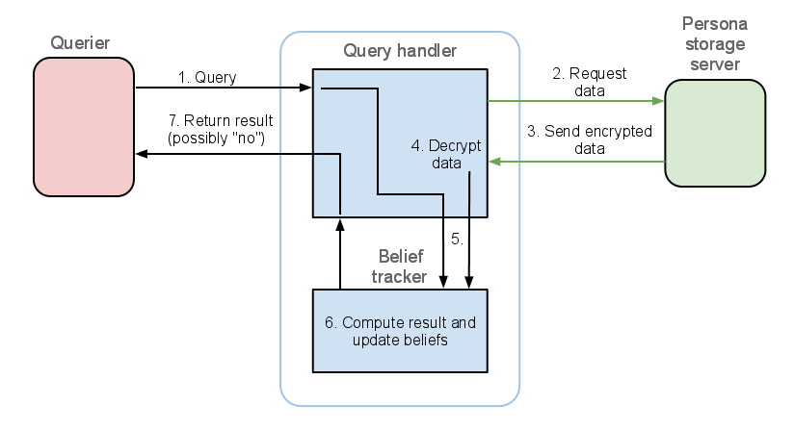
Annual Conference of ITA
ACITA 2010
Secure Sharing in Distributed Information Management Applications:
Problems and Directions
Piotr Mardziel, Adam Bender, Michael Hicks, Dave Levin, Mudhakar Srivatsa*, Jonathan Katz
University of Maryland, College Park * IBM Research, TJ Watson
Sharing vs. Not Sharing
Sharing (enough) is useful
Sharing (too much) can be harmful
Not sharing (enough) can be harmful
Information hub / Collaborative reviewing
Improve reputation, gain valuable insights
Negative backlash
Military
Share: potential targets, suspicious activity, technical problems, vulnerabilities
Potential for misuse, unauthorized leaks, compromised assets
Online social networks
Find employment, gain business connections, social capital, improved interaction experience
Identity theft
Please use this section of the poster as you see fit. You may wish to consider the following:
Make it eye catching – images and colours work well
Make sure that any images you use are high enough quality to scale up to the A1 size printed version
Ensure the title and authors (in the header, above) match those on the camera-ready version of the paper
Not too much text – your poster should have some level of detail, but don’t copy whole sections of the paper in as large blocks of text.
Remember your poster will be large (A1) so small fonts will appear tiny in relation to the large size.
Headings need to be large (e.g. font size 88)
Normal text for bullet points and image titles in the middle (e.g. font size 48)
A suggested lower limit on font size is 32.
We will convert all received PPT files to PDF to ensure no issues with printing. The PDF version of the poster will be included in the conference proceedings
Don’t forget to delete this text from your poster!!!
How can we encourage sharing and make it secure?
Economic (dis)Incentives
Encourage productive sharing
Exchange shared data for external value
Discourage illicit information release
Penalize policy faults via transfer of external value
Monetary value
Data valuation
Measurement (of leaks)
Payment schemes
One-time payment upon data transfer
One-time payment upon data leakage
Recurring payment to maintain data use
Measurement
Principle of Least Sharing
Provide mechanism for access to (only) what is needed to achieve utility
Simultaneously protect privacy
Compute F(x,y) where x, y are private to server and client respectively, reveal neither x nor y
Privacy-preserving computation
Computational splitting
Split F into segments to be performed by the individual parties or fail (cannot split)
Secure multiparty computation
Recovery of secret inputs computationally infeasible
Very inefficient
Quantified information flow
How much “information” does a query provide?
How much do multiple queries provide?
Relative entropy
Track belief (or view) an attacker might have about private information
Belief as a probability distribution over secret data
Privacy measure: how accurate is this view?
What to do if privacy measure will be violated?
Reject query, redact, add noise
Relative entropy between belief and truth
1 bit reduction in entropy = doubling of guessing ability
Policy: “entropy >= 10 bits” = attacker has 1 in 1024 chance of guessing secret
Personal Information broker
Keep track of queries and resulting belief changes
Reject queries violating information flow restrictions
Notes:
1

