Slide 1
Secure sharing in distributed information management applications: problems and directions
Piotr Mardziel, Adam Bender, Michael Hicks,
Dave Levin, Mudhakar Srivatsa*, Jonathan Katz
University of Maryland, College Park, USA
* IBM Research, T.J. Watson Lab, USA

Slide 2
To share or not to share
Information is one of the most valuable commodities in today’s world
Sharing information can be beneficial
But information used illicitly can be harmful
Common question:
For a given piece of information, should I share it or not to increase my utility?

Slide 3



Example: On-line social nets
Benefits of sharing
find employment, gain business connections
build social capital
improve interaction experience
Operator: increased sharing means increased revenue
advertising
Drawbacks
identity theft
exploitation easier to perpetrate
loss of social capital and other negative consequences from unpopular decisions

Slide 4



Example: Information hub
Benefits of sharing
Improve overall service, which provides interesting and valuable information
Improve reputation, authority, social capital
Drawbacks
Risk to social capital for poor decisions or unpopular judgments
E.g., backlash for negative reviews

Slide 5
Example: Military, DoD
Benefits of sharing
Increase quality information input
Increase actionable intelligence
Improve decision making
Avoid disaster scenarios
Drawbacks
Misused information or access can lead to many ills, e.g.:
Loss of tactical and strategic advantage
Destruction of life and infrastructure

Slide 6
Research goals
Mechanisms that help determine when to and not to share
Measurable indicators of utility
Cost-based (dis)incentives
Limiting info release without loss of utility
Reconsideration of where computations take place: collaboration between information owner and consumer
Code splitting, secure computation, other mechs.

Slide 7
Remainder of this talk
Ideas toward achieving these goals
To date, we have more concrete results (though still preliminary), on limiting release
Looking for your feedback on the most interesting, promising directions!
Talk to me during the rest of the conference
Open to collaborations

Slide 8
Evidence-based policies
Actors must decide to share or not share information
What informs this decision?
Idea: employ data from past sharing decisions to inform future ones
Similar, previous decisions
From self, or others

Slide 9
Research questions
What (gatherable) data can shed light on cost/benefit tradeoff?
How can it be gathered reliably, efficiently?
How to develop and evaluate algorithms that use this information to suggest particular policies?

Slide 10
Kinds of evidence
Positive vs. negative
Observed vs. provided
In-band vs. out-of-band
Trustworthy vs. untrustworthy
Gathering real-world data can be problematic; e.g., Facebook’s draconian license agreement prohibits data gathering

Slide 11
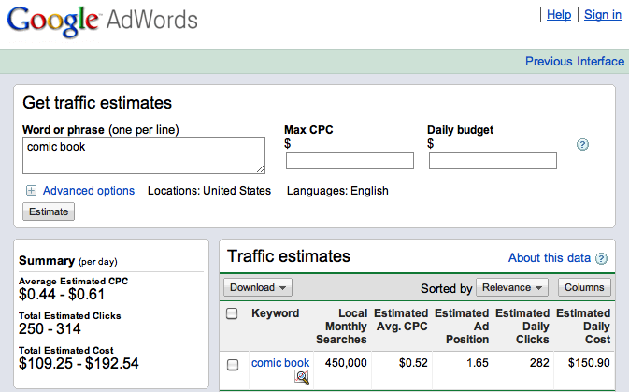
Economic (dis)incentives
Explicit monetary value to information
What is my birthday worth?
Compensates information provider for leakage, misuse
Encourages consumer not to leak, to keep the price down

Slide 12

Research goals
Data valuation metrics, such as those discussed earlier
Based on personally collected data, and data collected by “the marketplace”
Payment schemes
One-time payment
Recurring payment
One-time payment on discovered leakage

Slide 13
High-utility, limited release
Now: user provides personal data to site
But, the site doesn’t really need to keep it. Suppose user kept ahold of his data and
Ad selection algorithms ran locally, returning to the server the ad to provide
Components of apps (e.g., horoscope, friend counter) ran locally, accessing only the information needed
Result: same utility, less release

Slide 14
Research goal
Provide mechanism for access to (only) what information is needed to achieve utility
compute F(x,y) where x, y are private to server and client respectively, reveal neither x nor y
Some existing work
computational splitting (Jif/Split)
But not always possible, given a policy
secure multiparty computation (Fairplay)
But very inefficient
No work considers inferences on result

Slide 15
Privacy-preserving computation
Send query on private data to owner
Owner processes query
If result of query does not reveal too much about the data, it is returned, else rejected
tracks knowledge of remote party over time
Wrinkles:
query code might be valuable
honesty, consistency, in response

Slide 16
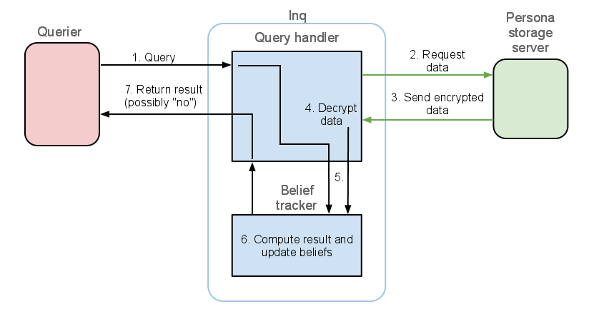
WIP: Integration into Persona
Persona provides encryption-based security of Facebook private data
Goal: extend Persona to allow privacy-preserving computation

Slide 17
Quantifying info. release
How much “information” does a single query reveal? How is this information aggregated over multiple queries?
Approach [Clarkson, 2009]: track belief an attacker might have about private information
belief as a probability dist. over secret data
may or may not be initialized as uniform

Slide 18
Relative entropy measure
Measure information release as the relative entropy between attacker belief and the actual secret value
1 bit reduction in entropy = doubling of guessing ability
policy: “entropy >= 10 bits” = attacker has 1 in 1024 chance of guessing secret

Slide 19
Implementing belief tracking
Queries restricted to terminating programs of linear expressions over basic data types
Model belief as a set of polyhedral regions with uniform distribution in each region

Slide 20
Example: initial belief
Example: Protect birthyear and gender
each is assumed to be distributed in {1900, ..., 1999} and {0,1} respectively
Initial belief contains 200 different possible secret value pairs
belief distribution
d(byear, gender) =
if byear <= 1949
then 0.0025
else 0.0075
or as a set of polyhedrons
1900 <= byear <= 1949, 0 <= gender <= 1
states: 100, total mass: 0.25
1950 <= byear <= 1999, 0 <= gender <= 1
states: 100, total mass: 0.75

Slide 21
Example: query processing
Secret value
byear = 1975,
gender = 1
Ad selection query
Query result = 0
{1900,..., 1980} X {0,1} are implied possibilities
Relative entropy revised from ~7.06 to ~6.57
Revised belief:
if 1980 <= byear then
return 0
else
if gender == 0 then
return 1
else
return 2
1900 <= byear <= 1949, 0 <= gender <= 1
states: 100, total mass: ~0.35
1950 <= byear <= 1980, 0 <= gender <= 1
states: 62, total mass: ~0.65

Slide 22
Example: query processing (2)
Alt. secret value
byear = 1985,
gender = 1
Ad selection query
Query result = 2
{1985,..., 1999} X {1} are the implied possibilities
Relative entropy revised from ~7.06 to ~4.24
Revised belief:
if 1980 <= byear then
return 0
else
if gender == 0 then
return 1
else
return 2
1980 <= byear <= 1999, 1 <= gender <= 1
states: 19, total mass: 1
probability of guessing becomes
1/19 = ~0.052

Slide 23
Security policy
Denying a query for revealing too much can tip off the attacker as to what the answer would have been. Options:
Policy could deny any query whose possible answer, according to the attacker belief, could reveal too much
E.g., if (birthyear == 1975) then 1 else 0
Policy could deny only queries likely to reveal too much, rather than just those for which this is possible
Above query probably allowed, as full release unlikely

Slide 24
Conclusions
Deciding when to share can be hard
But not feasible to simply lock up all your data
Economic and evidence-based mechanisms can inform decisions
Privacy-preserving computation can limit what is shared, but preserve utility
Implementation and evaluation ongoing

