Slide 1



Probabilistic Computation for Information Security
Piotr (Peter) Mardziel (UMD) Kasturi Raghavan (UCLA)

Slide 2
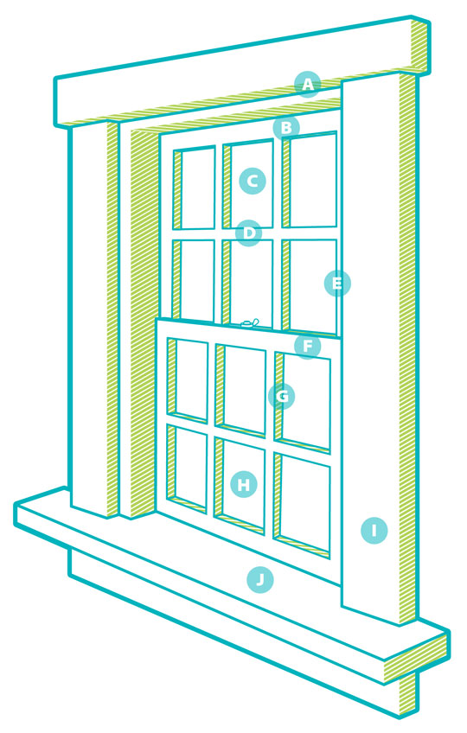




Convenience
params
~params
prior
secret
Alice’s secret
B₁~secret
Bob’s belief about secret
~sample = model(~params)
B₁~visible = sys(B₁~secret)
~params | [ model(~params) == sample ]
posterior
B₁~secret | [ sys(B₁~secret) == sys(secret) ]
= B₂~secret
Bob’s revised belief

Slide 3

Convenience
B₁~secret
Bob’s belief about secret
secret = (age, gender, engaged?)
Alice’s secret
B₂~visible = fun₁(B₁~secret)
Photography
B₁~visible = special-offer(B₁~secret)
B₂~secret | [ sys(B₂~secret) == fun₂(secret) ]
= B₃~secret
B₁~secret | [ sys(B₁~secret) == special-offer(secret) ]
= B₂~secret
Bob’s revised belief
special-offer(age, gender, engaged?) =
return (24 <= age <= 30 and
gender == ‘female and
engaged?)

Slide 4
Protection
B₁~secret
secret = (age, gender, engaged?)
Alice’s secret
special-offer (secret)
Photography
B₂~secret
Assumptions

Slide 5
Obfuscation/Noising
special-offer(secret)
?
special-offer’(secret)
special-offer’(age, gender, engaged?) =
return (24 <= age <= 30 and
gender == ‘female and
engaged?)
or Bernoulli(0.1)
?
N(special-offer(O(secret)))
…

Slide 6
Information flow
Information flow / Non-interference:
Does information flow?
B₂~secret =? B₁~secret
Quantified information flow:
How much information flows?
H(B₂~secret) – H(B₁~secret)
Yes?
No?
B₃~secret
B₂~secret
B₁~secret
0
∞
Entropy / Min-entropy / Guessing entropy / etc..

Slide 7
“Semantic” information flow
Information flow / Non-interference: Does information flow?
Quantified information flow: How much information flows?
Knowledge tracking / “semantic” information flow
What information flows?
distributions over secret
. B₃~secret
min-entropy
guessing entropy
. B₂~secret
…
. B₁~secret
entropy
…

Slide 8
“Semantic” information flow
Which quantity is appropriate?
H(B₂~s)
H∞(B₂~s)
G(B₂~s)
KL(A~s || B₂~s)
s = (age, gender, engaged?)
distributions over secret
. B₃~secret
min-entropy
guessing entropy
. B₂~secret
…
. B₁~secret
entropy
…

Slide 9
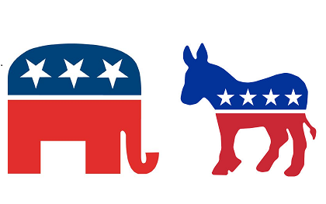
More convenience
Alice wants to hide her political preference.
(not an aspect of the secret)
Take function pol-pref: secret → { } that predicts political preference from demographics (age, gender, engaged?)
distributions over secret
. B₃~secret
min-entropy
guessing entropy
. B₂~secret
…
. B₁~secret
entropy
…

Slide 10
“Blacklist” function
distributions over secret
. B₃~secret
ambiguous
privacy
implication
. B₂~secret
. B₁~secret
B_{i}~party = pol-ref(B_{i}~secret)
distributions over party
“less”
ambiguous
privacy
implication
. B₂~party
. B₃~party
. B₁~party

Slide 11
Limiting knowledge
Alice can use knowledge tracking to enforce limits to knowledge.
distributions over secret
. B₃~secret
. B₄~secret
. B₂~secret
. B₁~secret
Policy(~secret) → {true,false}

Slide 12
Assumptions
Alice knows what Bob believes about her secret initially.
Alice can perform the probabilistic interpretation and conditioning “accurately enough”.
distributions over secret
. B₃~secret
. B₄~secret
. B₂~secret
. B₁~secret
. B’₄~secret
Policy(~secret) → {true,false}

Slide 13
Assumptions
Alice knows what Bob believes about her secret initially.
Alice can perform the probabilistic interpretation and conditioning “accurately enough”.
distributions over secret
. B₃~secret
. B₄~secret
. B₂~secret
. B₁~secret
. B’₄~secret
Soundness: Policy(B_{i}~secret) == false → Policy(B’_{i}~secret) == false
Policy(~secret) → {true,false}

Slide 14
An approach
distributions over secret
. B₃~secret
. B₄~secret
. B₂~secret
. B₁~secret
Abstract representation of sets of distributions.
Abstract probabilistic semantics and conditioning, over-approximating the exact semantics and conditioning.
Policy: sound check for min-entropy bounds
Piotr Mardziel, Stephen Magill, Michael Hicks, Mudhakar Srivasta.
Dynamic enforcement of knowledge-based security policies using abstract interpretation.

Slide 15
Probabilistic computation for information security
Convenient reasoning about information security.
“Semantic” information flow: more flexible than quantified information flow
Enforcement mechanisms require soundness to guarantee security conditions.

Slide 16
Probabilistic computation for information security
Convenient reasoning about information security.
“Semantic” information flow: more flexible than quantified information flow
Enforcement mechanisms require soundness to guarantee security conditions.
How to take advantage of ML-inspired probabilistic programming techniques for information security?
More efficient inference?
Search problems: find “optimal” noising/obfuscation parameters
. B₃~secret
. B₄~secret
. B₂~secret
. B₁~secret

Slide 17
Go back.

