Slide 1
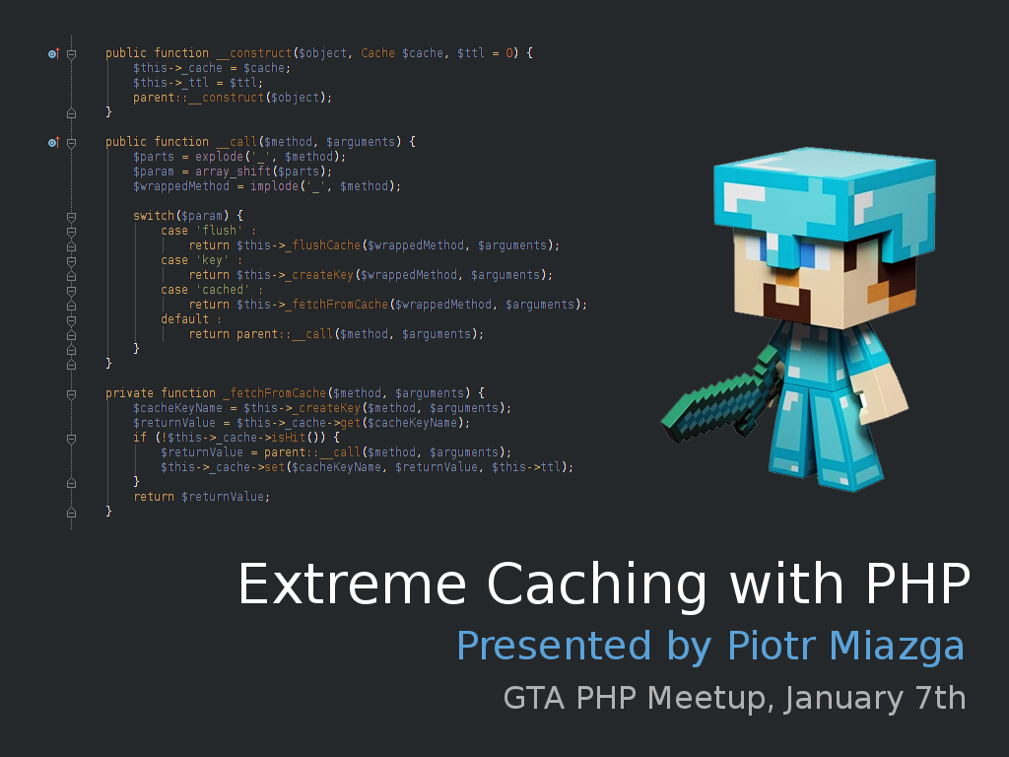

Slide 2
Exteme Caching with PHP
7+ years of PHP, MySQL and JS, Mootools
scallable enviroments experience (1000+ servers)
Banking, CMS, Social, e-Learning and much more
In free time – pool, car racing and Minecraft
Never thought that in future will be Web App Dev

Slide 3
Exteme Caching with PHP
Part 1
PHP Accelerators
(known as OPCode caching)

Slide 4
Exteme Caching with PHP
Why use it
opcode caching,
reduce disk I/O
store opcode in shared data
APC allows shared user cache
Notes:
Xcache and APC max 5.4
Zend Opcache is integrated in PHP from 5.5, previously was known az Zend Optimizer+
In March 2013 Zend opensourced ZendOptimzer

Slide 5
Exteme Caching with PHP
Most Popular
APC
Zend OpCache
XCache
Notes:
Xcache and APC max 5.4
Zend Opcache is integrated in PHP from 5.5, previously was known az Zend Optimizer+
In March 2013 Zend opensourced ZendOptimzer

Slide 6
Exteme Caching with PHP
Normal PHP flow
Execute PHP
script
Read the file
Zend Compile
Zend execute
function call
Include/require

Slide 7
Exteme Caching with PHP
PHP opcode cache
flow
Execute PHP
Script
Is in cache?
Open file
no
Zend compile
yes
Store in shared
memory
Zend execute
function call
Include/require

Slide 8

Exteme Caching with PHP
What is this opcode ??

Slide 9
Exteme Caching with PHP
<?php
echo 'World';
EXT_STMT
ECHO 'Hello'
RETURN

Slide 10
Exteme Caching with PHP
<?php
echo 'World';
?>
EXT_STMT
ECHO 'Hello'
EXT_STMT
RETURN
Good as a conversation
starter ;)

Slide 11
Exteme Caching with PHP
<?php
/** @file hello.php **/
set_include_path(__DIR__ . PATH_SEPARATOR .
__DIR__ . '/lib');
require_once('util.php');
hello('world');
<?php
/** @file lib/util.php **/
function hello($param) {
echo 'Hello ' . $param . PHP_EOL;
}

Slide 12
Exteme Caching with PHP
1. set_include_path(__DIR__ . PATH_SEPARATOR .
__DIR__ . '/lib');
2. require_once('util.php');
3. hello('world');

Slide 13
Exteme Caching with PHP
1. EXT_STMT
2. EXT_FCALL_BEGIN
3. CONCAT '/var/www/extreme', ':'
4. CONCAT ~0, '/var/www/extreme'
5. CONCAT ~1, '/lib'
7. SEND_VAL ~2
8. DO_FCAL 'set_include_path'
9. EXT_FCALL_END
10. EXT_STMT
11. EXT_FCALL_BEGIN
12. INCLUDE_OR_EVAL 'lib.php', REQUIRE_ONCE
13. EXT_FCALL_END
14. EXT_STMT
15. INIT_FCALL_BY_NAME 'hello'
16. EXT_FCALL_BEGIN
17. SEND_VAL 'world'
18. DO_FCALL_BY_NAME
19. EXT_FCALL_END

Slide 14

Exteme Caching with PHP
Why PHP has to read files
every single request ?

Slide 15
Exteme Caching with PHP
Without Zend Optimizer+
read(11, "GET /gtaphp/opcode.php HTTP/1.1\r"..., 8000) = 426
stat("/var/www/gtaphp/opcode.php", {st_mode=S_IFREG|0644, st_size=165, ...}) = 0
chdir("/var/www/gtaphp") = 0
lstat("/var/www/gtaphp/opcode.php", {st_mode=S_IFREG|0644, st_size=165, ...}) = 0
lstat("/var/www/gtaphp", {st_mode=S_IFDIR|0755, st_size=4096, ...}) = 0
lstat("/var/www", {st_mode=S_IFDIR|0755, st_size=4096, ...}) = 0
lstat("/var", {st_mode=S_IFDIR|0755, st_size=4096, ...}) = 0
open("/var/www/gtaphp/opcode.php", O_RDONLY) = 12
fstat(12, {st_mode=S_IFREG|0644, st_size=145, ...}) = 0
fstat(12, {st_mode=S_IFREG|0644, st_size=145, ...}) = 0
fstat(12, {st_mode=S_IFREG|0644, st_size=145, ...}) = 0
fstat(12, {st_mode=S_IFREG|0644, st_size=145, ...}) = 0
close(12) = 0
lstat("/var/www/gtaphp/lib.php", 0x7fffc4591da0) = -1 ENOENT (No such file or directory)
lstat("/var/www/gtaphp/includes/lib.php", {st_mode=S_IFREG|0644, st_size=76, ...}) = 0
lstat("/var/www/gtaphp/includes", {st_mode=S_IFDIR|0755, st_size=4096, ...}) = 0
lstat("/var/www/gtaphp/includes/lib.php", {st_mode=S_IFREG|0644, st_size=76, ...}) = 0
lstat("/var/www/gtaphp/includes", {st_mode=S_IFDIR|0755, st_size=4096, ...}) = 0
open("/var/www/gtaphp/includes/lib.php", O_RDONLY) = 12
fstat(12, {st_mode=S_IFREG|0644, st_size=76, ...}) = 0
fstat(12, {st_mode=S_IFREG|0644, st_size=76, ...}) = 0
fstat(12, {st_mode=S_IFREG|0644, st_size=76, ...}) = 0
fstat(12, {st_mode=S_IFREG|0644, st_size=76, ...}) = 0
close(12) = 0
writev(11, [{"HTTP/1.1 200 OK\r\nDate: Thu, 02 J"..., 215}, {"Hello world\n", 12}], 2) = 227

Slide 16
Exteme Caching with PHP
With Zend Optimizer+
read(12, "GET /gtaphp/opcode.php HTTP/1.1\r"..., 8000) = 373
stat("/var/www/gtaphp/opcode.php", {st_mode=S_IFREG|0644, st_size=165, ...}) = 0
chdir("/var/www/gtaphp") = 0
writev(12, [{"HTTP/1.1 200 OK\r\nDate: Thu, 02 J"..., 215}, {"Hello world\n", 12}], 2) = 227
write(8, "::1 - - [01/Jan/2014:19:59:30 -0"..., 190) = 190

Slide 17
Exteme Caching with PHP
Difference
< lstat("/var/www/extreme/opcode/hello.php", {st_mode=S_IFREG|0644, st_size=159, ...}) = 0
< lstat("/var/www/extreme/opcode", {st_mode=S_IFDIR|0755, st_size=4096, ...}) = 0
< lstat("/var/www/extreme", {st_mode=S_IFLNK|0777, st_size=46, ...}) = 0
< readlink("/var/www/extreme", "/home/raynor/presentations/extreme_caching/src", 4096) = 46
< lstat("/home/raynor/presentations/extreme_caching/src", {st_mode=S_IFDIR|0755, st_size=4096, ...}) = 0
< lstat("/home/raynor/presentations/extreme_caching", {st_mode=S_IFDIR|0755, st_size=4096, ...}) = 0
< lstat("/home/raynor/presentations", {st_mode=S_IFDIR|0755, st_size=4096, ...}) = 0
< lstat("/home/raynor", {st_mode=S_IFDIR|0755, st_size=4096, ...}) = 0
< lstat("/home", {st_mode=S_IFDIR|0755, st_size=4096, ...}) = 0
< open("/home/raynor/presentations/extreme_caching/src/opcode/hello.php", O_RDONLY) = 13
< fstat(13, {st_mode=S_IFREG|0644, st_size=159, ...}) = 0
< fstat(13, {st_mode=S_IFREG|0644, st_size=159, ...}) = 0
< fstat(13, {st_mode=S_IFREG|0644, st_size=159, ...}) = 0
< fstat(13, {st_mode=S_IFREG|0644, st_size=159, ...}) = 0
< mmap(NULL, 159, PROT_READ, MAP_SHARED, 13, 0) = 0x7fccce5b2000
< stat("/home/raynor/presentations/extreme_caching/src/opcode/hello.php", {st_mode=S_IFREG|0644, st_size=159, ...}) = 0
< fcntl(9, F_SETLKW, {type=F_WRLCK, whence=SEEK_SET, start=0, len=1}) = 0
< fcntl(9, F_SETLK, {type=F_UNLCK, whence=SEEK_SET, start=0, len=1}) = 0
< munmap(0x7fccce5b2000, 159) = 0
< close(13) = 0
And goes on....

Slide 18
Exteme Caching with PHP
Real Data example
siege 'localhost/owncloud/index.php' -v -t 30s
SSD drive + hacked owncloud to skip authorization

Slide 19
Exteme Caching with PHP
Pros/Cons
+ makes php to app load faster
+ reduce disc I/O
+ APC – in-memory store, session cache
? needs extra RAM (really ?)
- slam
- needs extra care during deployments
- sometimes can slow down development
Notes:
But does not make PHP application run faster. Sometimes Zend Opcache can reduce the opcode, but it's not big number

Slide 20
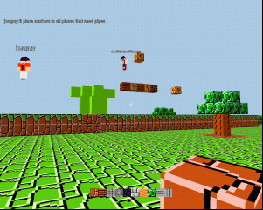
Exteme Caching with PHP
Alternatives ?
classmaps (Zend Class Map generator)
concatenate common files to “includecache.php”
ramdisks

Slide 21
Exteme Caching with PHP
Part 2
Data caching

Slide 22
Exteme Caching with PHP
Why I should use cache?
Don't need all data in one request
Lot of reads, only few updates
Much faster access
Can use TTL to decrease app complexity
It's easy to scale

Slide 23
Exteme Caching with PHP
What shouln'd be stored in cache ?
Php objects
Html
Data that we cannot loose
Notes:
Deserialization can end up with PHP fatal
HTML is changing too often, can cache PHP error

Slide 24
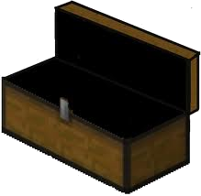
Exteme Caching with PHP
What should be stored in cache ?
user sessions
shared data as simple types (int,string,array)
locks and counters
Notes:
Memcache add/incremenent

Slide 25
Exteme Caching with PHP
For how long ??
meausure
check statistics
try to guess – maybe “infinity” ??
The magic number : 259200
Notes:
Cannot store longer than one day

Slide 26

Exteme Caching with PHP
Most Popular
APC
Memcached
Redis
Riak ?

Slide 27
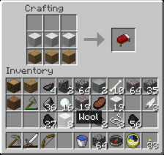
Exteme Caching with PHP
Definitions
hit
miss
ttl
key
eviction

Slide 28

Exteme Caching with PHP
Basic operations
set($key, $value, $ttl)
get($key)
delete($key)
add($key, $value, $ttl)
increment($key, $value, $ttl)
decrement($key, $value, $ttl)
Check the PSR-6
https://github.com/Crell/fig-standards/blob/Cache/proposed/cache.md
Notes:
Get can return false on fail and false when it is false
apc_store, apc_fetch, apc_delete, apc_add, apc_inc, apc_dec

Slide 29
Exteme Caching with PHP
Redis is crazy
Strings,Hashes,Lists,Sets,Sorted Sets,Pub/Sub
and Transactions !
GET, SET, INCR, DECR, INCRBY, DECRBY, APPEND, STRLEN, SETRANGE, GETRANGE, MGET, MSET, HSET, HGET, HEXISTS, HMSET, HMGET, HVALS, HSCAN, HDEL, HINCRBYFLOAT, BLPOP, LSET, LREM, LTRIM, LPUSH, PUBLISH, SUBSCRIBE, UNSUBSCRIBE and much much more !
http://redis.io/commands
Notes:
Get can return false on fail and false when it is false
apc_store, apc_fetch, apc_delete, apc_add, apc_inc, apc_dec

Slide 30
Exteme Caching with PHP
Session cache with memcache
[session]
session.save_handler=memcached
session.save_path=”hostA:11211,hostB:11211”
And you are ready to go !

Slide 31
Exteme Caching with PHP
Advanced Session Handling
class SessionHandler implements SessionHandlerInterface {
public close()
public destroy($session_id)
public gc($maxlifetime)
public open($save_path, string $session_id)
public read($session_id)
public write($session_id, $session_data)
}
session_set_save_handler(SessionHandlerInterface $handler);
/** @see session.serialize_handler **/

Slide 32
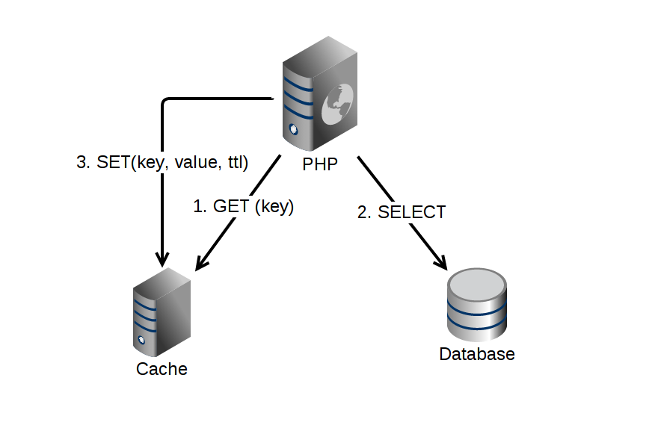
Exteme Caching with PHP
Regular cache
flow in app

Slide 33
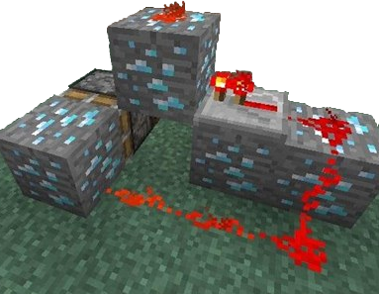
Exteme Caching with PHP
Let's see the code

Slide 34
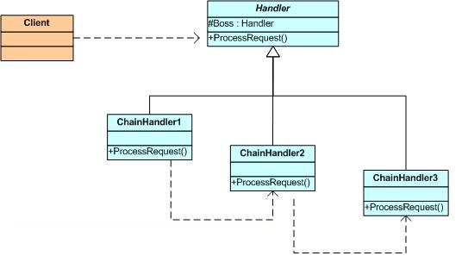
Exteme Caching with PHP
Chain of Responsibility Pattern

Slide 35
Exteme Caching with PHP
Traps!
can do more harm than good (hits<misses)
memcache returns false for not found
max ttl = 30 days
boom protect, race codition
evictions sometimes are unpredictable
sessions locking

Slide 36
Exteme Caching with PHP
Part 3
Response caching

Slide 37
Exteme Caching with PHP
Ways to cache using headers.
Last-Modified
ETag
Expires

Slide 38
Exteme Caching with PHP
Last-Modified
Server sends header
  Last-modified : Thu, 31 May 2007 20:35:00 GMT
For future requests browser will send
  If-Modified-Since : Thu, 31 May 2007 20:35:00 GMT

Slide 39
Exteme Caching with PHP
ETag
Server sends header
  Etag: abc123cde
For future requests browser will send
  If-None-Match: abc123cde

Slide 40
Exteme Caching with PHP
Expires
Server sends header
  Expires: Thu, 01 Dec 2014 16:00:00 GMT
Browser is not going to ask for this resource again till 1 Dec 2014

Slide 41
Exteme Caching with PHP
Cache-control headers
public
private
no-cache
max-age
s-maxage
no-store
Must-revalidate
Pragma: no-cache

Slide 42
Exteme Caching with PHP
How to enable it (apache) ?
<IfModule mod_expires.c>
ExpiresActive on
ExpiresByType text/html "access plus 0 seconds"
ExpiresByType image/gif "access plus 1 month"
ExpiresByType image/jpeg "access plus 1 month"
ExpiresByType image/png "access plus 1 month"
ExpiresByType application/javascript "access plus 1 year"
ExpiresByType text/css "access plus 1 year"
</IfModule>

Slide 43
Exteme Caching with PHP
How to enable it (php) ?
<?php
header("Expires: Wed, 31 Dec 2014 00:00:00 GMT");
?>

Slide 44
Exteme Caching with PHP
Good practices
Don't overuse cookies
Use POST only for update requests
If it is possible, always use Expires header
Remember – different browsers understand headers differently
Cache all assets (css,js,images)
Notes:
Firefox can calculate expiration Time
Now + (0.1 * Time since last modification)
If you want to prevent all caching (e.g. force a reload when using the back button) you need:
* no-cache for IE
* no-store for Firefox
Mobile browsers have very aggresive caching, it's enabled by default

Slide 45
Exteme Caching with PHP
Expires header how-to
pass a version as a GET param, for example last deployment date
Example: /js/application.js?v=123223245
Add something to filename, and strip it with mod_rewrite
Example: /js/application:h6fa
RewriteRule ^js/(.+):[a-z0-9]+$ js/$1.js
/js/application:h6fa
/js/application.js

Slide 46
Exteme Caching with PHP
Varnish

Slide 47
Exteme Caching with PHP
Questions ??

Slide 48
Exteme Caching with PHP
https://github.com/piotrmiazga/extreme_caching
http://pecl.php.net/package/vld
http://www.php.net/manual/en/book.apc.php
https://github.com/Crell/fig-standards/blob/Cache/proposed/cache.md
http://redis.io/commands

